Slide 1
The Basics of Residential Licensing

Slide 2
Arizona Department of Health Services Cara Christ M.D., Director Division of Public Health Licensing Bureau of Residential Facilities Licensing Diane Eckles, Bureau Chief

Slide 3
Office Locations and Phone Numbers
Phoenix: 150 N. 18th Ave., Suite 420
602-364-2639 FAX: 602-324-5872
Tucson: 400 W. Congress St., Suite 116
520-628-6965 FAX: 520-628-6991

Slide 4
Purpose of the Bureau of Residential Facilities Licensing (BRFL)
Mission Statement:
“To protect the health and safety of Arizonans by providing information, establishing standards, and licensing and regulating health and child care services”
To promote and protect public health through a comprehensive compliance system

Slide 5
Bureau of Residential Facilities Licensing (BRFL)
BRFL Licenses and regulates:
Residential Healthcare Facilities
Assisted Living Centers and Homes
Behavioral Health Residential Facilities
BRFL also licenses and regulates:
Adult Day Health Care Facilities
Adult Foster Care Homes
Behavioral Health Respite Homes
Behavioral Health Therapeutic Homes

Slide 6
Department of Health Services
Does NOT license or regulate:
Child Foster Care Homes
Does license, but doesn’t monitor programs:
Developmentally Disabled Group Homes*
These facilities are licensed and regulated by the Department of Economic Security (DES)
*the term “group home” is typically used by DES, not DHS

Slide 7
Purpose of this Training
To help you, the potential provider, to determine what kind of facility you want to own and operate
Review application requirements
Navigating the Bureau’s website
Notes:
We have nothing to do with money, placements. You have to choose what population you serve. We will get to more specific licensure steps in the next training session, the Licensure Process. Try to have participants hold questions till the end.

Slide 8
Applicable Rules and Statutes
Licensing of Residential Facilities is governed by the Arizona Revised Statutes (“A.R.S.”), primarily Title 36: Public Health and Safety, Chapter 4: Health Care Institutions
Reference to a statute generally uses this format:
A.R.S. § 36-401.A.1. or A.R.S. § 36-401(A)(1)
Statutes are law, and authorize the Department to adopt Rules which are specific to each facility type

Slide 9
Applicable Rules and Statutes
Reference to a rule generally this format:
Title 9, Chapter 10, Article 8 (specific subclass), Rule Number 803.A.3.a
Example of an Assisted Living Rule
R9-10-803.A.3.a

Slide 10
Rules Governing Residential Facilities
Article 1: General
Article 7: Behavioral Health Residential Facilities
Article 8: Assisted Living Facilities
Article 11: Adult Day Health Care Facilities
Article 16: Behavioral Health Respite Homes
Article 18: Adult Behavioral Health Therapeutic Homes
ALL Subclasses must follow Article 1

Slide 11
BRFL Website
Download and print the Articles specific to your subclass from our website:
http://www.azdhs.gov/licensing/residential-facilities/index.php#providers-home
Articles 7, 8, 11, 16, and 18 are effective July 1, 2014
Article 1 is effective January 1, 2015
Notes:
ALL Subclasses must follow Article 1

Slide 12
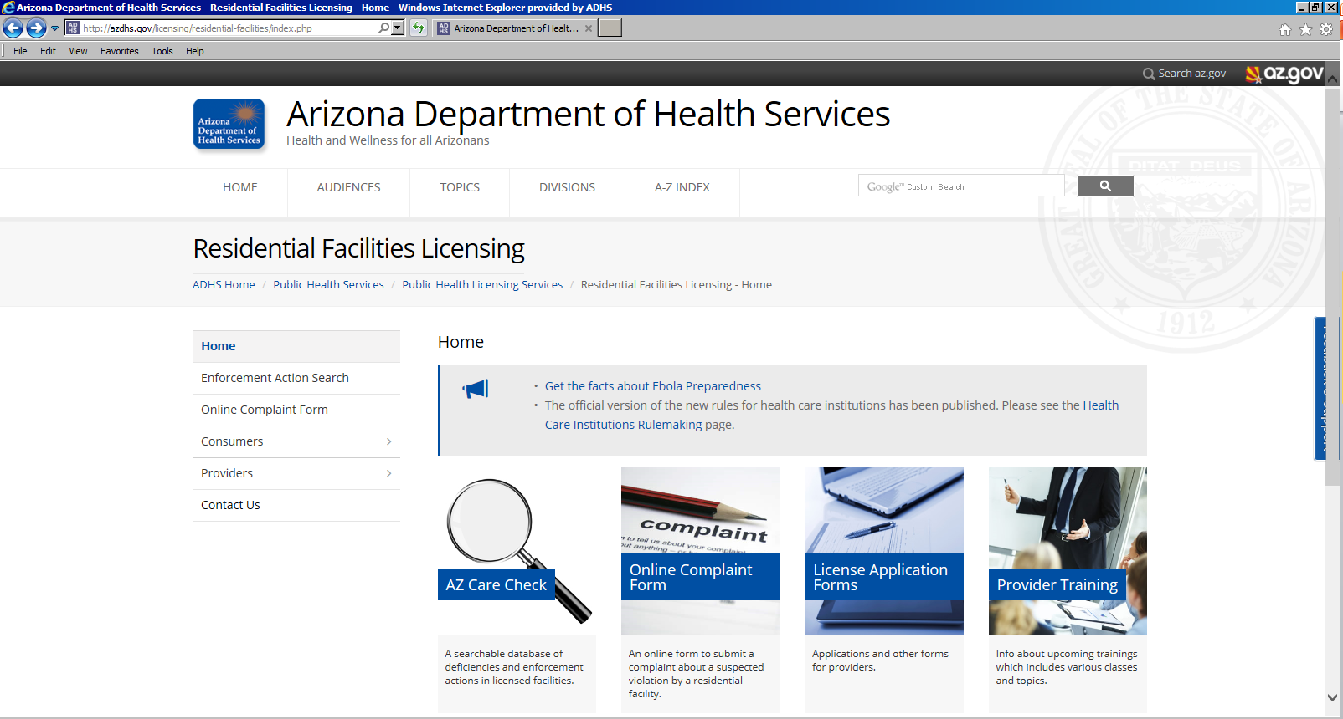

Slide 13
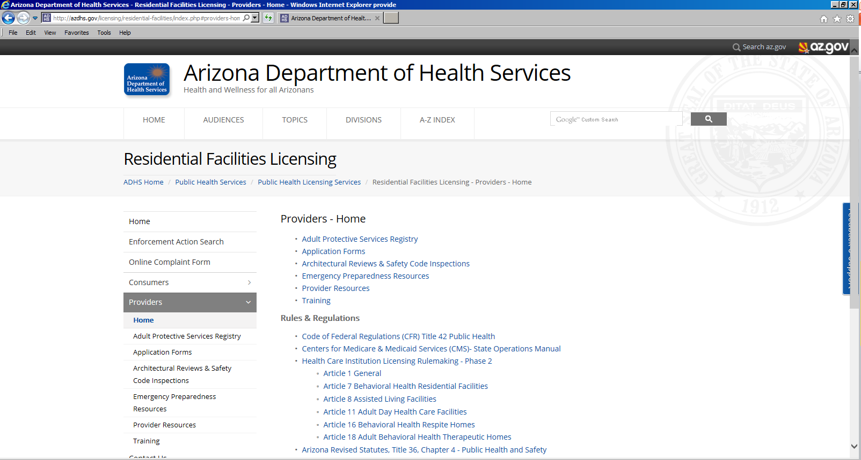

Slide 14
Definitions

Slide 15
Regulation of Residential Facilities
Health Care Institutions (A.R.S. § 36-401.A.21)
"Health care institution" means every place, institution, building or agency, whether organized for profit or not, that provides facilities with medical services, nursing services, behavioral health services, health screening services, other health-related services, supervisory care services, personal care services or directed care services and includes home health agencies as defined in section 36-151, outdoor behavioral health care programs and hospice service agencies
Notes:
Discuss unlicensed care and that an applicant cannot begin operating until (and unless) the Department issues a license. If a facility is operating under the exemption in A.R.S. § 36-

Slide 16
Assisted Living definition
A.R.S. § 36-401.A.8. "Assisted living facility" means a residential care institution, including an adult foster care home, that provides or contracts to provide supervisory care services, personal care services or directed care services on a continuous basis

Slide 17
Assisted Living Facilities
Assisted Living Home: 10 beds or fewer
Usually in a house
Assisted Living Center: 11 beds or more
Usually in a commercial building
Adult Foster Care Home: 4 beds or fewer; the sponsor must live in the home and integrate the residents into their family

Slide 18
Assisted Living Centers & Adult Day Health Care
Assisted Living Centers (11 or more beds) and Adult Day Health Care facilities are required to go through Architectural Review before applying for a license
Other Residential Facilities need to work with their local jurisdiction

Slide 19
Levels of Care – Assisted Living
Supervisory care services: general supervision, including daily awareness of resident functioning and continuing needs, the ability to intervene in a crisis and assistance in the self-administration of prescribed medications
Personal care services: assistance with activities of daily living that can be performed by persons without professional skills or professional training and includes the coordination or provision of intermittent nursing services and the administration of medications and treatments by a nurse who is licensed pursuant to title 32, chapter 15 or as otherwise provided by law
Directed care services: programs and services, including supervisory and personal care services, that are provided to persons who are incapable of recognizing danger, summoning assistance, expressing need or making basic care decisions

Slide 20
Residents in Assisted Living Facilities may have:
Mild limitations: General supervision only, no hands-on care
Severe physical limitations: Hands-on care
Physical or cognitive deficits requiring assistance with self-administration of medications or medication administration
Severe cognitive deficits such as Alzheimer’s disease

Slide 21
Behavioral Health Residential Facility: Definition
R9-10-101.29. "Behavioral health residential facility" means a health care institution that provides treatment to an individual experiencing a behavioral health issue that:
Limits the individual’s ability to be independent,
or
- Causes the individual to require treatment to maintain or enhance independence

Slide 22
Behavioral Health Residential Facilities
Provide services to people whose primary need is for services related to:
A Mental Disorder (i.e., schizophrenia, bipolar disorder, depression, personality disorders, etc.)
Substance Abuse
“Mental Disorder” DOES NOT include Alzheimer’s disease or other dementia

Slide 23
Key Personnel
An Assisted Living Facility must have a certified Assisted Living Manager who is responsible for the assisted living services provided
A Behavioral Health Residential Facility must have a Behavioral Health Professional (BHP) who must be available to oversee the behavioral health services provided; an administrator must be responsible for the services provided

Slide 24
The Application Process

Slide 25
Application forms
Download and print from our website: http://azdhs.gov/licensing/residential-facilities/index.php#providers-application-forms
The application must be complete before the Bureau will conduct an inspection and issue the license
DO NOT leave anything blank. Use “N/A” if something does not apply to your facility
Submit ALL required documents

Slide 27
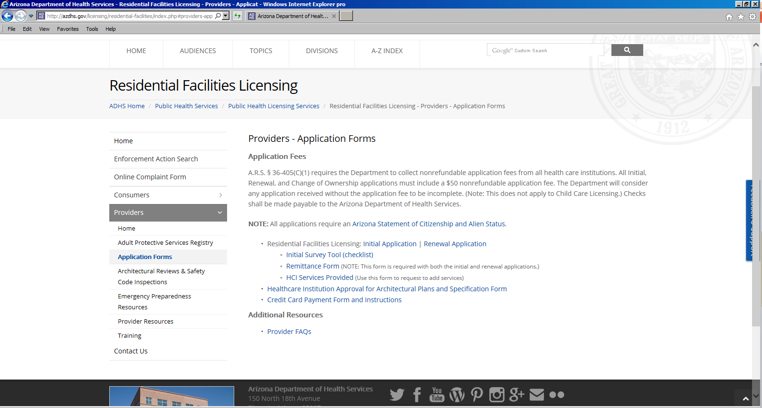
Not required for corporations or LLCs
Only required for AL Centers and Adult Day Health Care Facilities

Slide 28
Filling out the initial application

Slide 29
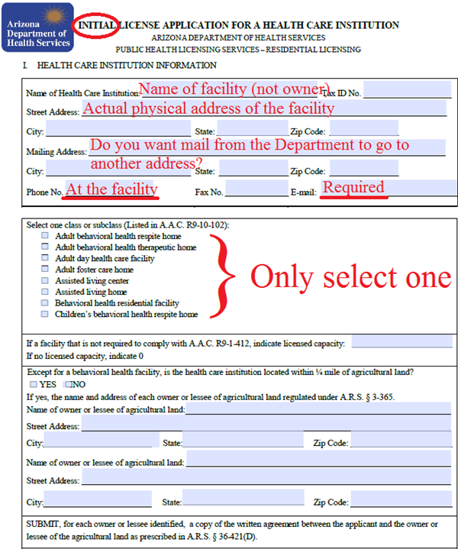
Notes:
Ensure application is legible (can fill out on computer); R9-1-412 only applies to ADHC & ALC facilities.

Slide 30
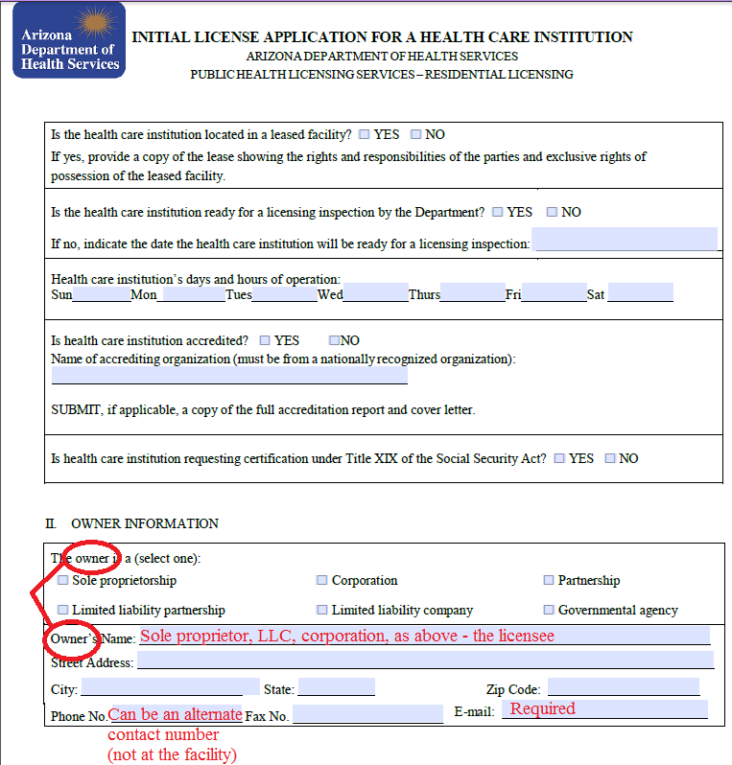

Slide 31
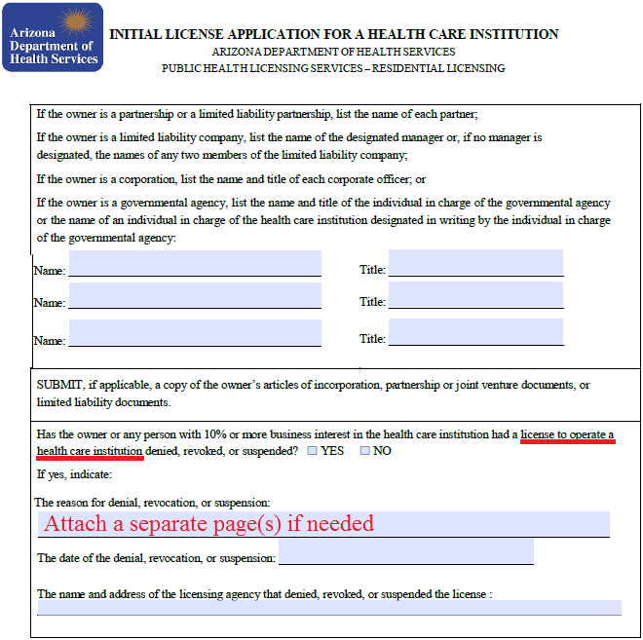

Slide 32
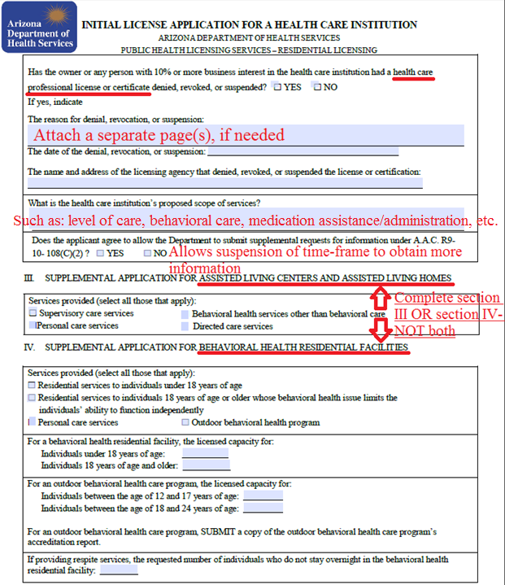

Slide 33
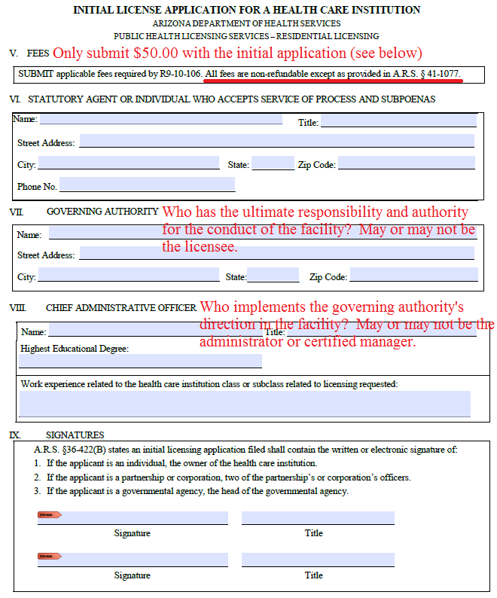

Slide 34
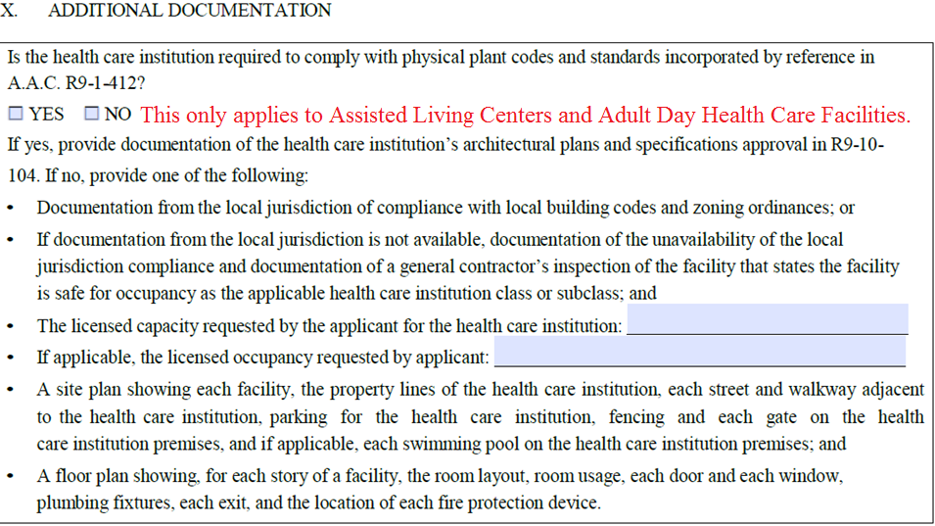

Slide 35
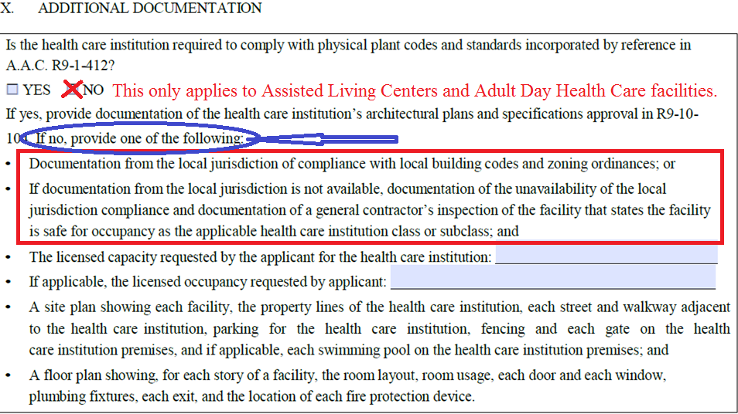

Slide 36
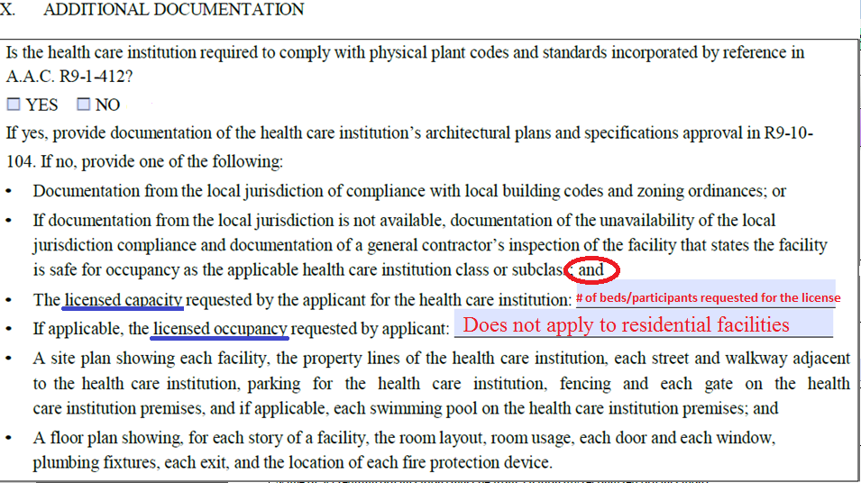

Slide 37
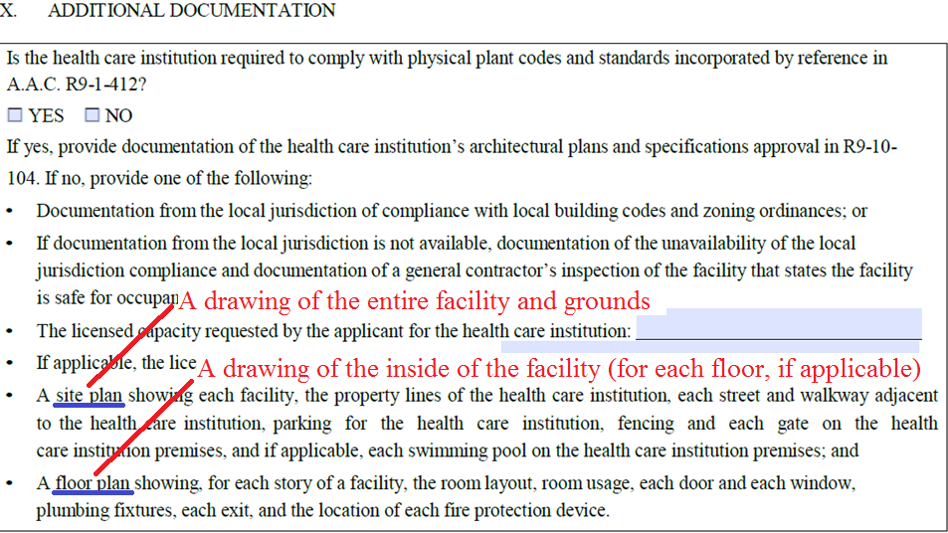

Slide 38
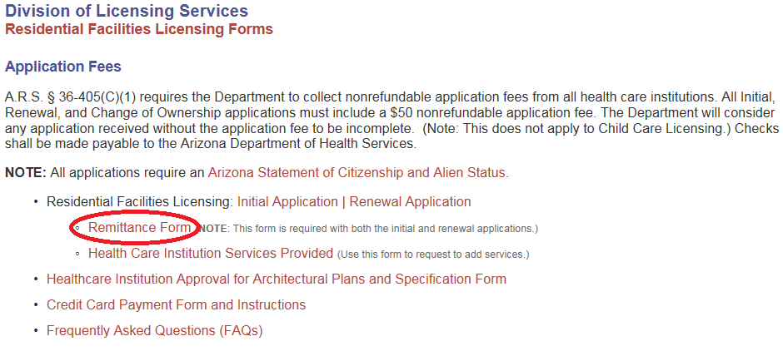
Fees

Slide 39
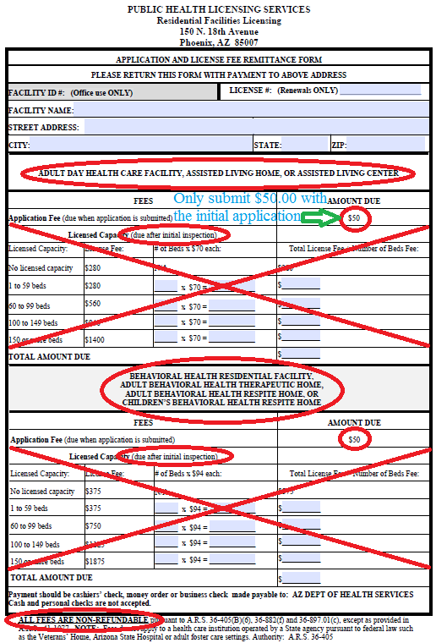
Notes:
The reason why we don’t want the licensing fees with the application, refunds…

Slide 40
Submitting your application
Once the application is submitted, you will receive a letter telling you that your application is either complete or incomplete
A complete application will be forwarded to a supervisor (team lead) to be assigned to a surveyor who will contact you to schedule the inspection
An incomplete application will prompt our administrative staff to contact you (in writing) requesting the information needed to complete your application
Notes:
If your inspection takes place at the end of the month and you want your license right away, the license may only be good for 11 months and one day – i.e., if issued April 30, it will expire March 31.
It may be to your advantage to wait a day (or a few) to get your license at the beginning of a month, so it’s good for closer to 12 months – i.e., if license is issued May 1, it will expire April 30.

Slide 41
Timeframes
The Department has 120 days (total) to issue the license. This is broken down by:
Administrative, 30 days
Substantive, 90 days
A license is valid for a maximum of one year (365 days) and expire on the last day of the month

Slide 42
Next Steps
Once you have submitted an application, contact our office to sign up for the next segment in our New Provider training series
(602) 364-2639 (Phoenix)
or
(520) 628-6965 (Tucson)

Slide 43
Resources

Slide 44
Bureau of Residential Facilities Licensing Website
http://azdhs.gov/licensing/residential-facilities/index.php
Contains Links to:
Frequently Asked Questions
License application forms
Rules and Regulations
Online Complaint System
www.azcarecheck.com has facility information, including survey history and enforcement actions

Slide 45
Arizona Health Care Cost Containment System (AHCCCS)
Phone: 602-417-4000 or 1-800-654-8713
Website: www.azahcccs.gov
AZDHS Division of Behavioral Health Services
Phone: 602-364-4558 or 1-800-867-5808
Website: azdhs.gov/bhs
DBHS monitors the contact for the Regional Behavioral Health Authorities (RBHAs)

Slide 46
Other Resources
DES Long-Term Care Ombudsman:
Phone: (602) 542-6454
Website: www.azdes.gov
Community Information and Referral Services
Phone: 2-1-1 or (602) 263-8845 x100
Website: www.211arizona.org
Arizona Board of Examiners of Nursing Care Institution Administrators and Assisted Living Facility Managers
Phone: (602) 364-2273
Website: www.aznciaboard.us

Slide 47
Other Resources
DES Department of Child Safety (DCS [Foster care]):
Phone: 1-877-KIDS-NEEDU (1-877-543-7633)
DES Department of Developmental Disabilities (DDD):
Phone: (602) 542-0419 or (866) 229-5553
DES Website: https://www.azdes.gov/

Slide 48
Local Jurisdiction Contacts
City of Phoenix:
Office of Customer Advocacy: 602-534-7344
Fire Department: 602-262-7860
City of Mesa:
Building Safety Division: 480-644-4057
Fire Prevention: 480-644-2622
City of Glendale:
Building Safety: 623-915-3263
Fire Prevention Office: 623-930-4420

Slide 49
Local Jurisdiction Contacts
City of Surprise:
Community Development Dept.: 623-222-3000
Fire Prevention Division: 623.222.5100
City of Tucson:
Planning & Development Services Department: 520-791-5550
Fire Prevention: 520-791-4502

Slide 50
QUESTIONS?
Phoenix office: 150 N. 18th Ave., Suite 420
602-364-2639 FAX: 602-324-5872
Tucson office: 400 W. Congress St., Suite 116
520-628-6965 FAX: 520-628-6991
Website: www.azdhs.gov/als/residential
Email: Residential.Licensing@azdhs.gov

