Slide 1
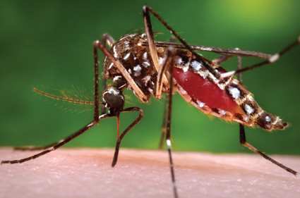
The Great Arizona Mosquito Hunt - 2017

Slide 2
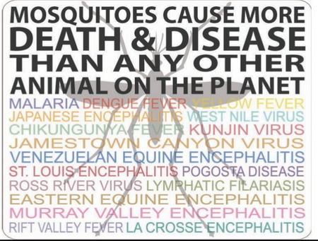
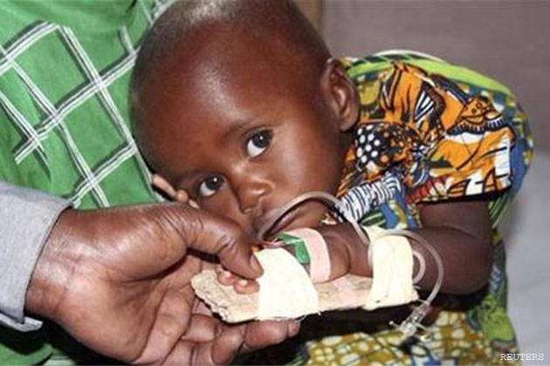
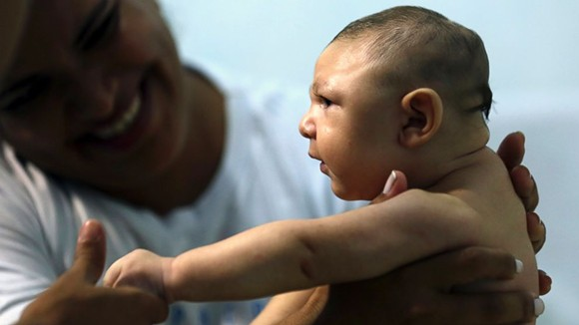
Why should I care about mosquitoes?
This little girl is being treated for malaria, which kills over 600,000 people each year, mostly children.
This is the first U.S. child born with microcephaly (a serious birth defect causing the brain to be very small) due to Zika.

Slide 3
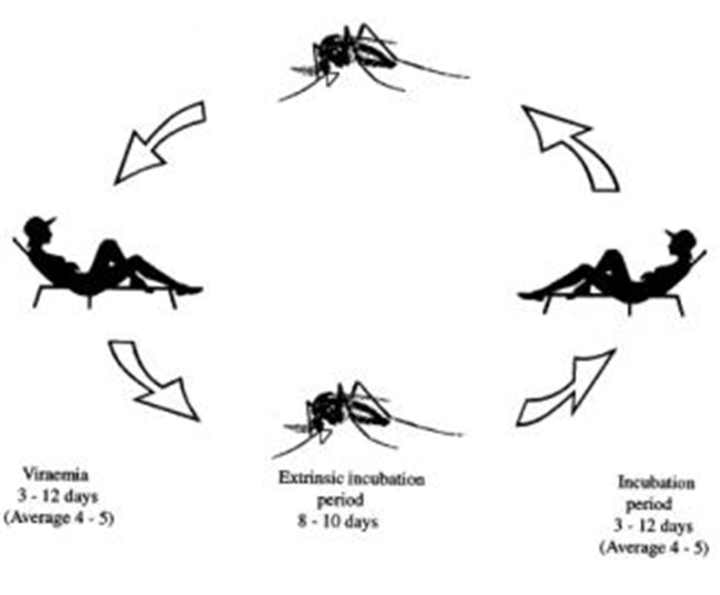
How do mosquitoes carry (transmit) diseases?
Step 1:
The female mosquito
searches for a human to bite. She will use the blood to make eggs.
Step 2:
A person is sick with a disease that can be carried by that species of mosquito. The disease organism lives in the person’s blood and makes the person feel sick. If a mosquito bites while the person is sick, the disease organism gets picked up by the mosquito.
Step 4:
The mosquito now has the disease organism in her saliva. She bites another person and that person becomes sick.
Step 3: The disease organism grows in the mosquito and move into her saliva. This can take a few days to a week.

Slide 4
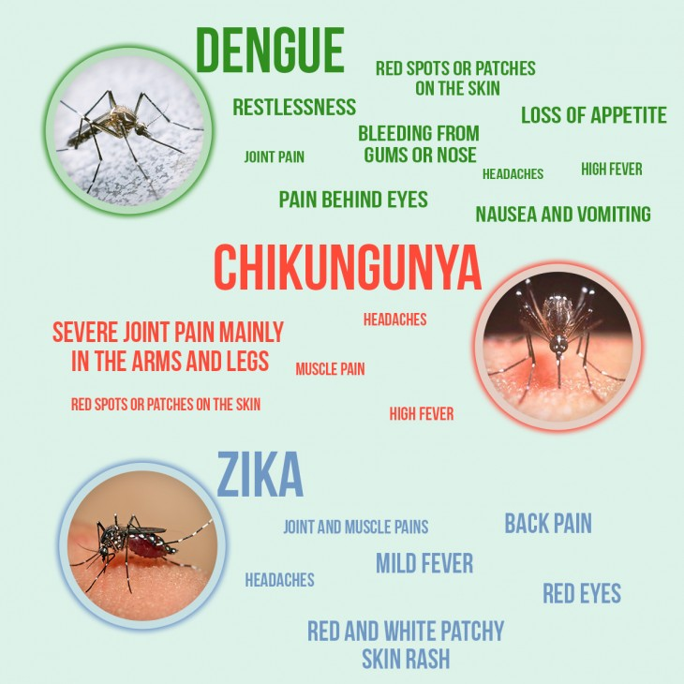
These three viruses are all transmitted by the Aedes aegypti mosquito, which is present in Arizona. So far, the mosquito is not transmitting these viruses in our state.
Often people infected with dengue or Zika don’t feel sick at all. However, any of these viruses can cause serious complications:
Dengue can be fatal in the hemorrhagic form.
Chikungunya can cause permanent disability in some people.
Zika infections during pregnancy can cause severe birth defects.

Slide 5
Aedes aegypti – the yellowfever mosquito
Is the main vector of Dengue, Chikungunya, Zika and Yellow Fever.
Aedes aegypti behavior:
Like all mosquitoes, the young mosquitoes are aquatic. The female mosquito lays her eggs in small containers of water (NOT big one like lakes or swamps).
Eggs can dry out and remain alive for months, waiting for more water.
Females bite during the day, often preferring ankles.
This mosquito likes human blood the most, but will also bite dogs and cats (but this mosquito does not transmit diseases to pets).

Slide 6
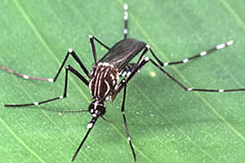

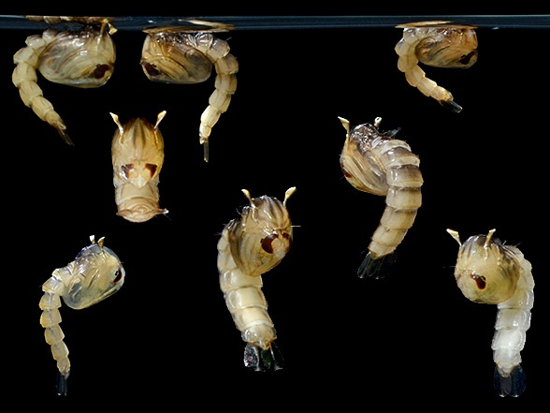
How to recognize Aedes aegypti
Adults – black and white markings, lyre-shaped pattern on back.
Larvae – aquatic, worm-like, breathing tube (siphon)
Pupae – aquatic, horned, look a bit like tadpoles

Slide 7
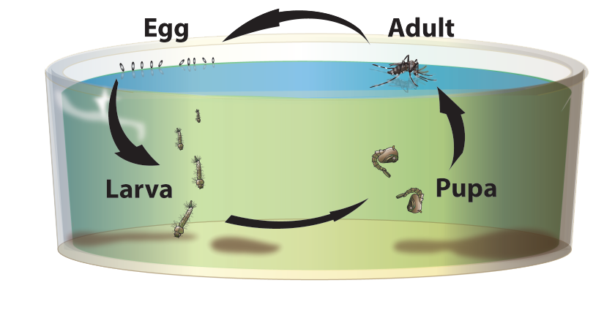
Basic Mosquito Biology
Over 3000 mosquito species world-wide
  About 180 species in the United States
  About 40 species in Arizona
Mosquitoes have 4 life stages. The egg, larvae and pupal stages are aquatic.
Only adult females bite and they use the blood to make eggs.
Different mosquito species prefer different host animals for blood and lay their eggs in specific habitats.
Life cycle of Aedes aegypti

Slide 8
Preventing dengue, Zika & chikungunya
Scientists are working to develop vaccines for these diseases, but none are currently available in the United States.
There is no medication to cure these infections. Patients receive treatment for the symptoms and hope their own immune systems can get rid of the virus.
So, the way to control spread of the disease is to focus on the mosquitoes.

Slide 9
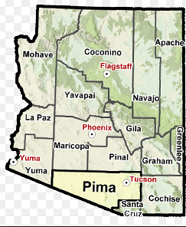
First step in mosquito control:
Figure out where the mosquito is
Public health officials in Arizona want to help communities prepare and protect themselves against possible introductions of dengue, Zika and chikungunya viruses.
The first step is to find out where the Aedes aegypti mosquitoes are.
Your role in the project will help generate an Aedes aegypti distribution map for the entire state of Arizona !
Aedes
Distribution
in Arizona ???

Slide 10
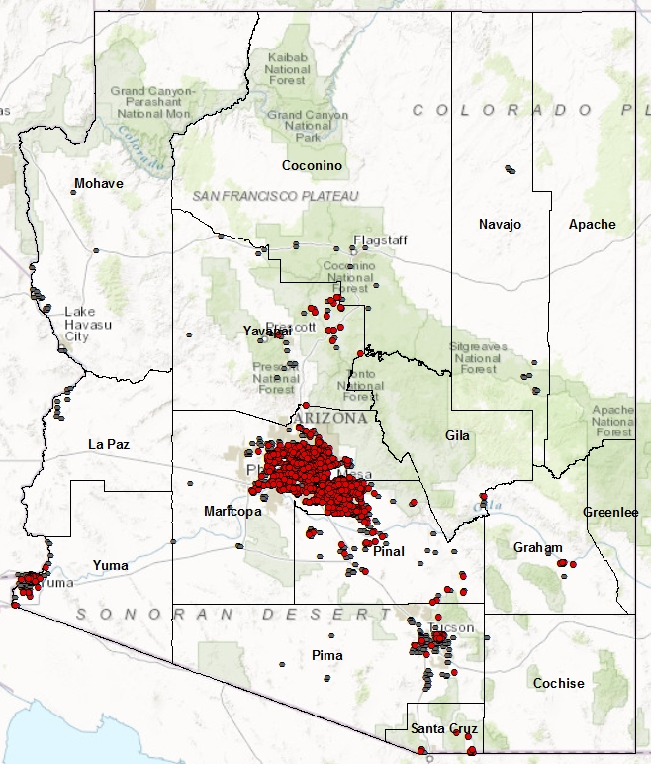
Recent surveillance for Aedes aegypti by county health departments shows the mosquito is established in Arizona, but there are many communities with little or no mosquito surveillance.
This mosquito is also invasive, which means it may be moving into new communities each year.
How do we solve this surveillance problem?
CITIZEN SCIENCE!
Map of AZ county mosquito surveillance in 2016.
Traps that caught Aedes aegypti.
Traps that did not catch Aedes aegypti.

Slide 11
What is Citizen Science ?
Citizen Science involves two groups:
  The sponsoring organization who
    Develops the project and data collection protocol
    Provides data and support where needed
    Collects, analyzes data submitted
    Publishes results in scientific journals and publications
  The citizen volunteers who collect and submit the data

Slide 12
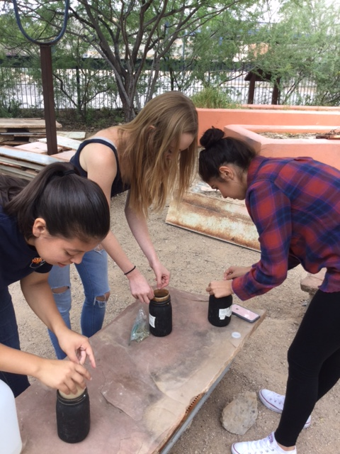
The Great Arizona Mosquito Hunt
Sponsoring Organizations:
  Arizona Department of Health Services
  University of Arizona Cooperative Extension
  Arizona Partnership for Science
Citizen scientists
  Students and teachers from all over Arizona.

Slide 13
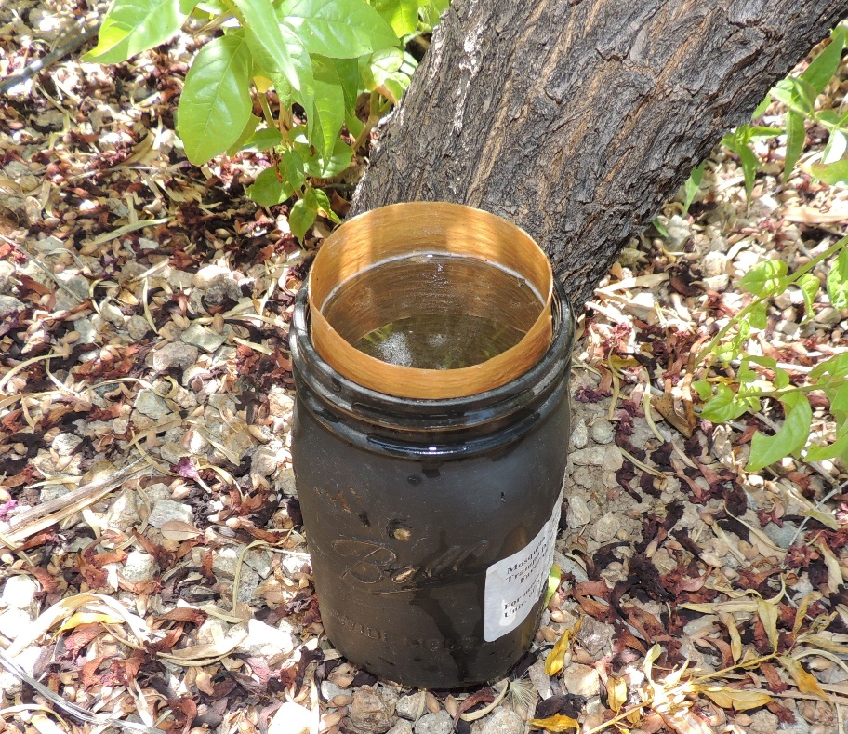
How to participate in the GAMH 2017
We are asking schools around the state to set out Aedes aegypti oviposition (egg-laying) traps to check for presence of this mosquito.
These traps are safe, easy to use and good indicators of Aedes aegypti presence.
To get your trap kit, register at this link:
http://www.azdhs.gov/preparedness/epidemiology-disease-control/mosquito-borne/index.php#hunt-home
You should receive your kit by early September.
Each kit contains instructions, supplies needed to make 10 oviposition traps, and a pre-stamped return envelope.
This is an oviposition trap. Female Aedes aegypti are attracted to the stinky water and lay their eggs on the paper liner. The paper can be removed to collect the eggs.

Slide 14
Building your mosquito trap
Step 1: Make sure you have everything
Besides what you receive in your kit, you will need:
  A cup, jar or container, ideally black. (You can also paint it black or wrap black paper around it.)
Only two or three alfalfa pellets and one seed germination paper sheet are needed per trap.

Slide 15
Step 2: Assemble the trap
Write the name of your school and starting date on the seed paper in Sharpie or pencil.
Place the paper in to line the inside of the container.

Slide 16
Step 3: Activate the trap
Drop in the two to three pieces of rabbit food (alfalfa pellets)
Then just add water

Slide 17
Step 4: Set the trap
Place the trap in a shady location, possibly near some plants. Do not place right next to a hose or sprinkler. If needed, place rocks to prevent the trap from tipping over. Let the trap sit out for one week.
Use the additional paper and alfalfa pellets to place additional traps and to trap in each location for 2 to 4 weeks total.

Slide 18
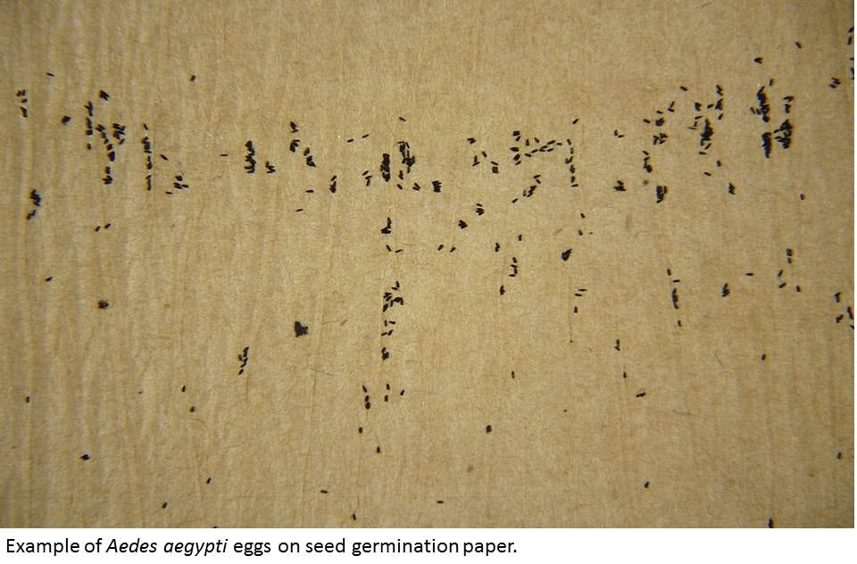
Step 5: Collect the eggs (if any)
Pull the seed germination paper out of the trap and dump out remaining water. To continue trapping for another week, add more water and alfalfa pellets and line with a new, labelled seed paper.
Take the used seed paper and allow it to dry completely. Examine it with a hand lens to see if eggs are present.

Slide 19
Step 6: Send us your data!
Once you have completed all the weeks of mosquito trapping you plan to do and dried the seed papers, send all the papers to the University of Arizona using the stamped, self-addressed envelope provided in your kit. We will examine each sheet again for eggs, rear the mosquitoes and email you to let you know what we find.
Also, please enter your data on the Great Arizona Mosquito Hunt website: azhealth.gov/mosquito
THANK YOU!!!!!!!

Slide 20
Frequently Asked Questions
Are these mosquito eggs?
It is hard to be sure when you haven’t seen the eggs before. Make your best guess, but be sure to send us all the papers so we can confirm your findings.
We didn’t find any eggs. Did we mess up?
No, unless you forgot something or the traps were knocked over by crazed javelinas (it can happen!). An absence of eggs can mean the mosquitoes are not present in your area (hooray!) or that they were not able to find the trap. If you place only one trap for just one week, the mosquitoes may not find it. If you trapped in multiple locations for several weeks and still didn’t collect mosquitoes, it is reasonable to conclude that Aedes mosquitoes are not currently present in your location.
It’s starting to get cold at night. Does that affect our traps?
Yes, Aedes aegypti is a warm-weather mosquito. August and September are the peak months for Aedes aegypti activity in Arizona. Trapping too late or too early in the season may result in negative trap results, even if the species is present.

Slide 21
Findings from GAMH 2016
Students and volunteers from 58 schools and 4-H groups in 13 counties participated as citizen scientists in the 2016 Great Arizona Mosquito Hunt.
GAMH citizen scientists helped to document the new expansion of Aedes aegypti into Graham and Greenlee counties, and found the mosquito in new areas of other counties.
GAMH citizen scientists provided additional mosquito surveillance in rural areas with limited surveillance.

Slide 22
Happy Mosquito Hunting!
For more information, contact:
Kathleen Walker Kara Tarter
Assistant Professor Vector-borne & Zoonotic Disease Epidemiologist
Department of Entomology Office of Infectious Disease
University of Arizona Cooperative Extension Arizona Department of Health Services
krwalker@cals.arizona.edu vbzd@azdhs.gov

