Slide 1

Goal Council 3
Reducing Opioid Deaths
Breakthrough Project
August 23, 2017
Cara Christ, MD, MS
Chair, Goal Council 3
Director, Arizona Department of Health Services

Slide 2
How did we get here?

Slide 3
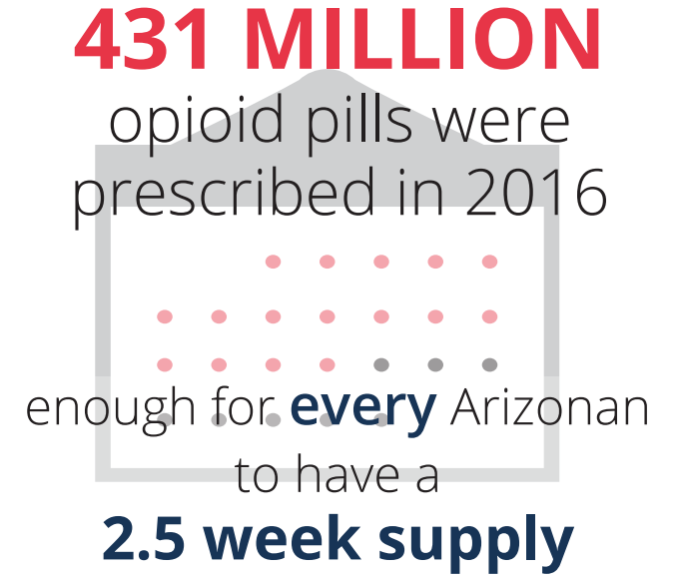
2016 Data
Opioid Use is Increasing in Arizona

Slide 4
2016 Data
Opioid Deaths are Increasing
More than two Arizonans die each day from an opioid overdose
In the past decade, 5,932 people died from opioid-induced causes
Arizona opioid death rates start to rise in the late teens and peak at age 45-54
74% increase in deaths since 2012
Full report available at azhealth.gov/opioid

Slide 5
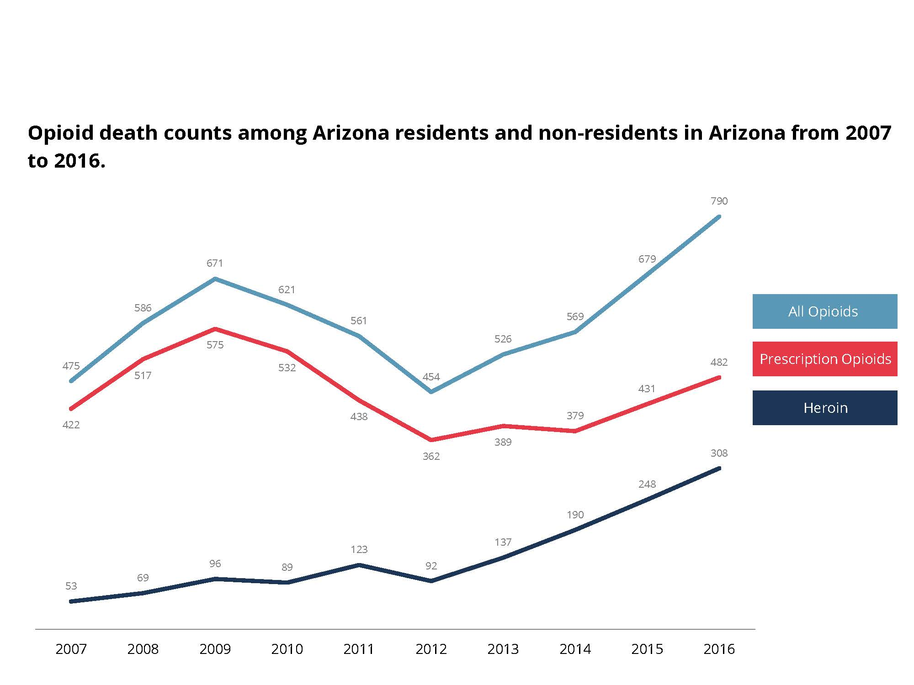
2016 Data
Opioid Deaths are Increasing
Opioid death counts in Arizona from 2007 to 2016

Slide 6
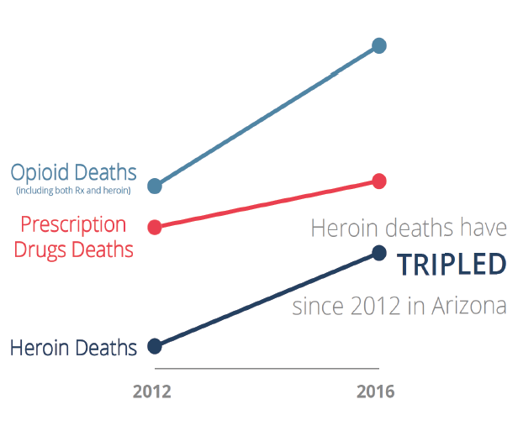
2016 Data
Opioid Deaths are Increasing

Slide 7
What are we doing about it?

Slide 8

Arizona Management System
Website: ams.az.gov

Slide 9
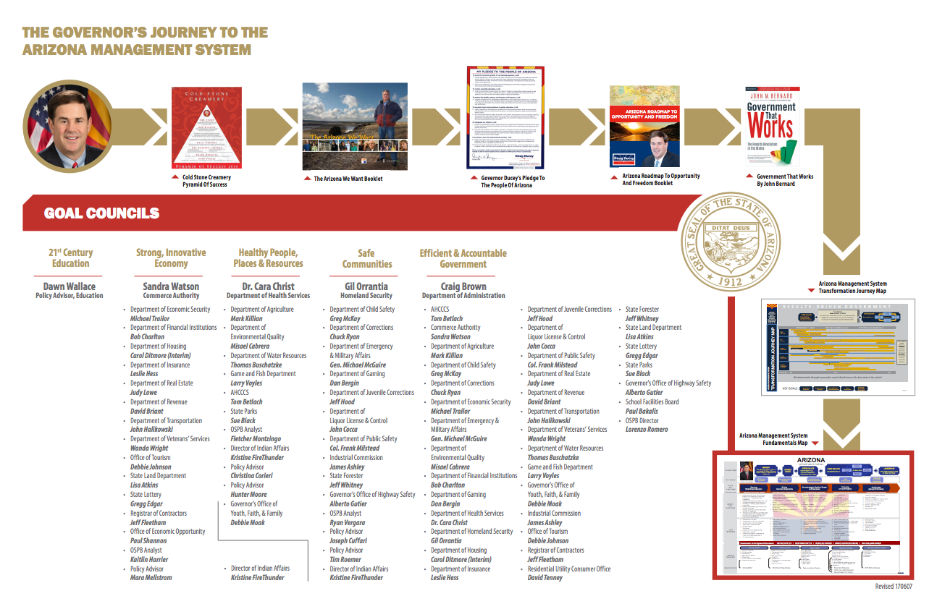
Arizona Management System

Slide 10
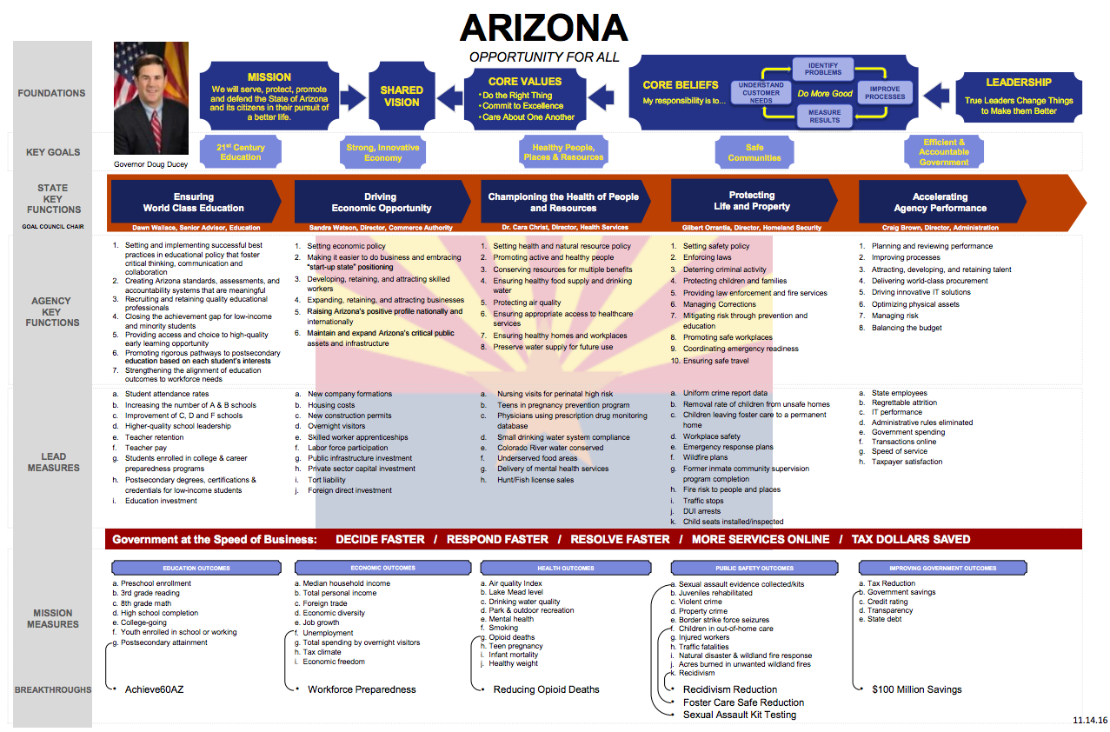
Arizona Management System

Slide 11

Arizona Management System
Governor Ducey’s Goal Council 3:
Healthy People, Places and Resources

Slide 12
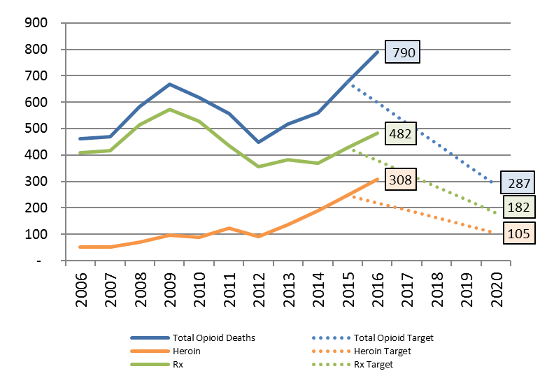
Project Lead: Dr. Cara Christ (DHS)
Project Coach: John Bernard
Project Manager: Trista Guzman
Policy Advisor: Christina Corieri
Update: June 2017
Opioid
Project Dashboard
Activity Updates:
DHS activated its Health Emergency Operations Center (HEOC) in response to the Governor’s Declaration of Emergency
DHS developed and submitted recommendations for the enhanced surveillance advisory
Developed and planned statewide Naloxone trainings for law enforcement, public health, and first responders (June 19 – Flagstaff; June 23 – Tucson; June 29 – Phoenix)
Coordinating day-long conference for Core Team and all subgroups
  Standard work development, A3s, initial data from enhanced surveillance, identify action steps and measures
Coordinating with all state agencies to identify opioid related activities, barriers, and unique issues in order to better coordinate statewide efforts
Awarded SAMHSA grant ~$24 million for Arizona activities over two years
Challenges
No Good Samaritan Law in AZ
Goal | 2-year | 5-year
↓ the # of opioid deaths (Base: 638) | 30% (446) | 55% (287)
Project Agencies: AHCCCS, Health Services, Youth Faith & Family, Board of Pharmacy

Slide 13
Goal Council 3
Current Activities
June 26 Goal Council 3 Summit launches subgroup work
Subgroups identify problem statement, goal, scope
Subgroup leaders convene groups to identify draft recommendations

Slide 14
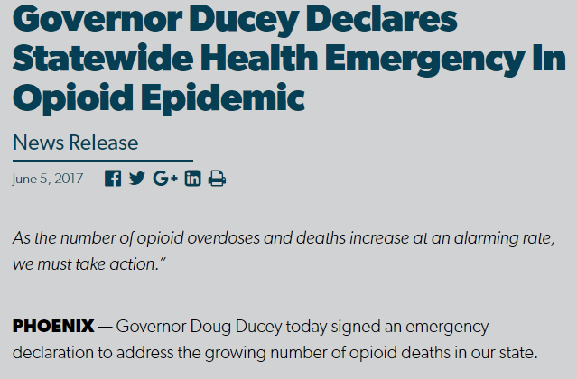
Emergency Declaration
On June 5, 2017,
Arizona Governor Doug Ducey declared a
State of Emergency
due to an opioid overdose epidemic

Slide 15
Emergency Declaration
ADHS Responsibilities
Provide consultation to governor on identifying and recommending elements for Enhanced Surveillance
Initiate emergency rule-making for opioid prescribing and treatment practices
Develop guidelines to educate providers on responsible prescribing practices
Provide training to local law enforcement agencies on proper protocols for administering naloxone in overdose situations
Provide report on findings and recommendations by September 5, 2017

Slide 16
Emergency Declaration
Timeline
Enhanced Surveillance Advisory went into effect June 15, 2017
Opioid Overdose Epidemic Response Report due September 5, 2017

Slide 17
What progress has been made since June 5th?

Slide 18
ADHS Response Activities
Health Emergency Operations Center
ADHS staff have devoted over 6,000 hours since June 5th addressing opioid-related response activities
Notes:
Following the Governor’s declaration, ADHS activated our Health Emergency Operations Center (HEOC) to tackle the deliverables of the declaration and maximize the resources we were able to bring to bear on the response.

Slide 19
ADHS Response Activities
Treatment Capacity Survey – General*
242 respondents from all 15 counties
Mix of inpatient and outpatient facilities
Referrals accepted from large variety of sources
99% of inpatient beds occupied
1,249 individuals presented for care who were unable to receive services within the last 3 months (from 58 facilities)
*data come from self reports by Medicaid providers; these data may not represent overall statewide capacity or availability
Notes:
Limitations of this include the number of respondents – some of this data is for a subset of respondents. Overall, the data collected demonstrates that there are not enough treatment services available in the state. We’ve seen that many people are being turned away or placed on waiting lists.

Slide 20
ADHS Response Activities
Treatment Capacity Survey – Waitlist*
88% of respondents do NOT have a waitlist
Of the 19 respondents with a waitlist, a total of 500 individuals are waitlisted (mostly inpatient)
Only 67% of those waitlisted were given a referral to another service
*data come from self reports by Medicaid providers; these data may not represent overall statewide capacity or availability

Slide 21
ADHS Response Activities
Treatment Capacity Survey – MAT*
There is additional opportunity to increase the number of buprenorphine prescribers in Arizona.
But, only 35% of respondents indicated interest in becoming a waivered medication-assisted treatment (MAT) provider.
*data come from self reports by Medicaid providers; these data may not represent overall statewide capacity or availability

Slide 22
Emergency Declaration
ADHS Responsibilities
Provide consultation to governor on identifying and recommending elements for Enhanced Surveillance
Initiate emergency rule-making for opioid prescribing and treatment practices
Develop guidelines to educate providers on responsible prescribing practices
Provide training to local law enforcement agencies on proper protocols for administering naloxone in overdose situations
Provide report on findings and recommendations by September 5, 2017

Slide 23
ADHS Response Activities
Opioid Prescribing &Treatment Rules
ADHS initiated immediately
ADHS submitted draft rules to Attorney General
Attorney General approved and submitted final rules to Secretary of State - July 28
Emergency rules in effect - July 28
Initiating regular rulemaking

Slide 24
R9-10-120, Article 1. General
Rulemakings In Progress - Opioid Prescribing and Treatment (Emergency) http://azdhs.gov/director/administrative-counsel-rules/rules/index.php#rulemakings-active-opioid-prescribing
Notice of Emergency Rulemaking http://azdhs.gov/documents/director/administrative-counsel-rules/rules/rulemaking/opioid-prescribing/approved-emergency-rulemaking.pdf
ADHS Response Activities
Opioid Prescribing &Treatment Rules

Slide 25
ADHS Response Activities
Opioid Prescribing &Treatment Rules
The new rules in A.A.C. R9-10-Article 1
  Focus on health and safety
  Provide regulatory consistency for all health care institutions

Slide 26
ADHS Response Activities
Opioid Prescribing &Treatment Rules
Establish, document, and implement policies and procedures for prescribing, ordering, or administering opioids as part of treatment
Include specific processes related to opioids in a health care institution’s quality management program; and
Notify the Department of a death of a patient from an opioid overdose.

Slide 27
Rules Training Webinars
ADHS Response Activities
Opioid Prescribing &Treatment Rules
Webinar Date & Audience | # Attended
8/7 – Medical Facilities | 140
8/8 – Residential Facilities | 112
8/10 – Long Term Care Facilities | 94
8/11 – Medical Facilities | 112
 | 458
Notes:
We offered 4 training webinars on these emergency rules with interactive Q&A sessions. The numbers here are likely underestimates of the number of people trained because we understand that multiple people call in from the same room. We utilized this feedback to create FAQs for our website.

Slide 28
Emergency Declaration
ADHS Responsibilities
Provide consultation to governor on identifying and recommending elements for Enhanced Surveillance
Initiate emergency rule-making for opioid prescribing and treatment practices
Develop guidelines to educate providers on responsible prescribing practices
Provide training to local law enforcement agencies on proper protocols for administering overdose situations
Provide report on findings and recommendations by September 5, 2017

Slide 29
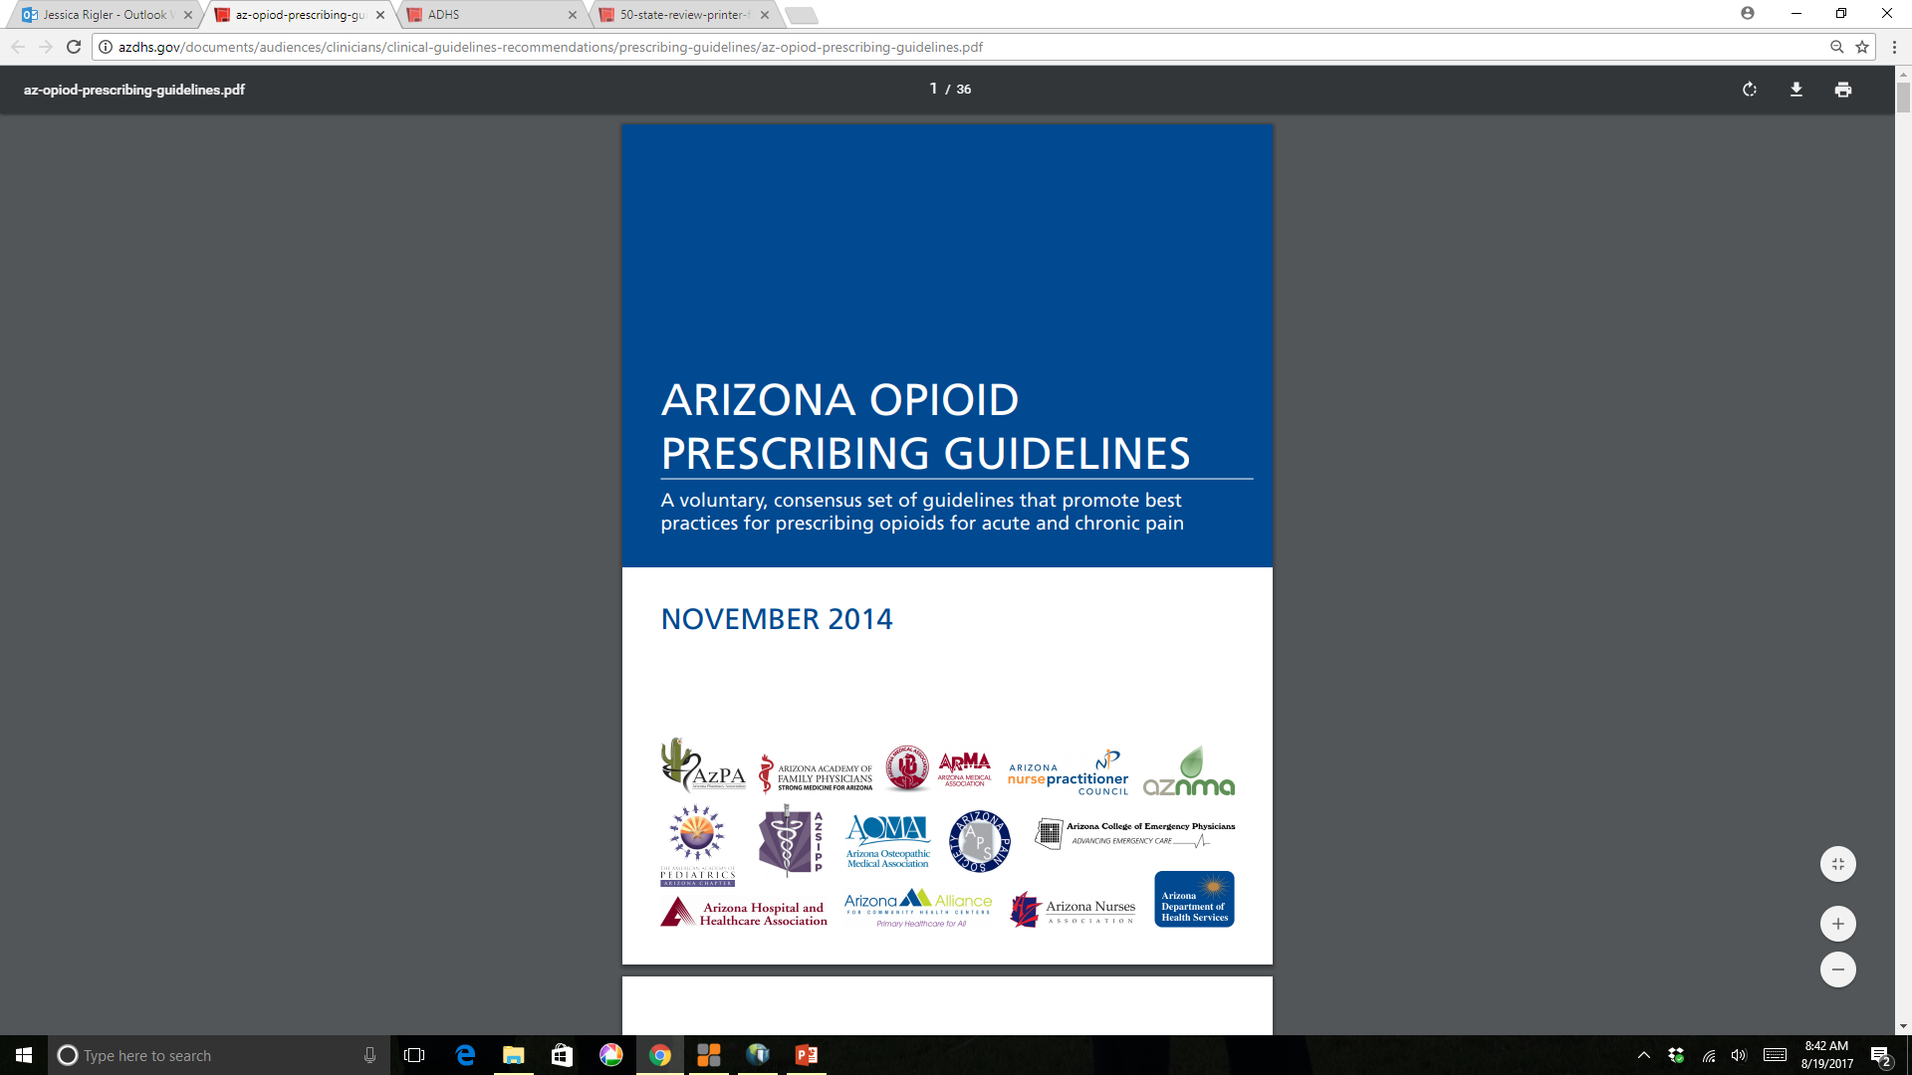
ADHS Response Activities
Prescribing Guidelines Update
Since the June 5th declaration, the Rx Initiative Healthcare Advisory Team has convened three times to discuss revisions
Draft update will be released by Sept. 5
Finalize by end of December

Slide 30
Emergency Declaration
ADHS Responsibilities
Provide consultation to governor on identifying and recommending elements for Enhanced Surveillance
Provide training to local law enforcement agencies on proper protocols for administering naloxone in overdose situations
Provide report on findings and recommendations by September 5, 2017

Slide 31
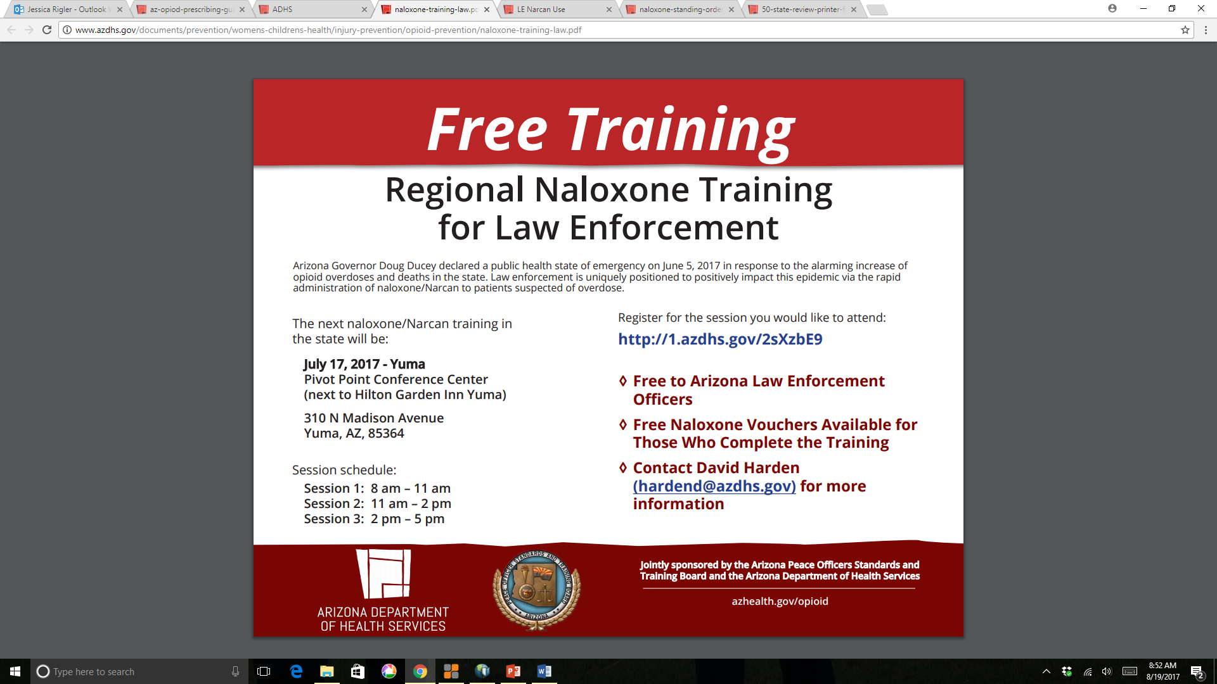
ADHS Response Activities
Naloxone Trainings
Notes:
We’ve worked with AZ-POST and offered a series of trainings for law enforcement agencies on identifying opioid overdoses and administering naloxone.

Slide 32
ADHS Response Activities
Naloxone Trainings
Webinar Date & Location | # Trained
June 19 - Flagstaff | 81
June 23 - Tucson | 245
June 29 - Phoenix | 445
July 17 - Yuma | 212
 | 983
Notes:
To date, we’ve trained nearly 1,000 officers. Attendees at these trainings receive a voucher for free naloxone for their agency.

Slide 33
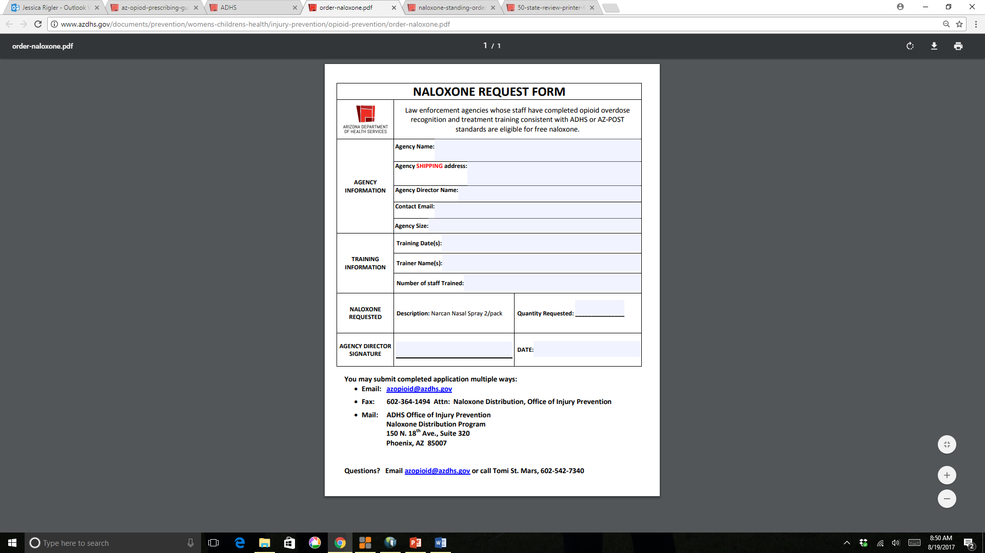
ADHS Response Activities
Naloxone Distribution
To date, ADHS has distributed 3,116 kits of naloxone to 36 law enforcement agencies.
Notes:
Law enforcement agencies whose staff have completed opioid overdose recognition and treatment training consistent with ADHS or AZ-POST standards are eligible for free naloxone.
Form is under Naloxone Information on azopioid website

Slide 34
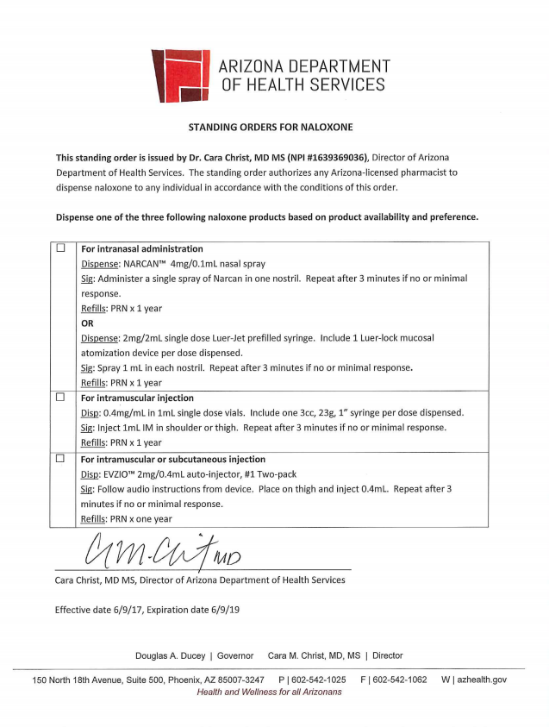
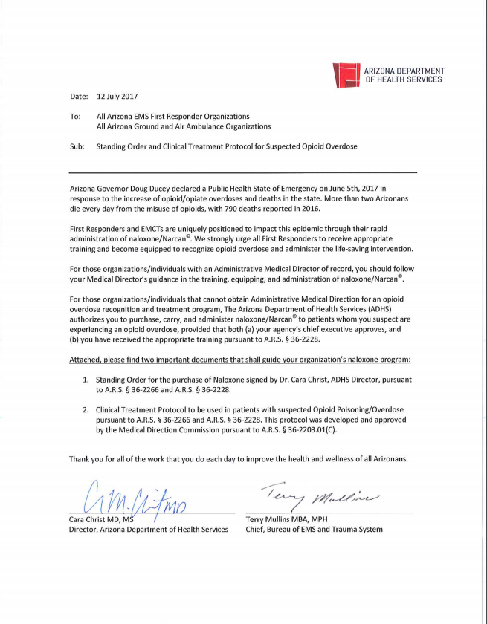
ADHS Response Activities
Naloxone Standing Orders
Notes:
In order to support increased use of naloxone to save lives in Arizona, I’ve signed standing orders that allow pharmacists to dispense naloxone to any individual in the state and that allow EMS officers, law enforcement officers, detention officers, and some other categories to use naloxone.

Slide 35
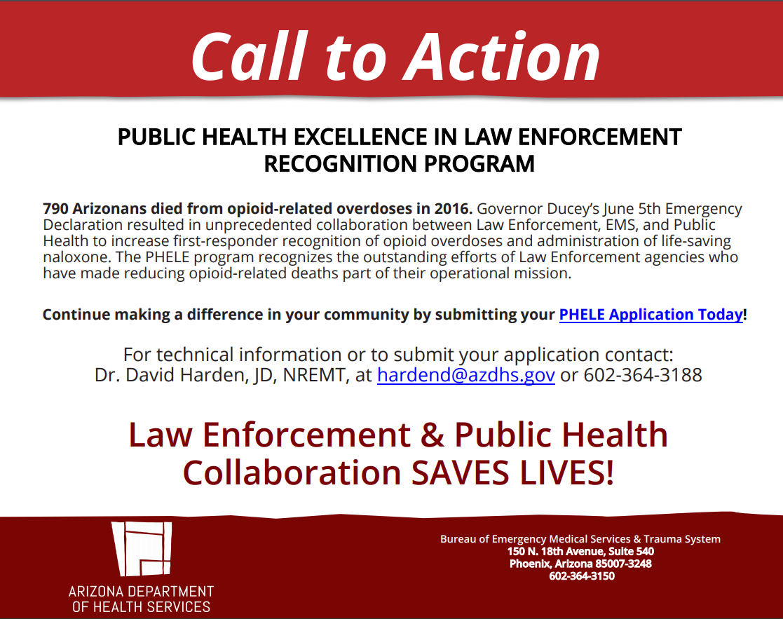
ADHS Response Activities
Naloxone Policies
ADHS has provided support for 21 law enforcement agencies to develop a naloxone program
Notes:
This includes providing sample policies for usage, training, discussions on operationalizing the program, storage, and documentation forms.
We’ve also developed a Public Health Excellence in Law Enforcement Recognition Program that works to strengthen linkages between law enforcement, EMS agencies, and public health to recognize opioid overdose, administer naloxone when necessary, and report information to ADHS.

Slide 36

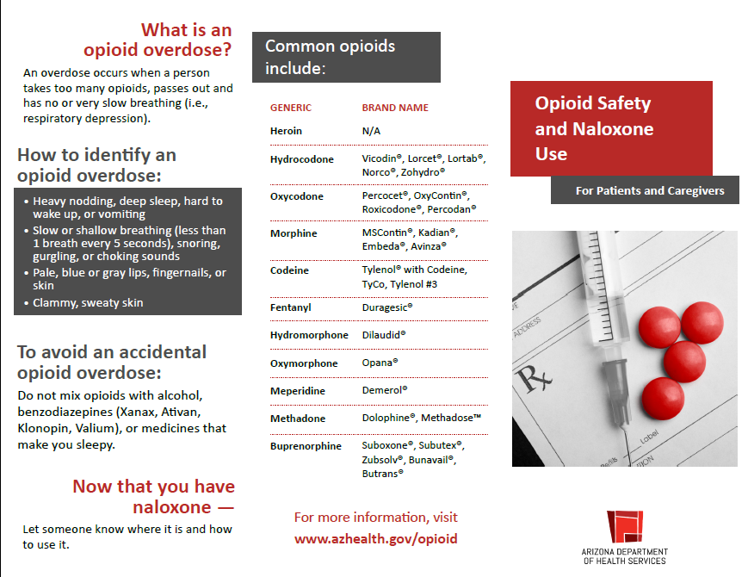
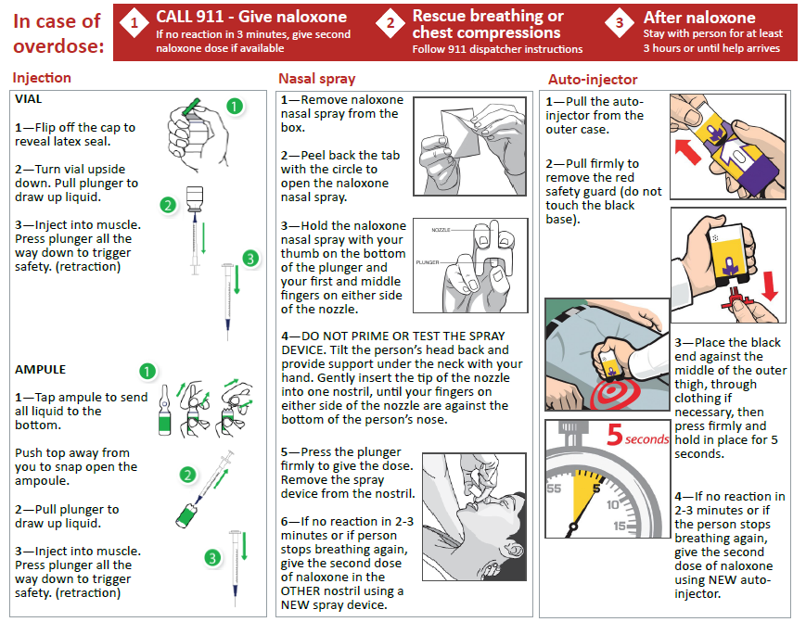
ADHS Response Activities
Naloxone – Public Information
Notes:
Great new public brochure on our website under the Naloxone Info tab. May be very helpful for pharmacists dispensing naloxone, physicians prescribing naloxone, and community organizations

Slide 37
Emergency Declaration
Enhanced Surveillance
Authorized by A.R.S. 36-782
Benefits of enhanced surveillance:
    More timely data
    Ability to more accurately assess the burden
    Provides information to build recommendations to better target prevention and intervention

Slide 38
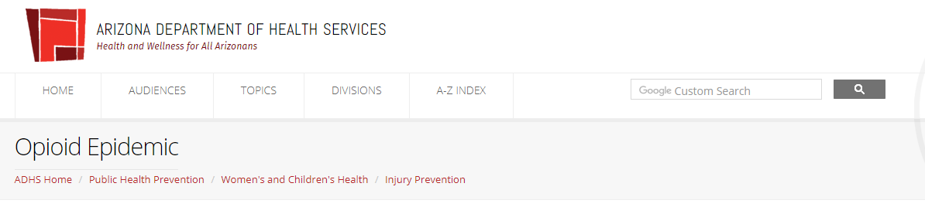
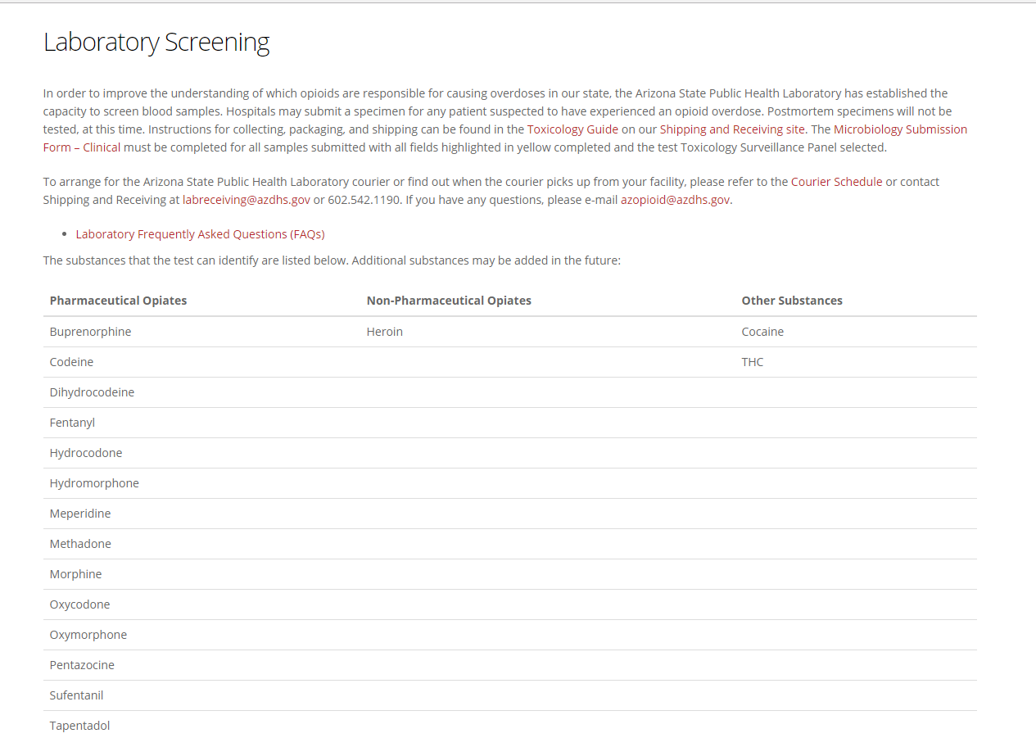
Enhanced Surveillance
Enhanced Surveillance Includes New Reporting, Information Sharing and Laboratory screening
Voluntary submission of blood specimens from suspected overdose cases
Screening completed at the Arizona State Public Health Laboratory
52 specimens submitted from 20 facilities since July 31st

Slide 39
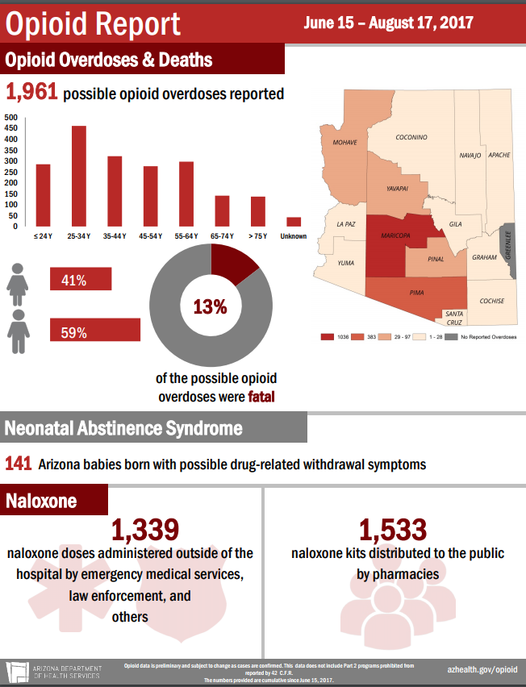
Enhanced Surveillance
Enhanced Surveillance Includes New Reporting, Information Sharing and Laboratory-testing
Suspected opioid overdoses
Suspected opioid-related deaths
Neonatal Abstinence Syndrome
Naloxone administered
Naloxone dispensed

Slide 40
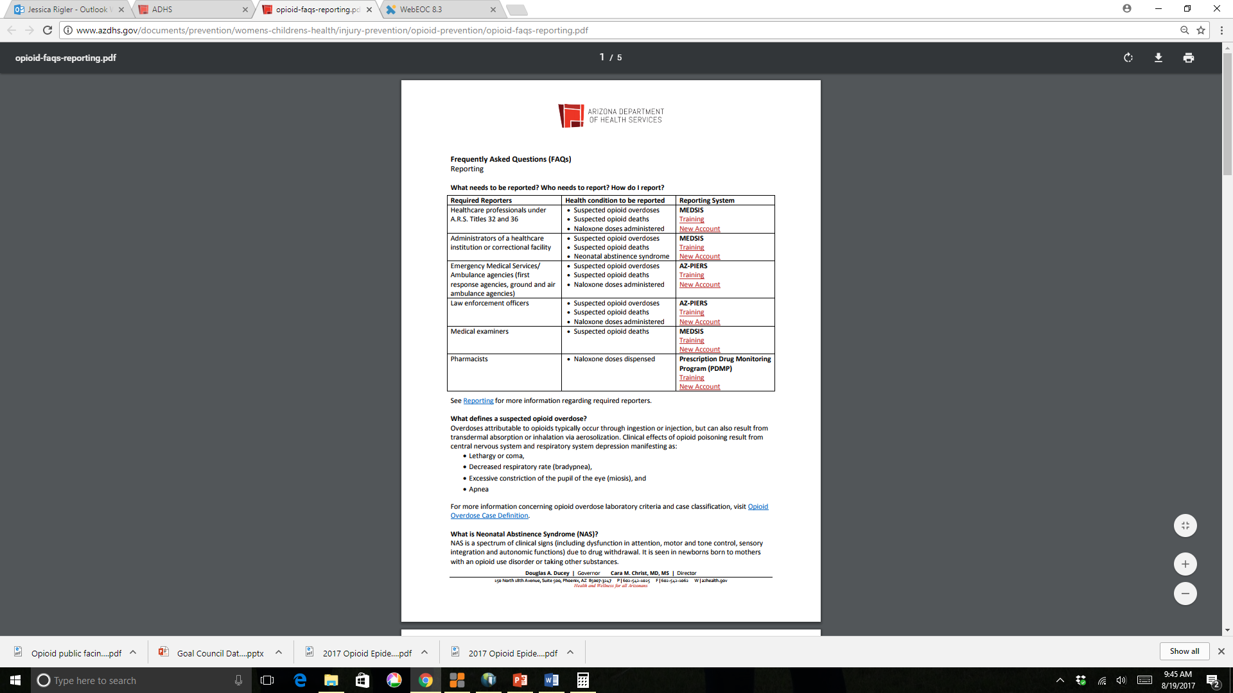
Enhanced Surveillance
Support for New Reporting
ADHS trained 171 healthcare, EMS and law enforcement reporters during 3 webinars for new reporters

Slide 41
What have we learned from the enhanced surveillance?
Notes:
Now I’m going to share some of the data we’ve been able to gather from enhanced surveillance reporting. Please note that this data is still incomplete and subject to change. We continue to provide education to better support reporters in providing the required data. Also important is the fact that this data comes from multiple databases, which can pose limitations. For example, data across multiple databases do not always match, so some of the data presented is for a subset of the reported overdoses rather than all 1,961 possible overdoses reported.
Our team continues to review medical records and toxicology screenings to determine whether each possible overdose is truly an overdose, so these numbers changes as overdoses are confirmed or ruled out. That means this data is still preliminary and subject to change.

Slide 42
In the first 6 months of 2017,
Opioid Prescriptions in Arizona
Notes:
First I’ll talk about opioid prescribing overall in the 1st 6 months of 2017. This is to all Arizonans, not just those who overdosed.

Slide 43

In the first 6 months of 2017,
2,850,535 opioid prescriptions
Opioid Prescriptions in Arizona

Slide 44
In the first 6 months of 2017,
2,850,535 opioid prescriptions
205,256,807 opioid pills
Opioid Prescriptions in Arizona

Slide 46
Over the last 6 months, the number of opioid pills prescribed per week has ranged from 275,615 to 8,435,275.
January
July
Opioid Prescriptions in Arizona

Slide 47
Over the last 6 months, the number of opioid pills prescribed per week has ranged from 275,615 to 8,435,275.
Executive Order 2016-06: Prescription Opioid Initial Fill Limitation in effect
January
July
Opioid Prescriptions in Arizona

Slide 48
Over the last 6 months, the number of opioid pills prescribed per week has ranged from 275,615 to 8,435,275.
January
July
Opioid Prescriptions in Arizona
Notes:
The average number of opioid prescriptions per week is 95,017. This amounts to an average of 6.8 million pills.

Slide 49
Enhanced Surveillance Period:
June
S | M | T | W | T | F | S
 |  |  |  | 1 | 2 | 3
4 | 5 | 6 | 7 | 8 | 9 | 10
11 | 12 | 13 | 14 | 15 | 16 | 17
18 | 19 | 20 | 21 | 22 | 23 | 24
25 | 26 | 27 | 28 | 29 | 30
July
S | M | T | W | T | F | S
 |  |  |  |  |  | 1
2 | 3 | 4 | 5 | 6 | 7 | 8
9 | 10 | 11 | 12 | 13 | 14 | 15
16 | 17 | 18 | 19 | 20 | 21 | 22
23 | 24 | 25 | 26 | 27 | 28 | 29
30 | 31
August
S | M | T | W | T | F | S
 |  | 1 | 2 | 3 | 4 | 5
6 | 7 | 8 | 9 | 10 | 11 | 12
13 | 14 | 15 | 16 | 17 | 18 | 19
20 | 21 | 22 | 23 | 24 | 25 | 26
27 | 28 | 29 | 30 | 31
Opioid Overdoses & Deaths
Notes:
Now I’m going to transition to talk about what we learned about the opioid overdoses and deaths reported so far during our enhanced surveillance period. As a reminder, the overdoses and deaths discussed here were reported under the Governor’s executive order for enhanced surveillance, which started June 15th. For the purposes of this presentation, the data was frozen on August 10th for analysis.

Slide 50
1,557 possible opioid overdoses
Opioid Overdoses & Deaths

Slide 51
1,557 possible opioid overdoses
13%
of the possible opioid overdoses were fatal
Opioid Overdoses & Deaths

Slide 52
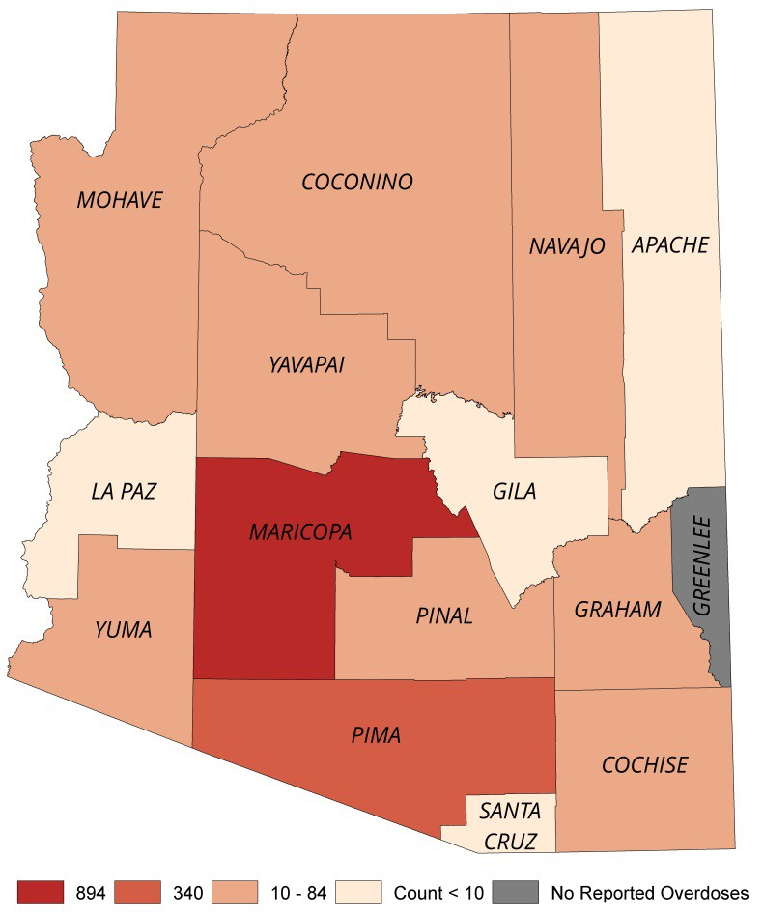
1,557 possible opioid overdoses
13%
of the possible opioid overdoses were fatal
14 out of 15 counties have reported a possible opioid overdose.
Opioid Overdoses & Deaths

Slide 53
1,557 possible opioid overdoses
Opioid Overdoses & Deaths

Slide 54


1,557 possible opioid overdoses
41%
59%
Opioid Overdoses & Deaths

Slide 55
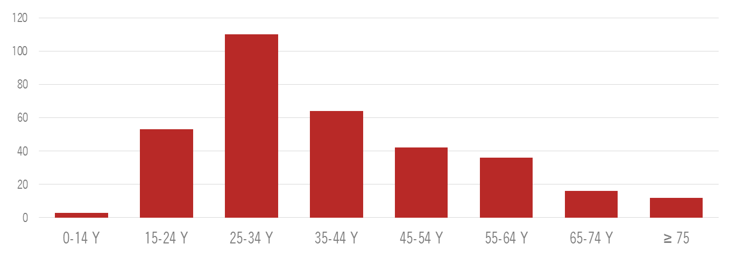
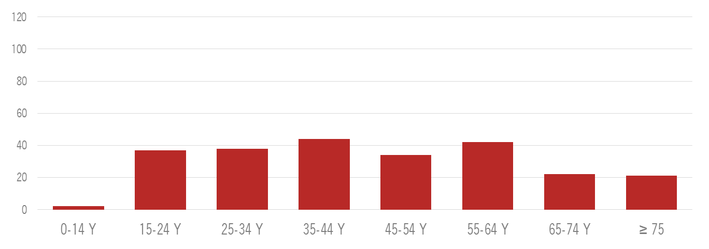
Female
Male
Opioid Overdoses & Deaths
Notes:
There have been more males than females who have had possible opioid overdoses but the 25 – 34 year old age group has seen the most overdoses in males.

Slide 56
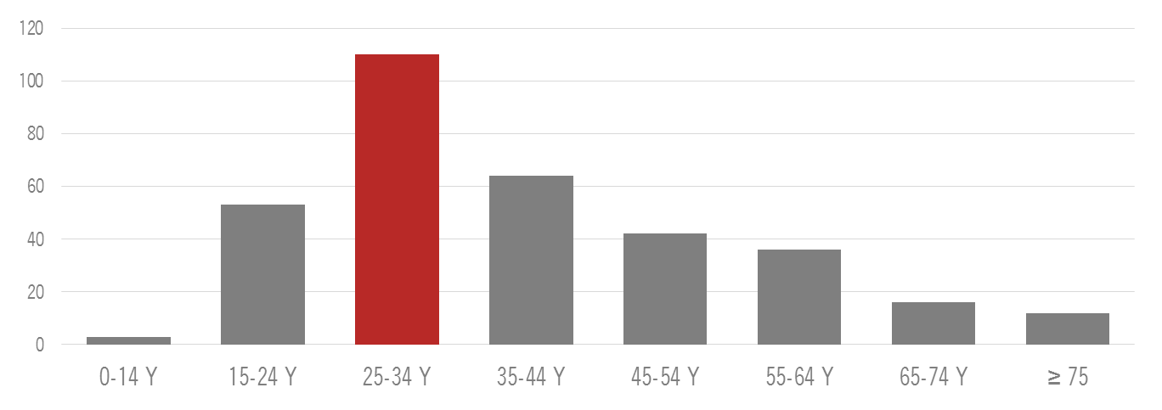
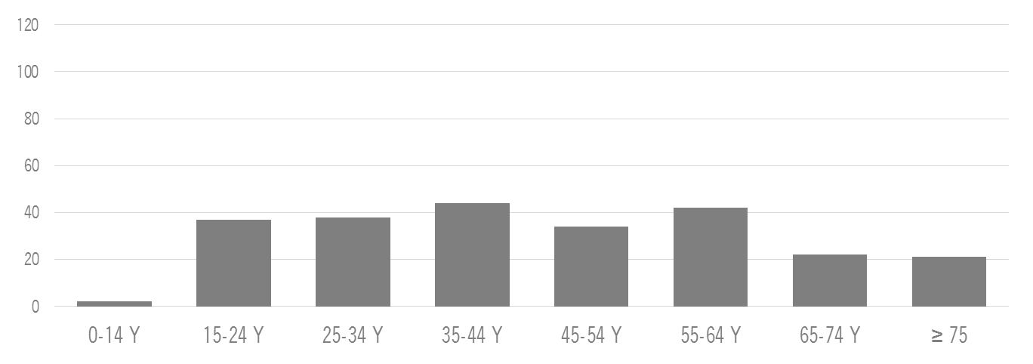
Female
Male
Opioid Overdoses & Deaths
Notes:
There have been more males than females who have had possible opioid overdoses but the 25 – 34 year old age group has seen the most overdoses in males.

Slide 57
Prior Hospitalization

Slide 58
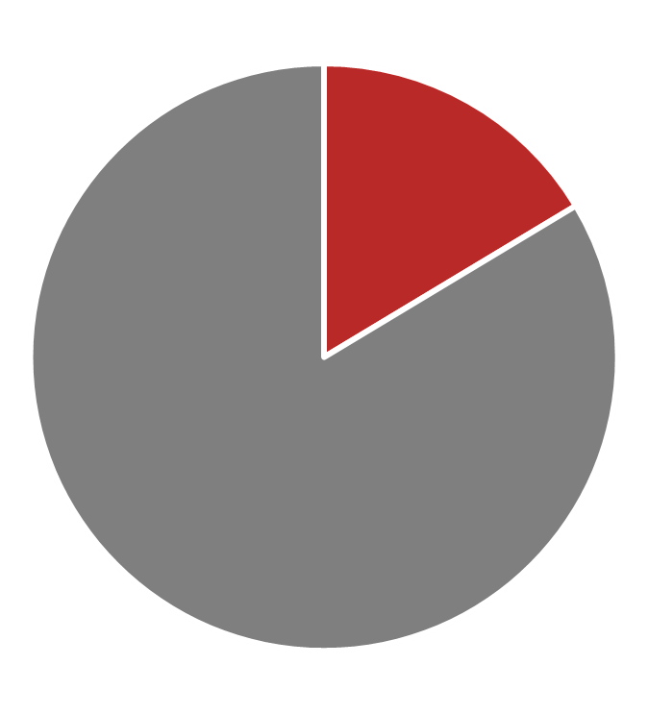
255 (16%) of possible opioid overdoses during the enhanced surveillance period were hospitalized in 2016 with an opioid-related cause.
Prior Hospitalization

Slide 59
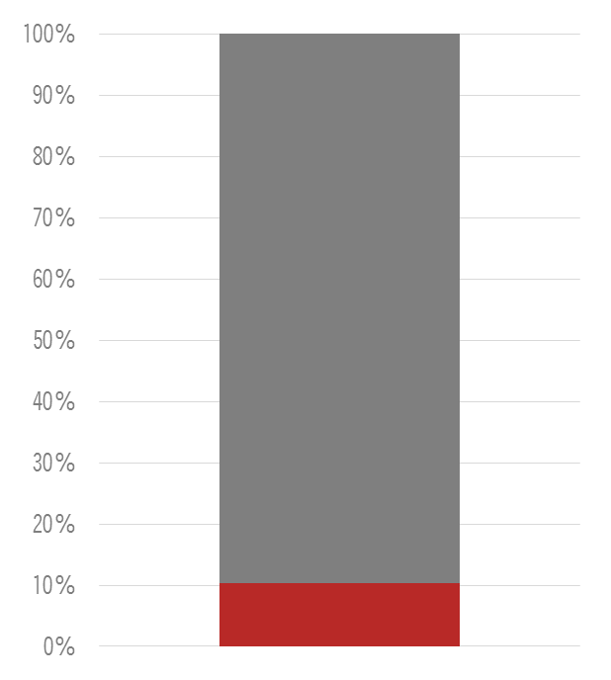
Non-Fatal
Fatal
And 10% of those resulted in a fatal overdose during our enhanced surveillance period.
Prior Hospitalization

Slide 60
Repeat Overdoses

Slide 61
During the enhanced surveillance period, 10 individuals had multiple overdoses.
9 individuals overdosed twice and 1 overdosed 3 times.
Repeat Overdoses

Slide 62
Opioid Prescriptions to Possible Overdose Cases

Slide 63
There were 8,430 opioid prescriptions written for 794 possible opioid overdoses over the past year.
Opioid Prescriptions to Possible Overdose Cases

Slide 64
There were 8,430 opioid prescriptions written for 794 possible opioid overdoses over the past year.
The average MME per individual over the last year was 96.
Opioid Prescriptions to Possible Overdose Cases

Slide 65
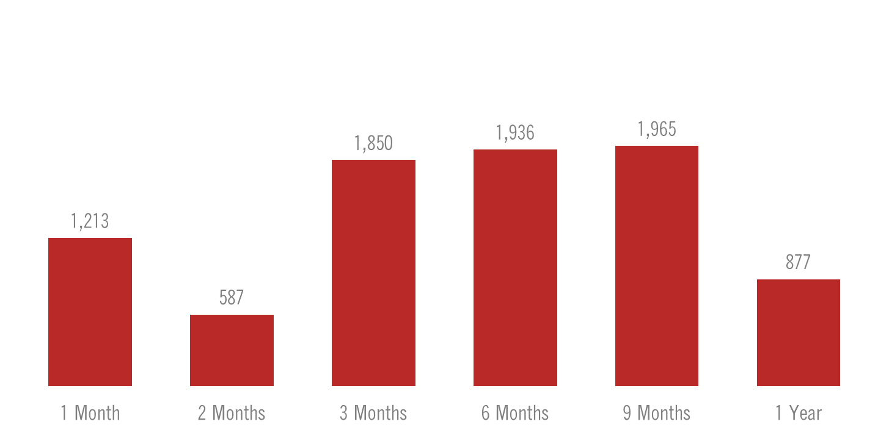
There were 8,430 opioid prescriptions written for 794 possible opioid overdoses over the past year.
Opioid Prescriptions to Possible Overdose Cases
Notes:
- This is the breakdown of opioid prescriptions written for possible opioid overdoses in the 1 month prior to overdose, 2 months prior to overdose, etc.

Slide 66
In 2017, 493 (74%) individuals had more than one opioid prescription.
Opioid Prescriptions to Possible Overdose Cases

Slide 67
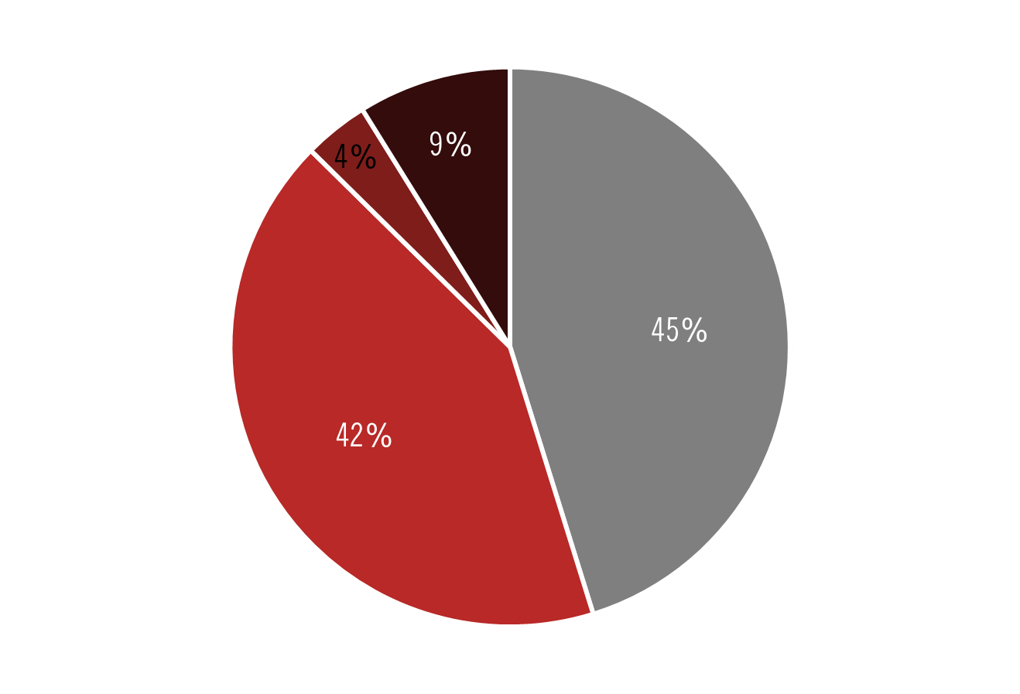
During 2017, the most common drug combination was opioids and benzodiazepines.
Opioid Only
Opioid + Benzodiazepine
Opioid + Muscle Relaxer
Opioid + Zolpidem
Opioid Prescriptions to Possible Overdose Cases

Slide 68
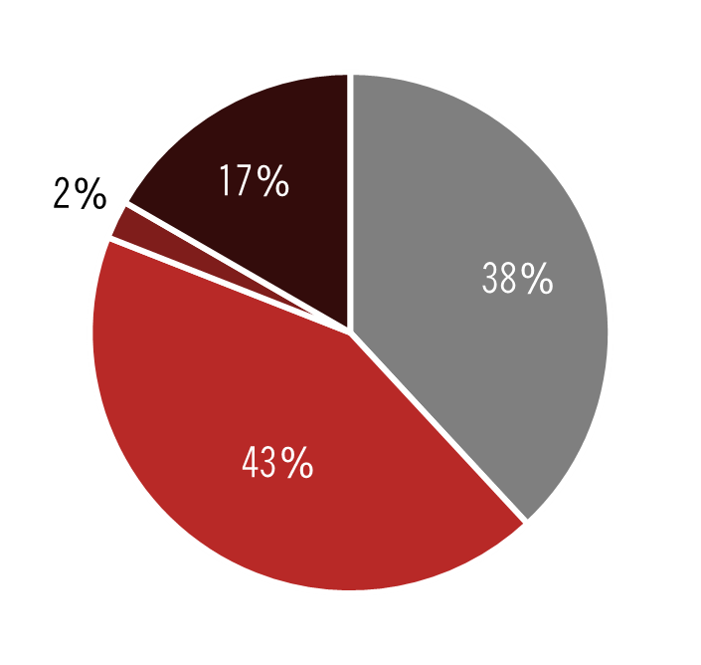
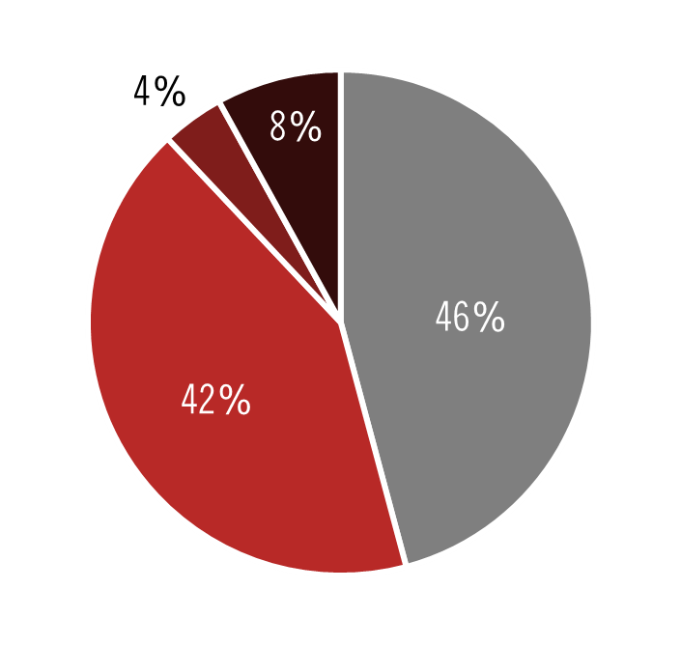
Non-fatal
Fatal
Opioid Only
Opioid + Benzodiazepine
Opioid + Muscle Relaxer
Opioid + Zolpidem
Opioid Prescriptions to Possible Overdose Cases

Slide 69
Two months prior to the overdose,
Opioid Prescriptions to Possible Overdose Cases

Slide 70
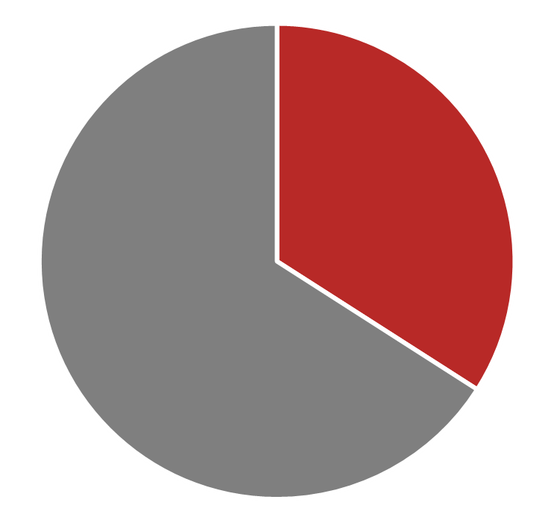
Two months prior to the overdose,
535 (33%) of possible opioid overdoses had an opioid prescription.
Opioid Prescriptions to Possible Overdose Cases

Slide 71
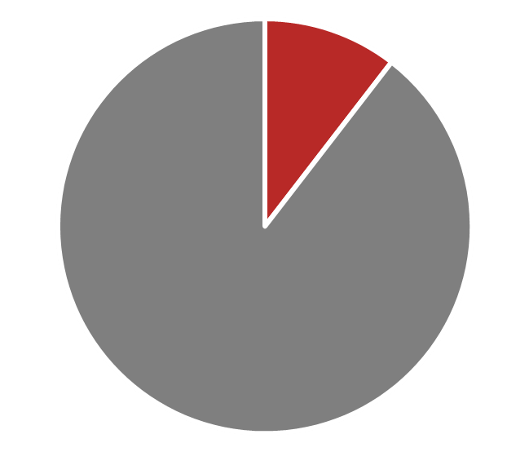
Two months prior to the overdose,
535 (33%) of possible opioid overdoses had an opioid prescription.
12% of those individuals with an opioid prescription two months prior had a fatal overdose,
Opioid Prescriptions to Possible Overdose Cases

Slide 72
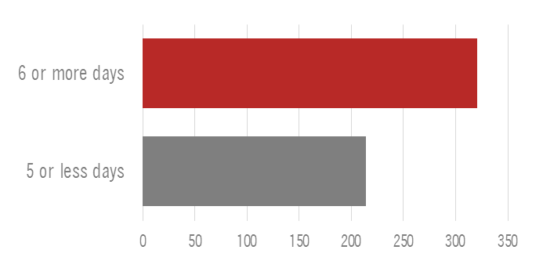
Two months prior to the overdose,
535 (33%) of possible opioid overdoses had an opioid prescription.
12% of those individuals with an opioid prescription two months prior had a fatal overdose,
& 60% had an opioid prescription written for 6 or more days.
Opioid Prescriptions to Possible Overdose Cases

Slide 73
Opioid Prescriptions by Providers

Slide 74
During 2017, 502 prescribers wrote an opioid prescription to a possible opioid overdose.
Opioid Prescriptions by Providers

Slide 75
There were 457 providers who wrote opioid prescriptions to non-fatal possible opioid overdoses and 45 providers who wrote opioid prescriptions to fatal possible opioid overdoses.
38%
47%
62%
53%
Opioid Prescriptions by Providers

Slide 76
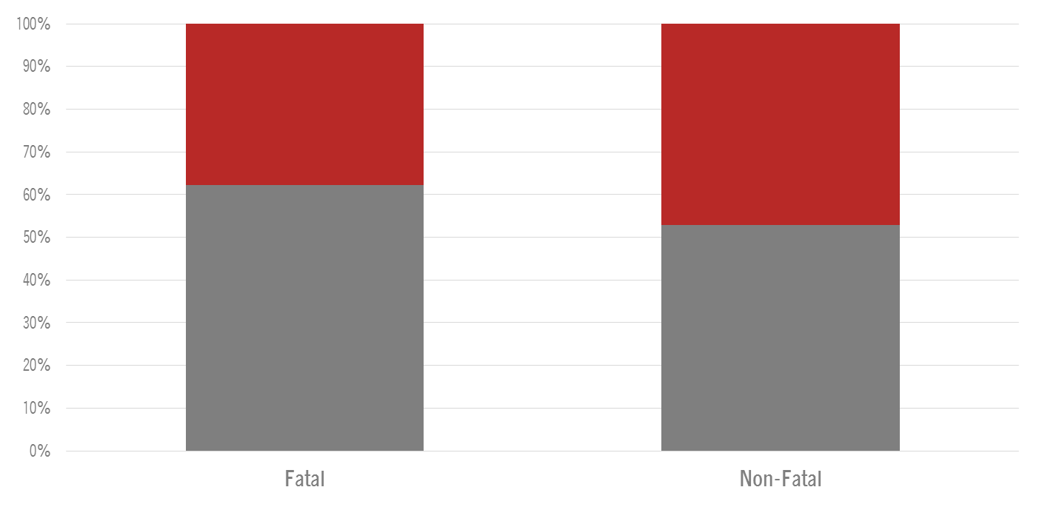
There were 457 providers who wrote opioid prescriptions to non-fatal possible opioid overdoses and 45 providers who wrote opioid prescriptions to fatal possible opioid overdoses.
More than one prescription written
38%
47%
62%
One prescription written
53%
Opioid Prescriptions by Providers

Slide 77
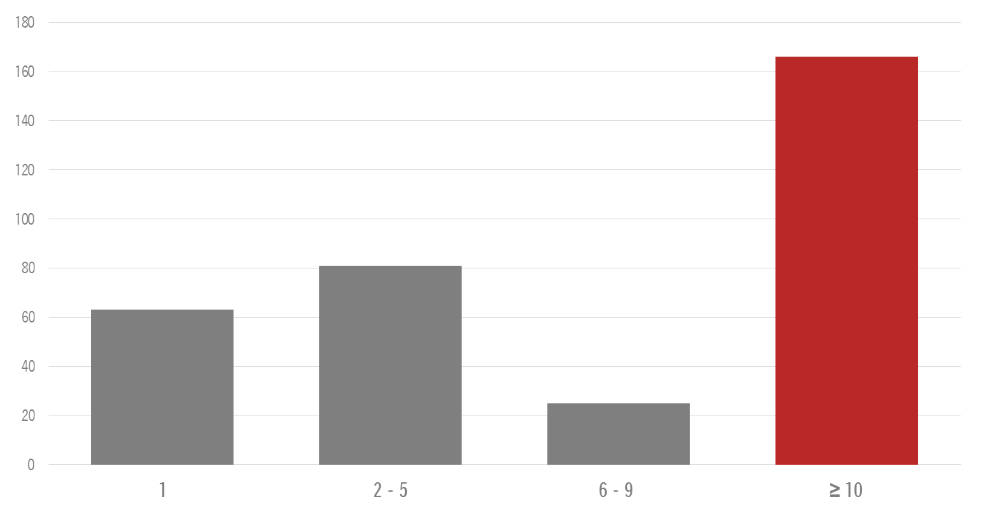
50% of individuals who experienced an overdose during the enhanced surveillance period had 10 or more providers prescribe opioids to them over the last year.
Opioid Prescriptions by Providers

Slide 78
Drugs Reported by Hospitals & Medical Examiners

Slide 79
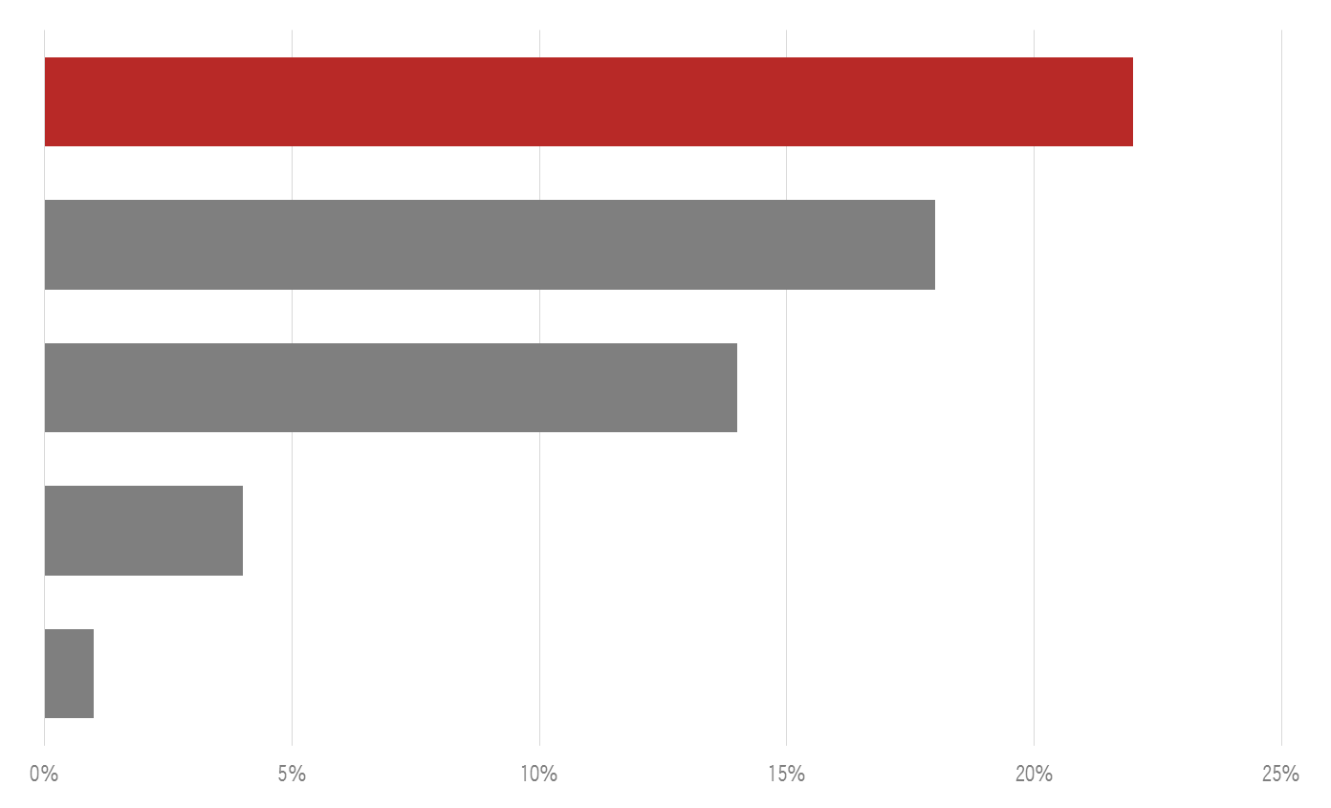
Heroin was the drug most commonly noted in the overdose reports.
Heroin
Oxycodone
Benzodiazepine
Hydrocodone
Tramadol
Drugs Reported by Hospitals & Medical Examiners

Slide 80
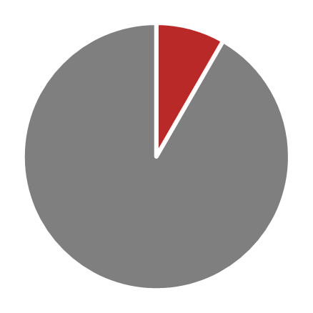
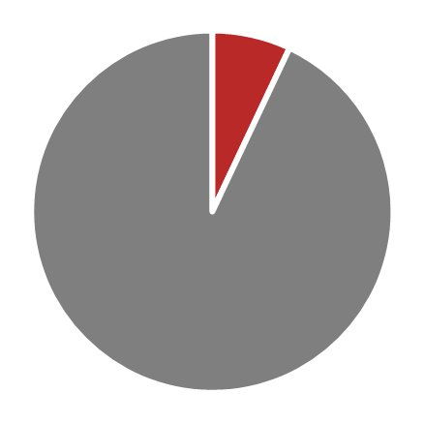
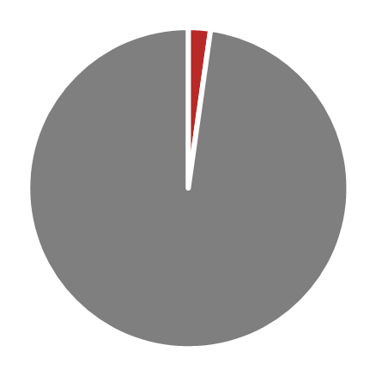
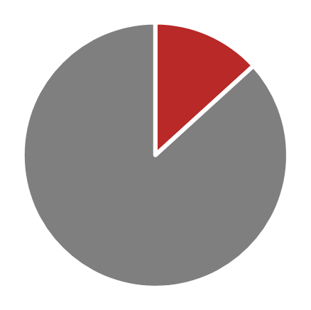
Of those with heroin noted in the opioid overdose report, 19% were fatal. During this time period there were no fatalities associated with tramadol.
Heroin
Oxycodone
Hydrocodone
Benzodiazepine
Drugs Reported by Hospitals & Medical Examiners

Slide 81
Suicide/ Suicide Attempts

Slide 82
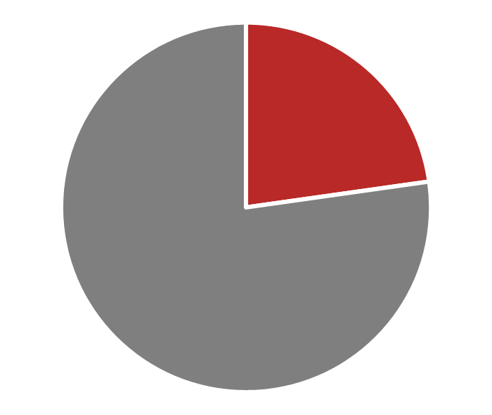
23% of the possible opioid overdoses were suicide or suicide attempts.
Suicide/ Suicide Attempts

Slide 83
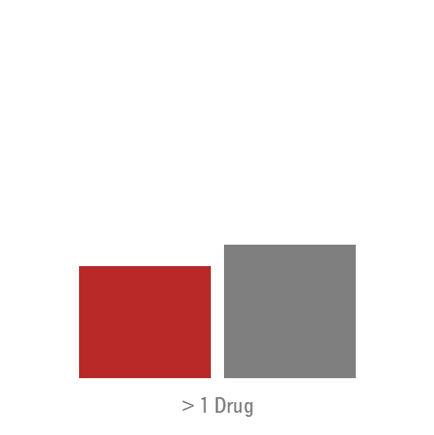
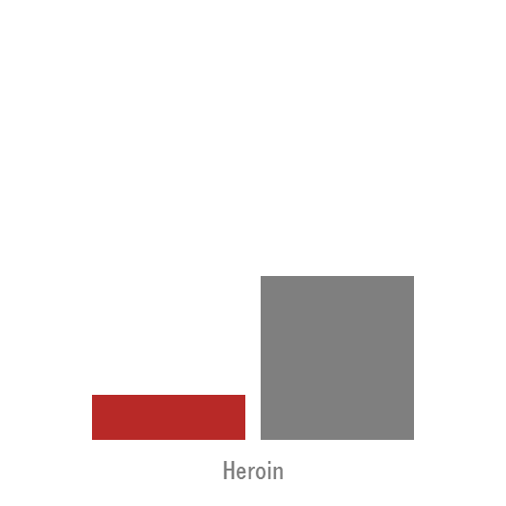
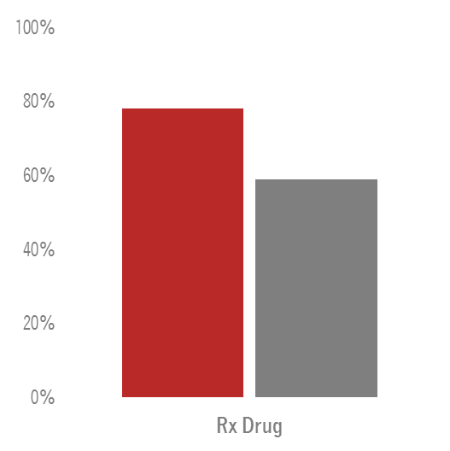
A large majority of suicides or suicide attempts reported taking a prescription opioid.
Suicide/ Suicide Attempt
Unintentional
Suicide/ Suicide Attempts

Slide 84
Overdose Location & Behavioral Health Referral

Slide 85
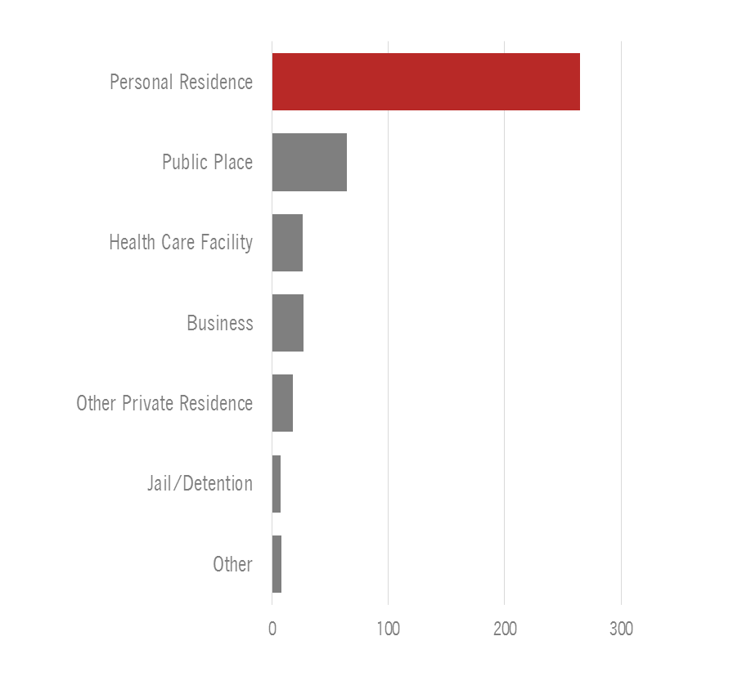
A majority of the possible opioid overdoses occurred in a personal residence.
Overdose Location & Behavioral Health Referral

Slide 86
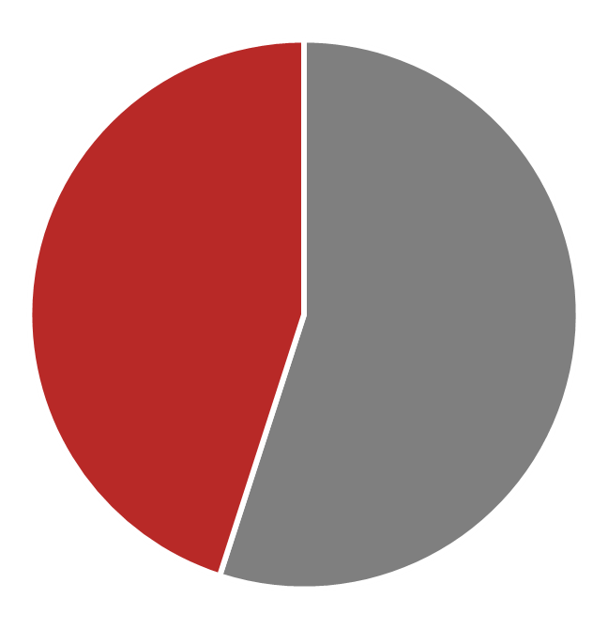
A majority of the possible opioid overdoses occurred in a personal residence.
45% of individuals were referred to behavioral health after their possible opioid overdose.
Overdose Location & Behavioral Health Referral

Slide 87
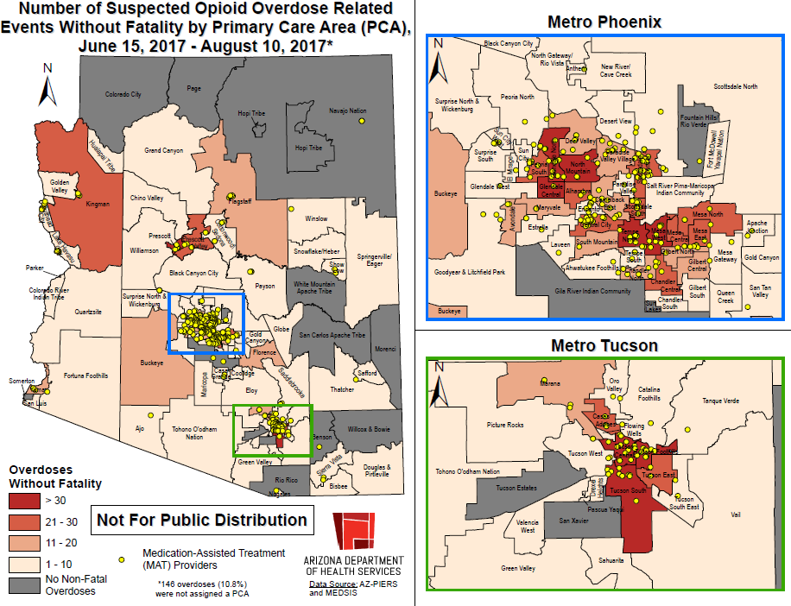
Notes:
This map shows the reported opioid overdoses who survived mapped by area of the state. The yellow dots on the map are locations of MAT providers.

Slide 88
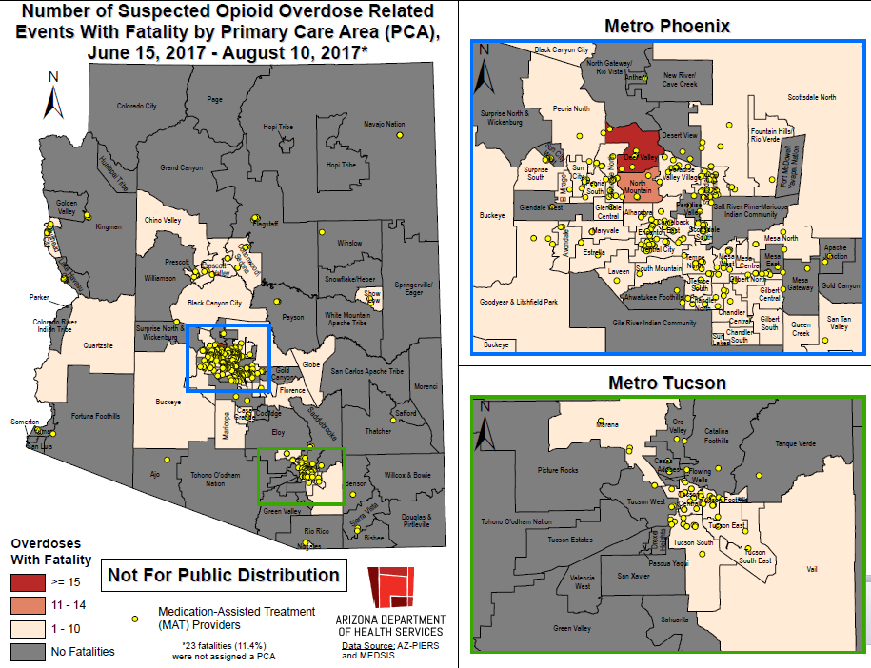
Notes:
This map shows the reported fatal opioid overdoses by area of the state. The yellow dots on the map are locations of MAT providers.

Slide 89
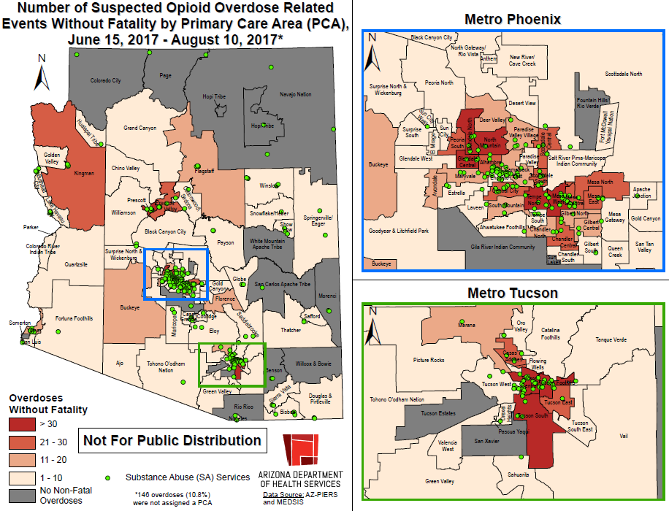
Notes:
This map shows the reported opioid overdoses who survived by area of the state. The green dots on the map are locations of substance abuse services.

Slide 90
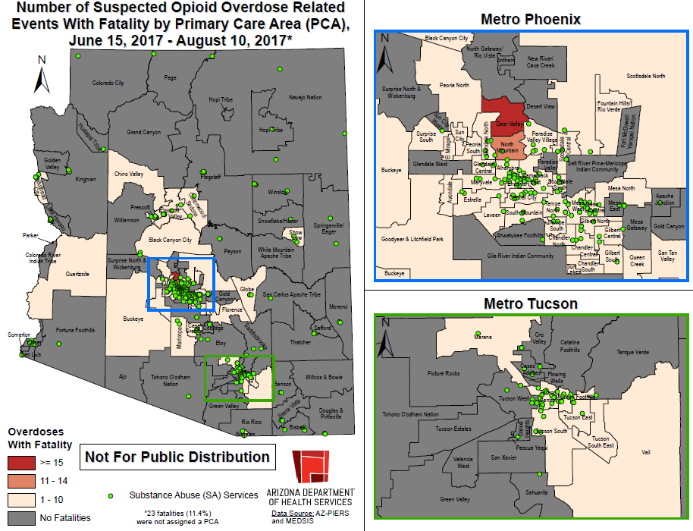
Notes:
This map shows the reported fatal opioid overdoses by area of the state. The green dots on the map are locations of substance abuse services.

Slide 91
Neonatal Abstinence Syndrome
Notes:
Now I’m going to transition to discussing reports of neonatal abstinence syndrome during the enhanced surveillance period.

Slide 92

50% of mothers of NAS cases were being medically supervised while taking opioids during pregnancy.
Neonatal Abstinence Syndrome

Slide 93
Naloxone Administered
Notes:
Now I’m going to discuss reports of naloxone administered during the enhanced surveillance timeframe.

Slide 94
1,199 doses of naloxone administered
Naloxone Administered

Slide 95

1,199 doses of naloxone administered
Excluding deaths, 84% of the possible opioid overdoses received naloxone pre-hospital.
Naloxone Administered

Slide 96

1,199 doses of naloxone administered by
Emergency Medical Services
Law Enforcement
Other Health Care Professional
Bystander/Layperson
Naloxone Administered

Slide 97

1,199 doses of naloxone administered
Naloxone doses were reported to be administered in 13 of the 15 counties since June 15th.
Naloxone Administered

Slide 98

Notes:
This map shows the opioid overdoses who survived mapped by geographic area of the state. The blue dots on this map show the geographic areas where one or more doses of naloxone were administered by law enforcement.

Slide 99

Notes:
This map shows the fatal opioid overdoses mapped by geographic area of the state. The blue dots on this map show the geographic areas where one or more doses of naloxone were administered by law enforcement.

Slide 100
What is our charge today?

Slide 101
Goal Council 3
Subgroup Structure

Slide 102
Goal Council 3
Goal Council Structure
Governor’s Leadership Team
Core Team: chair, subgroup team leads, Governor’s office
Subgroup
Subgroup
Subgroup
Subgroup
Subgroup
Formulate Ideas & Implement Actions

Slide 103

Goal Council 3

Slide 104
Goal Council 3
Illicit Supply Group
Heroin deaths in Arizona have risen 334% since 2012.
  Recently, synthetic opioids and opioids mixed with other powerful drugs like fentanyl have created large clusters of overdose
  Impacting the illicit opioid supply is critical to preventing these deaths.
Team Lead: Tim Roemer
Focus: point in time when a person either acquires an opioid with the intent to distribute, use or sell, an illegally or legally produced opioid and goes through the event when an individual uses the opioid without a prescription

Slide 105
Goal Council 3
Rx Supply Group
Opioid prescriptions have increased by 300% since 1999 without any change in reported pain.
In 2016, there were enough pills prescribed to provide every person in Arizona a 2 ½ week supply of medication.
Safe prescribing and use of opioids can improve patient safety, reduce harm, and prevent unintended consequences.
Team Lead: Sheila Sjolander
Focus: point in time when a patient presents with a perceived pain need and ends with the patient using the prescribed opioid

Slide 106
Goal Council 3
Demand Group
The U.S. is one of the largest consumers of opioids in the world.
In Arizona, we’ve seen a continued rise in prescriptions written since 1999.
As a result, the continued manufacturing of opioids, both legal and illegal has continued to amplify the available supply.
Team Lead: Elizabeth Dodge
Focus: begins with the examination of the desire, curiosity, or perceived need for an opioid by an individual and bounded by their attempt to procure the opioid

Slide 107
Goal Council 3
Youth Prevention Group
Individuals who begin using alcohol or tobacco when they are very young are more likely to abuse them later in life, when it becomes much more difficult to quit.
  Intervening early—before high school—is critical.
  The data suggest that patterns of substance abuse become worse in the high school years.
Team Lead: Sam Burba
Focus: youth substance abuse knowledge, understanding of messaging, and efforts to increase the number of youth completing secondary education

Slide 108
Goal Council 3
Interventions & Treatment Group
Effective substance abuse interventions and treatments have different areas of focus and can be implemented in a variety of settings
Early intervention and treatment carries significant benefits for individuals.
Team Leads: Aaron Bowen and Sara Salek
Focus: on strategies to assist individuals who are misusing, have become tolerant, dependent or addicted to opioids prior to a first or recurring negative outcome through completion of treatment

Slide 109
Goal Council 3
Death Group
Arizona has seen a 74% increase in opioid deaths since 2012.
Deaths due to opioids negatively impact families and communities every day.
Team Lead: Colby Bower
Focus: the time of a poisoning event that subsequently results in the death of the individual
  Identifying strategies to reduce the number of deaths resulting from opioids in Arizona

Slide 110
Goal Council 3
Goals for Today
Review and provide input on draft recommendations
  Break into subgroups
  Review input from next exercise
  Prioritize the top 2-3 recommendations to be considered for inclusion in the September 5th ADHS report to Governor Ducey
Focus on actionable, high impact ideas that need high level support for implementation
Refine language of selected recommendations to ensure specificity and clarity

Slide 111
Questions?

Slide 112

Visit
azhealth.gov/opioid
for more information

