Slide 1

Prescription Drug Overdose National Perspective
Len Paulozzi, MD, MPH
Division of Unintentional Injury Prevention
National Center for Injury Prevention and Control
Centers for Disease Control and Prevention
Arizona Opioid Prescribing Summit, March 15, 2014
National Center for Injury Prevention and Control
Division of Unintentional Injury Prevention

Slide 2
Outline of presentation
State comparisons
States with opioid guidelines
Common elements of guidelines
Guideline adherence
Impacts of guidelines reported by states

Slide 3
Motor vehicle traffic, poisoning, and drug poisoning (overdose) death rates, US, 1980-2010
NCHS Data Brief, December, 2011, Updated with 2009 and 2010 mortality data

Slide 4
Drug overdose deaths by major drug type, US, 1999-2010
16,651
CDC/NCHS National Vital Statistics System, CDC Wonder.

Slide 5
Death Rates for Drug Overdose by State, 2010
13.1
12.9
3.4
10.4
12.9
7.3
11.8
6.3
10.9
7.8
15.0
13.9
6.7
8.6
15.3
NH 11.8
20.7
10.0
14.4
16.1
VT 9.7
16.9
28.9
MA 11.0
10.6
12.7
6.8
RI 15.5
9.6
17.0
23.6
CT 10.1
11.4
NJ 9.8
17.5
16.9
DE 16.6
23.8
19.4
12.5
14.6
MD 11.0
DC 12.9
11.4
11.8
10.7
9.6
13.2
16.4
11.6
10.9
Age-adjusted rate per 100,000 population
3.4 - 10.9*
10.9* - 13.9
14.0 - 28.9
Footnote: *10.9 is in two ranges due to rounding. HI is 10.88 while WI is 10.94
Notes:
Arizona ranked sixth nationally in 2010.
Data: WONDER multiple causes mortality files, age-adjusted death rates for 2010. Deaths whose underlying cause was coded to unintentional (X40-44), intentional (X60-64, X85), or undetermined intent (Y10-14) drug poisoning.
Source: Centers for Disease Control and Prevention , National Center for Health Statistics. Multiple Cause of Death 1999-2010 on CDC WONDER Online Database, released 2012. Data are from the Multiple Cause of Death Files, 1999-2010, as compiled from data provided by the 57 vital statistics jurisdictions through the Vital Statistics Cooperative Program. Accessed at http://wonder.cdc.gov/mcd-icd10.html

Slide 6
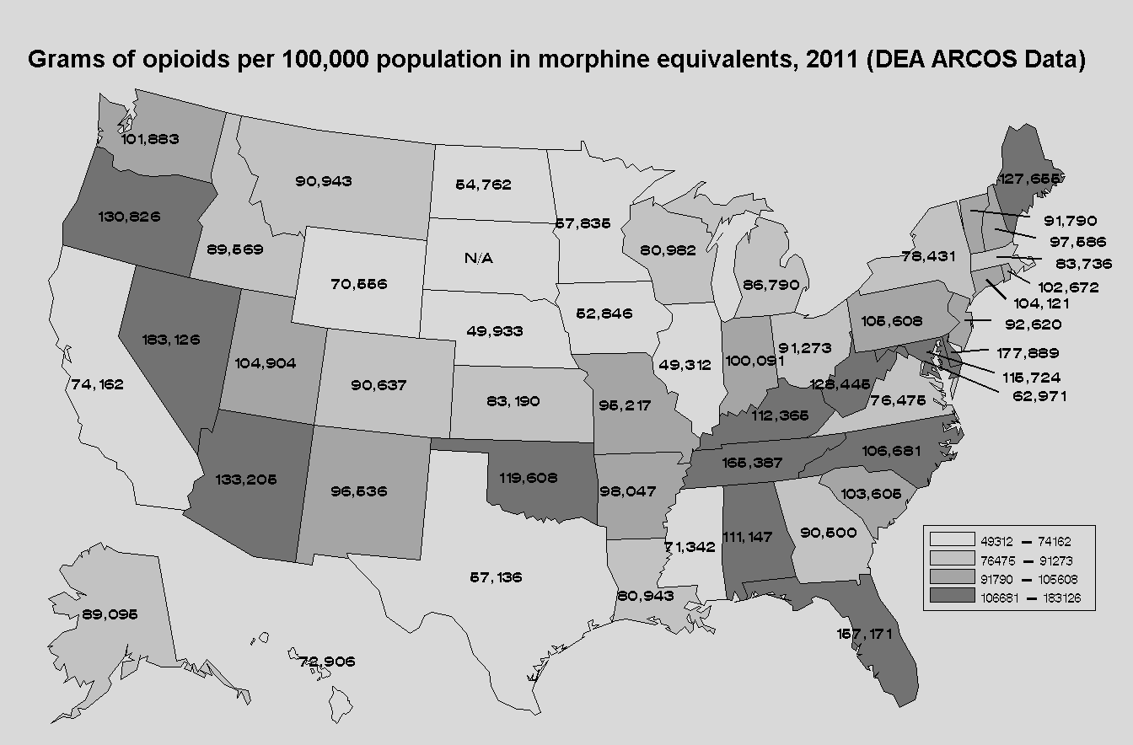
Opioid analgesic prescribing rates, United States, 2011
Notes:
Arizona had the 5th highest rate among states in 2011.
Behind, NV, FL, TN, and DE.

Slide 7
Recent state opioid analgesic prescribing guidelines for chronic pain
Guideline | Year(s)
Washington State Agency Medical Directors Group Interagency Guideline on Opioid Dosing for Chronic Noncancer Pain | 2007, 2010
Utah Clinical Guidelines on Prescribing Opioids for Treatment of Pain | 2009
New York City Opioid Prescribing Guidelines | 2011
New Mexico Clinical Guidelines on Prescribing Opioids for Treatment of Pain | 2011
Ohio Guidelines for Prescribing Opioids for the Treatment of Chronic, Non-Terminal Pain | 2013
Indiana Healthcare Providers Guide to the Safe, Effective Management of Chronic Non‐Terminal Pain | 2013
Opioid Prescribing Guidelines for Oklahoma Health Care Providers in the Office-Based Setting | 2014
Notes:
In general, if the guidelines do not specify “chronic” pain in their title, they will have material related to acute pain.

Slide 8
Features of opioid guidelines by state: Pre-treatment
Recommendation* | UT | WA | NYC | NM | OH | IN | OK
Assess onset, location, quality, duration, and intensity of pain | Y | Y | Y | Y |  | Y | Y
Assess current level of function and change over time | Y | Y | Y | Y |  | Y | Y
Review previous treatments for pain, including prior medication use, and their results | Y | Y | Y | Y |  | Y | Y
Screen for personal or family history of mental health or substance use disorders | Y | Y | Y | Y |  | Y | Y
Determine pregnancy status of patient
Check Prescript Drug Monitor Program (PDMP) | Y | * | Y | Y |  | Y | Y
Conduct a physical exam | Y | Y | Y |  |  | Y
Conduct a urine drug test (UDT) | Y | Y | Y | Y |  | Y | Y
Indication: Opioids are for moderate to severe pain that has failed other indicated therapies | Y | Y | Y | Y | Y | Y | Y
*Recommendation listed here might differ from the wording in the guideline.
Notes:
LANGUAGE VARIES, FROM DIRECTIONS TO DO SOMETHING TO PHRASES SUCH AS “CONSIDER….”
WA did not have a PMP in 2010 when the latest edition of their guidelines was published.
Pregnancy screening is widely recommended in guidelines of professional societies, eg, AAPM/APS

Slide 9
Features of opioid guidelines by state: Initial opioid treatment
Recommendation* | UT | WA | NYC | NM | OH | IN | OK
LA/ER opioids should not usually be used as first-line agents | Y | Y | Y | Y |  |  | Y
Methadone is generally not considered a first-line opioid for chronic pain | Y | Y
The lowest effective dose should be given | Y | Y | Y | Y |  | Y
Initial course of treatment should be considered a trial and short-term (lasting from several weeks to several months) | Y |  | Y | Y |  | Y | Y
Do not combine opioids with sedative-hypnotics such as benzodiazepines or barbiturates unless there is a specific medical and/or psychiatric indication |  | Y | Y |  |  | Y
Informed consent and a signed treatment agreement should be executed | Y | Y | Y | Y |  | Y | Y
*Recommendation listed here might differ from the wording in the guideline.
Notes:
Utah talks about determining whether patients are taking sedatives but does not explicitly state that they should not be combined with opioids.
WA in contrast says “do not combine…unless there is a specific medical indication.”

Slide 10
Features of opioid guidelines by state: At each follow-up visit
Recommendation* | UT | WA | NYC | NM | OH | IN | OK
Assess pain intensity, level of function, adverse events, aberrant drug-related behavior | Y | Y | Y | Y | Y80 | Y | Y
Reassess treatment progress and treatment plan and consider other pain management approaches if patient receiving ≥ a specific dose in Morphine Mg Equivalent (MME)/day | 120-200 | 120 | 100 |  | 80 | 30
Do not combine opioids with sedative-hypnotics such as benzodiazepines or barbiturates unless there is a specific medical and/or psychiatric indication |  | Y | Y |  | Y | Y
Check PDMP | Y | * | Y | Y | Y80 | Y | Y
Conduct periodic random UDT on all patients receiving chronic opioid therapy. (yearly for low-risk and up to every 3 months for high-risk). Screen if patient demonstrates aberrant behavior | Y | Y | Y | Y | Y80 | Y
*Recommendation listed here might differ from the wording in the guideline.
Notes:
Ohio calls 80 MED a trigger point. Recommendations labeled “Y80” above apply only to patients at this dosage for 3 months or more.
WA did not have an operative PDMP in 2010 when the guidelines were updated.

Slide 11
Features of opioid guidelines by state: Opioid discontinuation
Recommendation* | UT | WA | NYC | NM | OH | IN | OK
Primary reasons for discontinuation include: no progress toward meeting therapeutic goals; serious or repeated aberrant drug related behaviors or drug diversion; intolerable side effects | Y | Y | Y | Y |  | Y | Y
Specific tapering strategies suggested, e.g., a 10% reduction in dose per week up to 25-50% reduction every few days | Y | Y | Y | Y |  |  | Y
If patient is suspected of meeting criteria for opioid dependence, explain treatment options and refer patient to an addiction specialist, buprenorphine providers, or methadone maintenance treatment program. |  | Y | Y | Y |  | Y | Y
*Recommendation listed here might differ from the wording in the guideline.

Slide 12
General findings in evaluating opioid prescribing guidelines
Wide variation (38%-66%) fraction of providers unaware of guidelines
Overall low level of adherence
Some components more likely to be adopted than others

Slide 13
Challenges to guideline adherence
Lack of familiarity
Conflicting recommendations among guidelines
Lack of empirical evidence to support recommendations
Work flow obstacles, e.g., time required to check PDMPs
Resource obstacles, e.g., lack of insurance coverage for options to opioids/urine tests, or lack of specialists for referrals

Slide 14

Changes in prescriber behavior after Washington State 2007 opioid prescribing guidelines
Survey in 2011 of prescribers asked:
“Has your opioid prescribing for chronic, noncancer pain changed in the past 3 years?”
Response rates <11%
Responses:
Now prescribes opioids to
More CNCP patients, 10.5%
Fewer CNCP patients, 44.4%
Stopped prescribing, 3.3%
Now prescribes
Higher doses more often, 5.7%
Higher doses less often, 46.6%
Source: Franklin et al. Changes in opioid prescribing for chronic pain in Washington State. JABFM 2013; 26(4):394-400

Slide 15
Changes in opioid prescribing to workers compensation claimants after Washington State 2007 opioid prescribing guidelines
Trends 1996-2010 in workers compensation system
Findings
Number of CSII and CSIII opioid rx declined
Mean MED declined 27% in 2002-2010
Proportion of claimants on opioids declined 37%
Proportion of claimants on 120+ MED declined 35%
Opioid-related deaths rose through 2009 and dropped sharply in 2010
Source: Franklin et al. Bending the prescription opioid dosing and mortality curves: impact of the Washington State Opioid Dosing Guideline. Am J Ind Med 2012; 55:325-331

Slide 16
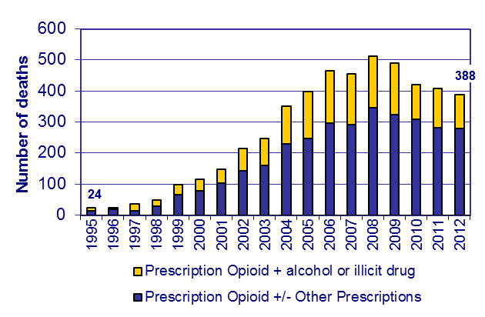
Unintentional Prescription Opioid Overdose Deaths Washington 1995-2012
* Tramadol only deaths included in 2009, but not in prior years.
Source: Washington State Department of Health, Death Certificates
Notes:
16
There was a coding change that became effective in 2009, which included tramadol as an opioid code. Deaths with tramadol as the only opiate were excluded prior to 2009. In 2009, there were 9 such deaths. It is likely that the decline from 2008 to 2009 would be slightly larger if tramadol only deaths had been included previously.

Slide 17

Adherence to Utah prescribing guidelines
Utah guidelines published in 2009
Followed by academic detailing campaign
Survey of 47 prescribers (55% response rate) of a university-based community clinic system in 2011
Source: Porucznik, et al. Opioid prescribing knowledge and practices: provider survey following promulgation of guidelines—Utah, 2011. J Opioid Manage 2013;9:217-223

Slide 18
Results of Utah prescribing guidelines survey
Among the 47 respondents:
77% prescribed opioids for chronic noncancer pain (CNCP)
39% were familiar with the guidelines
37% read them but didn’t remember them
72% used random urine toxicology tests for CNCP patients
41% used patient contracts always
Source: Porucznik, et al. Opioid prescribing knowledge and practices: provider survey following promulgation of guidelines—Utah, 2011. J Opioid Manage 2013;9:217-223

Slide 19
Number of occurrent* prescription-opioid deaths by year, Utah, 2000-2011
*Occurrent deaths include all individuals who died in Utah, whether or not they were a resident of Utah.
Source: Utah Department of Health. Prescription opioid deaths in Utah, 2011. At: http://useonlyasdirected.org/docs/RxOpioidDeaths.pdf

Slide 20
Conclusions
State guidelines for opioid prescribing for chronic pain proliferating
In general, guidelines components are similar, but language, obligation, and circumstances for action vary
Challenges to adherence as in any educational intervention
Clear evidence of effectiveness difficult to obtain
--- overall or for specific components of guidelines

Slide 21

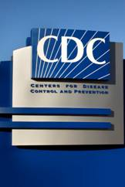

Thank you
Len Paulozzi, MD, MPH
lpaulozzi@cdc.gov
The findings and conclusions in this report are those of the author and do not necessarily represent the official position of the Centers for Disease Control and Prevention/the Agency for Toxic Substances and Disease Registry. The presenter has no conflicts of interest.

