Slide 1
Sustainable Plan of Corrections (POC)
Bureau of Residential Facilities Licensing
2018

Slide 2
Common Abbreviations
SOD = Statement of Deficiencies.
POC = Plan of Correction.
IDR = Informal Dispute Resolution.

Slide 3
POC Training Overview
Overview of the SOD and POC process.
Plan of Correction – 5 required components.
Description of Statement of Deficiencies Letters, Identifying Information, License ID, and Event ID #.
Sample Plan of Correction.
Practice writing a POC.
Reminders and clarifications.
Questions?

Slide 4
What is a POC?
After a survey, the provider is mailed a Statement of Deficiencies (SOD) listing the deficiencies based on the supporting evidence.
The provider is afforded the opportunity to create a plan to correct the deficiencies cited, both immediately and for the future.

Slide 5
Plan of Correction - 5 components
How will the deficiency be corrected on both a temporary and permanent basis?
  What action did you take immediately to correct the deficiency?
  What action will you take over time to correct the deficiency?
The date the correction will be completed. This can be a future date if the correction will take some time. DON’T hold the POC waiting on the correction. Tell us your PLAN and the deadline for your plan.
The name, title, and/or position of the person responsible for implementing the corrective action.
A description of the monitoring system you will use to prevent the deficiency from recurring.
What are you going to do, over time, to make sure this doesn’t happen again?
5. The signature, title and date signed of the person responsible for the POC on Page 1 of the SOD.

Slide 6
Importance of an acceptable POC
Decrease repeat deficiencies that lead to enforcement, which could mean civil money penalties (CMPs).
Survey can be closed sooner.
May not receive placement referrals until POC accepted.
Decrease the chance of a surveyor showing up to do an on-site follow-up.
POCs are public record if requested.
Help ensure the health and safety of residents.

Slide 7
Due Dates – Department Process
Once received, the POC is date stamped and submitted to the surveyor.
The surveyor will review the POC to ensure the provider has included the 5 required components outlined in the SOD letter.
POC must be legible.
The provider will either receive a “POC acceptable letter” or a “POC unacceptable Letter.”

Slide 8


Survey SOD/POC Process
Survey completed on-site
No deficiencies Deficiencies
You will receive a SOD SOD + Enforcement referral SOD + letter.
+ a letter. No response is
required. Start working on POC submit POC. but hold pending enforcement outcome
Submit POC after receipt
of final enforcement action letter.
D
10-14 days

Slide 9
Plan of Correction Process
SOD with deficiencies received by provider
IDR completed, if applicable
Enforcement completed, if applicable
                Surveyor reviews to determine if the POC is acceptable.
                The POC is acceptable.
                The POC addresses all 5 required components.
                A letter will notify the provider .
POC is created to address deficient practices and submitted to DHS
10-14 days!

Slide 10
Plan of Correction Process Continued
SOD with deficiencies received by provider
IDR completed, if applicable
Enforcement completed, if applicable
                Surveyor reviews to determine if the POC is acceptable.
                The POC is not acceptable. It does not include one or more of the 5 components of a POC. A letter will notify the provider of the missing information & an amended POC must be submitted.
POC is created to address deficient practices and submitted to DHS
10-14 days!

Slide 11
Statement of Deficiencies Letter
Description, Identifying Info, License ID & Event ID

Slide 12
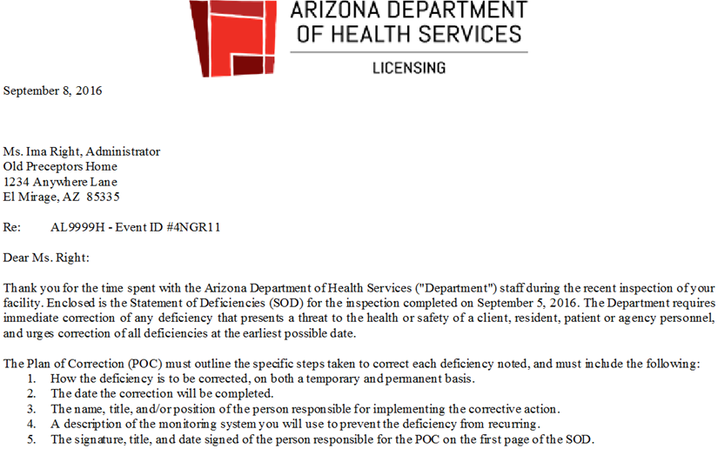
Event ID
License ID
POC Components

Slide 13
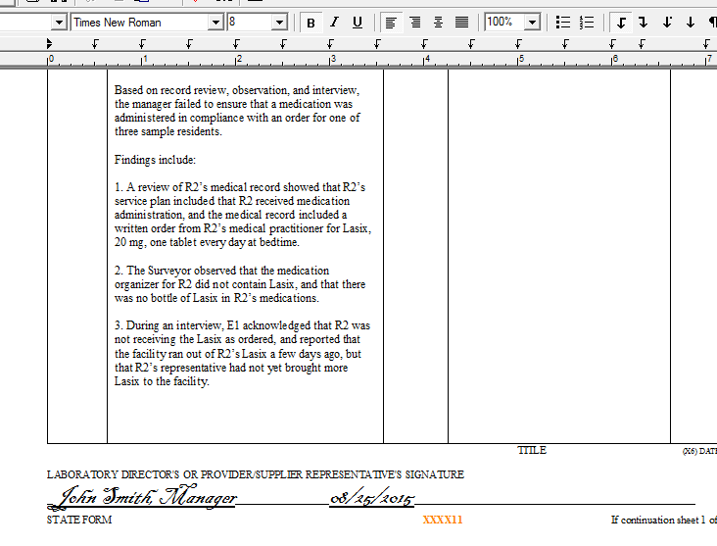
Event ID’s
Event ID

Slide 14

But what about . . . ?

Slide 15
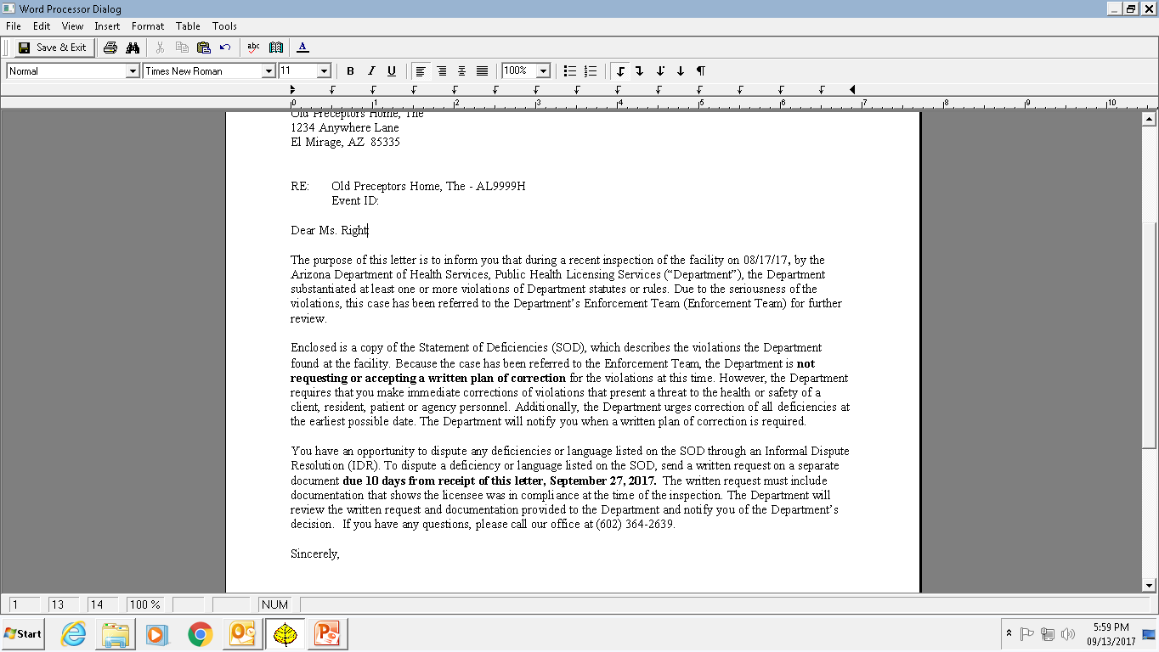
SOD letter with enforcement
Read your letter carefully
Hold POC
But start on corrections immediately

Slide 16
IDR: directions are provided in the cover letter of your SOD
You have an opportunity to dispute any deficiencies or language listed on the SOD through an Informal Dispute Resolution (IDR). To dispute a deficiency or language listed on the SOD, send a written request on a separate document due 10 days from receipt of this letter, September 27, 2017. The written request must include documentation that shows the licensee was in compliance at the time of the inspection. The Department will review the written request and documentation provided to the Department and notify you of the Department’s decision. If you have any questions, please call our office at (602) 364-2639.

Slide 17
Sample POC
Where can the provider find the information they need to complete a successful POC?
How does the provider know what exactly requires correction?

Slide 18
Anatomy of a Deficiency
Tag #.
Rule # from applicable Article.
Description of Rule (subsections).
Findings/Evidence the surveyor documented: what the provider did or did not do, that created a deficiency.

Slide 19
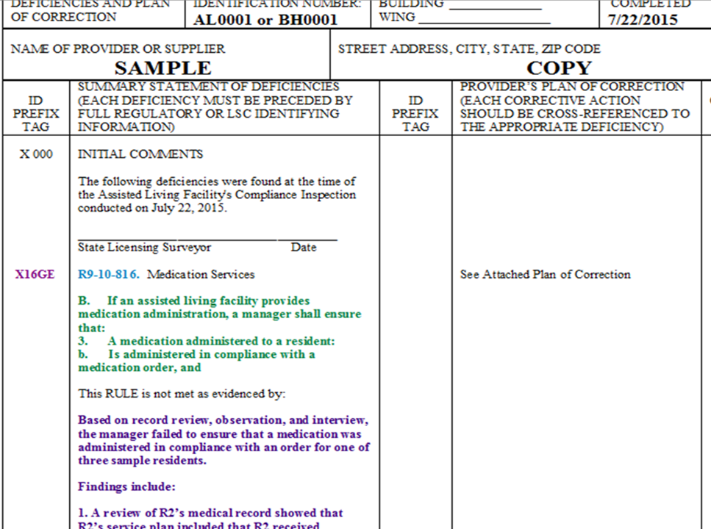
Tag #
Description of Rule
Rule #
Findings/Evidence

Slide 20

POC Pointers
What should a POC look like?
Sample POC (handout).
Importance of referencing the rule # or tag #.
Additional examples: complete POC directly on SOD or complete POC on a separate document.
Sign the bottom left corner of the SOD.
Keep a copy of SOD and POC for your records (for public to view).

Slide 21

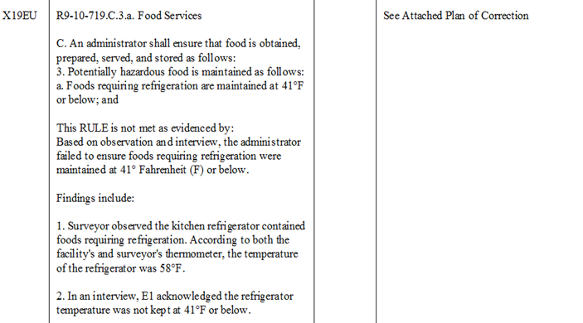




Sample Citation: survey date August 25, 2015
Rule #
Tag #
Description of Rule
Findings/Evidence

Slide 22
Example POC: Acceptable?
Rule Number: R9-10-719.C.3.a / Tag # X19EU
Name, Title of person responsible: John Smith, Manager
Completion Date: 08/25/2015
Correction on a temporary and permanent basis:
Temporary: Perishable food in kitchen refrigerator was thrown away. New food purchased and placed in our spare refrigerator which is kept at 41°F or below.
Permanent: Repair man is coming out on 9/1/2015 to fix the kitchen refrigerator. If it is unable to be repaired, the facility will purchase a new refrigerator at that time.
Monitoring System:
A temperature log will be placed on any refrigerator containing food for residents. Caregivers will check the refrigerator’s temperature on a daily basis and record on the log. On a weekly basis the manager will check the refrigerator’s temperature (to make sure 41°F or below) and ensure daily temperatures are being recorded on the logs.

Slide 23
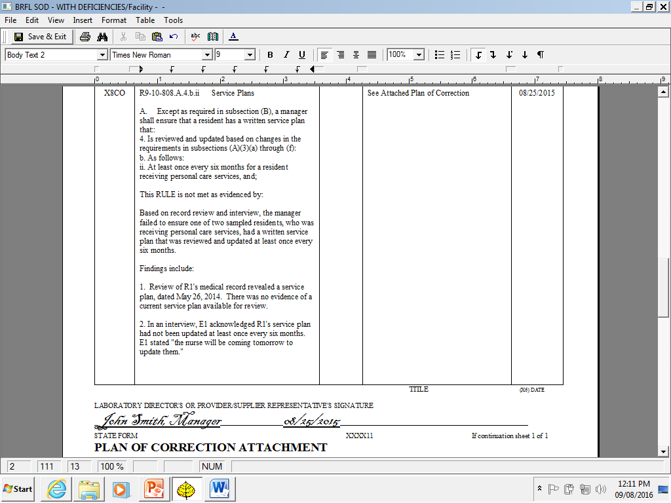
Sample Citation: survey date of August 15, 2015

Slide 24
Example POC: Acceptable?
Rule Number: R9-10-808.A.4.b.ii / Tag # X8CO
Name, Title of person responsible: Sharon Miller, Manager
Completion Date: 08/25/2015
Correction on a temporary and permanent basis:
Temporary: Service plans for both residents were reviewed and updated immediately on 8/25/2015.
Permanent: Service plans for all residents will be reviewed and updated according to the required service plan review date for supervisory, personal and directed level of care.
Monitoring System:
The Manager will conduct a file audit quarterly to review service plan dates for all residents. The Manager will ensure, through this quarterly review, all resident service plans are reviewed and updated according to the required due date.

Slide 25
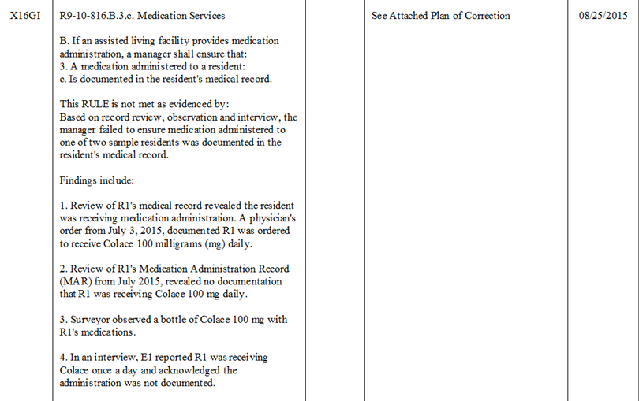
Sample Citation: survey date of August 15, 2015

Slide 26
Example POC: Acceptable?
Rule Number: R9-10-816.B.3.c
Name, Title of person responsible: John Smith, Manager
Correction on a temporary and permanent basis:
R1’s MAR was updated to include the Colace order.
Monitoring System:
The manager will ensure this does not happen again.

Slide 27
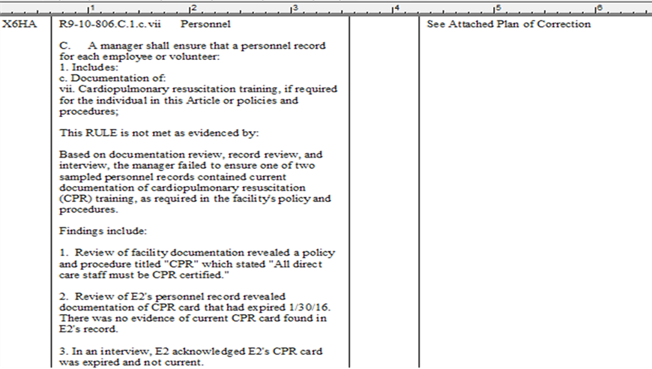
Sample Citation: survey date of February 5, 2016

Slide 28
Example POC: Acceptable?
Rule Number: R9-10-806.C.1.c.vii / Tag # 06HA
Name, Title of person responsible: Sharon Miller, Manager
Completion Date: 06/15/2016
Correction on a temporary and permanent basis:
The staff members took CPR on 6/15/2016. Copy of card attached.
Monitoring System:
A CPR trainer will come to the facility and train all employees in CPR on a regular basis.

Slide 29

Let’s practice

Slide 30
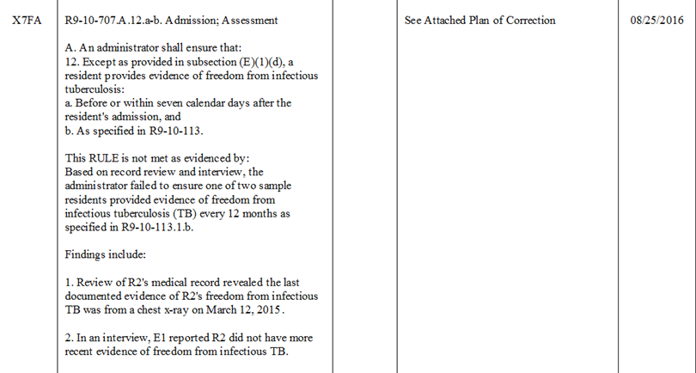
Practice writing a POC: survey date May 6, 2016

Slide 31
TB rule: R9-10-113(1)(b)
b. Every 12 months after the date of the individual's most recent tuberculosis screening test or written statement, one of the following as evidence of freedom from infectious tuberculosis:
i. Documentation of a negative Mantoux skin test or other tuberculosis screening test recommended by the CDC administered to the individual within 30 calendar days before or after the anniversary date of the most recent tuberculosis screening test or written statement that includes the date and the type of tuberculosis screening test; or
ii. If the individual has had a positive Mantoux skin test or other tuberculosis screening test, a written statement that the individual is free from infectious tuberculosis signed by a medical practitioner dated within 30 calendar days before or after the anniversary date of the most recent tuberculosis screening test or written statement.

Slide 32
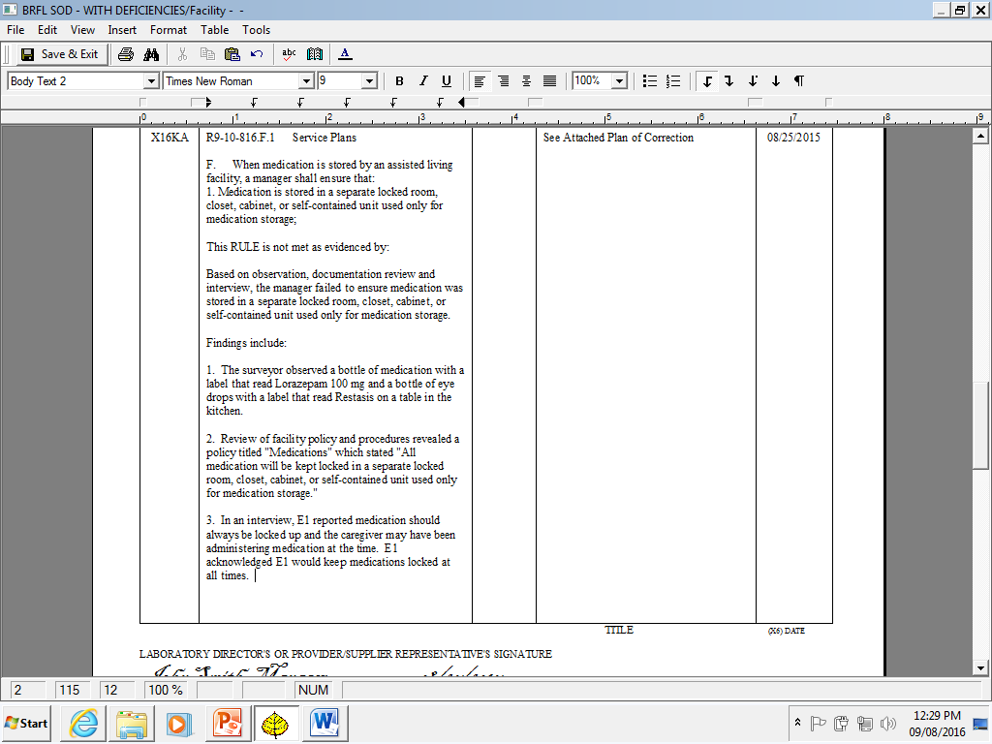
Practice writing a POC: survey date June 3, 2017

Slide 33

Reminders and Clarifications

Slide 34
Survey process review
SOD with deficiencies received by provider
IDR completed, if applicable
Enforcement completed, if applicable
                Surveyor reviews to determine if the POC is
                unacceptable or acceptable.
                The POC is not acceptable. It does not include one or more of
                the 5 requirements of a POC. The POC is acceptable.
                A letter will notify the provider of
                the missing information & an
                amended POC must be submitted.
POC is created to address deficient practices and submitted to DHS
10-14 days!

Slide 35
Due Dates – Provider Responsibility
The provider has 14 calendar days (10 business) to submit a Plan of Correction to the Department for review.
If the POC is not received within the appropriate timeframes, a POC “late letter” is generated and is mailed to the facility.
Department does not provide extensions.
POC’s and holidays (following business day).

Slide 36
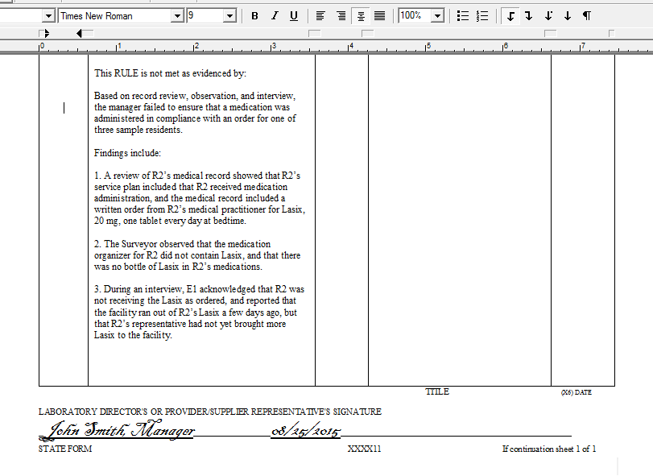

Sign Here
Event ID

Slide 37
Multiple Surveys, SOD’s & POC’s
When would a provider receive multiple reports?
Complaints vs. Compliance.
Event ID.

Slide 38
For clarification……
POC is: A plan to correct.
POC is not: A time to dispute the findings.
*The provider has an opportunity to clarify any issues with the surveyor while on site or before the SOD is sent out.

Slide 39
Informal Dispute Resolution (IDR) and the POC
The provider has 10 business days (or 2 weeks) from receipt of the SOD Letter to dispute the accuracy of the findings/evidence.
Provider must submit a written request on a separate document specifying the subject of dispute and include supporting documents.
The POC is not required by the Department until after the IDR process has concluded.

Slide 40
Importance of an acceptable POC
Decrease repeat deficiencies that lead to enforcement, which could mean civil money penalties (CMPs).
Survey can be closed sooner.
May not receive referrals until POC accepted.
Decrease the chance of a surveyor showing up to do an on-site follow-up.
POCs are public record if requested.
Help ensure the health and safety of residents.

Slide 41

Questions?

