Slide 1
Regional Report:
A Snapshot of Regional EMS & Trauma
Maureen Brophy, MPH
Vatsal Chikani, MPH
Rogelio Martinez, MPH

Slide 2
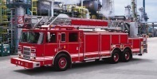



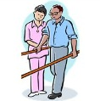
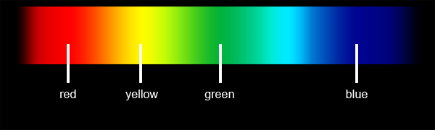
Pre-Injury
Pre-hospital
Hospitalization
Post-Acute Care
Data Collection
Data Analysis
EMS Infrastructure
Protocols
Medical
Direction
Triage and transport guidelines
Communications Infrastructure
911 training policies
Resource allocation, direction and guidance
Hospital infrastructure
Policies
Resources
Triage and transport
CQI,MM reviews, outreach
Injury
Injury prevention
Rehabilitation plans
Community reintegration
Healthy Reintegration
Disability
Death
Additional Data Sources:
Transportation
Vital Statistics
Economic
Geographical
Quality Assurance
Notes:
An EMS data collection model should look at all potential legs of care from the perspective of the patient. Data sources include injury prevention activities, 911 communication, pre-hospital care, hospital, and rehabilitation. The focus of the system should be treating the patient and preventing death/disability in order to maximize the health reintegration of the patient into society.
-Martinez Model of EMS Data Collection
Injury prevention will save more money, moving to the right (red) requires more resources, time, increased effort
USD of HHS Model Trauma System- http://www.ncdhhs.gov/dhsr/ems/trauma/pdf/hrsatraumamodel.pdf
NHTSA EMS Performance Measures- http://www.ems.gov/pdf/811211.pdf
Data Collection/Analysis/QA on the following activities:
Example- Public protection through bystander CPR, viable EMS agencies, maintaining up to date protocols, understanding rehab plans

Slide 3
Data
Originated from the word “datum” in 1646
  “something given”
Data: Values given to qualitative or quantitative variables that belong to set of items
Qualitative: color, texture, smell, appearance
Quantitative: length, time, volume, age, cost

Slide 4
Match the correct definition!!
Pr I
Quality Improvement
Performance Improvement
Quality Assurance
Process Improvement
___ A measurement technique that analyzes a series of actions to improve its effectiveness or efficiency
___ A system that improves the overall quality of a product or service
___ A system the improves the execution or accomplishment of its intended purpose.
___ A system that ensures a desired level of quality in the development, production, or delivery of a products and/or services.
QI
PI
QA
Notes:
ACS example of Performance Improvement- “A structured effort by a trauma program to demonstrate a continuous process for improving care for injured patients”.

Slide 5
Quality Assurance
A system that ensures a desired level of quality in the development, production, or delivery of a product and/or service.
(Benchmarked against the other products/services)

Slide 6
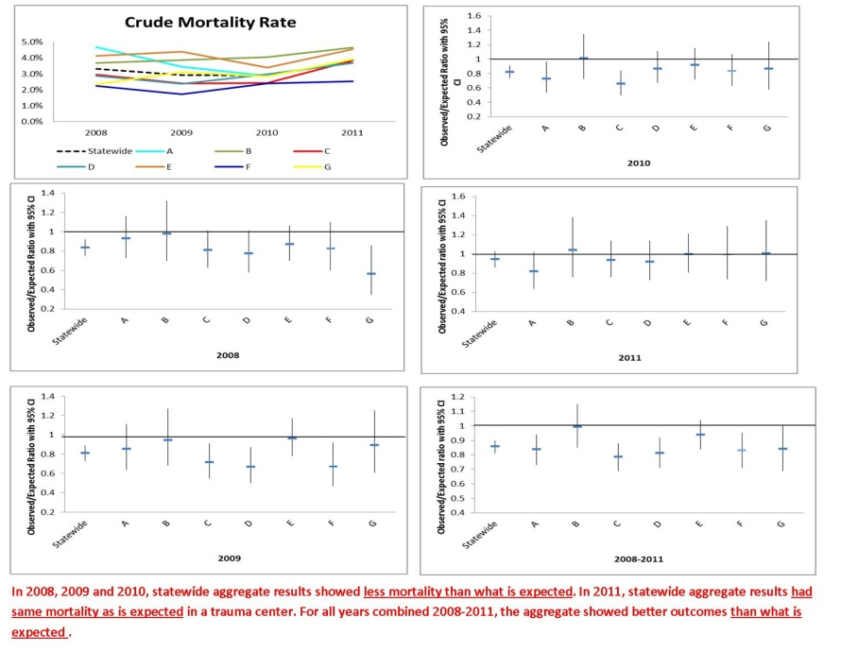
State Benchmarks
Notes:
Performance Improvement reports- http://www.azdhs.gov/bems/data/performance-improvement-reports.htm

Slide 7
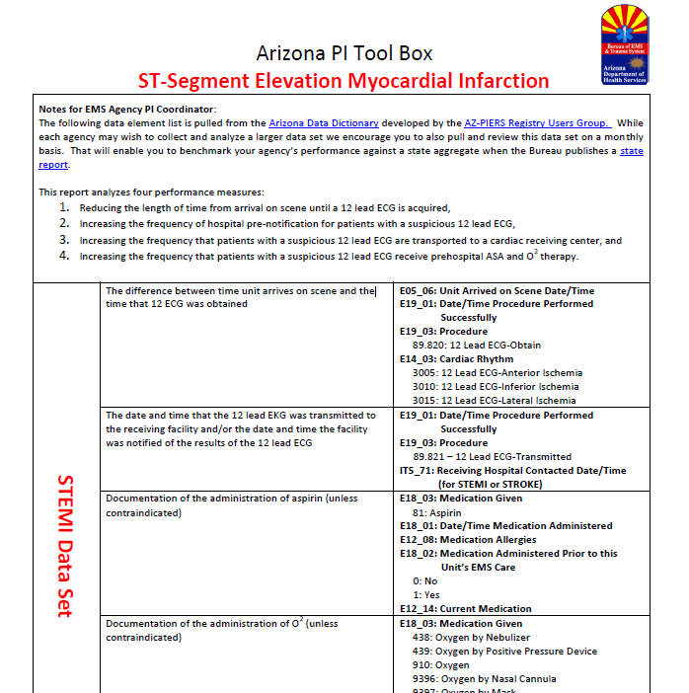
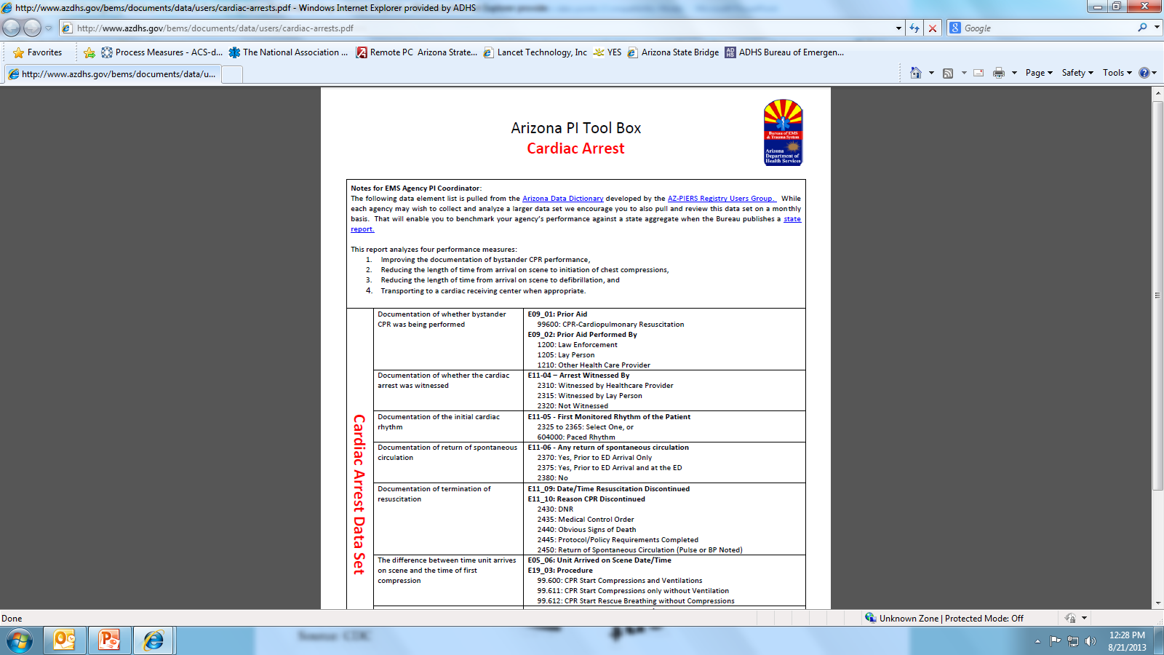
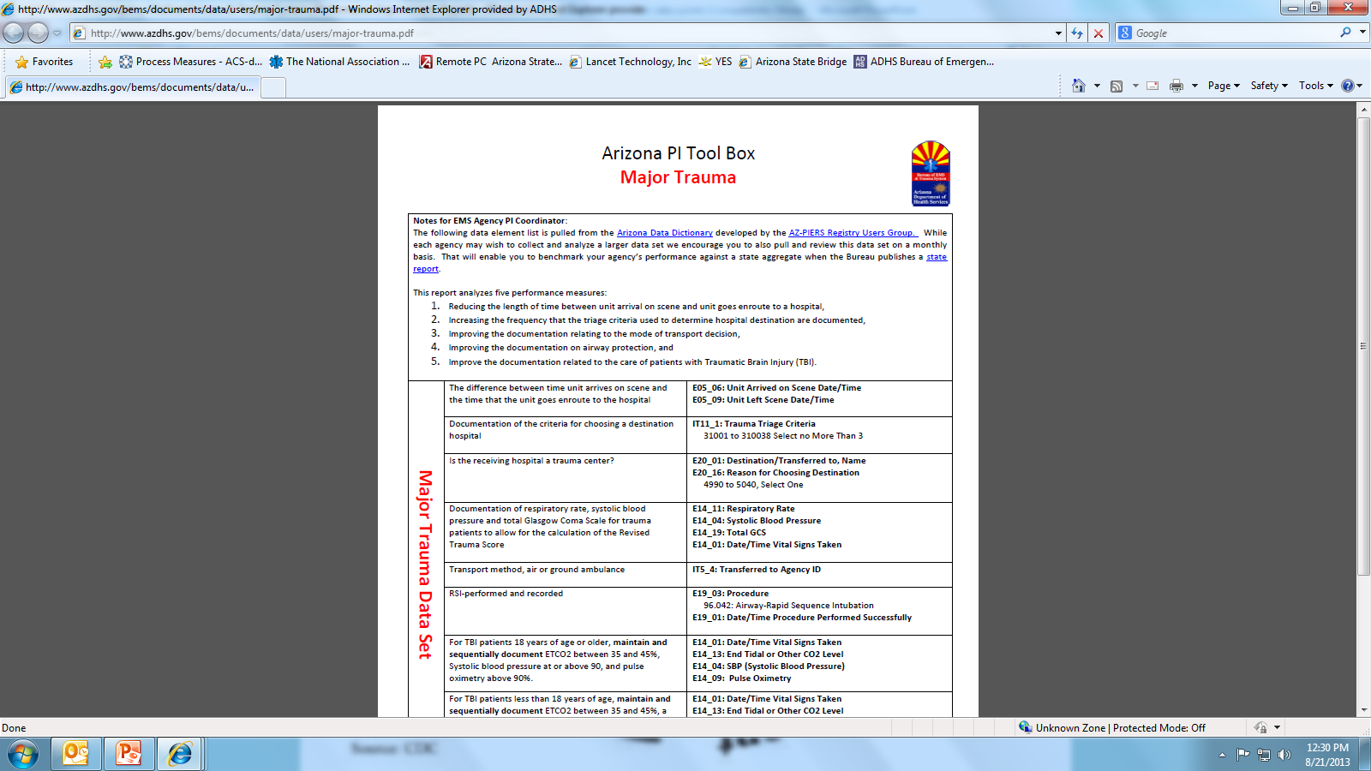
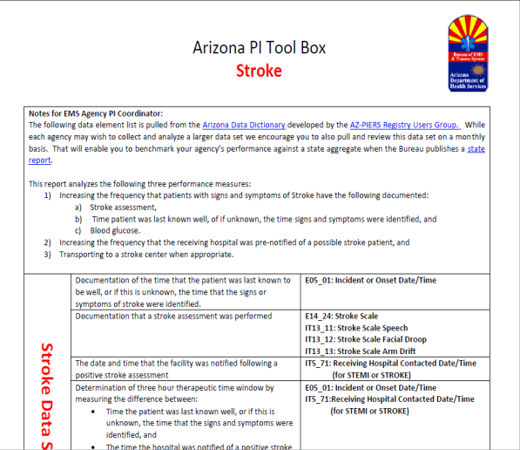
Quality Assurance Tools
Notes:
QA tools:
Cardiac Arrest- http://www.azdhs.gov/bems/documents/data/users/cardiac-arrests.pdf
STEMI- http://www.azdhs.gov/bems/documents/data/users/stemi.pdf
Stroke– http://www.azdhs.gov/bems/documents/data/users/stroke.pdf
Major Trauma- http://www.azdhs.gov/bems/documents/data/users/major-trauma.pdf

Slide 8
PEAP participating of CONs
Southeast Region has the largest number of EMS CON holders
Central Region has largest number of Premier EMS Agencies
* Northwest Fire District (Southeast) & Rio Verde Fire Department (Central) are non-CON holding Premier Agencies
Notes:
PEAP = Central (52%), North (<1%), South (16%), West (30%)
As of September 1, 2013: Current list is on www.azdhs.gov/bems/data/PEAP.htm

Slide 9
Emergency Medical Services
2012 Data on EMS agencies were obtained from BEMSTS Ambulance Program documentation on CON holders.
Notes:
Data is reported annually, with some agencies reporting on a fiscal year basis and others on a calendar year- all data is for 12 months.

Slide 10
Registered Ground Ambulances
Central Region has the most registered ambulances in the state
Notes:
In 2012, there were 837 registered ambulance in the state.
381 were in the Central,
134 were in the North,
224 were in the Southeast,
98 were in the West.

Slide 11
Ground Ambulances per Residents
Northern Region has the largest number of ground ambulances per capita
Notes:
When controlled for population size there were:
9 ambulance per 100,000 residents in the Central region,
25 ambulance per 100,000 residents in the Northern region,
18 ambulance per 100,000 residents in the Southeast region,
23 ambulance per 100,000 residents in the Western region.

Slide 12
Air Ambulances, State-Wide
Air ambulances cannot be segregated by region
AZ is serviced by 44 rotor ambulances & 26 fixed-wing ambulances
Notes:
Air ambulances are stationed throughout the state and at the various hospitals.

Slide 13
Run Volume
Central Region, being the most densely populated, has the highest run volume
Notes:
Total ALS = 362,310 Total BLS = 175,666
(Central 326,969 ALS=65%) (North 52,293 ALS=80%) (Southeast 117,905 ALS=60.9%) (West 40,809 ALS=86%)
Statewide percentage of ALS = 67%

Slide 14
Run Volume per 100,000 Residents
Despite having the highest volume, Central Region has the lowest rate of runs per 100,000 residents in the region
Northern Region is highest
Notes:
The statewide run volume per 100,000 resident is 8,278. This means that there are 8,278 for every 100,000 residents.
Central:
There are 7,556 ambulance runs per 100,000 residents.
North:
There are 9,939 ambulance runs per 100,000 residents.
Southeast:
There are 9,698 ambulance runs per 100,000 residents.
West:
There are 9,509 ambulance runs per 100,000 residents.

Slide 15
Median Charges
The state-wide median charge per ambulance run (BLS & ALS combined) was about $1,400
Notes:
The median charge for ambulance runs in the regions were:
1,278 per patient in the Central,
1,480 per patient in the North,
1,488 per patient in the Southeast,
1,330 per patient in the West.

Slide 16
Total Charges
Notes:
In 2012, the total ambulance charges for the state were 640,552,338.
338,395,001 were charged by the central region,
84,273,226 were charged by the northern region,
155,534,002 were charged by the southeast region,
62,350,109 were charged by the western region.

Slide 17
Trauma
Data on trauma were obtained from Arizona State Trauma Registry (ASTR) 2011

Slide 18
Hospitals Reporting to ASTR
Central Region has largest number of Trauma Centers (TCs), as well as 75% of the Level I TCs in the state
Notes:
As of October 1, 2013 there were 27 trauma centers around the state:
11 were in the Central,
7 were in the North,
6 were in the Southeast,
3 were in the Western.

Slide 19
Trauma Volume
Most trauma occurs in Central Region, the most densely population region
Notes:
There were 32,656 trauma patients in 2011.
15,800 were injured in the Central region,
3,490 were injured in the Northern region,
6,616 were injured in the Southeast region,
1,028 were injured in the Western region, AND
5,668 were missing.

Slide 20
Trauma Rate
Despite having the highest volume, Central Region has the lowest trauma rate per 100,000 residents in the region
Notes:
The statewide trauma rate was 481 per 100,000 residents.
The rate was lowest in the Central region (397 per 100,000 residents),
The Southeastern was the second lowest (526 per 100,000 residents),
The Western was the second highest (743 per 100,000 residents),
The Northern has the highest trauma rate (856 per 100,000 residents).

Slide 21
Mechanism of Injury
Notes:
Motor vehicle traffic, falls, struck by/against (mostly intentional such as in a fight) had the highest rates of traumas for regions.
An example is the Western region who had the highest rate of traumas from motor vehicle traffic.

Slide 22
Intent
Notes:
Most traumas in the state came from unintentional injuries. The Northern and Western region had the greatest rates in unintentional injuries.
The Northern region reported the highest rate of homicide/assault.

Slide 23
Age
Notes:
The highest rates of trauma came from the adults living in the Northern region. For every 100,000 residents there were 1,124 adult traumas.

Slide 24
Gender
Notes:
Traumas are more commonly seen in Males through all regions.

Slide 25
Race/Ethnicity
Notes:
Whites had the largest proportion of traumas across all the regions.
The Northern region is uncommon because of the large number of American Indian/Alaskan Natives that make up their traumas. All other regions report a large proportion of Hispanics that were second to traumas from Whites.

Slide 26
Air Transport
Notes:
Air transports should be reserved for patients with a high ISS and injured in the remote parts of Arizona. Trauma patients with a low ISS should be limited.
The statewide trend shows a healthy picture of air transports.

Slide 27
Golden Hour
*Missing data on time of injury results in a high proportion of missing values for Golden Hour calculation
Notes:
The golden hour refers to a patient’s ability to reach a trauma center within one hour of their injury. This is the most critical time for the best outcome.
A state wide trauma system benefits these patients by having those services nearer to them. This measure has a high proportion of missing injury times and makes it harder to find out how many trauma patient reach services within the golden hour.

Slide 28
Total Charges
Notes:
Trauma charges were highest in the Central region at 854 million dollars. This may reflects the large number of Level I Trauma Centers in this area.
The state of Arizona had $1,281,855,627 total charges from trauma patients in 2011.

Slide 29
ED Dwell Time (Category)
Notes:
Statewide, 22% of trauma patients had an Emergency Department (ED) Dwell Time of less than 2 hours, 74% had an ED Dwell Time of greater than 2 hours.
An ED Dwell time is the time that a patient spends in a Level IV Trauma Center before being transferred to a higher level of care.

Slide 30
Median ED Dwell Time
Notes:
25% of trauma patients had a dwell time of ≤ 2 hours, 50% had a dwell time of ≤ 3 hours, 75% had a dwell time of ≤ 4 hours

Slide 31
ED Dwell Time by Injury Severity Score (ISS)
Notes:
Statewide:
76% of patients with an ISS less than 15 have an ED Dwell Time greater than 2 hours
79% of patients with an ISS greater than 15 have an ED Dwell time greater than 2 hours
Central:
60% of patients with an ISS less than 15 have an ED Dwell Time greater than 2 hours
100% of patients with an ISS greater than 15 have an ED Dwell time greater than 2 hours
Western:
70% of patients with an ISS less than 15 have an ED Dwell Time greater than 2 hours
70% of patients with an ISS greater than 15 have an ED Dwell time greater than 2 hours
Northern:
70% of patients with an ISS less than 15 have an ED Dwell Time greater than 2 hours
100% of patients with an ISS greater than 15 have an ED Dwell time greater than 2 hours
Southeastern:
80% of patients with an ISS less than 15 had an ED Dwell Time of greater than 2 hours
90% of patients with an ISS greater than 15 had a dwell time of greater than 2 hours

Slide 32
Median ED Dwell Time by ISS
Notes:
Statewide:
The median dwell time for trauma patients with an ISS less than 15 was 3 hours
The median dwell time for trauma patients with an ISS greater than 15 was 2.8 hours
Central:
The median dwell time for trauma patients with an ISS less than 15 was 3.1 hours
The median dwell time for trauma patients with an ISS greater than 15 was 4.1 hours
Northern:
The median dwell time for trauma patients with an ISS less than 15 was 3.1 hours
The median dwell time for trauma patients with an ISS greater than 15 was 2.9 hours
Southeastern:
The median dwell time for trauma patients with an ISS less than 15 was 3.1 hours
The median dwell time for trauma patients with an ISS greater than 15 was 2.6 hours

Slide 33
Mortality at Non-Trauma Centers
*Data from Hospital Discharge Database, 2011
Notes:
In 2011, there were 175 potential trauma deaths at non-trauma centers. Of those:
86 were in the Central region,
9 were in the Northern region,
51 were in the Southeastern region,
18 were in the Western region, AND
11 had a missing region

Slide 34
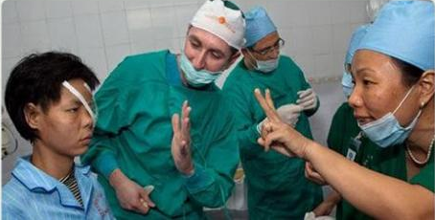
Notes:
The purpose of these measures is to stop viewing patients like this…..

Slide 35
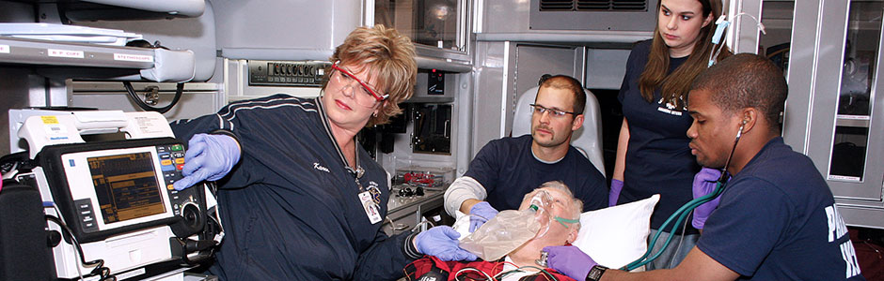
Notes:
Or this….

Slide 36

Notes:
But rather like this.
From a patient’s perspective.

