Slide 1
EMS Care of the VAD Patient
ADHS BEMS Education & PMD Committees
April 2018
Notes:
Approved at EMS Council May 24, 2018.

Slide 2
VAD Complexities
Assessing and managing VAD patients can be challenging and may not follow routine EMS protocols
We strongly encourage first-responders to utilize the VAD Hotline of the implanting hospital before and during every VAD patient encounter and/or transport

Slide 3
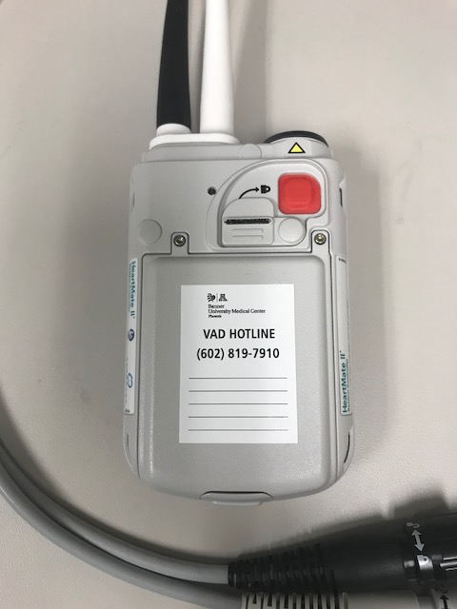
Banner University Medical Center-Phoenix (BUMC-P)
RN VAD Coordinator on-call 24/7
  Cell 602-819-7910
  Office 602-839-5137

Slide 4
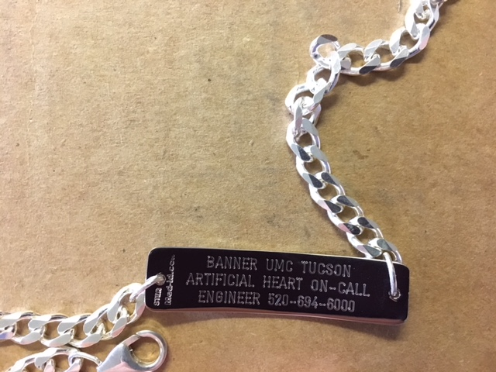
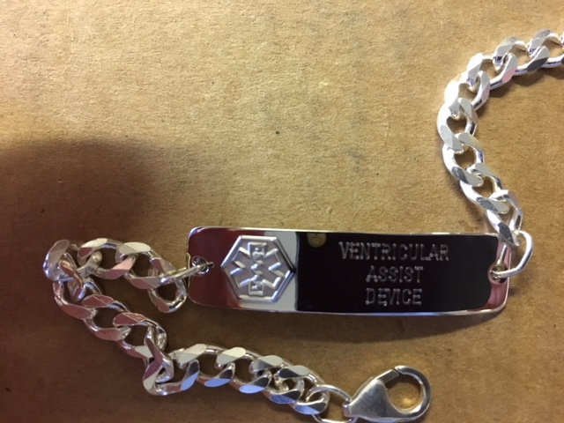
Banner University Medical Center-Tucson (BUMC-T)
VAD # = 520-694-6000
Ask for Artificial Heart Coordinator On-Call

Slide 5
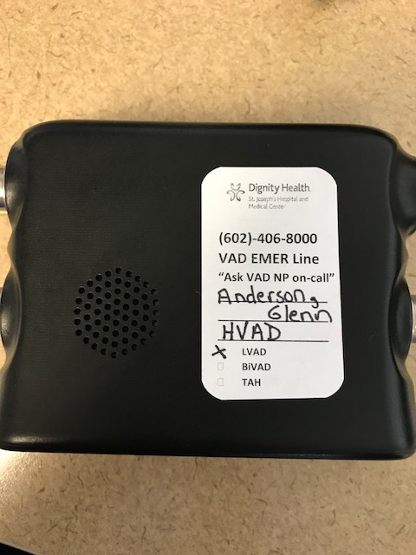

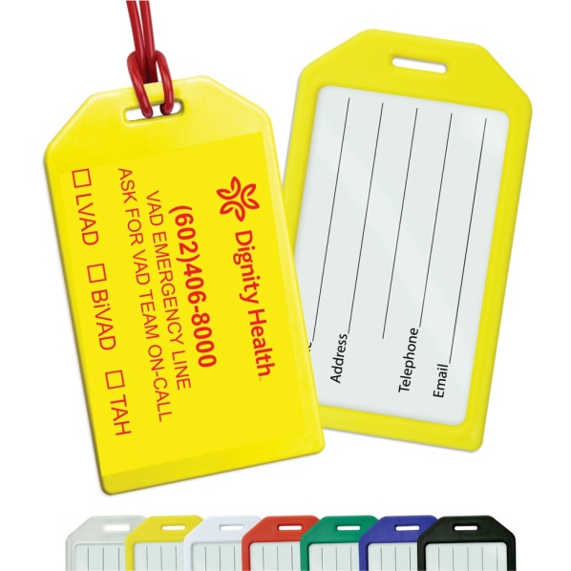
Dignity St. Joseph’s Medical Center
VAD # = 602-406-8000
Ask for VAD NP on-call
Notes:
Dignity has a backpack that contains the back up controllers and batteries. These will have the luggage tag on the outside and the backpack will say Dignity on it.

Slide 6
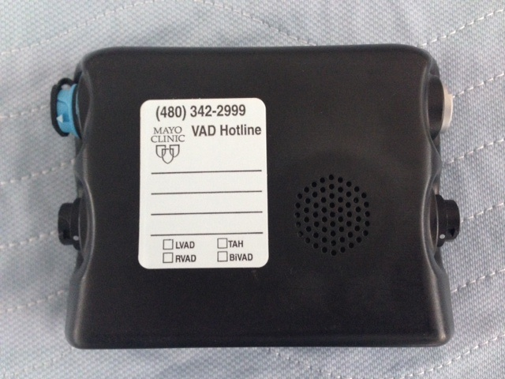
Mayo 24 HR VAD HOTLINE
Mayo VAD Coordinator: 480-342-2999
The VAD Hotline will connect you to a VAD Coordinator in under 2 minutes
The 24 Hr VAD Hotline is for patients, caregivers, and first responders to use as a consult service for emergent and non-emergent needs.
With calls involving 911, patients and caregivers are instructed to give first responders the phone when you arrive so EMS is immediately in communication with a VAD expert that is familiar with details about the patient
If 911 call comes from a bystander, an identifying sticker will be on the Controller with basic patient information and VAD Hotline number.

Slide 7
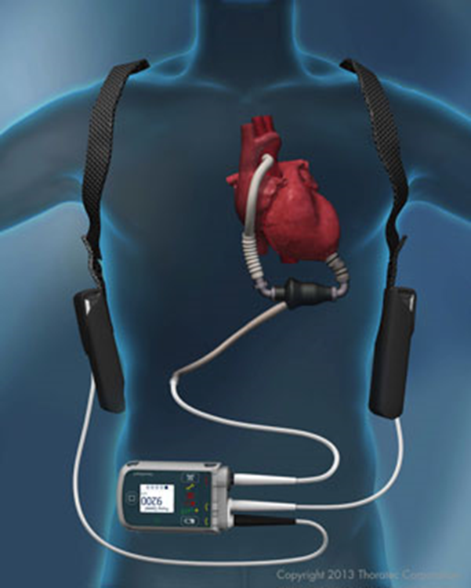
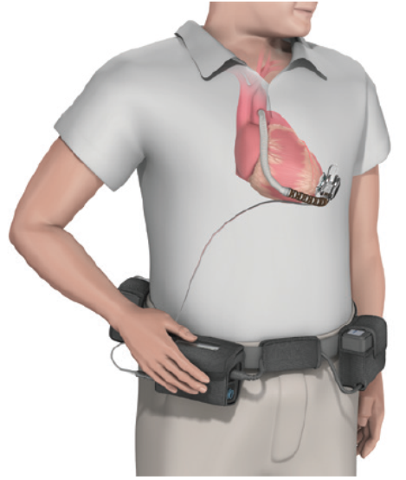
VAD Overview
A VAD is a Mechanical Circulatory Support (MCS) device designed to restore blood flow and improve survival, functional status, and quality of life for those suffering from advanced heart failure
The device is implanted in parallel with the heart, taking over a majority of its circulatory function
Multiple devices in use
No age limit

Slide 8
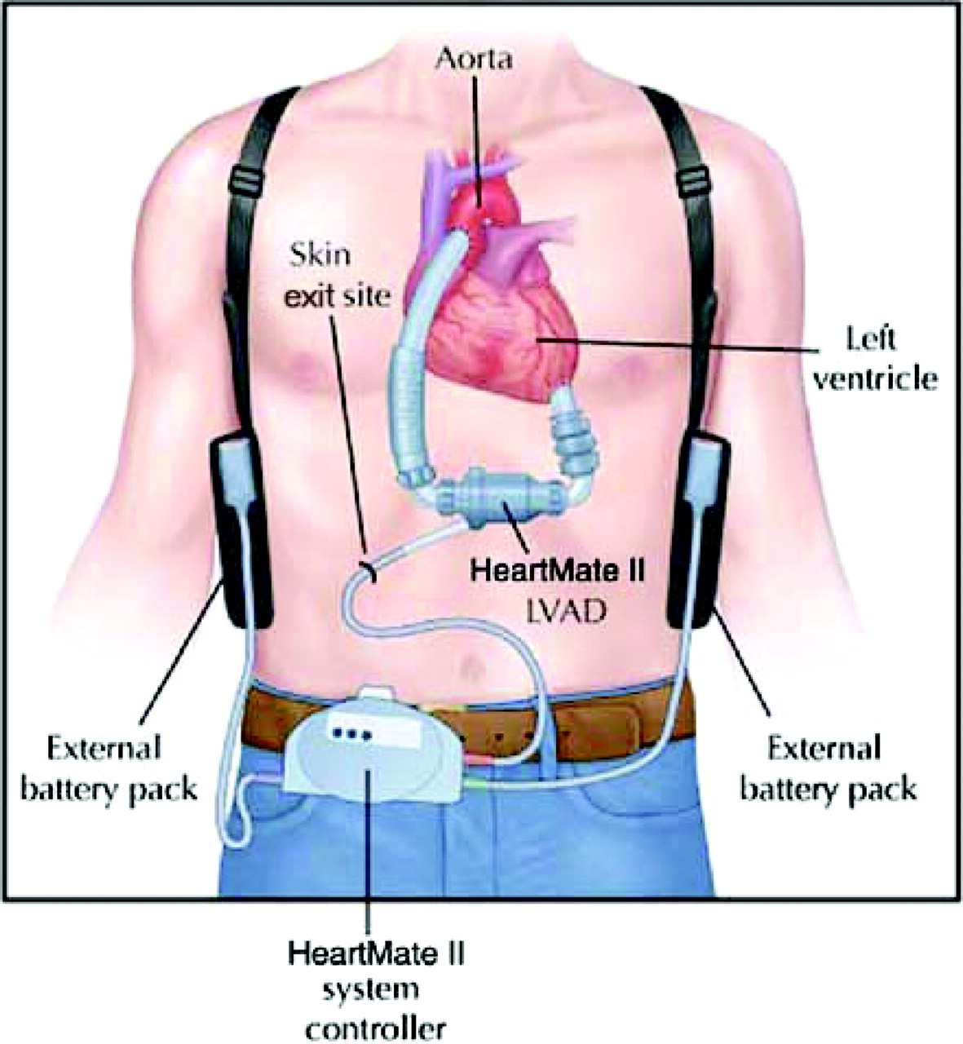
Ventricular Assist Device
Implanted in heart failure patients
Augments the function of the ventricles in circulating blood
Sometimes implanted as a temporary treatment, and sometimes used as a permanent solution to very low cardiac output

Slide 9
Ventricular Assist Device (VAD)
There are 2 indications for implanting an LVAD:
  Bridge to Transplant
    The patient must meet criteria to be listed for a heart transplant
    The VAD is taken out at time of transplant
  Destination Therapy
    The patient does not qualify for a heart transplant but meets criteria for Destination Therapy
    The patient lives the rest of their life with an VAD
  Bridge to Recovery
    VAD for a few days or weeks, provides temporary support
    Ex. Patient with post partum cardiomyopathy

Slide 10
VAD Special Considerations
VAD patients are unique and require specialized care
  Routine assessments such as blood pressure, pulses, and pulse-oximetry may not be unattainable
  Chest compressions are usually not indicated
  The patients carry external equipment: a controller and power sources that operate the implanted pump though a single driveline

Slide 11
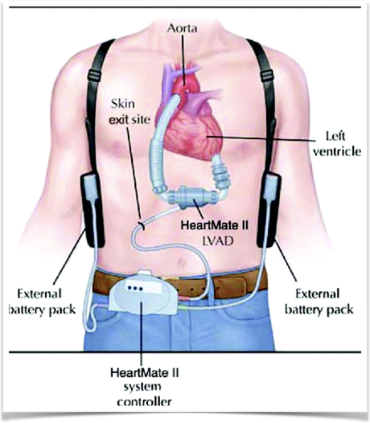
VAD Patient Assessment
Attempt to auscultate over the apex of the heart for a “whirling” or “smooth, humming” sound indicating that the VAD is working
A cable exits the abdominal wall that connects the device to power and the control unit
Many VAD patients also have an implanted cardiac defibrillator
Notes:
Auscultate below the apex the device sits below the diaphragm.

Slide 12
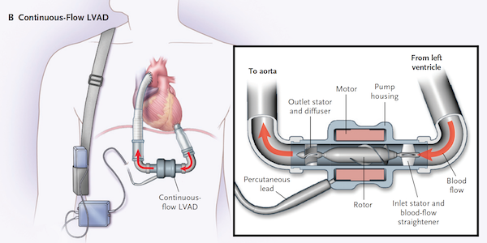
Auscultate over apex
Notes:
By auscultating over the apex, providers will be listening over the device itself.

Slide 13
VAD Patient Assessment
Blood Pressure (BP)
- BP taken with a manual cuff
- Automatic BP readings are considered unreliable
Pulse
  A palpable pulse is variable and clinically insignificant in VAD patients
Pulse Oximetry
  Can be unreliable
  Look for physical s/s of ↓ oxygenation

Slide 14
Patient Assessment cont.
EKG is typically unaffected
Patients are at high risk for bleeding complications due to blood thinner use
  Trauma
  Falls
  GI bleed

Slide 15
VAD Patient Rhythm Assessment
Because they have a blood pump, VAD patients may be stable in V-Tach or V-Fib
VAD flows may be affected
Persistent arrhythmias are treated after contacting the VAD coordinator
Many VAD patients have an ICD / Pacemaker
  If patient’s ICD delivers a shock, notify VAD Coordinator
Okay to defibrillate & cardiovert VAD patients per ACLS protocol
Okay to administer anti-arrhythmic medications per ACLS protocol

Slide 16

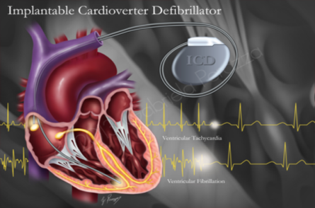
VAD Patients with Dysrhythmia
#1 = Contact VAD coordinator
#2 = Treat the patient, not the monitor!

Slide 17
VAD Patient Neuro Assessment
All VAD patients are on anticoagulation medications
They are at high risk for embolic or hemorrhagic stroke.
Level of consciousness may deteriorate rapidly
Because patients are already anti-coagulated, they do not follow routine stroke protocol

Slide 18

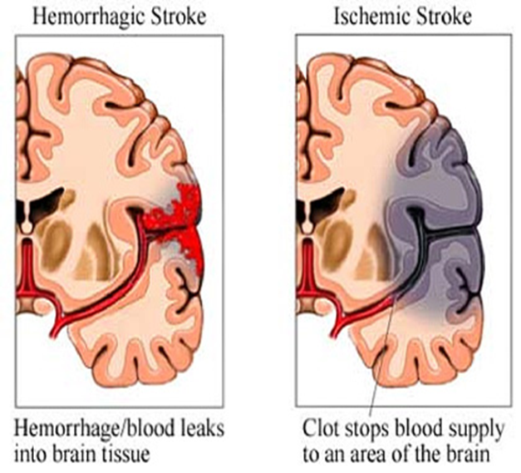
VAD Patients & Potential Stroke
Key point:
Transport these patients to their VAD center, not the closest stroke center!

Slide 19
VAD Management
Allow the patient and caregiver to guide your interaction with the device
Keep batteries and controller within reach and secured to the patient
Administer fluid boluses and vasopressors as you would with any other patient as indicated by signs of inadequate perfusion
Do NOT administer nitroglycerin to VAD patients
When in doubt. . . give a fluid bolus

Slide 20
Assessing for signs of Hypovolemia
Normal Flow Range 4 – 6 L/min Asymptomatic
Sub-optimal Flow 2.5 – 3.5 L/min Asymptomatic → Symptomatic May be dizzy, lightheaded, fatigued, change in LOC
Low Flow < 2.5 L/min Asymptomatic → Symptomatic May be dizzy, lightheaded, fatigued, change in LOC
Notes:
While this chart depicts pump flow, it is important for EMS to recognize signs and symptoms of hypovolemia

Slide 21
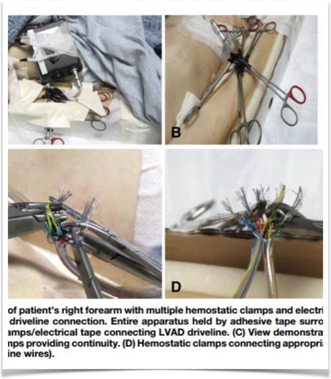
Caution with clothing removal
Use caution when cutting and removing clothes, to avoid damaging the device
Notes:
67 yo patient went into cardiac arrest after he accidentally cut his LVAD wires. ED physician reconnected with hemostats and restored flow.

Slide 22
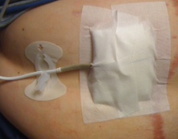
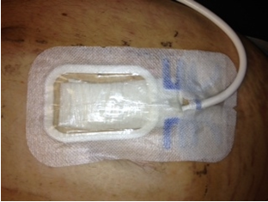
Driveline Exit Site - Sterile Dressing
VAD patients should always have a
sterile dressing covering the driveline
exit site in the lower abdomen.
The dressing should not get wet.

Slide 23
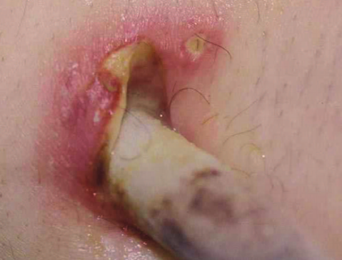
VAD complications: infection
Many hospital admissions in VAD patients are secondary to infection, not cardiac problems.
Assess for signs of infection (especially at the insertion point) or sepsis

Slide 24
VAD Management
#1 = Consult the patient’s VAD coordinator
Verify if chest compressions are indicated with the patient’s specific device
Consult family
View VAD identification card
Use electrical therapy as you would with any other patient
Avoid placing the pads directly over the device (consider anterior-posterior pad placement)

Slide 25
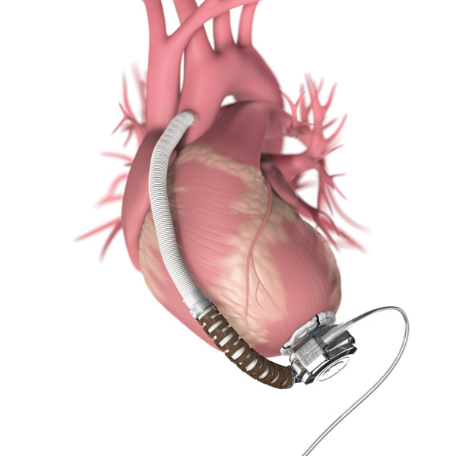
LVAD Patient Management
PRELOAD
AFTERLOAD
SVR
MAP 65-85
Volume
Blood Pressure
CVP / PVR
Right Heart Function
Valvular Function
Rhythm
ANTICOAGULATION
PUMP SPEED
Coumadin
ASA
INR 2-3
Set RPM to
BLOOD IN = BLOOD OUT

Slide 26
What if I hear an alarm?
HeartWare
Flashing Red (High-Critical Alarm)
  VAD stopped
  Critical Battery
  Controller has failed
What should you do?
  First, check your patient and treat as indicated
  Connect the driveline, replace the batteries, or change the controller as directed by the VAD coordinator
  Always change the batteries one at a time, at least one must be connected at all times

Slide 27
What if I hear an alarm?
Thoratec HeartMate II
Red Heart Alarm – there will be a red heart warning light on the system controller & a steady audio tone
  Pump flow is less than 2.5 LPM (inadequate to meet the patient’s condition)
  Pump has stopped
  Percutaneous lead (driveline) is disconnected
  Pump is not working properly
What should you do?
  Check your patient
  Make sure the system controller is connected to the percutaneous lead (driveline)
  Treat any sources of low flow or shock (bleeding, hypovolemia, tamponade, etc)
  Contact VAD coordinator

Slide 28
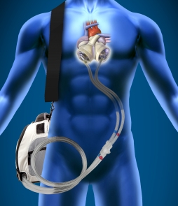
Total Artificial Heart (TAH)
Pump surgically implanted to provide biventricular circulatory support

Slide 29
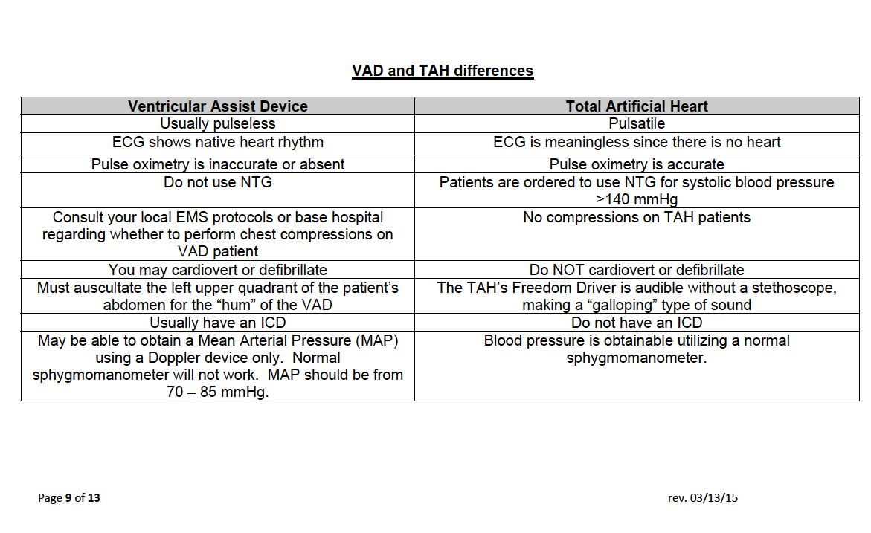
VAD versus TAH

Slide 30
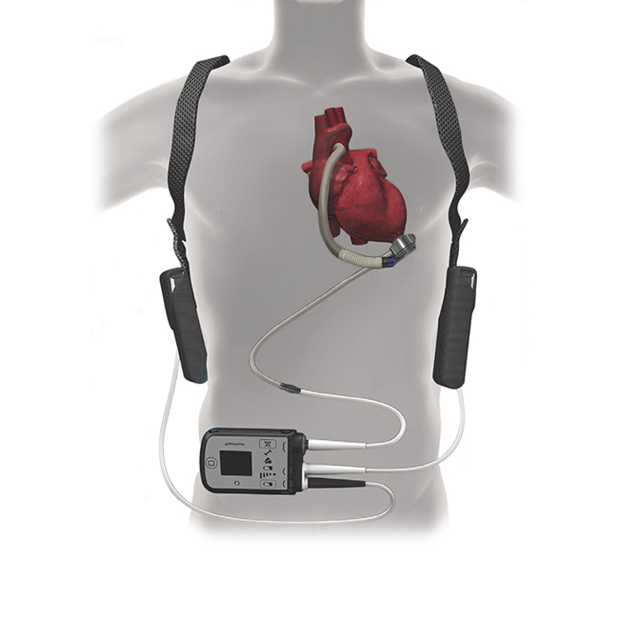
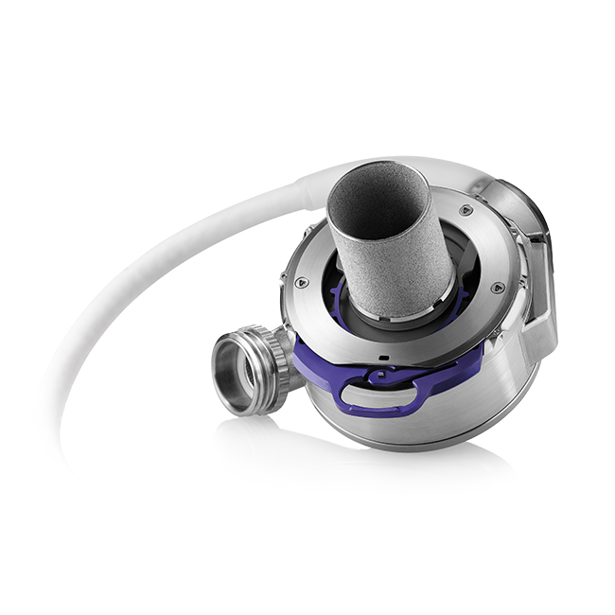
Abbott-Thoratec HeartMate 3

Slide 31
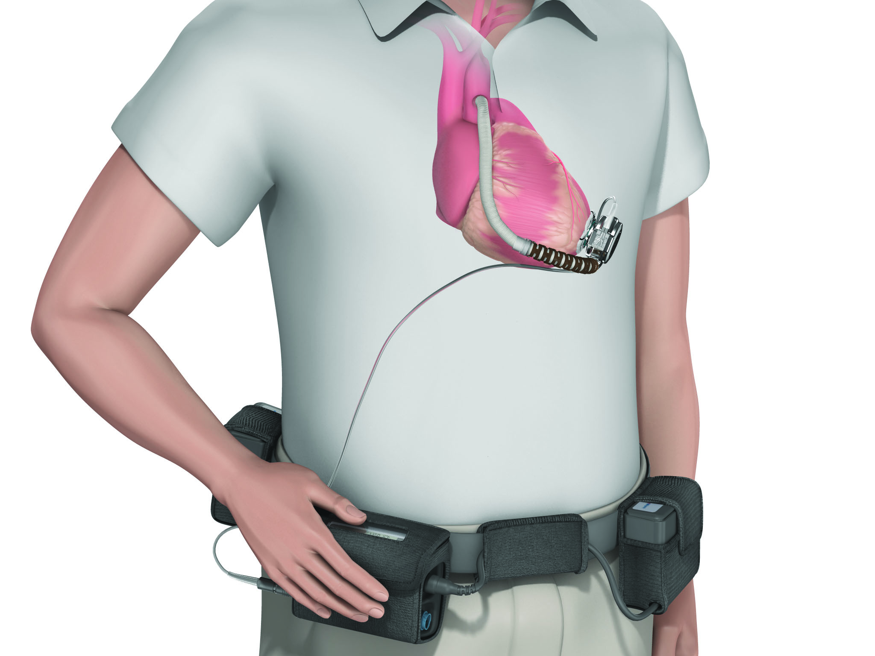
HeartWare System
Implanted Pump
Driveline
Battery
Battery
Controller

Slide 32
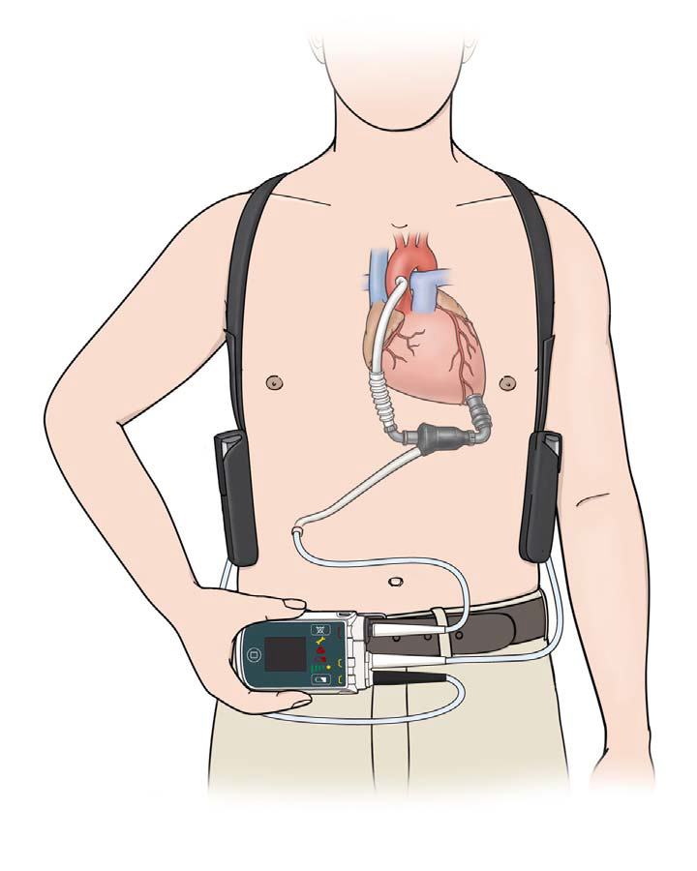
HeartMate II System
Implanted Pump
Battery
Battery
Controller
Driveline

Slide 33
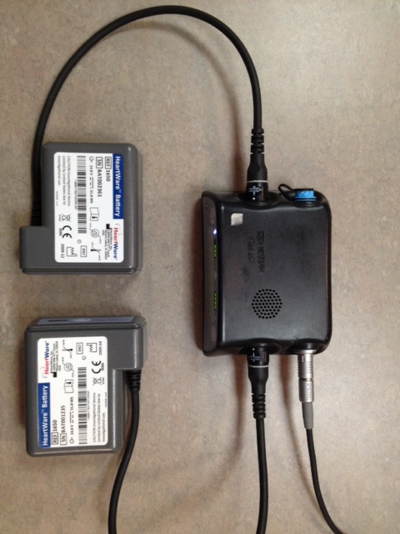
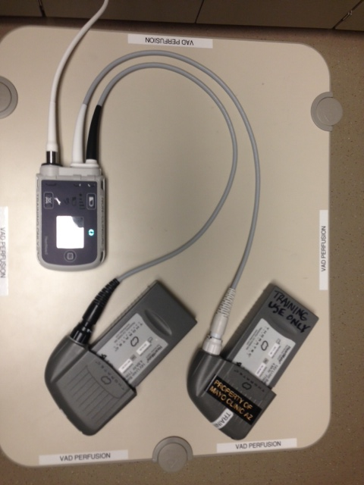
Critical VAD Connections
Never disconnect both power sources! Never disconnect driveline!
HeartWare HVAD
HeartMate II
Driveline
Power
Power
Power
Driveline
Power

Slide 34



External VAD Components
Patients have options for carrying their external equipment to best suit their comfort and lifestyle
Ensure that the equipment is protected
at all times with no stress on the driveline
Patients will have an additional
supply bag for their extra batteries and
backup Controller close at hand. This bag
should always accompany the patient on
transport

Slide 35

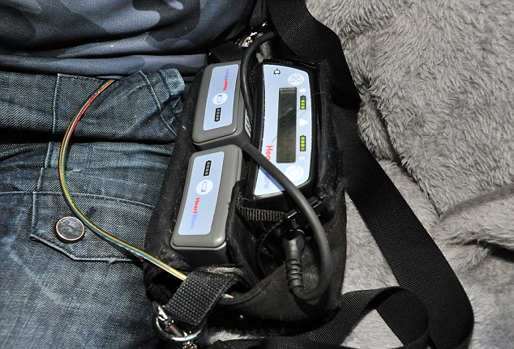
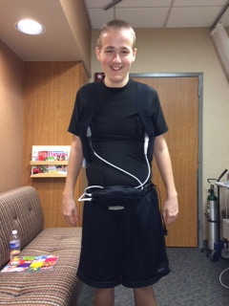
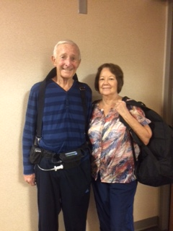


External VAD Components

Slide 36
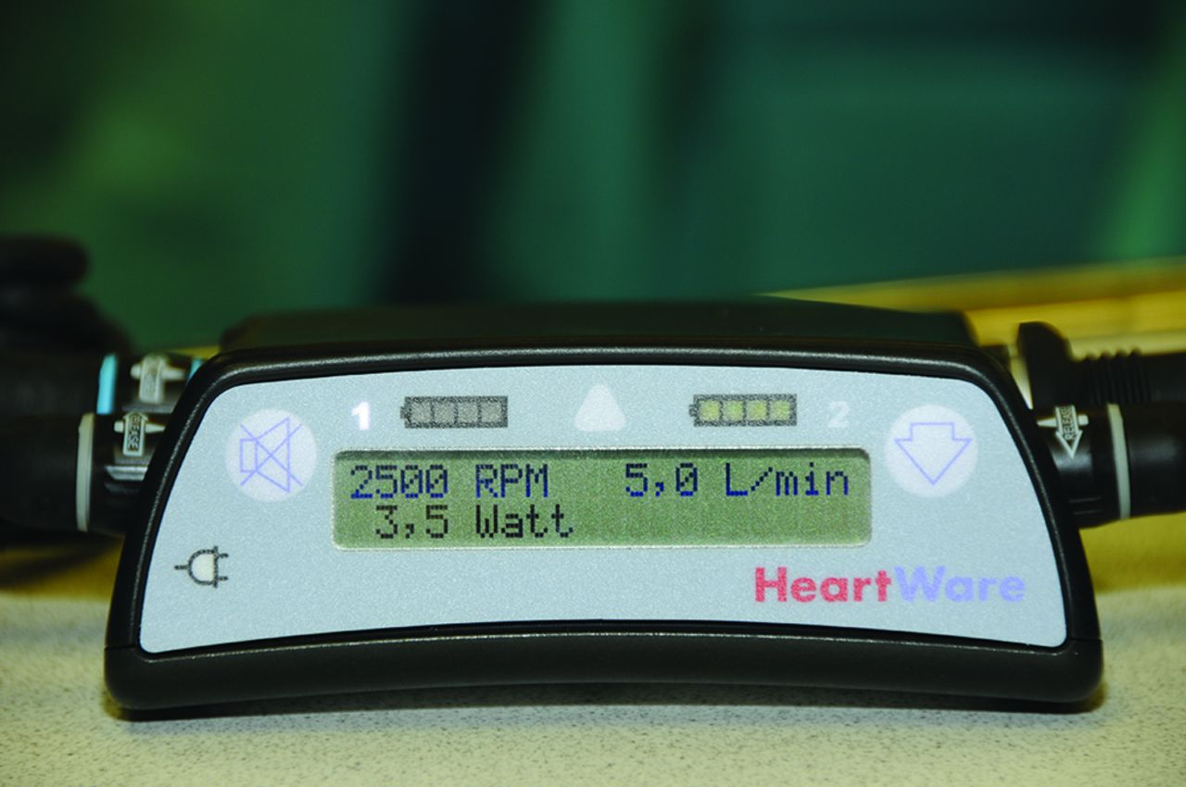
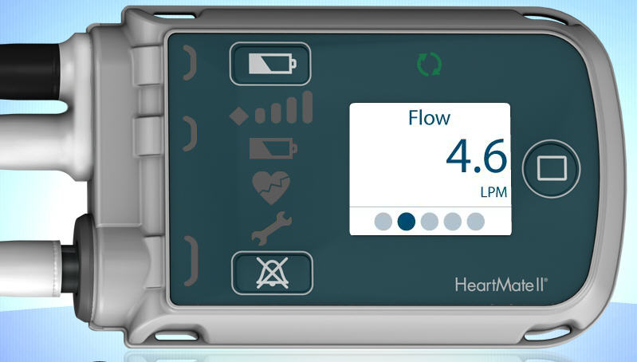
The Controller
Yellow (beeps)
Pump is ON
Alarms have symbol
and message on screen
For HeartMate 2 and 3
press MENU button
to access parameters
Red (steady tone)
Pump may be OFF
ALARM SILENCE

Slide 37
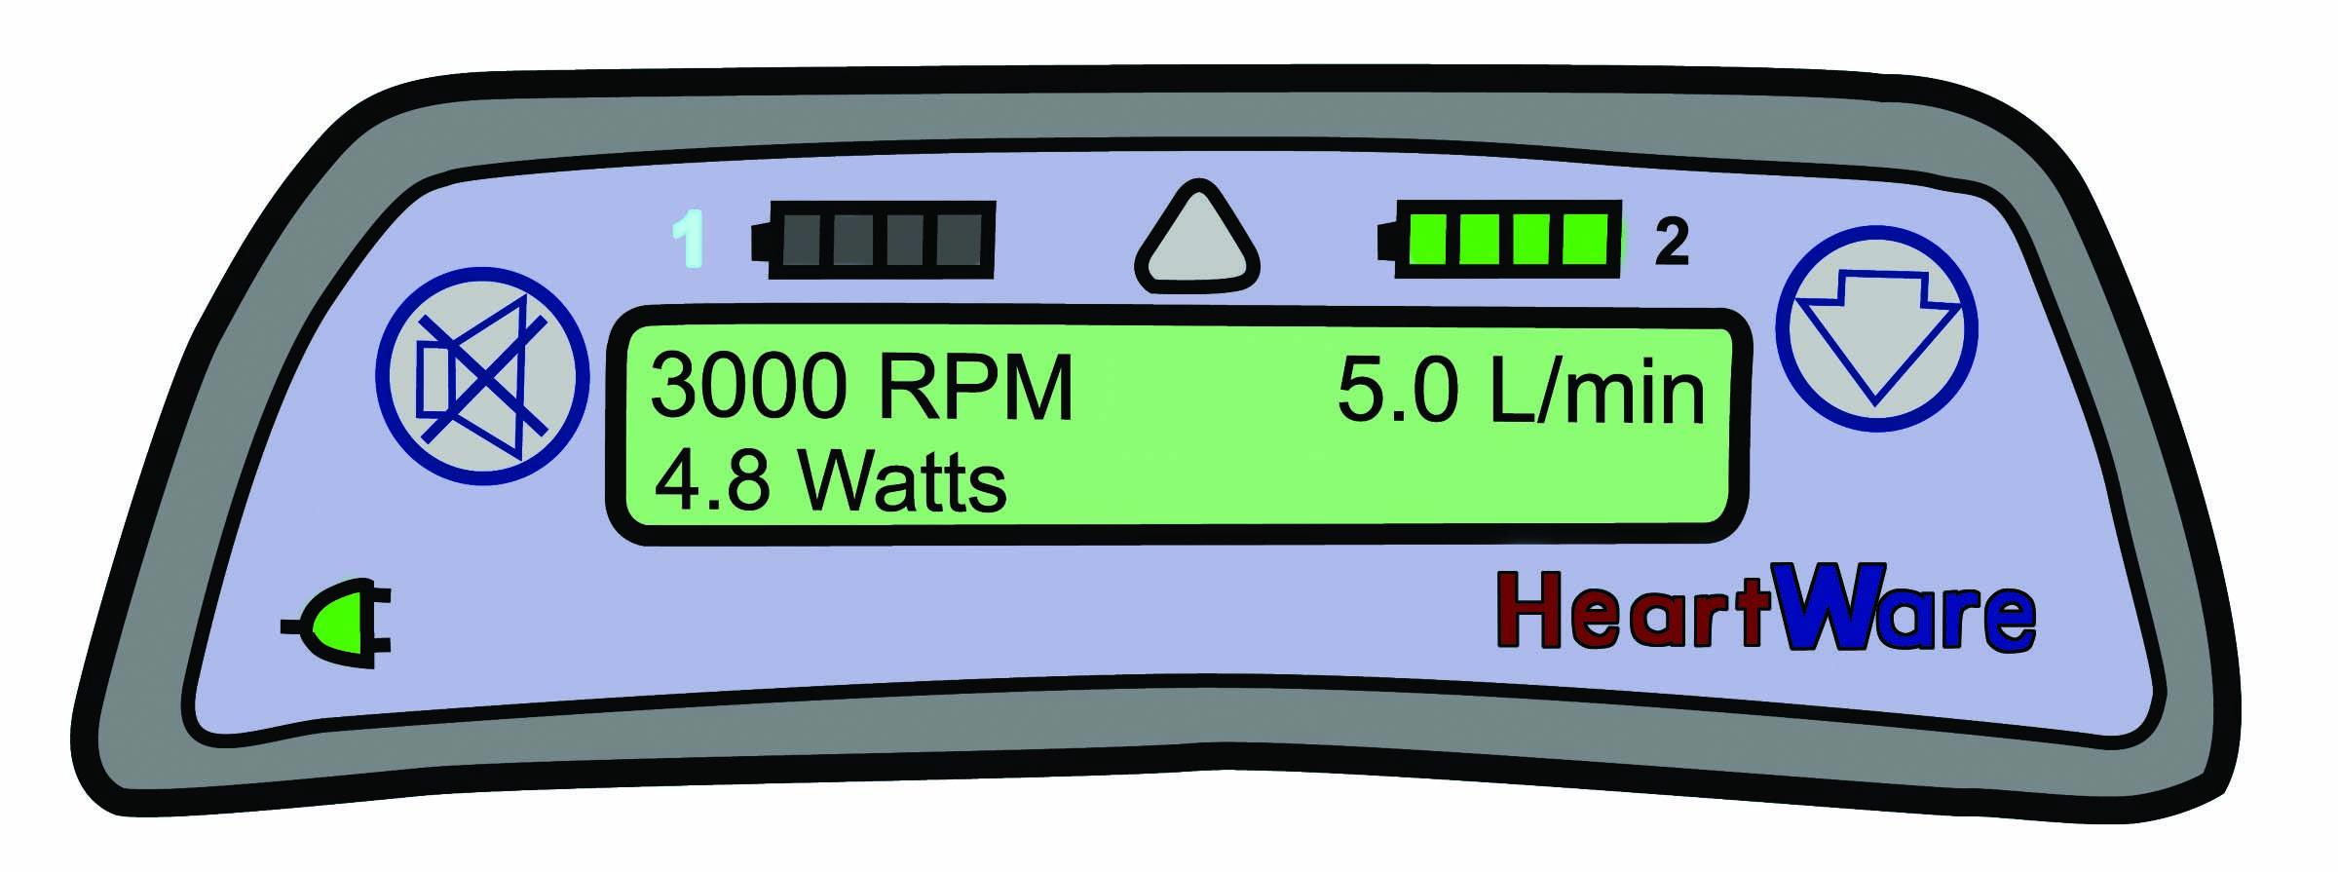
HVAD® Controller: Display Overview
Battery Indicator 1
Battery Indicator 2
Power Source 1
Alarm Indicator
Power Source 2
AC/DC Indicator

Slide 38
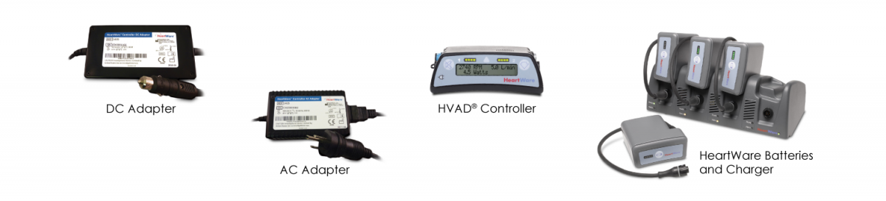
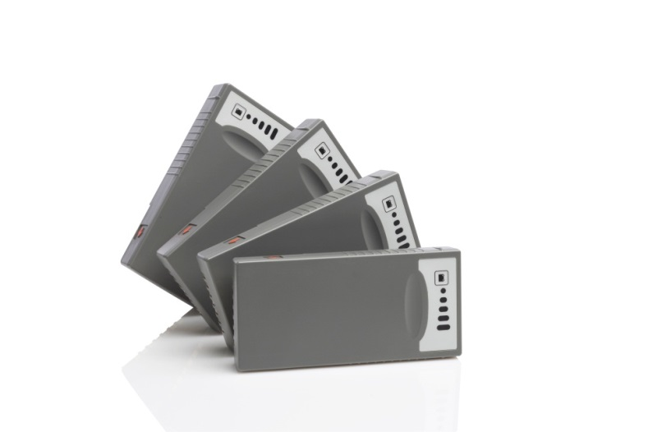
Power Management
Patients are responsible for managing their power
They have 6-8 batteries in rotation and a home charger
Batteries generally last 8 – 14 hours per pair
Exchanged one at a time, so one
power source is always connected
to the Controller
Patients only need to be on A/C power when sleeping

Slide 39
Assessing Pump Flow
Flow (L/min)
  Average adult Cardiac Output at rest is ~ 5 L/min
    Body size / blood volume effects pump flow potential
  The Flow parameter is an estimate
  Flow will mainly fluctuate with changes in activity, body position, and blood volume
    Hyper / hypovolemia
  Other physiologic conditions can also effect flow:
    Right Heart Function
    Rhythm disturbances
    Hypo / hypertension
    Valvular function
    Pulmonary hypertension
    Thrombosis
Pump Flow

Slide 40
Assessing Pump Flow
Normal Flow Range 4 – 6 L/min Asymptomatic
Sub-optimal Flow 2.5 – 3.5 L/min Asymptomatic → Symptomatic May be dizzy, lightheaded, fatigued, change in LOC
Low Flow < 2.5 L/min Asymptomatic → Symptomatic May be dizzy, lightheaded, fatigued, change in LOC

Slide 41
Routine LVAD Call / Transport
As soon as possible,
engage VAD Hotline
of implanting facility
If indicated, obtain ECG,
administer O2, start IV per
standard protocol
You’ll be unable to obtain an
accurate BP
(without doppler),
pulse, and pulse-oximetry.
Visual assessment of presenting signs and symptoms is always reliable
Ensure that bag containing
back-up LVAD equipment
accompanies patient on transport
If trained family member or
caregiver is present, allow them
to ride in ambulance with patient if possible
In consult with the VAD Hotline,
transport to nearest appropriate
facility.

Slide 42
VAD Emergency
Patient Unconscious
Note: Verifying PUMP ON
is like confirming a pulse
on an VAD patient
Verify
PUMP ON
Rule-out VAD power or driveline disconnect
  Re-connect if disconnected
  Verify VAD is running
    Listen for whirr of the pump over the apex
  If an alarm is present, silence it and consult
  with the VAD Coordinator on-call
Airway / Rescue Breathing / O2
Call patient’s VAD Hotline
PUMP ON
PUMP OFF
Life-support measures with CPR only after contacting VAD coordinator
Continue airway support / rescue breathing
Assess Rhythm
  ICD firing – Amiodarone
  V-tach / V-fib – Amiodarone,
  Cardioversion per ACLS protocol
Assess Doppler BP
Establish IV access
Use Code Drugs as indicated
VAD Hotline will help triage the equipment
and advise on any equipment-related
interventions
Note: VAD Equipment
failure is very unlikely
Transport

Slide 43

Questions?

