Slide 1
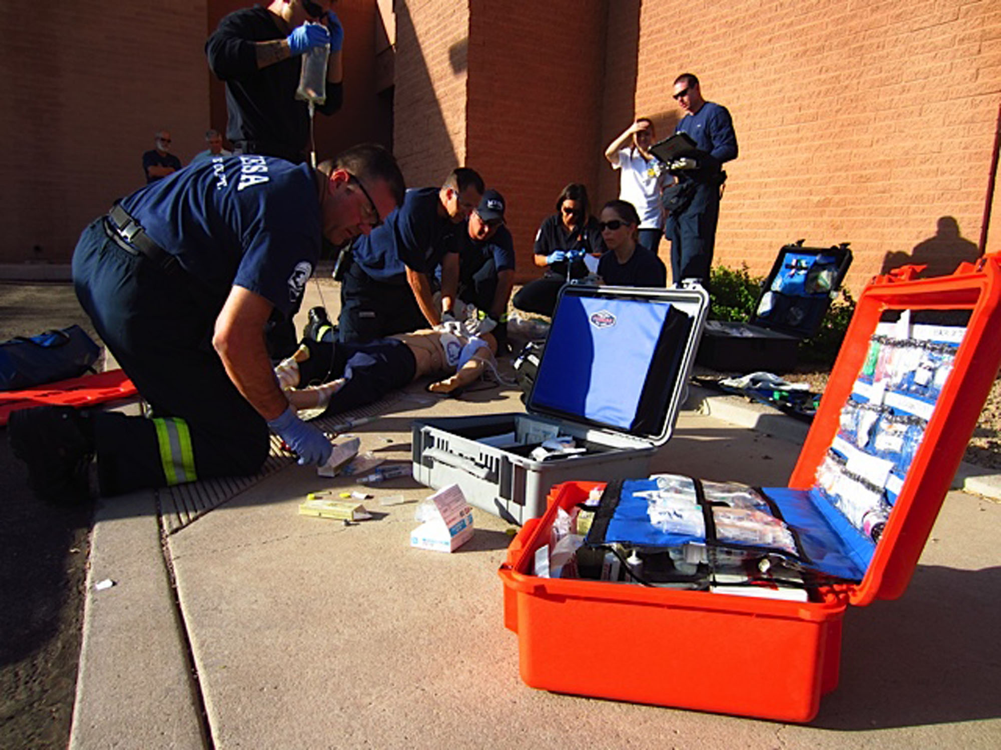
EMS Resiliency, Wellness, and Safety Summit
September 15, 2017

Slide 2
Acknowledgements:
Antonio Hernandez, MEP
Bureau of Public Health Emergency Preparedness-ADHS
AAA
AZFC
AZFD
AMR
EMT Resiliency, Wellness, and Safety Workgroup
Douglas W. Crunk BS, NRP - EMS Education & Training Manager
Paula Brazil, MA - ADHS

Slide 3
Housekeeping:
Coffee
Food
Bathrooms
Fire Exits
AED
CEs

Slide 4
Introductions:
Tania Glenn, PsyD, LCSW, CCTP, Clinical Psychologist
Dale Crogan, Captain, Mesa Fire and Medical Department
Amy Devins, First Responder Liaison, Cenpatico Integrated Care; Grant Cesarek, Deputy Chief, Health and Safety, Golder Ranch FD
Matt Carlson, LPC, LAC, PhD Candidate, Co-Founder of Building Warriors
Matt Shobert, Fire Chief (Retired)
Tina Buck, PHD, LPC; CEO, Biobalance Integrated Wellness

Slide 5
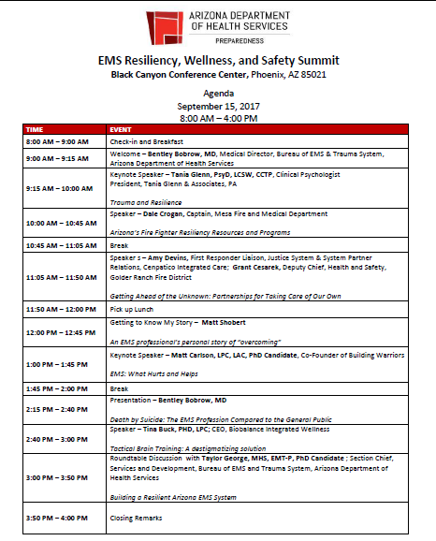

Slide 6
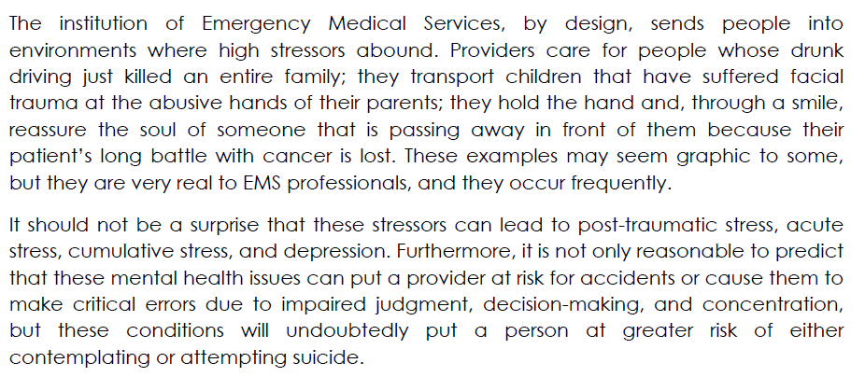
Statement of Issue

Slide 7
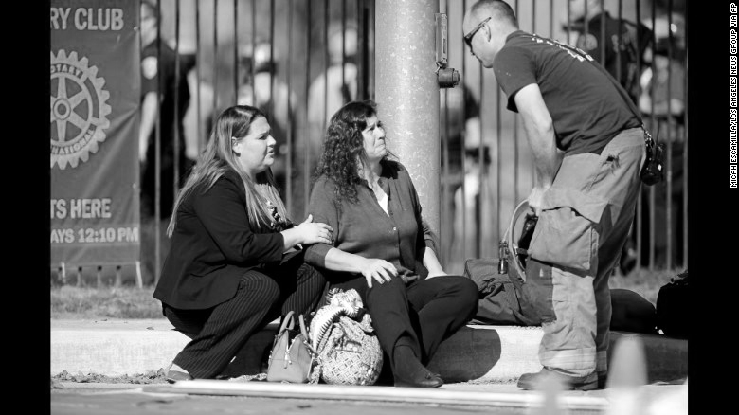
The EMT
First on scene of accidents, medical emergencies, and acts of violence
Care for victims of domestic violence, child abuse, extricate mangled bodies from crashed vehicles
Occasionally must physically restrain combative patients
Comfort and calm family members when a death has occurred
Culture of “being strong and pushing through adversity”

Slide 8
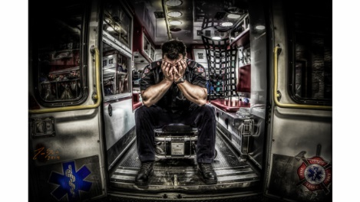
Sequelae
These events can lead to the development of negative emotional states
Psychological problems that result from emotional trauma can be acute or cumulative and take a variety of forms from mild to severe
Post-traumatic stress disorder (PTSD) is a more severe form with symptoms of disturbing thoughts, anxiety, poor sleep, and mental or physical distress
Untreated PTSD raises a sufferer’s risk of chronic pain (headaches/back pain, absenteeism, presenteeism, etc.) and suicide

Slide 9
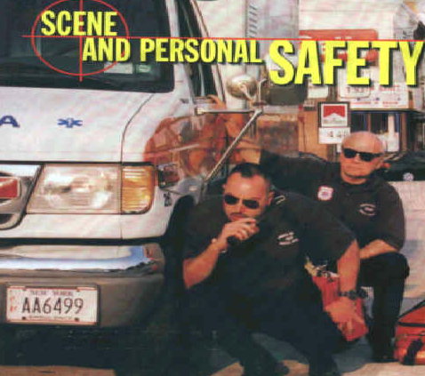

Slide 10
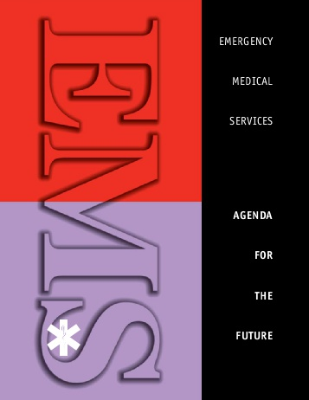
“Regardless of how integration with other health care services and increased use of advanced technology changes the picture of EMS, human resources remain our most precious commodity. Without effective “care” of our human resources, this exercise becomes academic.”

Slide 12
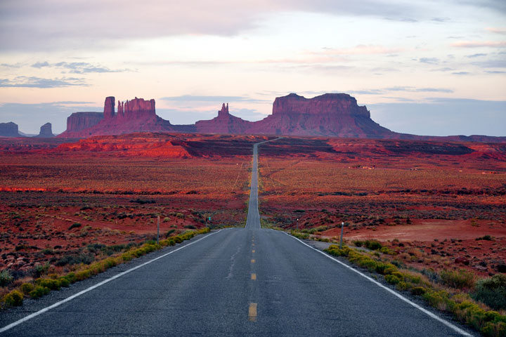
Roadmap for Helping our EMTs Help Others

Slide 13
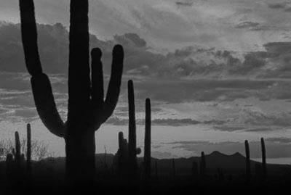
Opportunities:
We have more possibilities available in each moment than we realize.
- Thich Nhat Hanh

