Slide 1
Tania Glenn and Associates, PA Trauma Defense Team
Trauma and Resilience
Presented by: Tania Glenn, PsyD, LCSW
Notes:
1

Slide 2
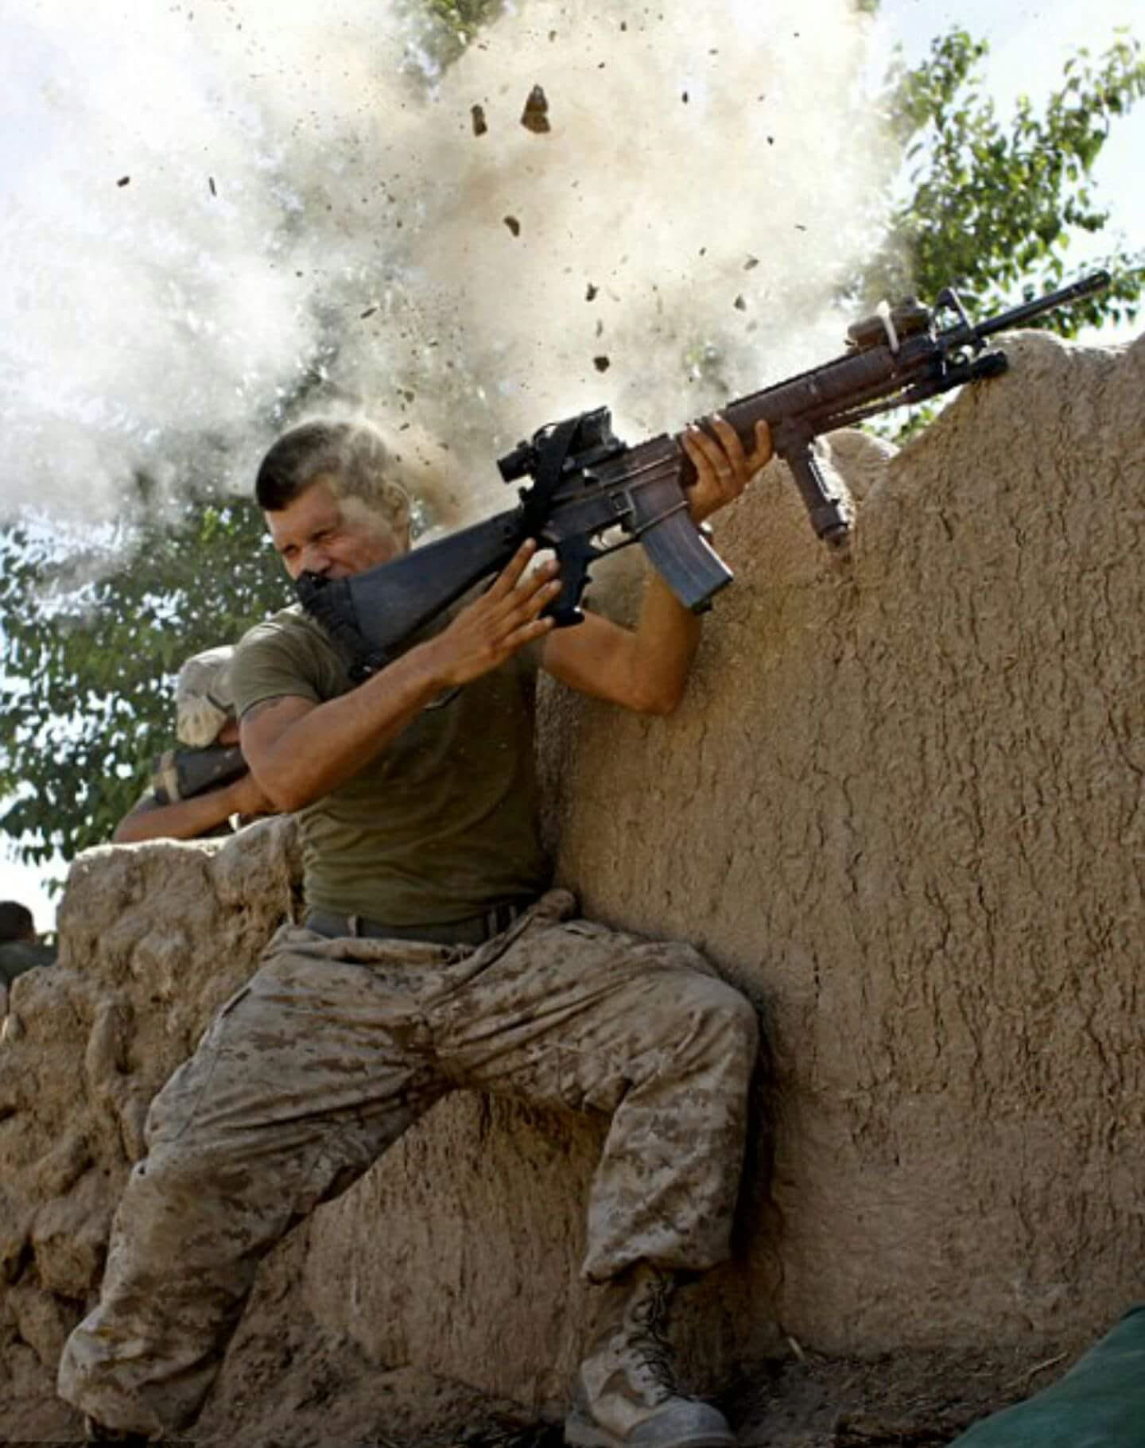
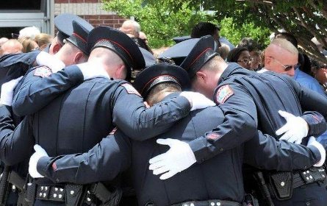
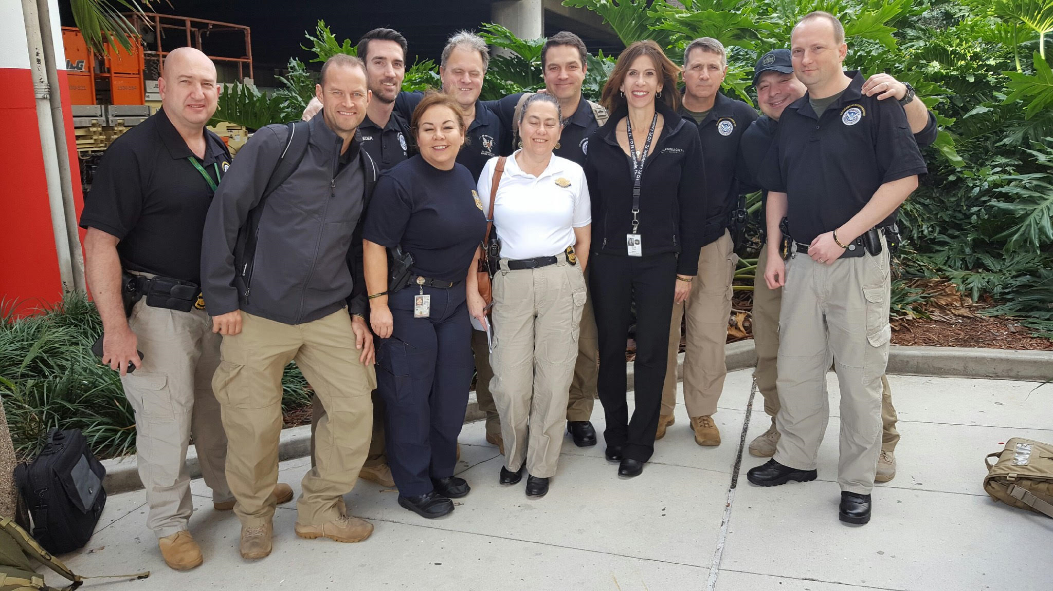
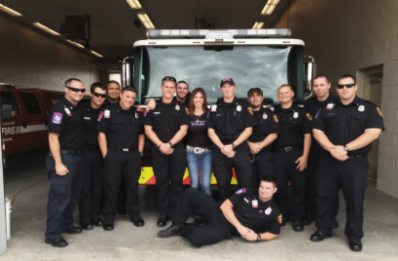
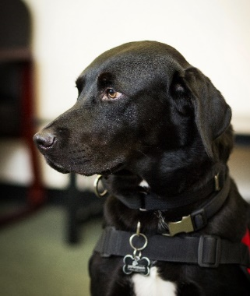
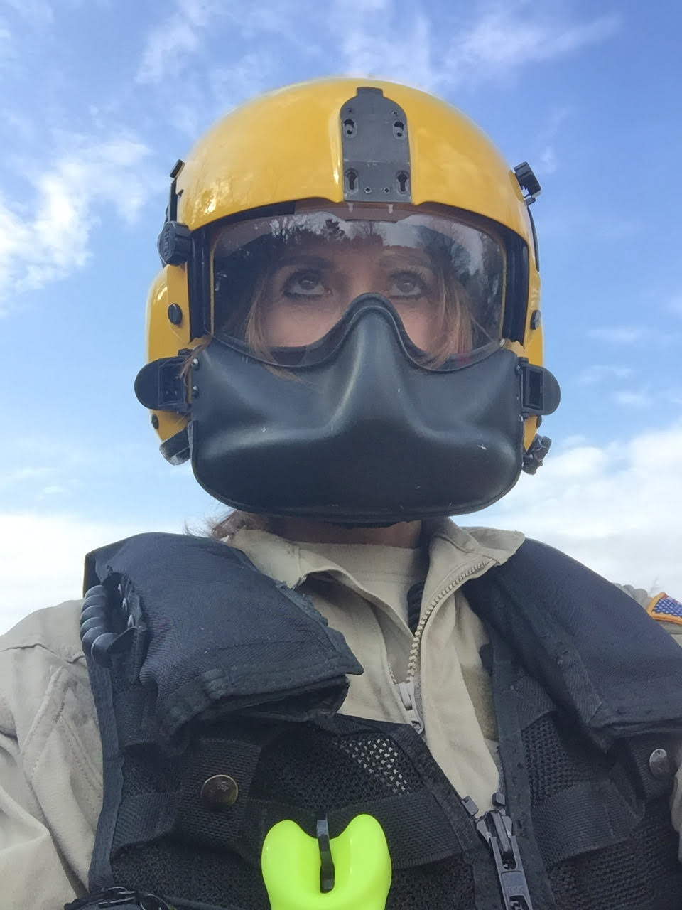
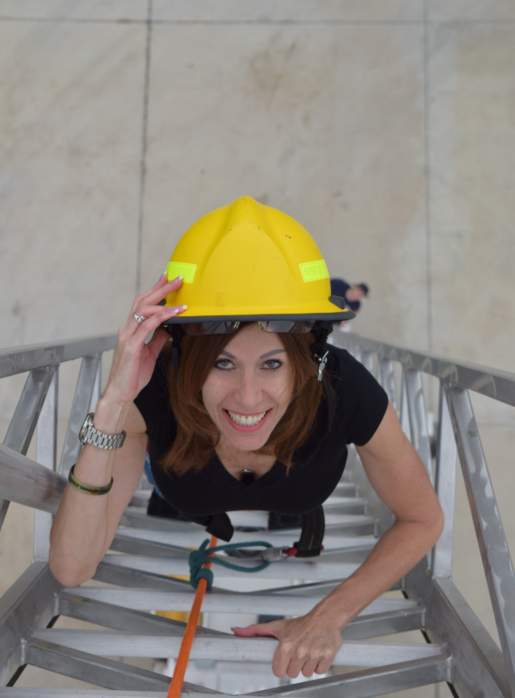
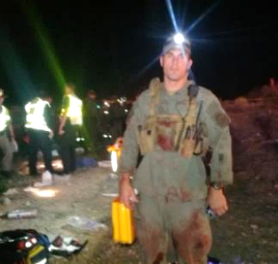
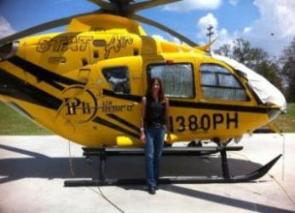
What it’s all about…

Slide 3
What is Stress?
A state of physical and emotional activation
A physical and psychological response to a perceived threat, challenge, or change
The core element of stress is fight or flight syndrome
Adrenaline, Glucose, Cortisol

Slide 4
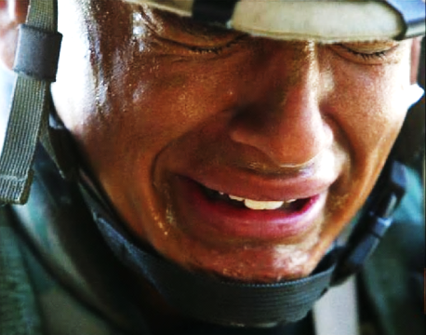
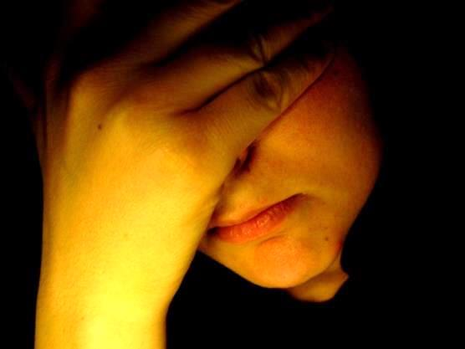
Types of Stress
Acute Stress
Delayed stress
Cumulative stress
Post-traumatic stress disorder

Slide 5
Acute Stress
Begins on-scene or within 24 hours
Very obvious, very connected to fight or flight
Responders may become overwhelmed
Physical symptoms kick in
Blood flow diversion and shaking
Bladder and bowel issues
Psychological responses
The prefrontal cortex shuts down

Slide 6
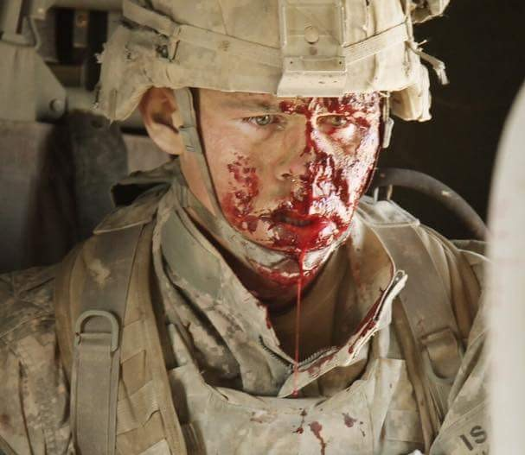
Acute Stress: The Look. The Thousand Yard Stare – What Do You Do?

Slide 7
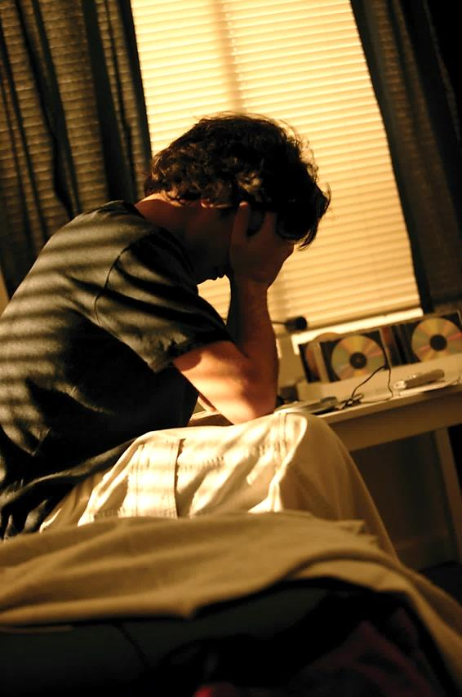
Delayed Stress
Begins 48 or more hours after the incident
Symptoms are similar to acute stress
Often confusion about this stress response due to the delay in onset

Slide 8
Cumulative Stress: Think Burnout!!!
Results from coupling unrealistic expectations with good intentions
Too much of something
Not enough time off / away
Not enough balance in one’s life

Slide 9
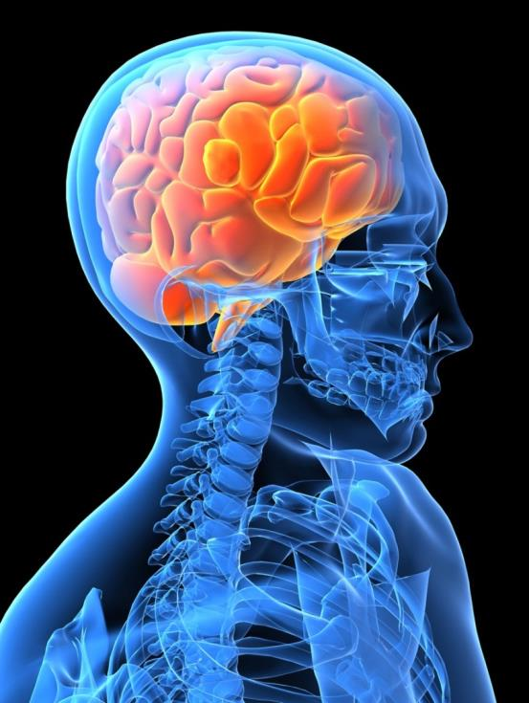
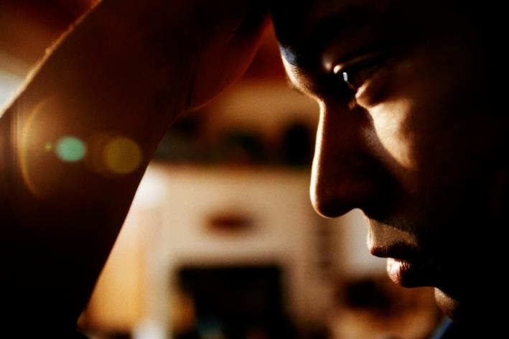
Stress and The Brain: Post-Traumatic Stress Disorder (PTSD)

Slide 10
Post-Traumatic Stress Disorder (PTSD)
Psychological disorder (PTSD) listed in the DSM-V
Is the end result of exposure to stress trauma which is so extreme, that it is beyond human coping capacity
Trauma gets stored in the frontal lobe and the brain is unable to process the event to long-term memory
Repeated attempts to process the event result in multiple fight or flight reactions
Glucocorticoids then damage the limbic system
PTSD is the survival response in the wrong cycle

Slide 11
PTSD
INTRUSION
Recurring thoughts, images, flash bangs, nightmares, the event feels like it is constantly in your face
AROUSAL
Increased anxiety, breathing, heart rate, etc., similar to the fight or flight response experienced on-scene
AVOIDANCE
We spend a great deal of time and energy trying not to think about it

Slide 12
Combatting PTSD
The sooner we implement care, the better. It’s never too late! PTSD is manageable.
Treatment includes Cognitive Behavioral Therapy, Mindfulness, EMDR and Progressive Desensitization
EMDR: The biggest tool in the toolbox – involves getting the frontal lobe to open the synapses and move traumatic images into memory
Progressive Desensitization – getting back out there!

Slide 13
Resilience
Resilience is the virtue that enables people to move through hardship and become better. No one escapes pain, fear and suffering. Yet from pain can come wisdom, from fear can come courage, from suffering can come strength – if we have the virtue of resilience.

Slide 14
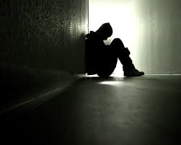
Resilience
It’s not enough to want to be resilient or to think about being resilient.
We have to choose a resilient life.

Slide 15
An Outcome-Driven Continuum of Care
Resistance
Resilience
Recovery
Create Resistance Enhance Resiliency Speed Recovery
Resistance refers to the ability to literally resist manifestations to reduce stress
Resilience may be thought of as the capability to withstand shock without too much of an impact
Recovery refers to the ability of an individual to literally recover the ability to function normally

Slide 16
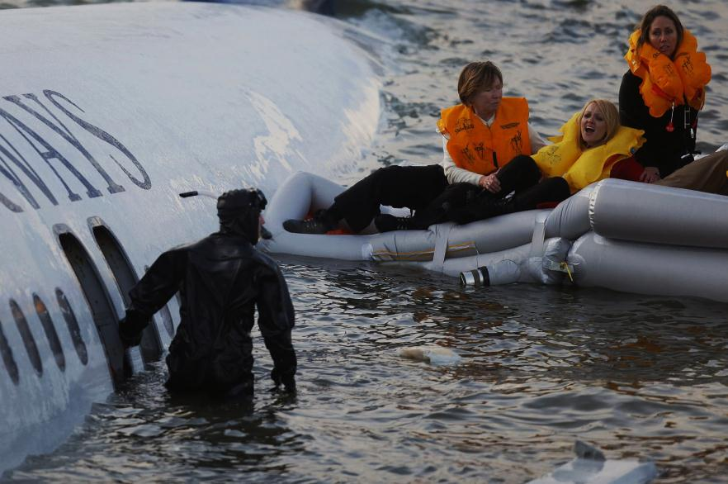
Resilience Continuum
l-----------------------l-----------------------l-----------------------l
Helplessness Surviving Resilience Perfection/
Invulnerability

Slide 17
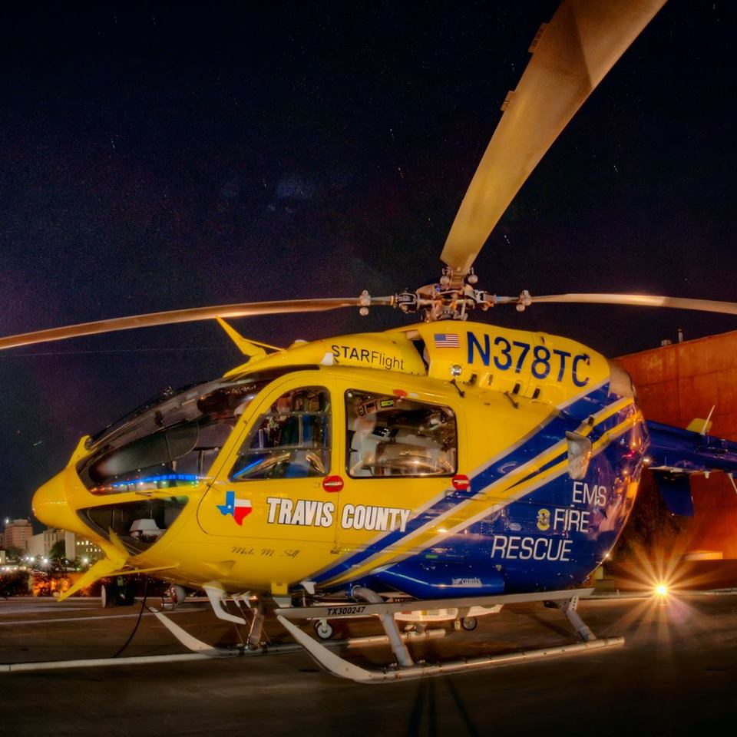
Another Resilience Continuum
l__________________l__________________l
Low Moderate High

Slide 18
Resilience
Everyone is resilient to some degree
No one is perfectly resilient
Resilience means generally working, playing, loving and expecting well
Resilience means functioning at the best possible level

Slide 19
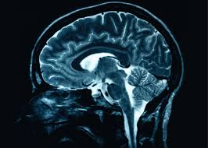
The Resilient Brain
The brain is plastic – it changes in structure and function as we grow through life and experience events
The hippocampus grows neurons as it recovers from stress
Brain health equals heart health

Slide 20
The Resilient Brain
Richard Davidson, University of Wisconsin
The stronger the path between the pre-frontal cortex to the amygdala means the brain's cognition is more likely to tell the brain's emotions to calm down

Slide 21
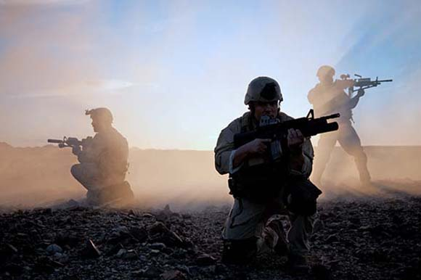
Navy Seals
Navy SEALs have high resilience
Brain imaging of SEALs show that their brains anticipate stress and strong emotions faster than the average brain
Navy SEALs also jump more nimbly between emotions and let go of them faster
Why? Because they are resilient

Slide 22
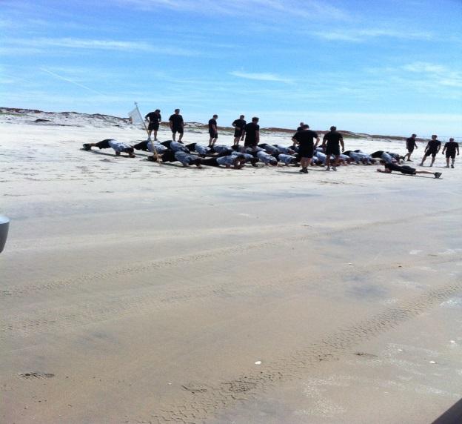
Aerobic Exercise
Exercise burns stress and lowers cholesterol
Exercise enhances cognitive function and prevents decline
Fitness is associate with academic performance
Exercise improves mood, happiness and confidence
Exercise reduces tension, depression and anxiety

Slide 23
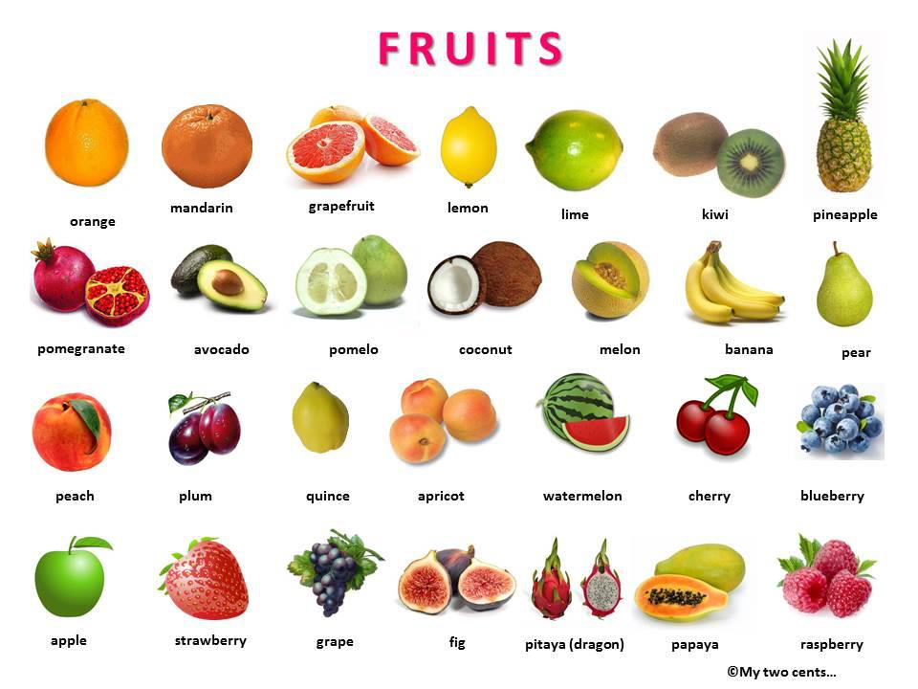
Nutrition
Nutrition is good for the heart and the brain
Power foods – plants and fish

Slide 24
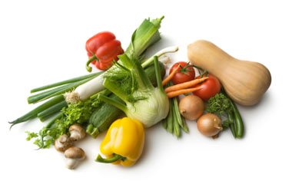
Nutrition
Choose good carbohydrates
Choose foods rich in antioxidants
Restrict Calories
Go with whole grains
High fiber

Slide 25
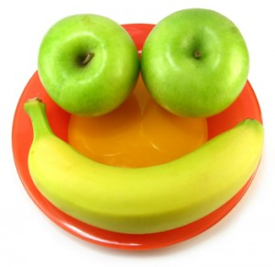
Nutrition
Vitamins
Dark chocolate
Nuts
Hydrate
Go lean

Slide 26
Sleep
Sleep recharges and refreshes the mind
Sufficient sleep has been linked to resilience
Creativity, problem-solving and better performance

Slide 27
Not Enough Sleep
REM sleep is shortened
Weight gain
Decreased blood flow to the brain – depression, anxiety, suicide
Seven to eight hours a night!

Slide 28
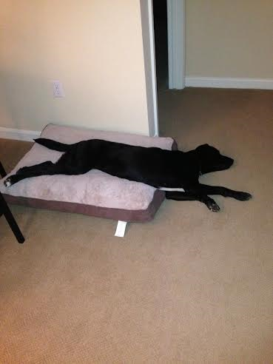
Tips for Good Sleep
Get enough
Keep a regular schedule
Create a sleep-friendly environment
Develop a relaxing routine

Slide 29
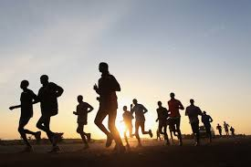
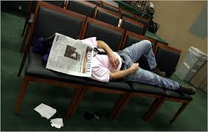
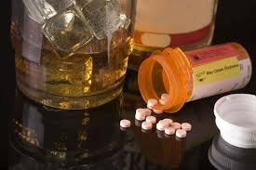
Tips for Good Sleep
Exercise
Consider regular naps
Avoid alcohol and caffeine and self-medication

Slide 30
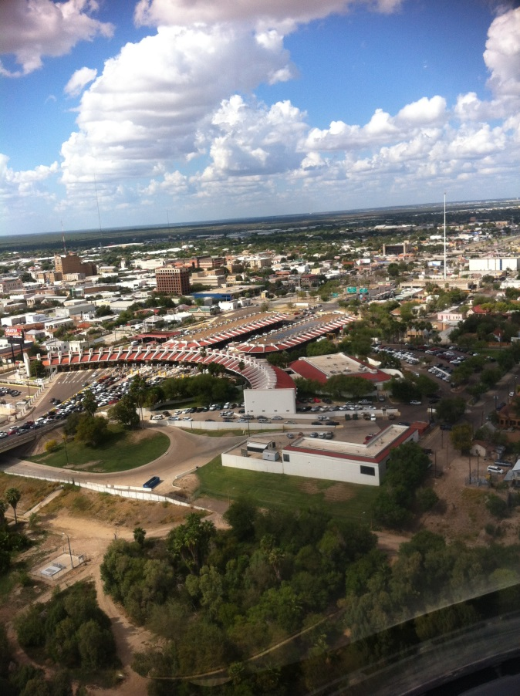
Happiness
Happiness is an overall feeling of satisfaction with one’s life and oneself – that these are worthwhile and meaningful

Slide 31
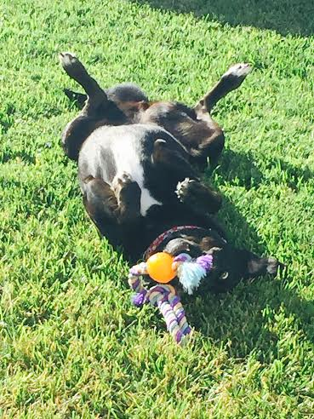
Happiness
Happiness is a combination of genetics and outside factors
Pathways to happiness include exercise, nutrition, sleep, light and Vitamin D

Slide 32
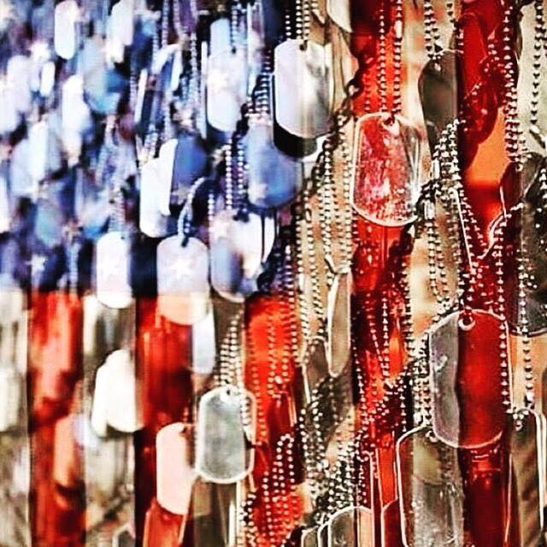
Gratitude
Gratitude is linked to happiness, health, job satisfaction, less pain and fatigue, feeling more connected to others

Slide 33
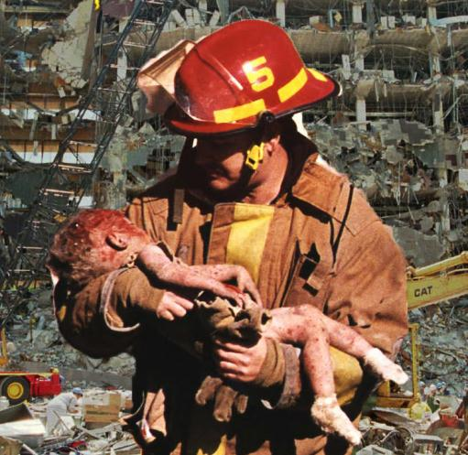
Altruism
Altruism is the unselfish concern for the welfare of others
Selflessness
Kindness
Benevolence

Slide 34
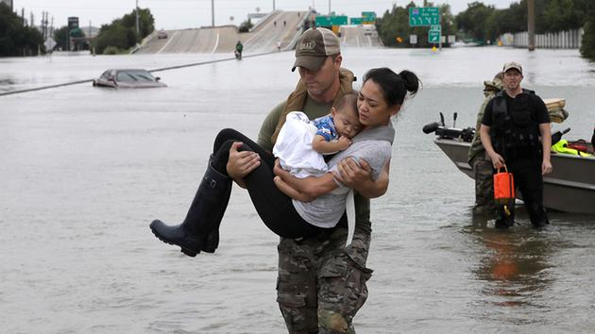
Altruism
Altruism is associated with kindness and less cynicism

Slide 35
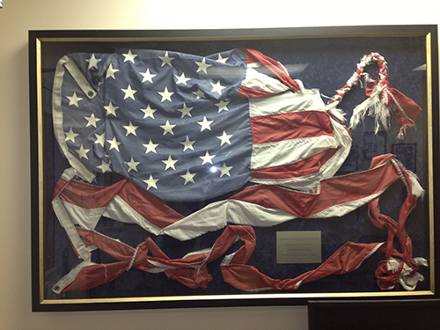
Moral Strength
Resilient people are moral. They live with integrity and meaning.
Moral people are happier. They possess inner peace.

Slide 36
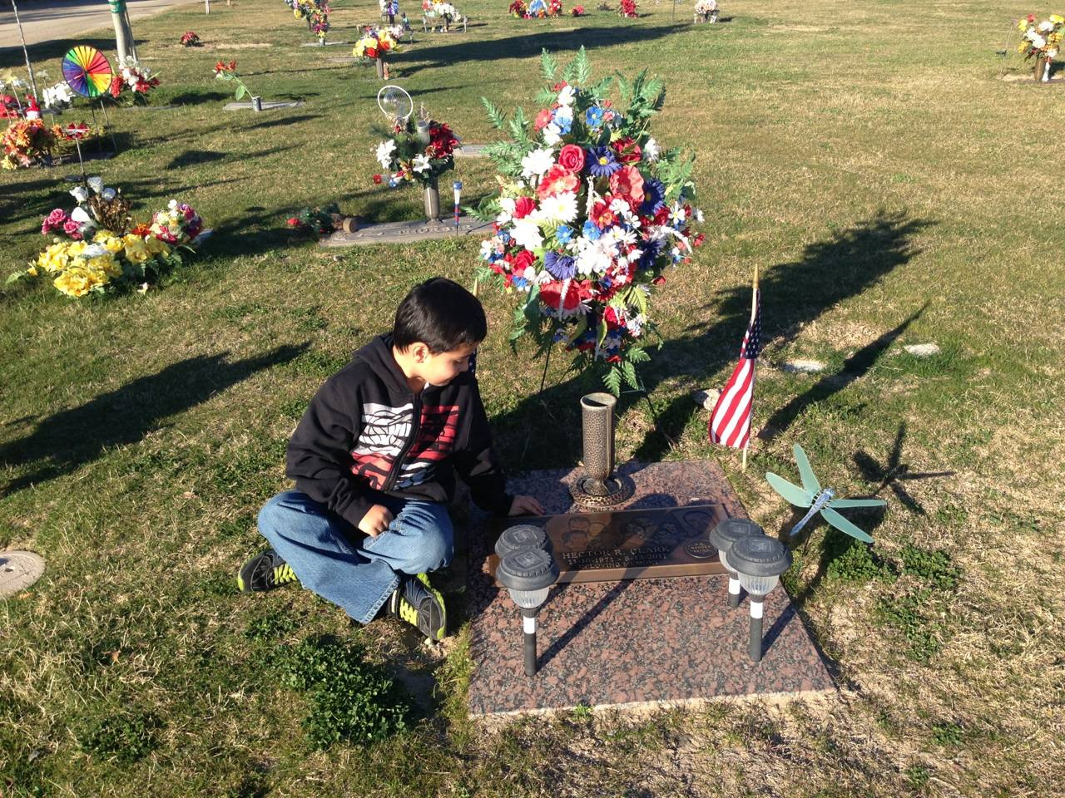
Suffering
Pain is inevitable, suffering is optional

Slide 37
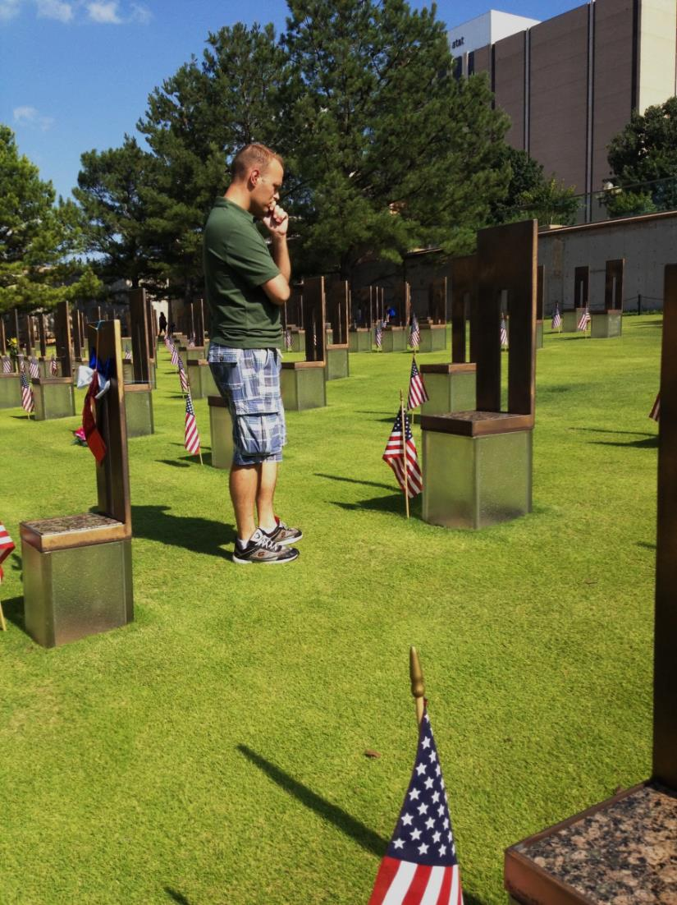
Growth through Suffering
Growth and distress coexist
Suffering is an important process
Develop a sense of mastery

Slide 38
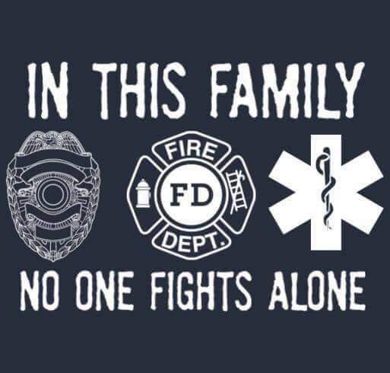
Growth through Suffering
Determine to persist
Be active, not passive
Aim to be challenged, not overwhelmed
Be aware of weaknesses
Maintain self-esteem

Slide 39
Spirituality
Spirituality is connected to greater optimism, health, resilience and altruism

Slide 40
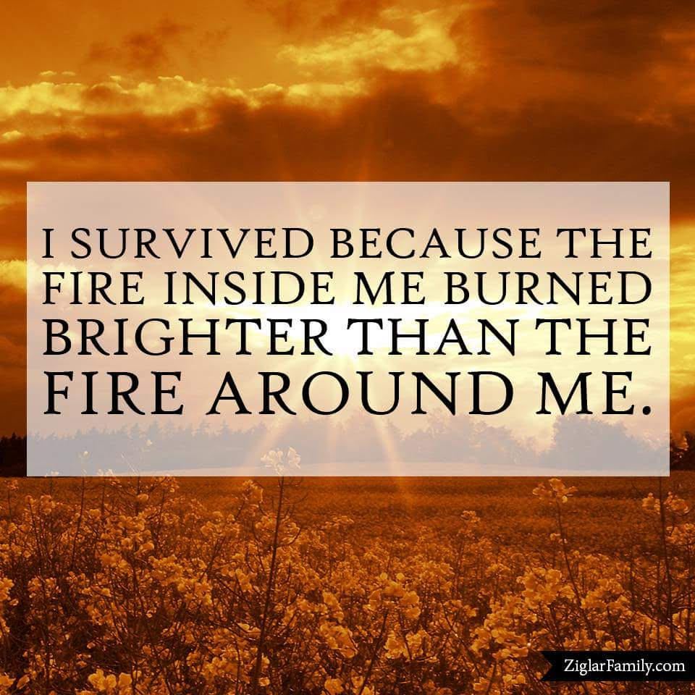
Resilience According to Tania
Hydration, nutrition, rest and exercise
Alcohol in moderation
Set reasonable goals and objectives to reach them
Get regular and comprehensive check-ups
Anger is a great tool – use it well
Forgive yourself

Slide 41
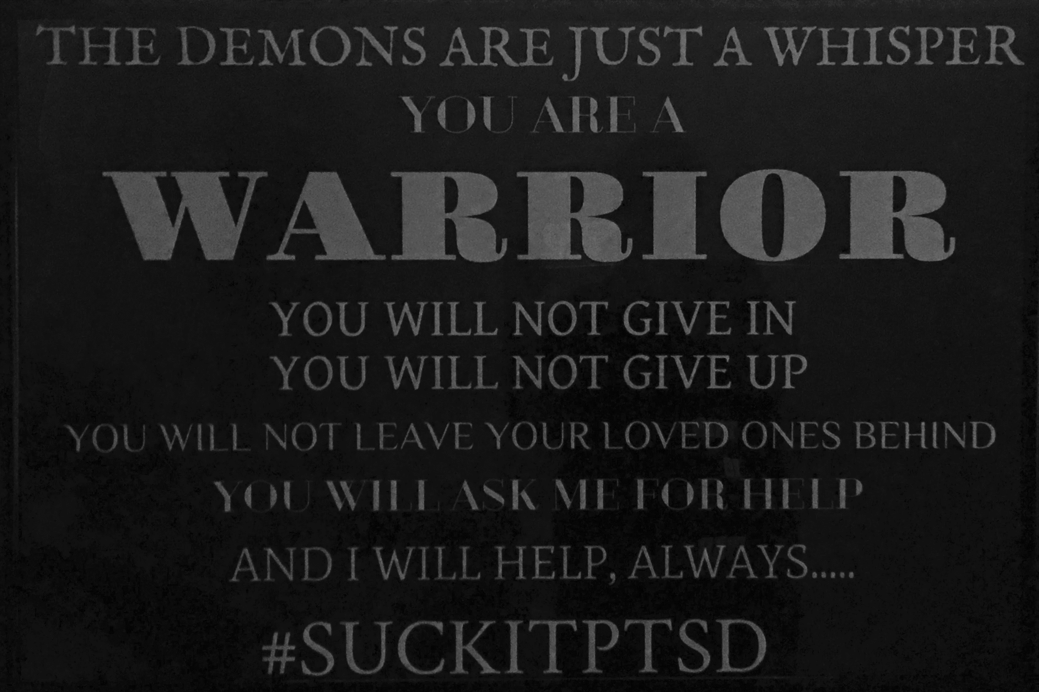
Resilience According to Tania
Develop a core set of beliefs that nothing can shake
Try to find meaning in whatever stressful or traumatic thing has happened
Be tenacious in your healing
Take cues from someone who is especially resilient
Don’t get stuck in a moment – take a step back and look at the big picture

Slide 42
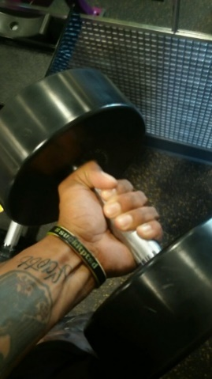
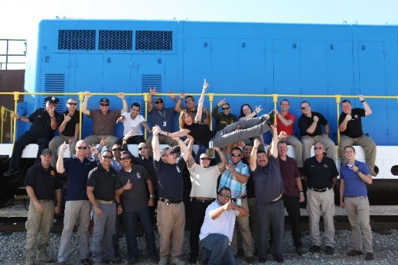
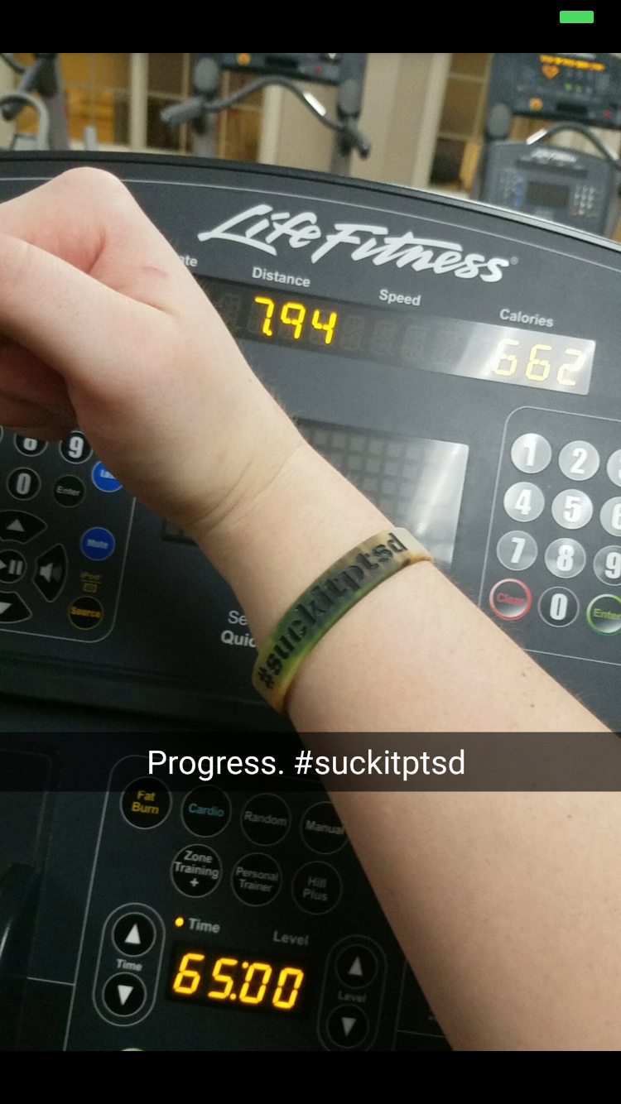
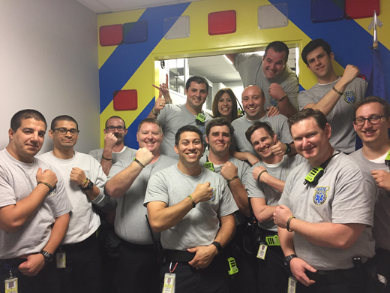
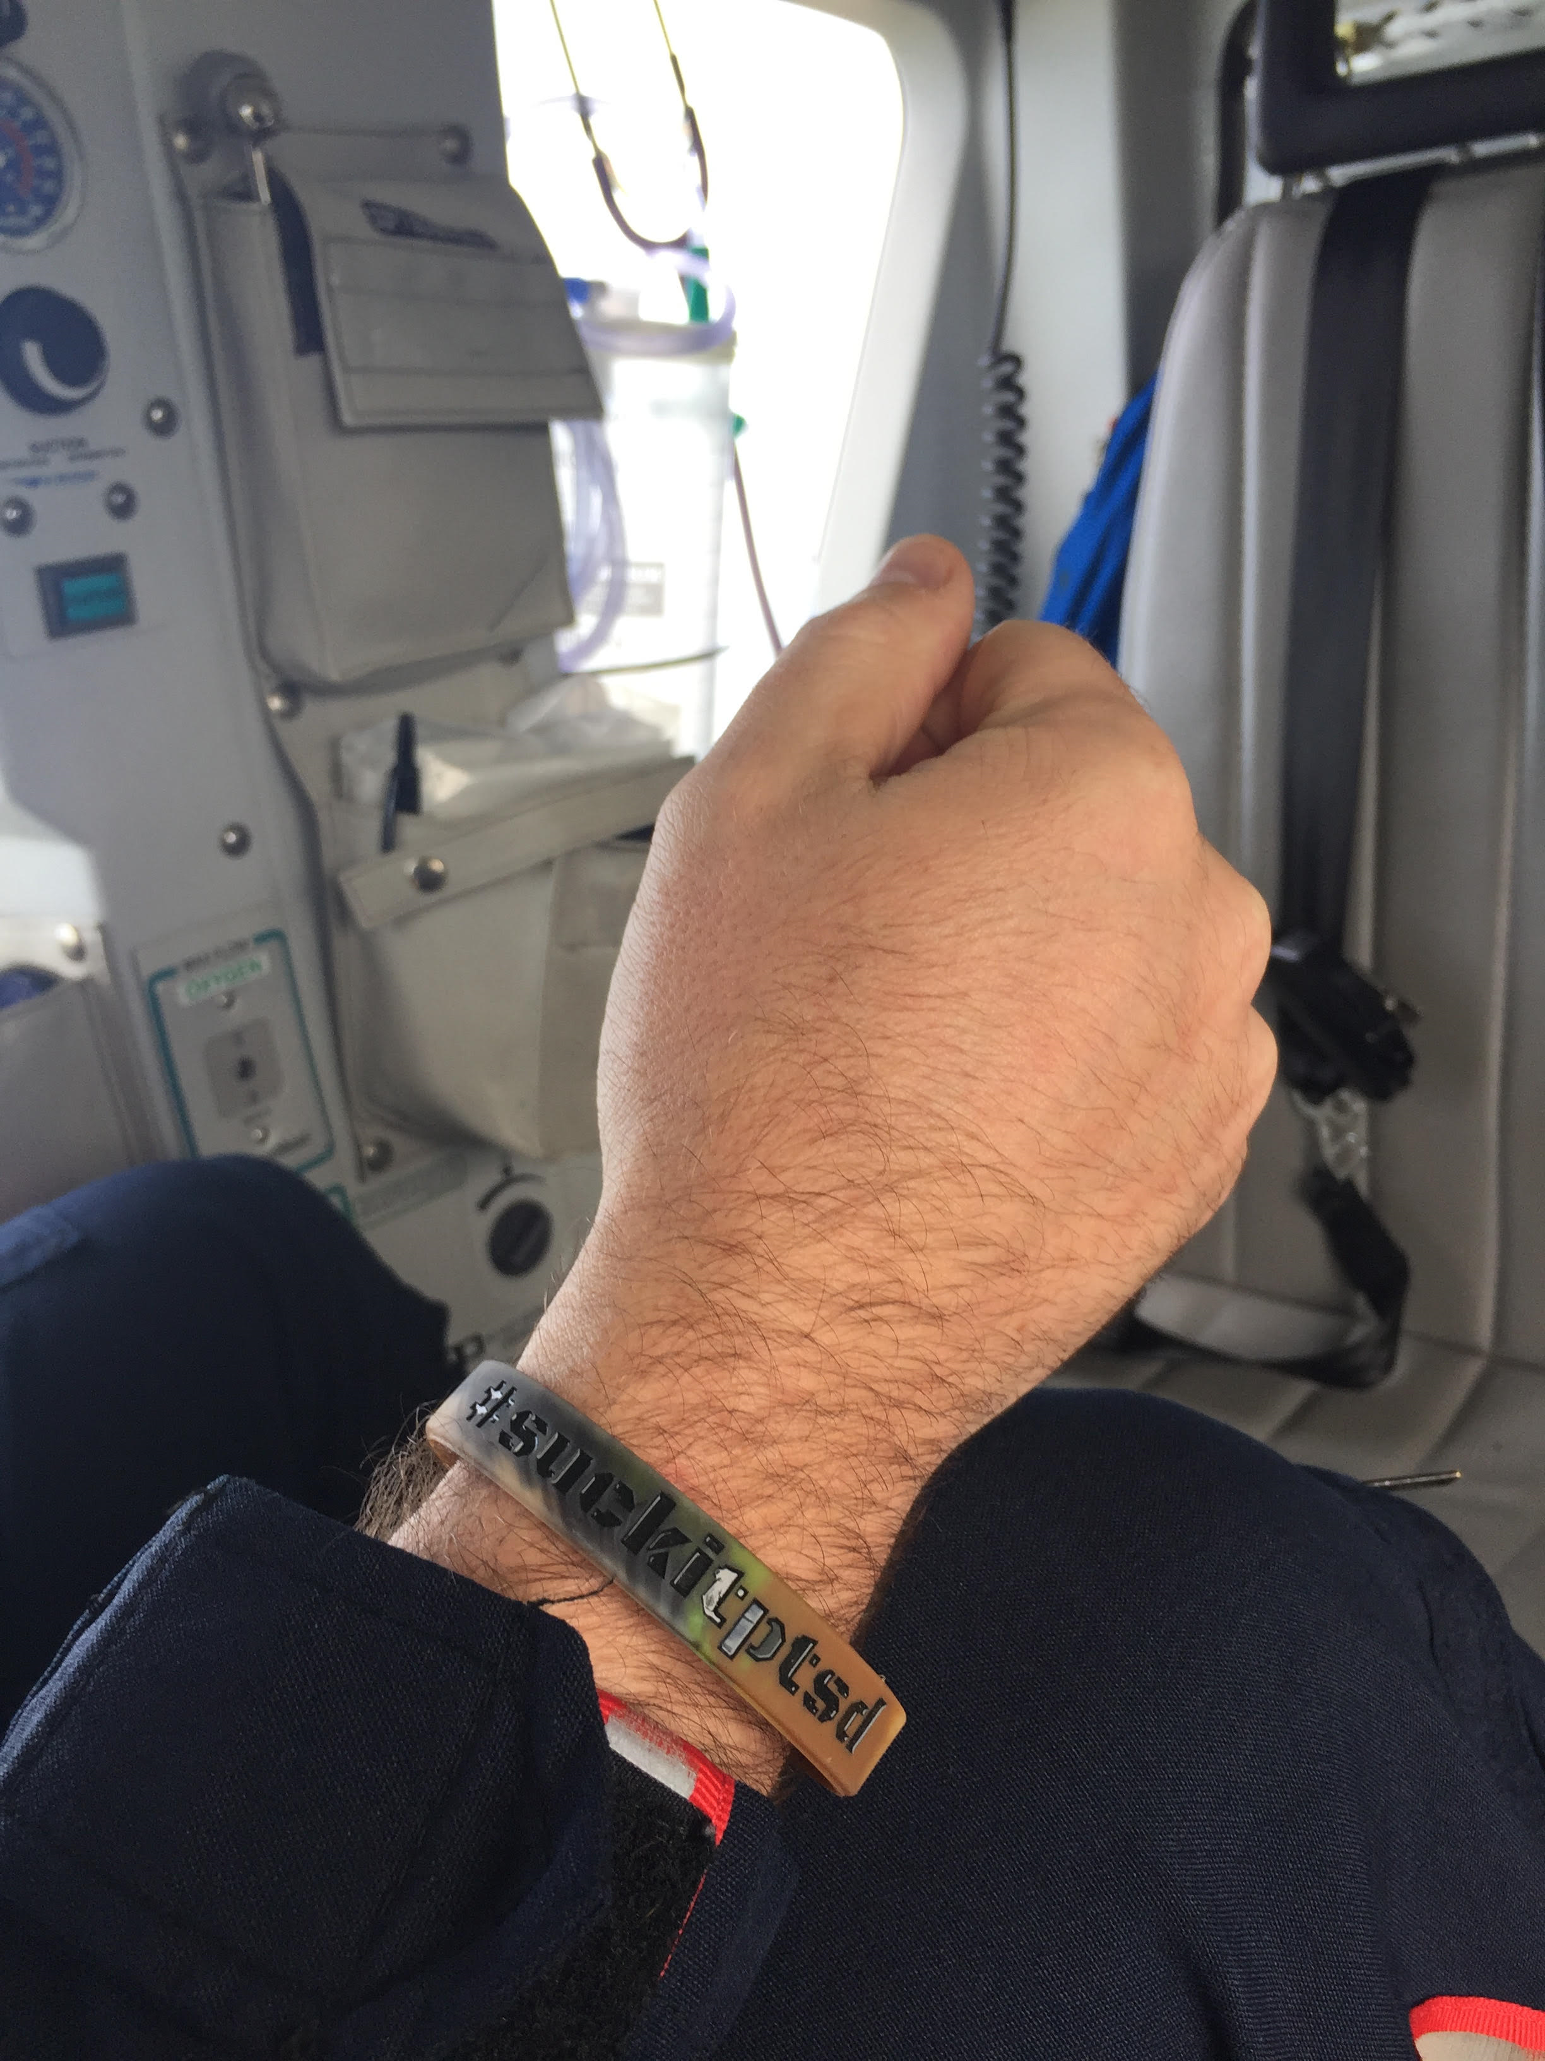
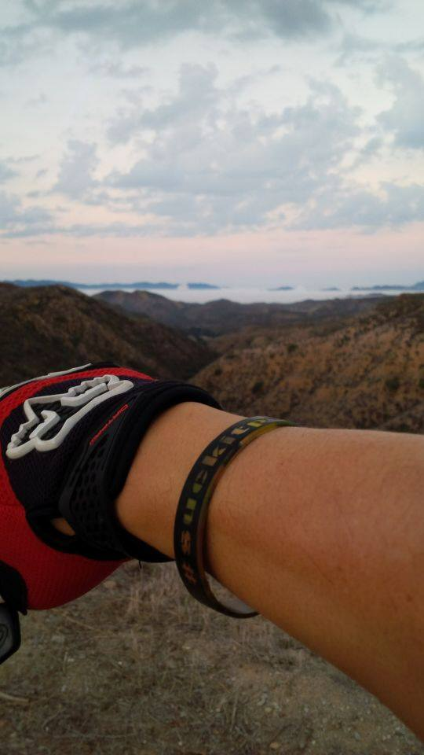
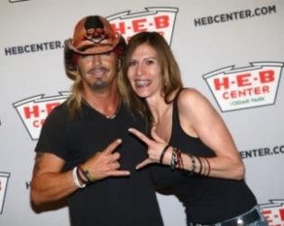
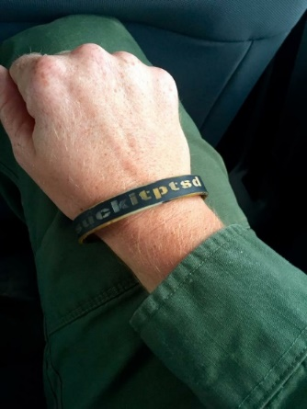
#suckitptsd

Slide 43
Questions and Answers
TANIA GLENN, PsyD, LCSW taniaglenn@gmail.com n 1.512.922.4265
www.taniaglenn.com
http://drtaniaglenn.blogspot.com
https://facebook.com/Dr Tania Glenn and Associates PA
https://twitter.com/DrTaniaGlenn

Slide 44
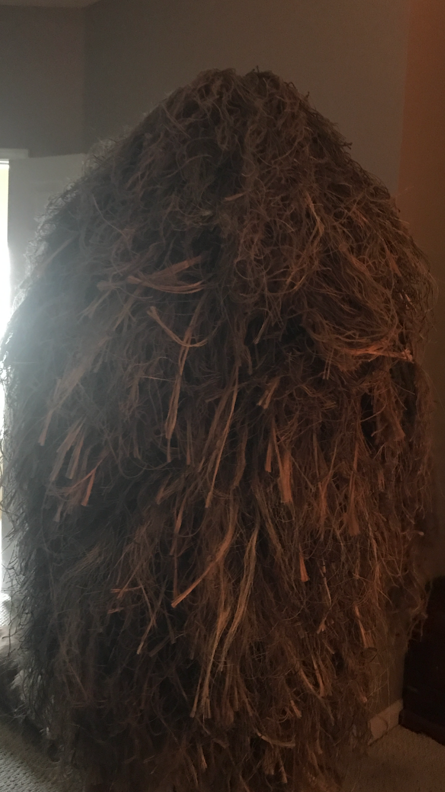
Thank you!

