Slide 1
First Responder Resiliency

Slide 2
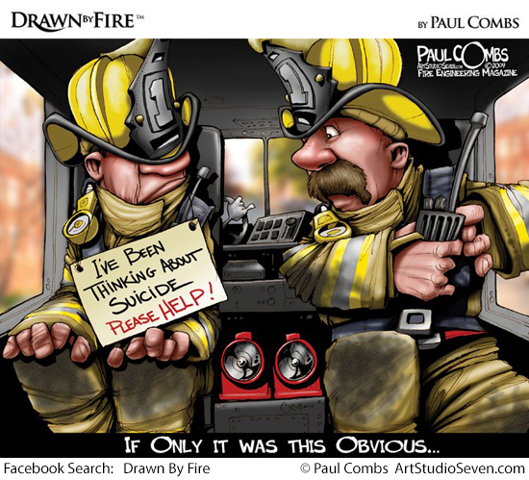
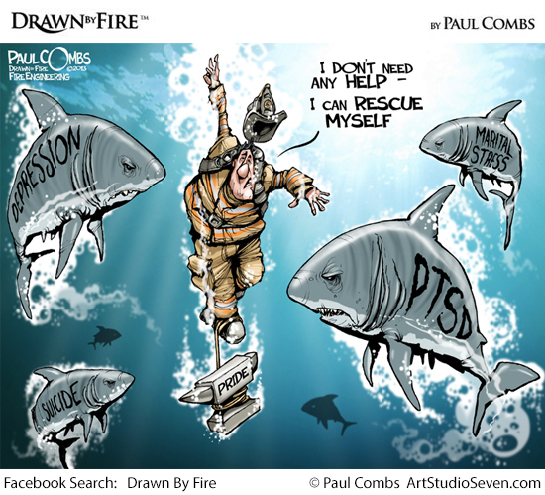

Slide 3
Peer Support Team Model
People
Trust
Follow-through

Slide 4
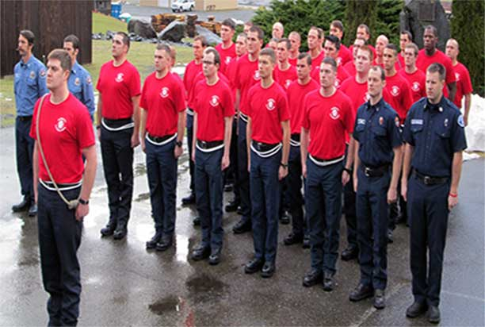
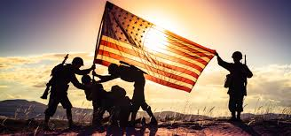
Who’s Coming Into your organization
Generational
Gen Xers
Millenials
Veterans
Green – No experience

Slide 5
How do you evaluate a new employee?
Interviews
Physical Testing
Psychological Examination
Medical Exam

Slide 6
How Do you pick your team?
Who in your organization is respected?
Volunteers
Experience
Mentoring Programs

Slide 7
Resiliency skills How Do You Train them?
Goal Setting
Eat Right
Exercise Might
Relaxation – Chill Out
Sleep Tight
Perspective Views
Self-Defeating Thoughts
ABCs Point Out
Empathy
Wins and Losses
Reaching Out
Social Support
Make-It-Yourself Resiliency

Slide 8
How Do you deploy your team?
On / Off duty
Types of Incidents
Levels of Interactions (single person vs. groups)

Slide 9
Family
How do you connect with family members?

Slide 10
Follow-Up
Personnel
Event
Short-term care
Long-term care
Aftercare

Slide 11
Evaluation / Critique
Event
Peer Team
Labor / Management

Slide 12
Questions?

