Slide 1
EMS: What Hurts and Helps
Matt Carlson, LPC, LAC, PhD Candidate
Co-Founder
matt@buildingwarriors.net
269-720-0071

Slide 2
Academy to Academy

Slide 3
Mayday

Slide 4
Grey Matter

Slide 5
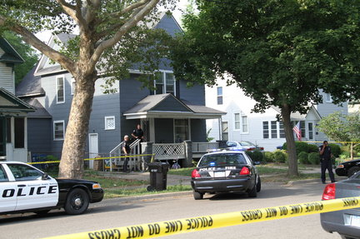
Life Saving Award Violence
0/49

Slide 6
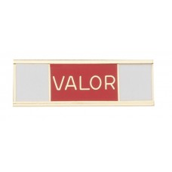
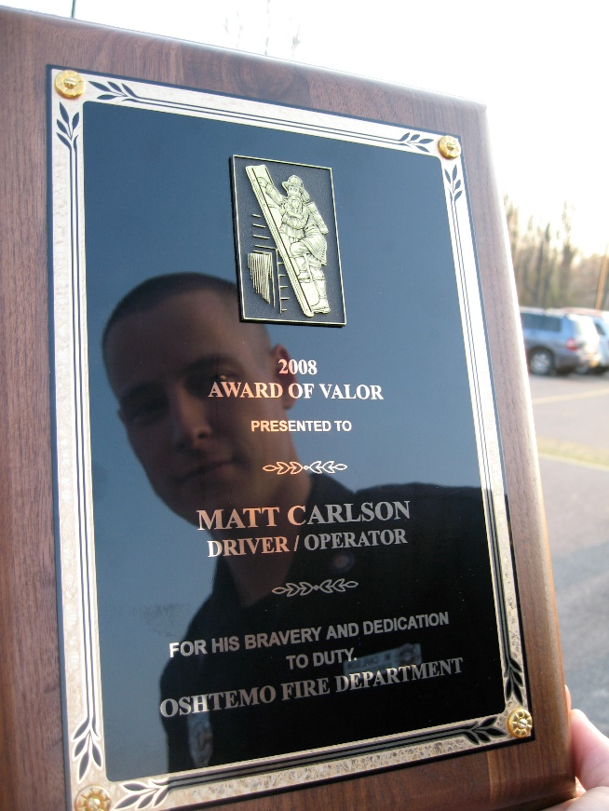
Suicides Rescues/Recoveries

Slide 7
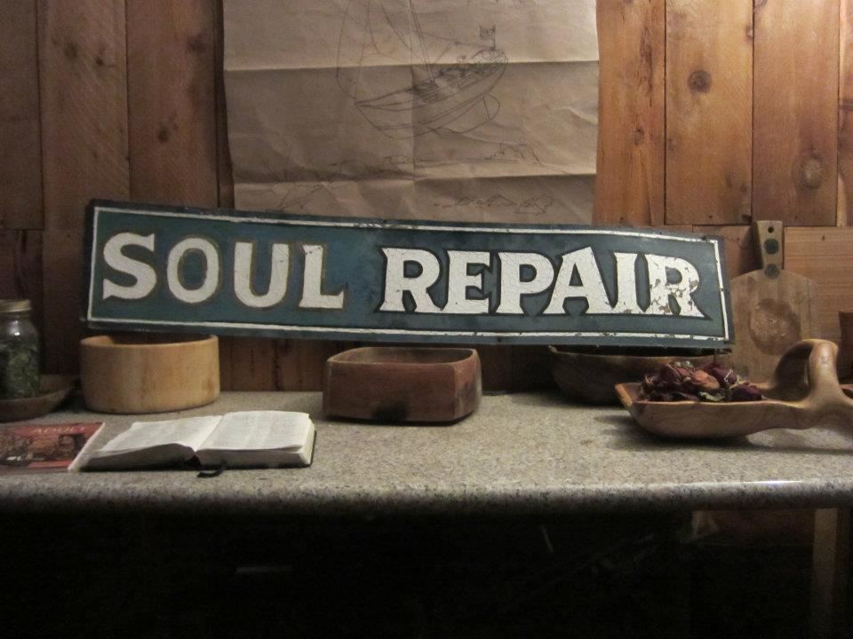
Moral Injuries

Slide 8
MCI
Fire Rescue

Slide 9
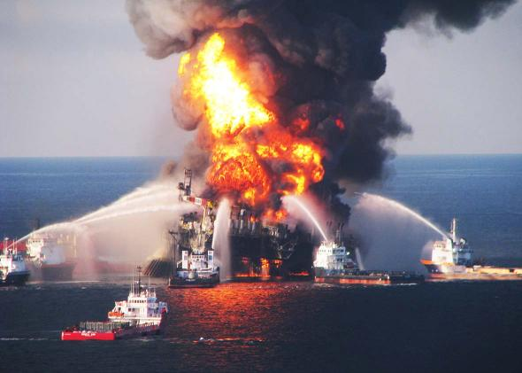
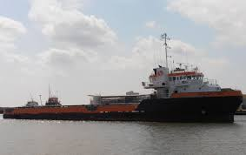
Deepwater Horizon
11 KIA
SEACOR PRIDE

Slide 10
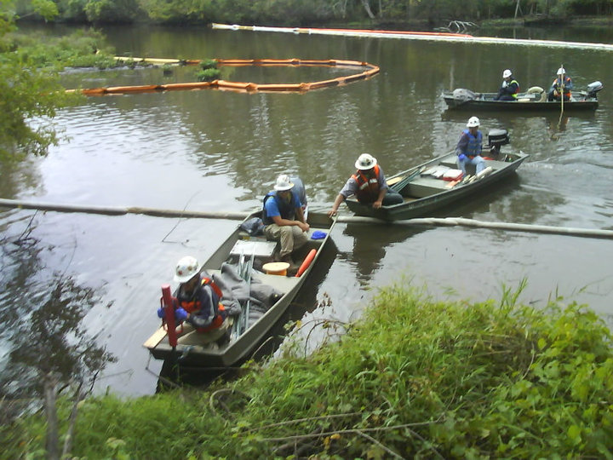
Kalamazoo Enbridge

Slide 11
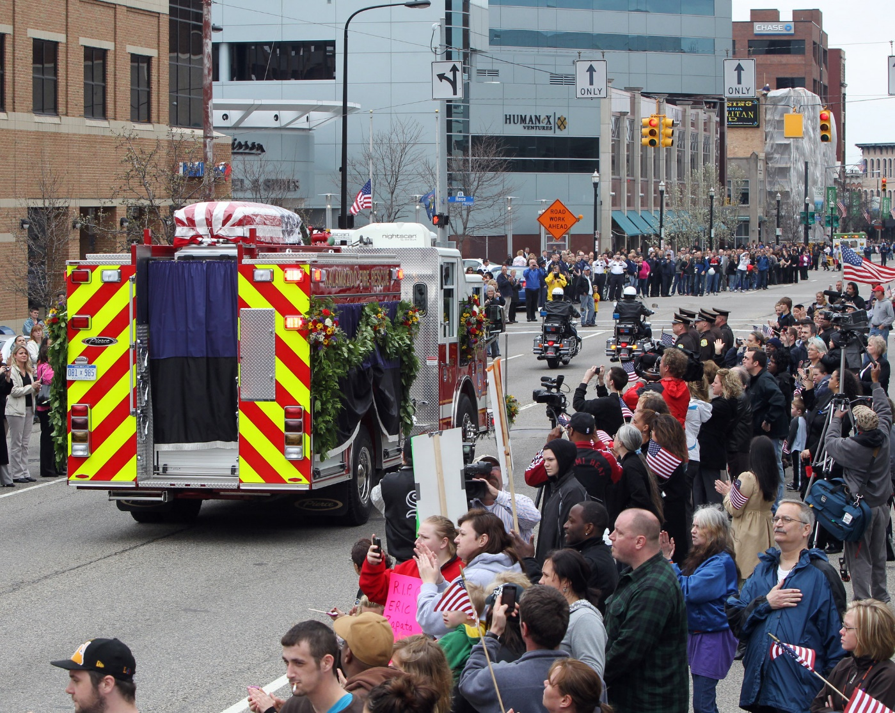
Line of Duty Death

Slide 12
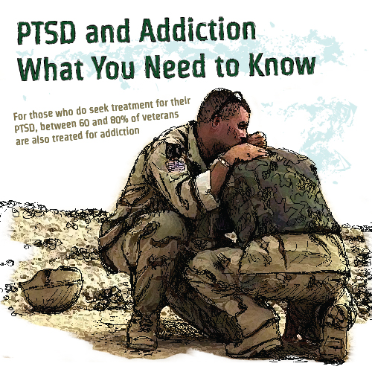
Aftermath
PTSD
Addiction
Relationship Issues
Workers comp

Slide 13
Game Change
Onward & Upward

Slide 14
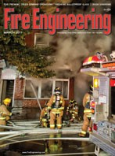
Education & Publication
MA Counseling Thesis: Firefighter Resilience Training (2012)
PhD Dissertation: Firefighter PTS, resilience, humor style
I need active firefighter research participants

Slide 15
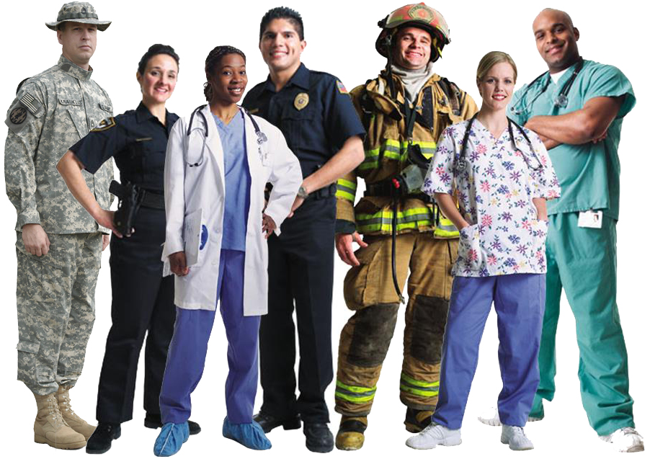
THIS IS OUR FAMILY
Building Warriors through calm, clear peace of mind, body and heart
www.buildingwarriors.net

Slide 16
Who We Are
Lt. Courtney Van Marter Peer Support Team Coordinator, Firefighter-Medic
Lt. John Coppedge Peer Support Team Coordinator, Sworn Police Officer
Sari Goldberg Individual & Family Counselor, Medic
Michelle Marzo Licensed Professional Counselor, Licensed Addiction Counselor, Peer Support Consultant, Medic
Moraya Rediker Office Manager, Firefighter Spouse
Melody Mesmer Peer Support Team Coordinator, Firefighter-Medic
Kristy Yarbough Physical Therapist
Matthew Carlson Co-Founder, Regional Director, Licensed Addiction and Professional Counselor, Firefighter
Kelli Gilchrist Co-Founder, Regional Director, Licensed Professional Counselor, Firefighter
Alexis Eliades Licensed Professional Counselor, Peer Support Consultant
Derek Weldon Medically Retired PSO (Police/Fire/EMS), Executive Officer for KVCC Police Academy, and Sworn Police Officer
Tony Guiterrez Certified Safety Manager, Professional Emergency Manager, Firefighter
Angela Christianson Individual & Family Counselor

Slide 17
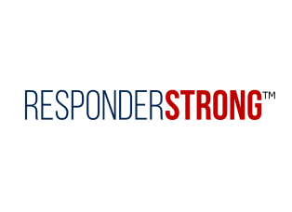
Consulting
We offer professional consulting in the areas of workplace safety, family services, curriculum, regional peer support teams, retirement, trauma-informed care, community resilience & emergency management.
Current Projects
Kalamazoo Resiliency Project
Critical Care Peer Support
National Behavioral Health Innovation center – CU Denver

Slide 18
Regional Peer Teams
Reduction in perceived stress, depression, and alcohol use
State & National Certification
Kinesthetic learning
Mental & Physical Self-Defense
Peak-2-Peak: Summit County (CO), 10 agencies and counting, 29 peer supporters, 8 peer specialists
North Area: Denver Metro (CO), 15 agencies and counting, 41 peer supporters, 1 peer specialist
Grand County (CO): 7 agencies and counting, 15 peer supporters
UCHealth: 100+ clinics, 7 hospitals, 3 states
We’ll give you a hug and a throat punch

Slide 19
Training
Total Defense Training Camp
Krav Maga Instructor
Resilience 18
Kids Krav
Fight Like a Family
Counselor Academy
Education & Experience
We offer training in peer support, family wellness, mental-physical self-defense, resilience, functioning with PTSD, addiction, responding to critical incidents and mass casualties, forced medical retirement, LODD and job related injuries.

Slide 20
Counseling
Main Referrals: acute/PTS, addiction, relationship
EMDR, CBT, MI, SFBT
Offices: Winter Park, Broomfield, Lakewood, Granby, Virtual
Free Mental Wellness for Responders/Family

Slide 21
Thank you
Matt Carlson
Building Warriors
720-504-6207 main
269-720-0071 cell
720-729-8464 fax
Mailing: PO Box 27586
Denver, CO, 80227
www.buildingwarriors.net
Get ready- stay ready!
Visit us on

