Slide 1

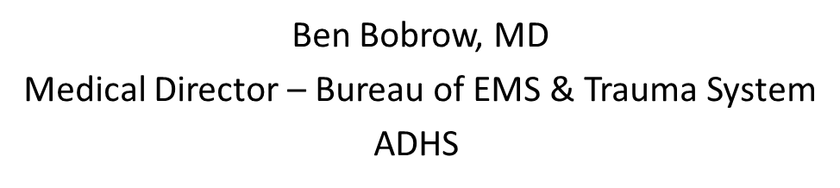
EMT Suicide
September 15, 2017

Slide 2
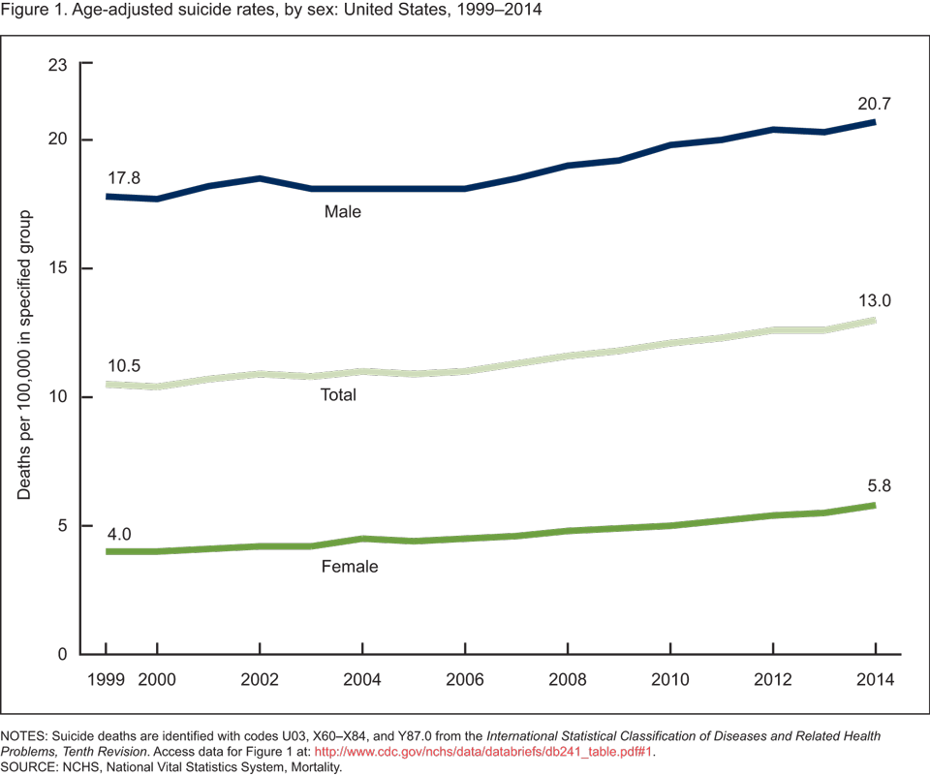
Age Adjusted Suicide in the US

Slide 3
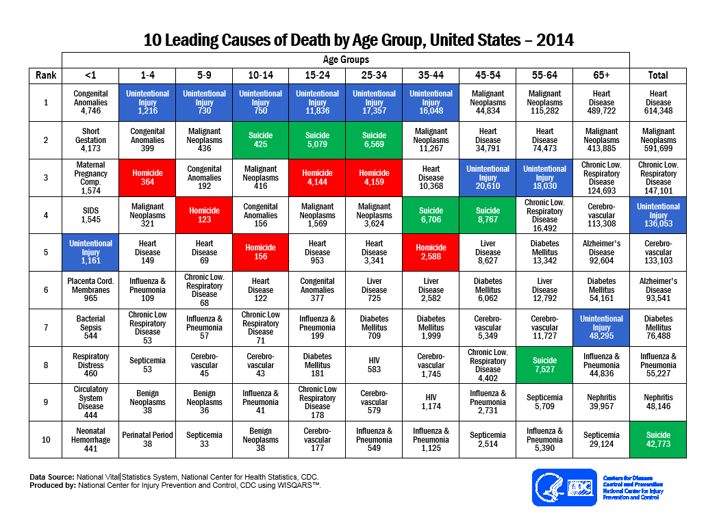

Slide 4
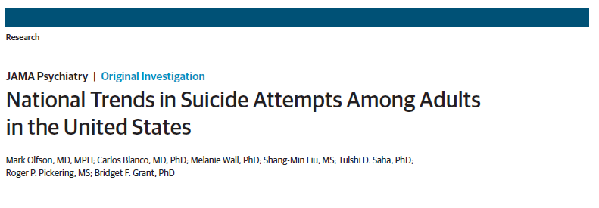
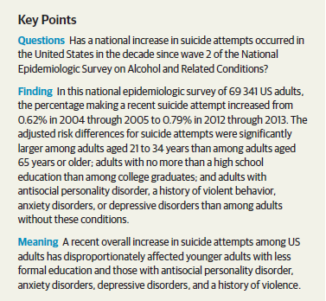

Slide 5
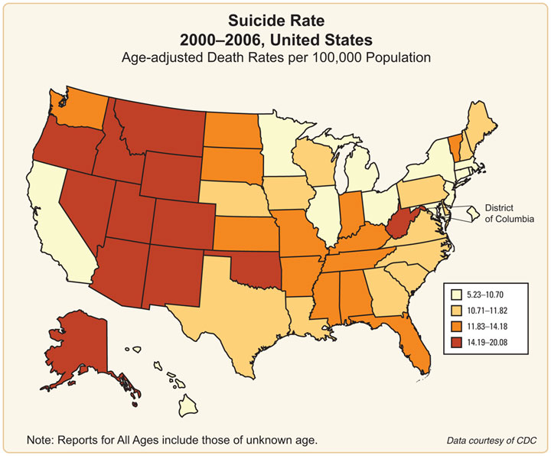

Slide 6
Suicide Rate: Arizona vs. Nation
Data Source: Centers for Disease Control and Prevention, National Center for Injury Prevention and Control. Web-based Injury Statistics Query and Reporting System (WISQARS) [online]. (2005) [2009-2015]. Available from URL: www.cdc.gov/injury/wisqars

Slide 7

Suicide in Veterans:
Since 2001, U.S. adult civilian suicides increased 23 percent, while Veteran suicides increased 32 percent in the same time period
After controlling for age and gender, the risk of suicide was 21 percent greater for Veterans than general population
Source: US Dept of Veteran’s Affairs

Slide 8
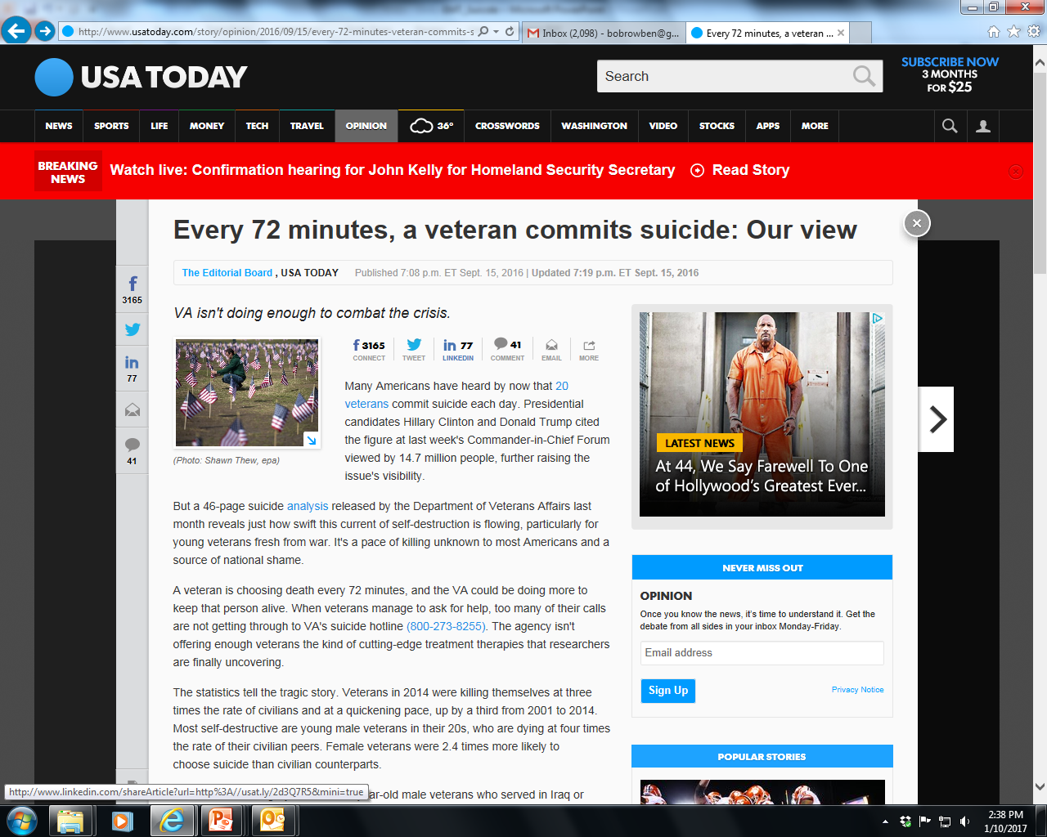

Slide 9
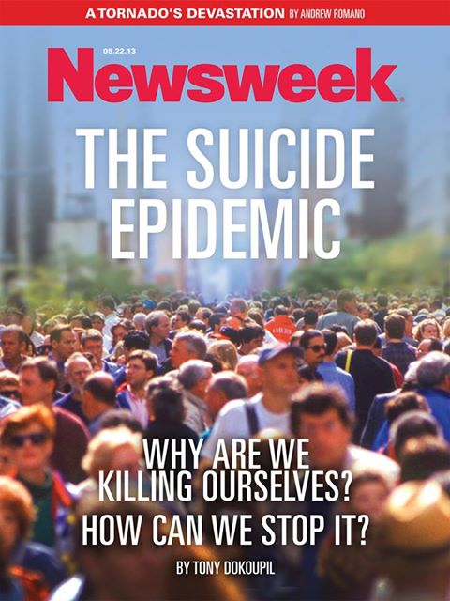

Slide 10

Law enforcement suicide: a national analysis
CDC & National Institute for Occupational Safety and Health National Occupational Mortality Surveillance data
Police and corrections officers
Proportionate mortality ratios (PMRs) for suicide were significantly higher for all races and sexes combined = 1.69, 95% CI = 150-191, p < 0.01, 264 deaths
Int J Emerg Ment Health. 2013;15(4):289-97.

Slide 11


Recent National EMCT Survey
4,022 respondents
3,447 (86%) experienced critical stress
1,383 (37%) of the respondents had contemplated suicide and
225 (6.6%) had actually tried to take their own life
These statistics are roughly 10 times greater than the national average for adults in America, according to a study done by the Centers for Disease Control and Prevention in 2012.

Slide 12
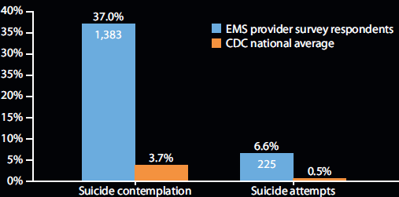

Slide 13
PICO Study Question:
Population: EMTs in Arizona
Intervention: Observational Study
Comparison: EMT vs non-EMT proportion of death by suicide
Outcome: Underlying Cause of Death Suicide or Other Cause based on ICD-10 E-Code

Slide 14
Methods
Data Source:
  Arizona Vital Statistics Information Management System-Electronic Death Registry
Study Population:
  Seven Years: January 1st 2009-December 31st 2015
  Adults (18 +)
EMCT vs Non-EMCT Cohorts:
  Manual review of decedent occupation free text field
  EMCT Cohort: any occupation related to Firefighter, Emergency Medical Technician (EMCT) or Paramedic
  Non-EMT Cohort: Aggregate of all other occupations
Outcome: Underlying Cause of Death
  Suicide or Other Cause based on ICD-10 E-Code
Analysis:
  Odds of suicide between EMCT and Non-EMCT cohorts
    Logistic regression model: adjusted for age, gender and race/ethnicity

Slide 15
Results: Demographics
 | Non-EMCT |  | EMCT
 | N | % | N | %
Total deaths from 2009 to 2015 | 349,793 | 100.0% | 1,205 | 100.0%
Age | 12,298 | 3.5% | 102 | 8.4%
18-34
35-54 | 36,194 | 10.3% | 191 | 15.8%
55-74 | 110,621 | 31.6% | 381 | 31.6%
> 75 | 190,680 | 54.5% | 531 | 44.0%
Gender | 184,987 | 52.8% | 1,127 | 93.5%
Male
Female | 164,806 | 47.1% | 78 | 6.4%
Race | 280,766 | 80.2% | 972 | 80.6%
White non-Hispanic
Hispanic/Latino | 41,383 | 11.8% | 62 | 5.1%
Black | 10,331 | 2.9% | 23 | 1.9%
Asian/PI | 3,961 | 1.1% | 4 | 0.3%
AI/AN | 13,352 | 3.8% | 144 | 11.9%
Cause of death | 342,018 | 97.7% | 1,142 | 94.7%
Other cause
Suicide | 7,775 | 2.2% | 63 | 5.2%

Slide 16
Results: Odds of Suicide
 | Crude |  | Adjusted*
 | Rate | 95% CI | Rate | 95% CI
EMCT vs. Non-EMCT | 2.43 | (1.88-3.13) | 1.39 | (1.06-1.82)
*Adjusted for age, gender and race/ethnicity
After adjusting for gender, age and race/ethnicity EMCTs had a higher odds of dying from suicide than Non-EMCTs.
The top three mechanisms of suicide among EMCTs and Non-EMCs in Arizona were Firearm (67% vs. 57%), Suffocation (24% vs. 21%), and Poisoning (9.5% vs. 17%).

Slide 17
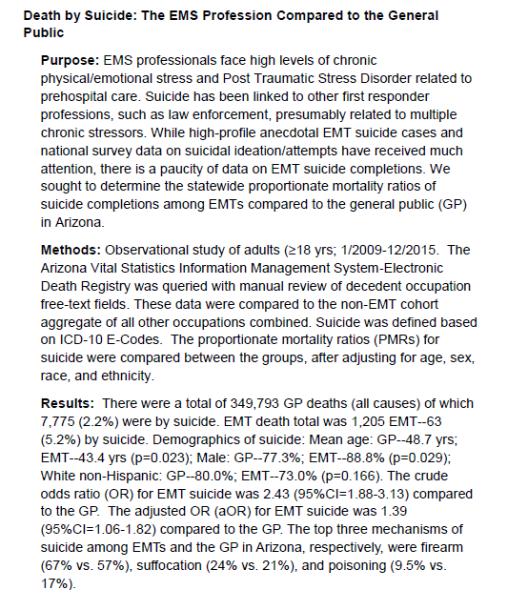

Slide 18
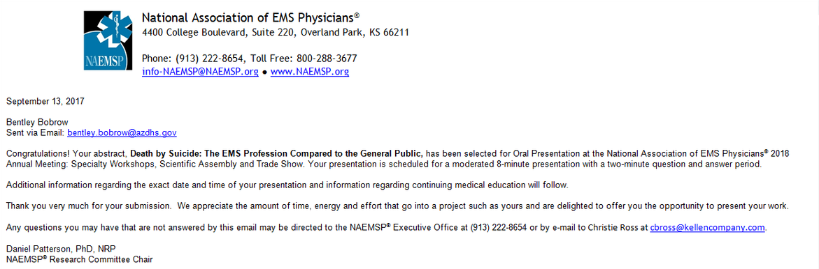

Slide 19
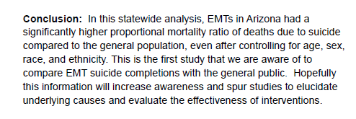
Conclusion

Slide 20


Slide 21

http://codegreencampaign.org/education/

Slide 22
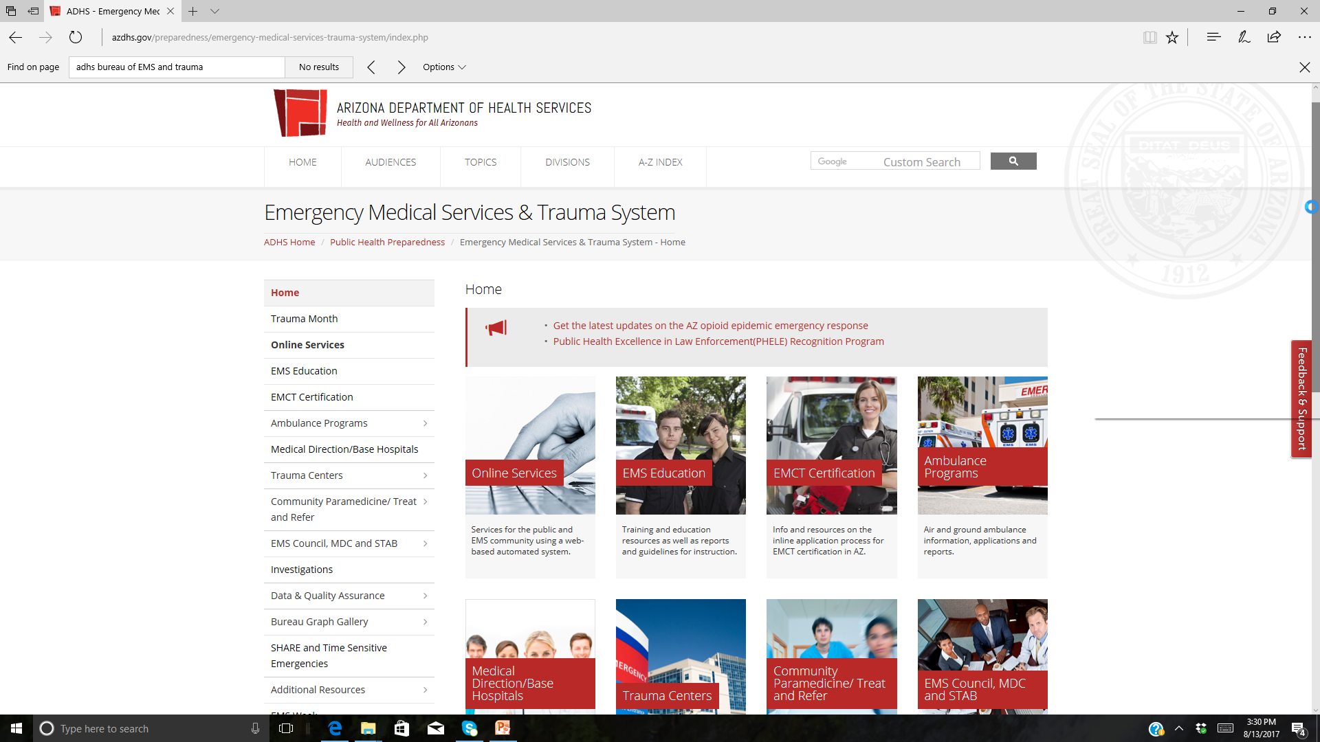
Workgroup:
Promote awareness
Education
Resources
CME
Other?

Slide 23



Slide 25

AZ-STRONG
Implement ZERO SUICIDE both FOR and THROUGH our EMS System
Veteran
Seniors
Tribal Communities

Slide 26

“Regardless of how integration with other health care services and increased use of advanced technology changes the picture of EMS, human resources remain our most precious commodity. Without effective “care” of our human resources, this exercise becomes academic.”

Slide 27
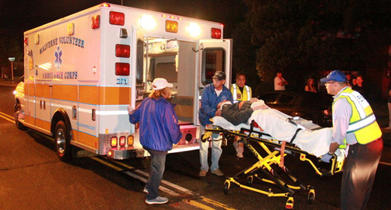
Thank You
Bentley.Bobrow@azdhs.gov

