Slide 1
Tina Buck, PhD, LPC
CEO

Slide 2
TaCtical brain training
effective, Evidence-based, Affordable, neurofeedback
Train the Body, Train the Brain
Peak Performance Training
Mental Clarity
Trauma Resiliency
Relaxed attentiveness

Slide 3
Electroencephalography
EEG Biofeedback / Neurofeedback
A very brief history
FDA approved for relaxation and education
More recently for ADD diagnosis
Level One Best Support for ADD/ADHD by the American Academy of Pediatrics
1950s Joseph Kamiya
1960s NASA – Barry Sterman accidentally found cats were seizure resistant after EEG biofeedback (no placebo effect)

Slide 4
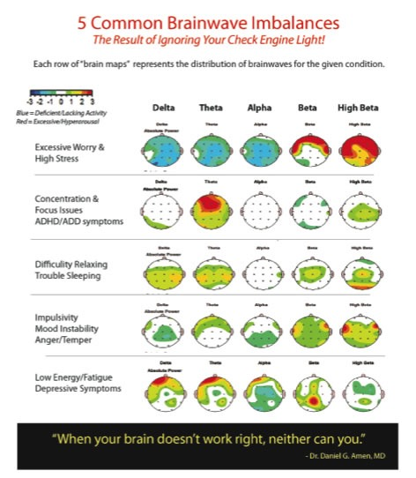
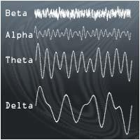
Dr. Daniel Amen

Slide 5
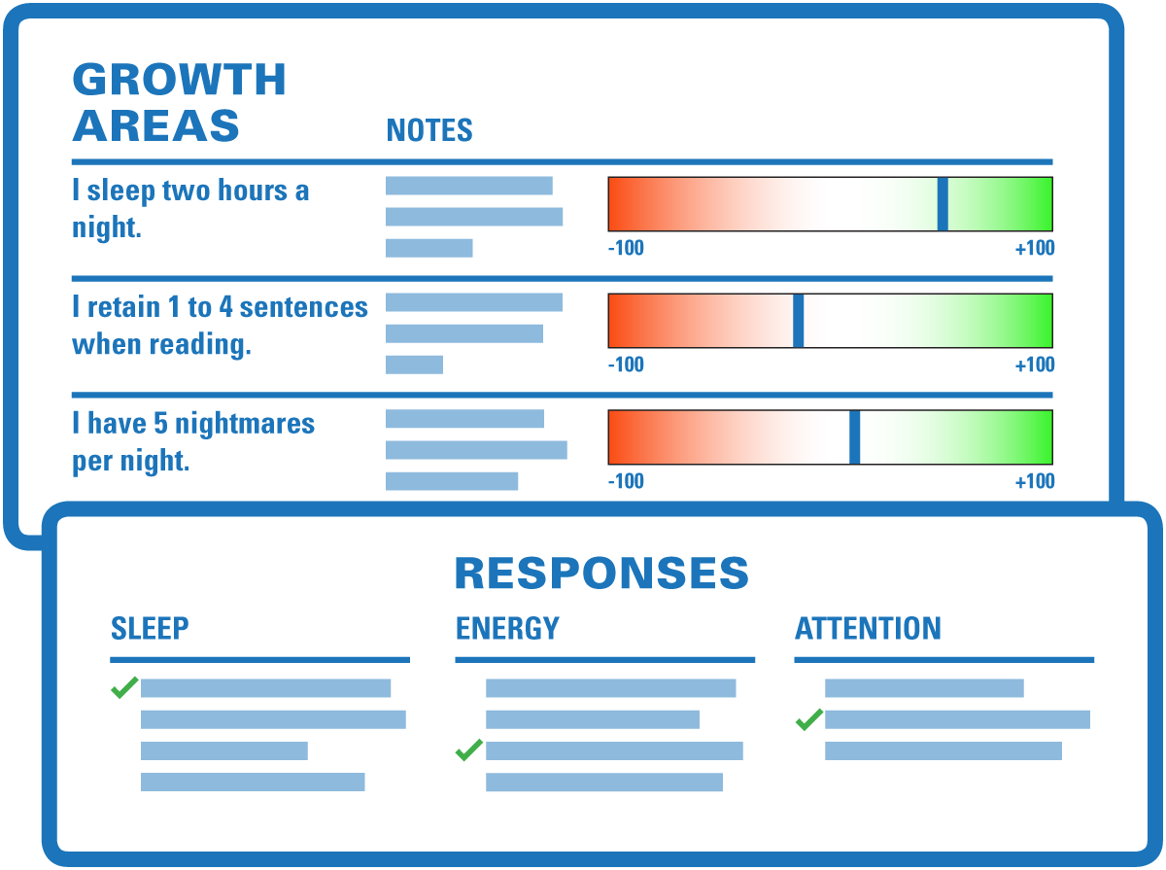
First Contact with Provider
Measurable Goals
Performance Game
Symptom Check List
90 question Evaluation

Slide 6
Individualized Protocols
90 question functional evaluation
Underarousal
Overarousal
Instabilities
Psychospiritual
(Limbic dysregulation)
Software uses algorithm to individualize protocol selection

Slide 7
Too Little
Poor sleep, dissociation
Robotic
Exhaustion
Scattered, distracted
Tired, depressed, unmotivated
Normal
Restorative sleep
Intuitive
Peaceful, calm, relaxed
Present, ready for action
Focused in action
Too Much
Depressed, sluggish
Fuzzy, foggy, daydreaming
Anxiety, hypervigilance
Depressed
Mind chatter, unable to relax
Brainwaves
in
Relation
to
Thoughts, Feelings, & Behaviors
Delta 1-4 Hz
Theta 4-8 Hz
Alpha 8-12 Hz
SMR 12-15 Hz
Beta 15-32 Hz

Slide 8
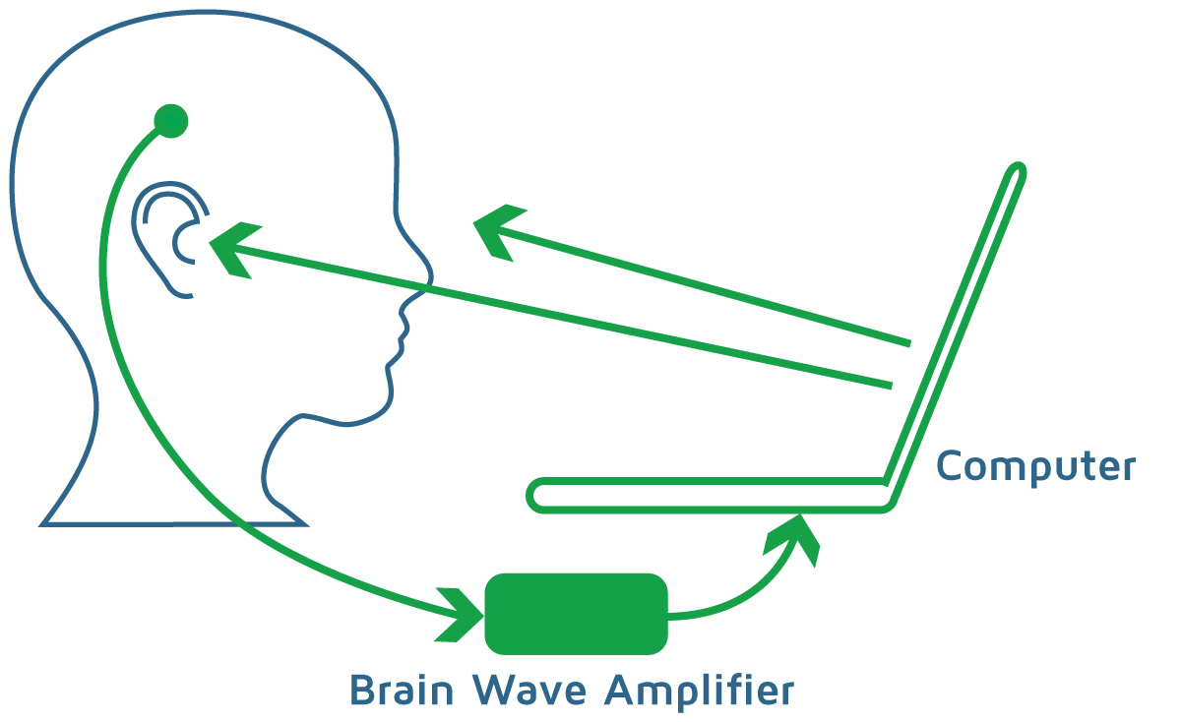
How Does it Work?
Electrodes are placed on the ears & scalp, reading “real-time” EEG.
Brainwaves are translated into
Audio Feedback (sounds) and
Visual Feedback (pictures).
Feedback rewards desired frequency changes
Amplifier calibrates at 60-80% reward
Training neuro-networks for efficiency and resiliency
No energy comes into the brain.

Slide 9
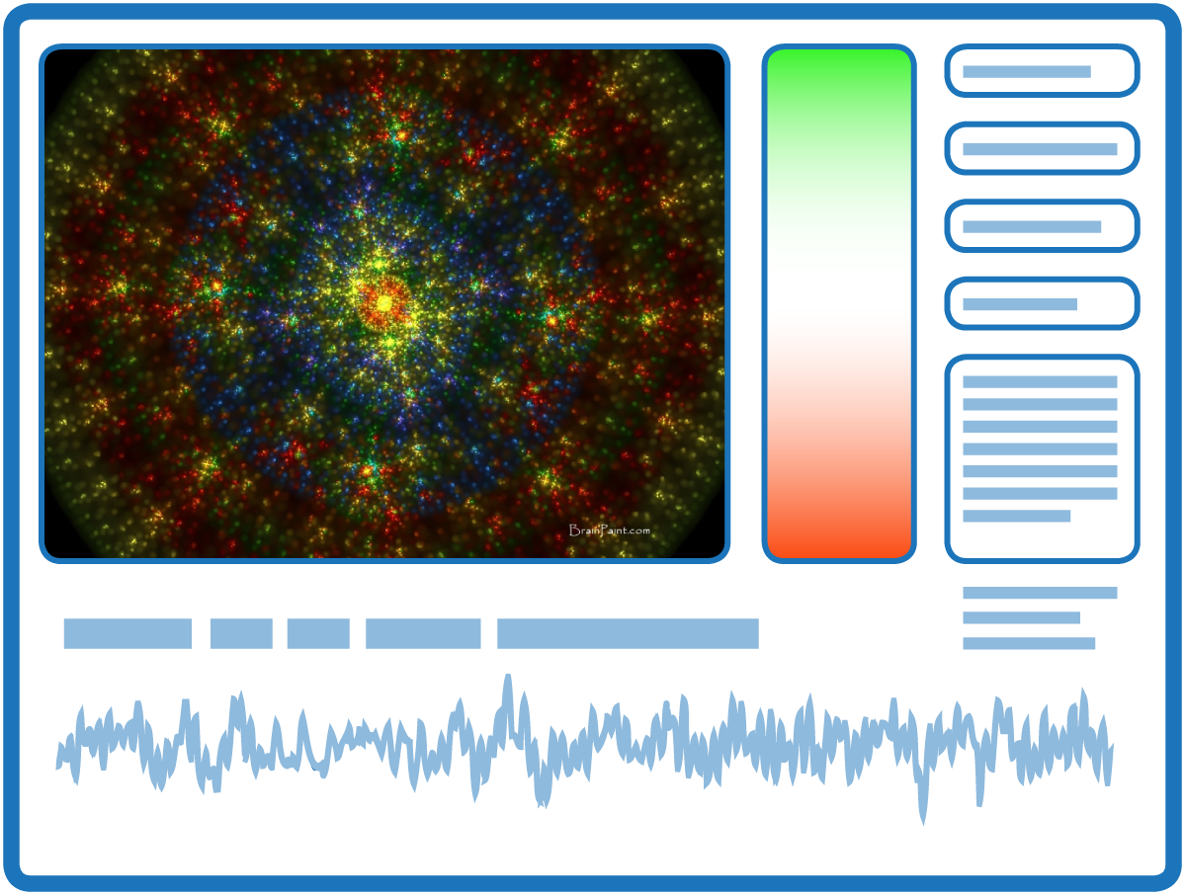
Training Sessions
Trainees notice feedback
Visual
Fractal images of EEG
40 frames per second
“What Is and What Isn’t” bar
right click for body/mind awareness
Points, Longest Hold Time
Increase/Decrease:
Muscle Tension
Presence
Progress bars at 2 minute breaks

Slide 10
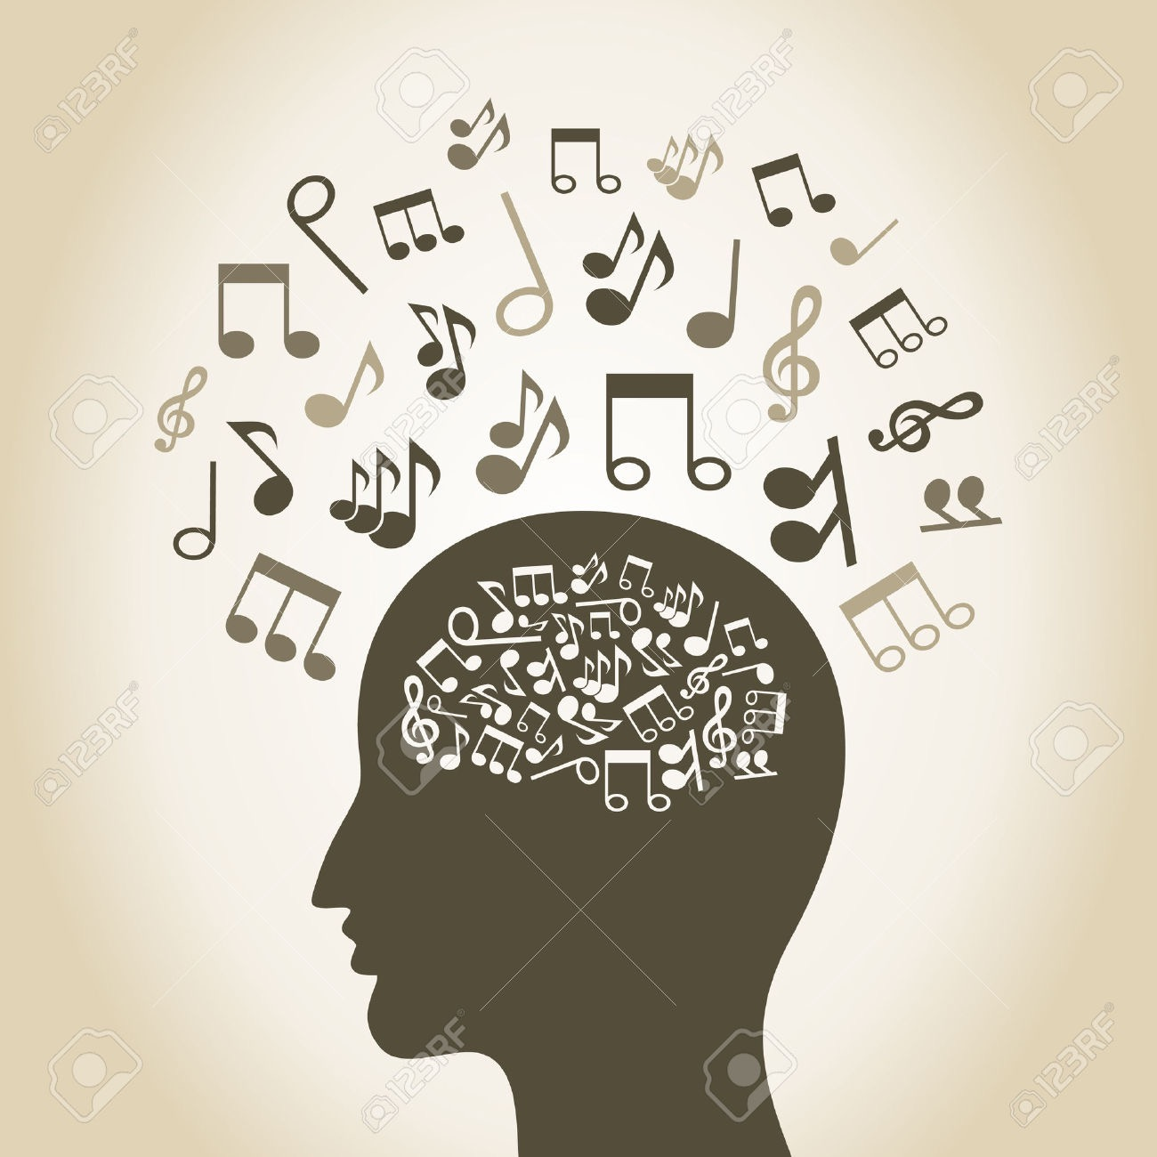
Audio feedback
32 frequencies
Represented by different sounds the brain recognizes as Pleasing or Not Pleasing
"What Is / What Isn’t" Bar notification
Alpha/Theta Guided visualization
Replicates UCLA addictions study
Bell music during crossover
Movement shaper
Limits EMG artifact
Helps with body/mind awareness

Slide 11
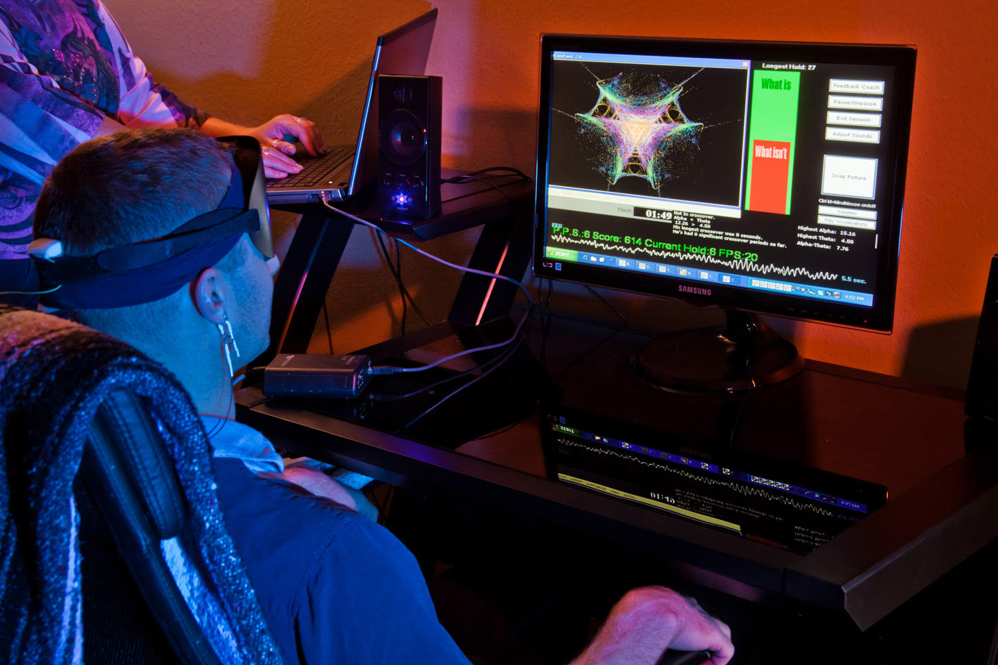
Thirty (30) sessions average to stabilize goals
Sessions average 30 minutes of training and take 50 minutes
Progress is tracked with measurable goals
Side effects and benefits tell software if we are on track
Can conduct Performance Game and Symptom Check List at regular intervals

Slide 12
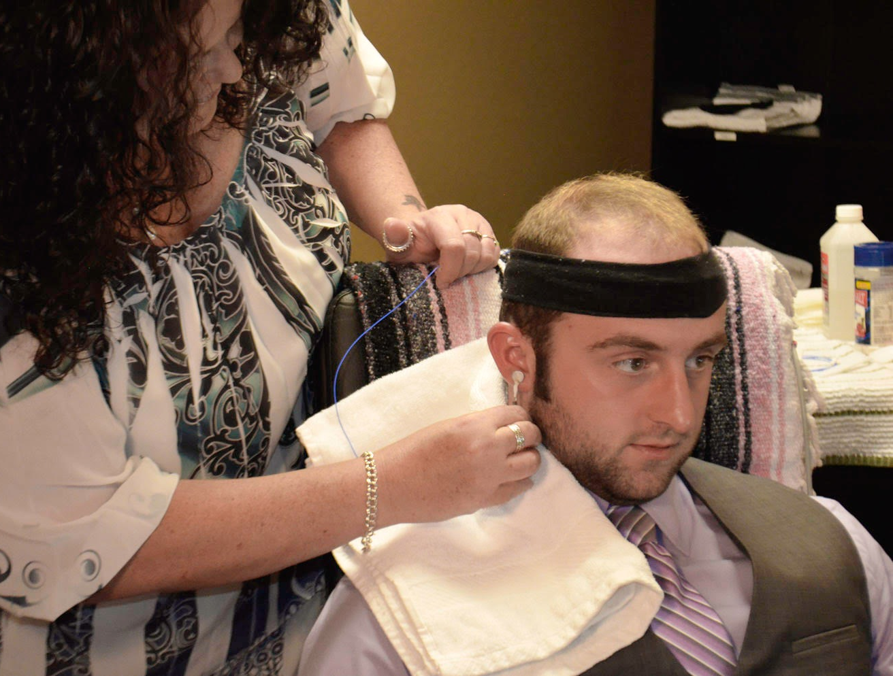
Progress and Stabilization
When the client has not shown improvement for 5 sessions in a row, we re-evaluate and go to next stage of training
3 primary approaches simplified:
Biological / hardware
Head injuries, mood, chronic fatigue
Limbic dysregulation / software
Addictions, Post Traumatic Stress
“BrainPrint”
Executive function / 2 channel
Attention, obsession, coherence

Slide 13
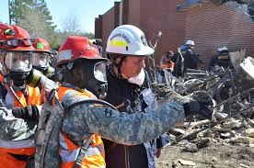
Composure Under Pressure
Peak Performance training used by athletes, coaches, Special Forces, surgeons, executives, results in
Fewer errors
better accuracy / precision
Efficiency & mental stamina
Improved decision making
Improved focus, concentration, confidence, and less anxiety under pressure

Slide 14
Trauma resiliency in afghanistan
In a deployed unit in Afghanistan, military members reported
Better impulse control
Less inappropriate anger
Improved job performance
Better teamwork
Significantly fewer medications
Better sleep, mood, motivation
Felt less likely to develop ptsd

Slide 15
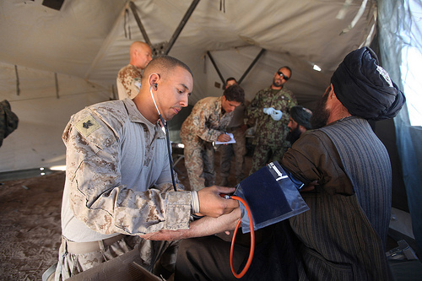
Trauma Resiliency at its root: The Brain
Deployed medical providers reported increased resiliency in spite of repeated trauma exposure.

Slide 16
Mechanisms of Alpha Theta Reactive Sensory Input
Alpha is the idle rhythm
of the cortex
Less active cortex has
Higher amplitude alpha
More active cortex has
lower amplitude alpha
Notes:
An addicted brain has its object of addiction ranked nearly as important as air, water and food. Getting sober threatens their long-term relationship with something the brain mistakes for survival. Getting sober is stressful.
It means that when the brain is excessively aroused or perceives danger the thinking and reasoning part of the brain gets bypassed. In other words, people react first and ask questions later. For an addicted person this too often has severe consequences.

Slide 17
Post-traumatic stress recovery
Symptoms are the tip of the iceberg…
Suffering runs deep
Two studies with Vietnam veterans resulted in 100% no longer meeting criteria for PTSD diagnosis…
…long term.
Among 819 people who self-identified with PTSD, 89% reported their symptoms were better or resolved by the 20th session of BrainPaint neurofeedback.

Slide 18
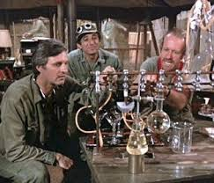
Addiction
Recovery
UCLA addictions study results after neurofeedback in treatment program:
Subjects stayed in treatment 1 ½ times longer than controls,
77% recovery rate a year later, &
Subjects came out of clinical range in 5 of 10 MMPI scales.
Privacy is maintained, and details of substance use do not need to be disclosed.
Behaviors slip away naturally as the brain rebalances.

Slide 19
Prevention of Suicides and family violence
Neurofeedback helps the brain to integrate unprocessed emotions that, when left unchecked, are likely to be expressed inappropriately.
Subjects in multiple studies reported improvements in quality of life such as mood stability, feeling satisfied and more agreeable, and a sense of well-being.

Slide 20
Resolving sleep issues
Sleep patterns often stabilize quickly:
Sleep Onset
Sleep Retention
Anxiety
Obsession
Shift-Work
Head Injuries

Slide 21
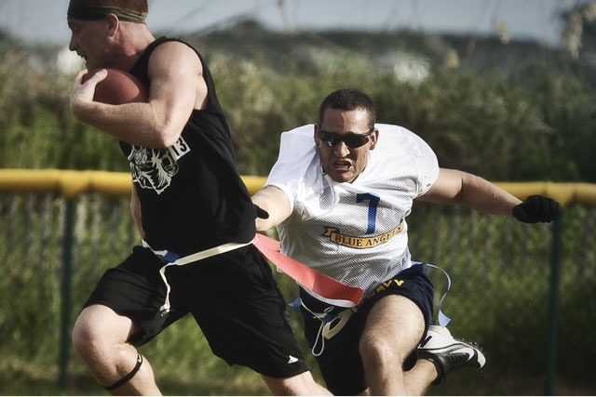
Stabilization after Head injuries
Neurofeedback helps with neuroplasticity
creates new pathways and strengthens existing ones.
Head injuries are difficult to research due to diffuse symptoms; however,
A meta-analysis of 22 studies on use of neurofeedback for head injuries resulted in all 22 studies showing benefit.
Clinically, we see people with head injuries improve more quickly than most other neurological conditions.

Slide 22
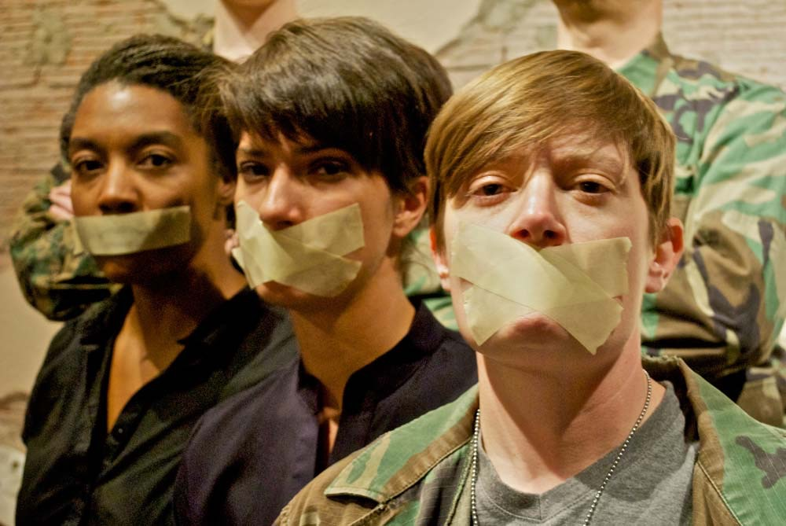
Elimination of Barriers to care including silence and stigma
There is no need for “diagnosis” or “treatment” for the training to be effective.
No need to talk or dig up past memories.
Trauma-related sensory information is neurologically integrated without re-traumatization.

Slide 23
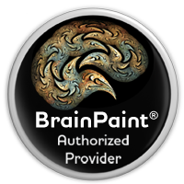
Targeted Symptom (82% Better or Resolved) | Number | Session #2 | Session #5 | Session #10 | Session #20
AHDH | n=1185 | 37 | 60 | 74 | 78
Autism | n=354 | 36 | 45 | 61 | 78
Chronic Fatigue | n=97 | 40 | 55 | 72 | 76
Chronic Pain | n=298 | 33 | 51 | 65 | 67
Depression | n=1544 | 37 | 60 | 74 | 78
Insomnia | n=1661 | 49 | 63 | 71 | 79
Migraines | n=147 | 36 | 47 | 68 | 77
Mood Swings | n=90 | 48 | 61 | 72 | 84
Motor Tics | n=18 | 33 | 36 | 46 | 100
Nightmares | n=222 | 62 | 73 | 72 | 85
OCD | n=337 | 42 | 64 | 71 | 75
Psychosis | n=19 | 71 | 63 | 86 | 100
PTSD | n=819 | 55 | 71 | 85 | 89
“As BrainPaint® is
effective, relatively
inexpensive, and
with a negligible
side-effect profile,
it represents an
important, intervention.”
Steven Lowen, PhD
Harvard Medical School

Slide 24
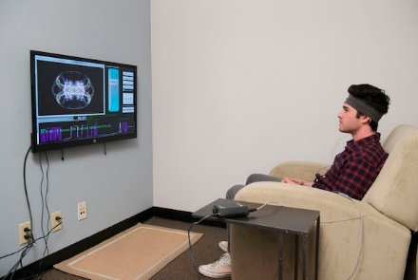
TRAIN Trauma Resiliency and Integrated neurotrainer Program
Recommended model includes
3 Certified Neurotrainers per
2 large rooms for gym-like environment,
4 trainees per room; &
2 small offices
Individual debriefing,
Care coordination, &
Re-evaluations.
Comprehensive Program to Include
BrainPaint neurofeedback
Conducted by peer support, veteran medic/corpsmen, Certified Neurotrainers.
Elective adjunct supports for connection to include
Community Resiliency Program, &
The Dark Thought Project.

Slide 25
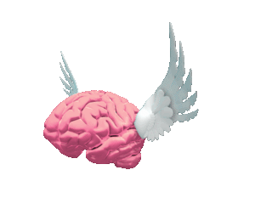
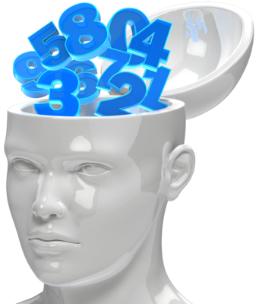
Neurofeedback: It’s a no brainer

