Slide 1

COVID-19 EMS Patient Screening & Training
Bureau of EMS & Trauma System
July 6, 2020

Slide 2

Goal of Training
This is an optional training to assist agencies in implementation of treat and keep home, treat and refer, and COVID-specific EMS guidelines
The decision regarding if and when to implement these guidelines should be made in coordination with your agency’s Administrative Medical Director and/or Base Hospital
It is critical to determine the incidence of COVID-19 in your community, the EMS call volumes, and hospital ED/inpatient bed availability/status when determining whether or not to implement these guidelines

Slide 3
COVID-19 Medical FAQs
Incubation period: 2–14 days (median 4–5 days)
Transmission: the virus is spread from person-to-person through close contact and respiratory droplets. Transmission can occur up to 48 hours before symptoms present.

Slide 4
COVID-19 Medical FAQs
Risk factors for serious illness:
Older age (age > 65 yo)
Cardiac disease
Diabetes
Immunocompromised (e.g., cancer treatment, smoking)
Chronic lung disease or moderate to severe asthma
Kidney disease
Liver disease

Slide 5
COVID-19 Medical FAQs
Symptoms:
Fever (≥100.4°F or 38°C) and chills
Cough
Dyspnea
Sore throat
Congestion or runny nose
GI symptoms: nausea, vomiting, diarrhea
Headache, weakness, fatigue, myalgias (muscle pain)
Loss of taste or smell

Slide 6
Overview of COVID-19 Medical Response
Dispatch Screening
EMS Guideline for Care of Patients with Suspected COVID-19
COVID-19 Respiratory Treatment Guideline
COVID-19 Alternative Destination Guideline
COVID-19 Patient Scripting
COVID-19 Patient Education

Slide 7
Dispatch Screening - 2 Groups
Have you had fever or chills?
Have you had a cough or trouble breathing?
Yes to 1 AND 2
Yes to 1 OR 2
COVID-19 Alert
Infectious Disease Alert with Symptoms

Slide 8
COVID-19 PSAP Screening
PSAP Screening for COVID-19 has been in place for several months
This is the first step in screening a patient for possible COVID-19
Note: Due to COVID-19 being classified as “community spread,” travel history is not a part of PSAP patient screening

Slide 9
On-Scene Screening Questions
It is critical to ask the screening questions a second time!
Only essential EMS personnel should make patient contact
Consider a “scout” paramedic to enter with ENHANCED PPE to perform these screening questions
Ask these questions on every call to determine the type of PPE for all EMS personnel having patient contact
All transported patients and patients with suspected COVID who are not transported should be given a surgical mask to wear upon initial patient contact

Slide 10
Other Patient Screening Questions
Have you been exposed to anyone diagnosed with COVID-19?
Has anyone in your [facility] been diagnosed with COVID-19?
Do you work in a high-risk area?
Healthcare (hospital, urgent care, doctor’s office, nursing home)
Fire, EMS, or law enforcement
Congregate setting (prison, residential facility for older adults, nursing home)
Have you been tested for COVID-19?
If so, do you have the result yet?

Slide 11
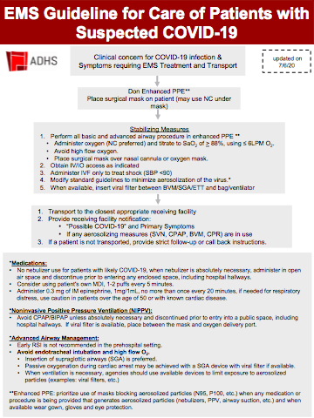
COVID-19 Guideline
Significant change in clinical practice from conventional to contingency/crisis standard of care
Approved by Arizona State Disaster Medical Advisory Committee (SDMAC)
Goal is to protect EMS personnel who may lack sufficient PPE, maintain prehospital workforce, and allow safe transfer of care at the receiving facility
Updated version approved by ADHS 7/7/2020

Slide 12
Why the change in patient management?
Goal is to eliminate or reduce the risk of aerosolization of COVID-19
The following procedures are associated with aerosolization:
SVN treatments (albuterol and atrovent)
BVM
Endotracheal intubation
CPR
High-flow oxygen via non-rebreather
Supraglottic airway placement
There are things you can do to limit your exposure risk!

Slide 13
Does this apply to all patients?
If the patient resides in a congregate care setting, assume they have been exposed to COVID-19
Due to the widespread community spread of COVID-19 in many parts of Arizona, you should assume that most patients you encounter who are symptomatic have COVID-19

Slide 14
Stabilizing Measure
Perform all basic and advanced airway procedure in enhanced PPE **
• Administer oxygen (NC preferred) and titrate to SaO₂ of > 88%, using ≤ 6LPM O₂.
• Avoid high flow oxygen.
• Place surgical mask over nasal cannula or oxygen mask.
Obtain IV/IO access as indicated
Administer IVF only to treat shock (SBP <90)
Modify standard guidelines to minimize aerosolization of the virus.*
When available, insert viral filter between BVM/SGA/ETT and bag/ventilator
New language added includes emphasizing the use of viral filters when available

Slide 15
Transport Considerations
Transport to the closest appropriate receiving facility
Provide receiving facility notification:
“Possible COVID-19” and Primary Symptoms
If any aerosolizing measures (SVN, CPAP, BVM, CPR) are in use
If a patient is not transported, provide strict follow-up or call back instructions
Key addition is the emphasis on strict follow-up or call back instructions for any patient not transported. Some of these patients may worsen, and it is critical that they understand when to access 911 services again.

Slide 16
EMS COVID-19 Medication Changes
No nebulizer use for patients with likely COVID-19, when nebulizer is absolutely necessary, administer in open air space and discontinue prior to entering any enclosed space, including hospital hallways.
Consider using patient's own MDI, 1-2 puffs every 5 minutes.
Administer 0.3 mg of IM epinephrine, 1mg/1mL, no more than once every 20 minutes, if needed for respiratory distress, use caution in patients over the age of 50 or with known cardiac disease.
Nebulizers (SVNs) place all EMS personnel, bystanders, and hospital personnel at risk for exposure to aerosolized particles.

Slide 17
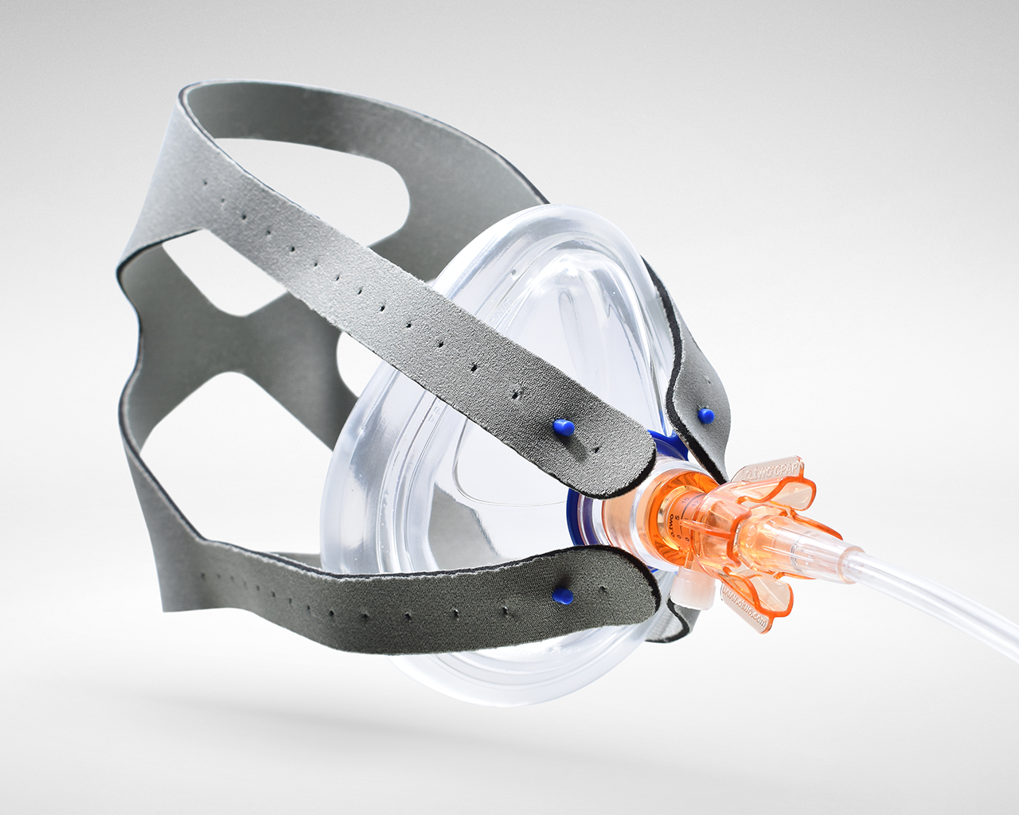
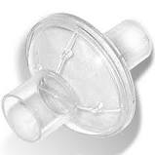
Noninvasive Positive Pressure Ventilation (NIPPV): CPAP and BiPAP
Avoid CPAP/BIPAP unless absolutely necessary and discontinue prior to entry into a public space, including hospital hallways.
If viral filter is available, place between the mask and oxygen delivery port.
Viral Filter

Slide 18
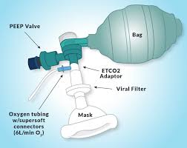
Advanced Airway Management
Early RSI is not recommended in the prehospital setting.
Avoid endotracheal intubation and high flow O₂.
Insertion of supraglottic airways (SGA) is preferred.
Passive oxygenation during cardiac arrest may be achieved with a SGA device with viral filter if available.
When ventilation is necessary, agencies should use available devices to limit exposure to aerosolized particles (examples: viral filters, etc.)

Slide 19
Why the recommendation for the Supraglottic Airways (SGA)
Placement is rapid
Much shorter time to adequate placement in comparison to ETT
Limited time-frame for higher risk exposure
Once in place, risk is decreased, unlike BVM which is ongoing
For agencies preforming passive oxygenation as part of their out-of-hospital cardiac arrest protocol:
The i-gel® allows for passive oxygenation at 8 LPM through a separate passive O2 port.
King® airways do not have a separate port for passive oxygenation port and will need to be connected to self inflating bag connected to oxygen source.
Both methods can be used with viral filter for passive oxygen insufflation.
Notes:
Passive oxygen insufflation is performed with chest compressions for cardiac causes of cardiac arrest (witnessed collapse)

Slide 20
Suspected COVID-19 & Oxygen Administration Summary
Administer oxygen sparingly
Nasal cannula at maximum 6 lpm
Maintain SpO2 > 88%
Place surgical mask over nasal cannula or oxygen mask
Do not use non-rebreather mask at 15 lpm (risk of aerosolization)
Avoid RSI and intubation

Slide 21
Suspected COVID-19 & Wheezing
Treatment options:
Use patient’s own multi-dose albuterol inhaler: 1–2 puffs every 5 minutes
Epinephrine 0.3 mg 1:1,000 IM, once up to every 20 minutes
Use with caution in patients > 50 years old or with underlying cardiac disease
Oxygen via nasal cannula, at maximum 6 lpm, maintain SpO2 > 88%
•Remember: No nebulizer use for patients with likely COVID-19. When nebulizer is absolutely necessary, administer in open air space and discontinue prior to entering any enclosed space, including hospital hallways.

Slide 22
Suspected COVID-19 & Cardiac Arrest
Enhanced PPE (N95, eye protection, face shield, gown)
CCR – standard care
Insert supraglottic airway, ie. King® or i-gel®
If limited PPE, have EMS personnel with the most available PPE place airway
Follow normal guideline:
Return Of Spontaneous Circulation?
Termination of Resuscitation?

Slide 23
Cardiac Arrest: COVID-19 not suspected
CCR – treatment as usual
Examples:
Patient calls 911 with chest pain collapses on EMS arrival
Patient with STEMI, has V-Fib arrest en-route to hospital
CCR not indicated – treatment as usual, standard resuscitation
Examples:
Trauma code
Drowning
Overdose
Notes:
Include still?

Slide 24
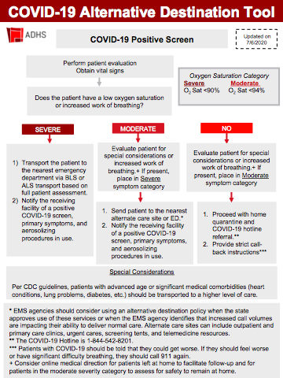
Alternative Care Sites
Alternate Care Sites need to be identified by your agency prior to referring a patient to them
These may include:
Urgent Care
Tent in a hospital parking lot
State or Military temporary hospital or medical site
This will continue to evolve rapidly
As the COVID-19 patient volume increases, we may transition to taking relatively ill patients to alternate care sites

Slide 25
Destination Determination - Alternate Care Sites
Key deciding factors are:
Oxygen saturation
Work of breathing
Risk factors (heart conditions, lung problems, diabetes, etc)
If a patient meets ALS criteria for transport for other reasons (hypotension, arrhythmia, etc), they still need ALS transport to the hospital regardless of COVID severity
If a patient has a positive response to an intervention, they still need transport based on their initial COVID severity
Ex. Patient with initial room air oxygen saturation 68% meets severe category, even if oxygen saturation increases to 94% with supplemental oxygen

Slide 26
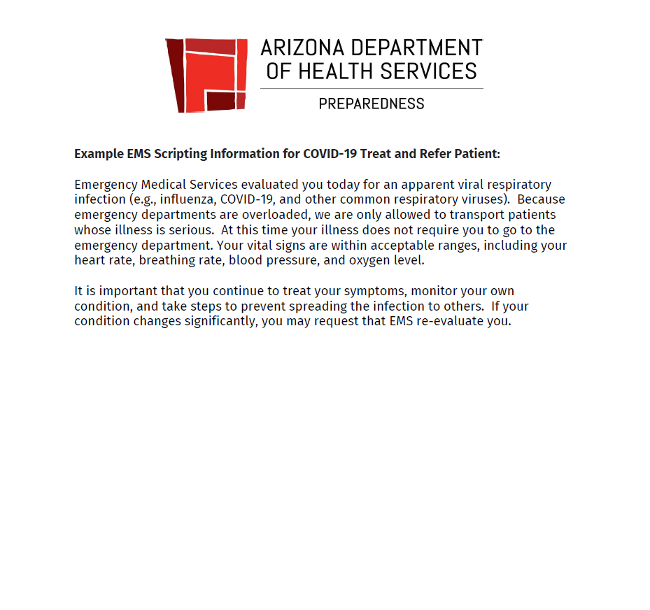
Scripting
It is critical to explain to patients why they may not be transported to the hospital
This is sample scripting language provided by ADHS

Slide 27
Patient Education
If patients are advised to stay home, we must provide them with printed patient education materials regarding COVID-19
The next slide is a 2-page document patient education handout from the CDC
Be sure to point out to the patient or their family the following:
When to call 911 again, or go to the hospital
To self-isolate

Slide 28
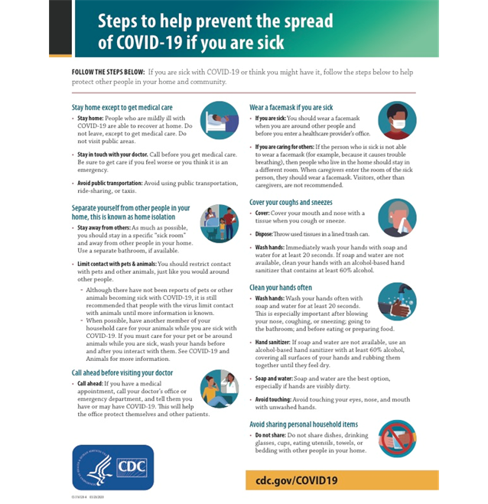
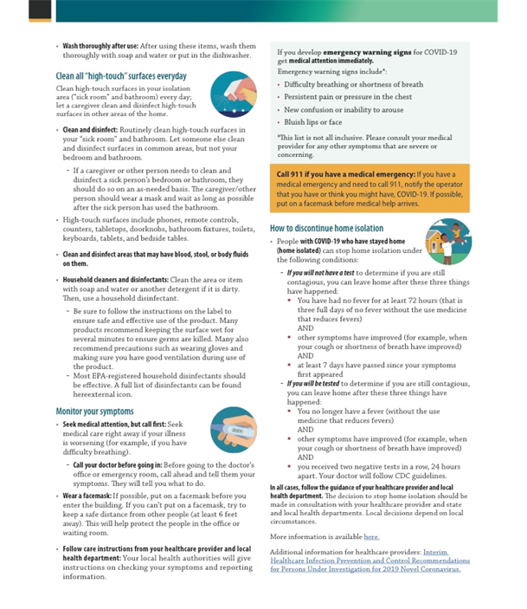

Slide 29
Notification to Receiving Facilities
Notify any receiving facility using simple language:
“This patient is high risk for COVID-19”
Provide presenting symptoms:
Fever and cough, hypoxemia, etc.
Provide any additional information regarding interventions that might generate aerosols:
Supraglottic airway, CPR, etc.

Slide 30


THANK YOU
Gail Bradley, M.D. | Bureau of EMS & Trauma
gail.bradley@azdhs.gov | 602-364-3150
facebook.com/azdhs | @azdhs | azdhs.gov

