Slide 1
Identification and Management of Sepsis in the Prehospital Environment
Notes:
Approved at 3/21/2024 Education Committee.

Slide 2
Objectives
Define the different forms of sepsis
Understand the pathophysiology of sepsis
Understand the transformation of sepsis management
Understand the key elements of sepsis management
Understand the EMS role in sepsis identification and therapy initiation
Understand Sepsis Triage, Treatment and Transport Guideline

Slide 3
Notes:
Sepsis is a complicated disease process that high a high mortality rate. Until the early 2000s, 50% of people would die. Over the past 15 years, we have learned more about the disease and enhanced therapy has greatly decreased mortality. Over 750,000 people in the US develop sepsis annually at a cost $22,100 per case or $16.7 billion per year.

Slide 4
“Sepsis is caused when the body’s immune system becomes overactive in response to an infection, causing inflammation which can affect how well other tissues and organs work.”
–National Institute for Health and Care Excellence Guidelines
Notes:
"Sepsis is caused when the body’s immune system becomes overactive in response to an infection, causing inflammation which can affect how well other tissues and organs work. When sepsis is recognized early, people can be quickly given the right treatment. However, the signs and symptoms of sepsis can vary and may be subtle which can lead to it being missed if it is not considered early on."

Slide 5
Defining Sepsis
Sepsis is the body’s extreme response to an infection. It is a life-threatening medical emergency. Sepsis happens when an infection you already have triggers a chain reaction throughout your body.
Without timely treatment, sepsis can rapidly lead to tissue damage, organ failure, and death.
Source: Centers for Disease Control and Prevention, What is Sepsis?

Slide 6
Notes:
Nasir N, Jamil B, Siddiqui S, Talat N, Khan FA, Hussain R. Mortality in Sepsis and its relationship with Gender. Pak J Med Sci. 2015 Sep-Oct;31(5):1201-6. doi: 10.12669/pjms.315.6925. PMID: 26649014; PMCID: PMC4641283.
Vasiljević Z, Stojanović B, Kocev N, Stefanović B, Mrdović I, Ostojić M, Krotin M, Putniković B, Dimković S, Despotović N. [Hospital mortality trend analysis of patients with ST elevation myocardial infarction in the Belgrade area coronary care units]. Srp Arh Celok Lek. 2008 May;136 Suppl 2:84-96. Serbian. doi: 10.2298/sarh08s2084v. PMID: 18924478.
Kühnl A, Erk A, Trenner M, Salvermoser M, Schmid V, Eckstein HH. Incidence, Treatment and Mortality in Patients with Abdominal Aortic Aneurysms. Dtsch Arztebl Int. 2017 Jun 5;114(22-23):391-398. doi: 10.3238/arztebl.2017.0391. PMID: 28655374; PMCID: PMC5504510.
Lieberg J, Pruks L-L, Kals M, Paapstel K, Aavik A, Kals J. Mortality After Elective and Ruptured Abdominal Aortic Aneurysm Surgical Repair: 12-Year Single-Center Experience of Estonia. Scandinavian Journal of Surgery. 2018;107(2):152-157. doi:10.1177/1457496917738923
COPY CITATION
Wise ES, Hocking KM, Brophy CM. Prediction of in-hospital mortality after ruptured abdominal aortic aneurysm repair using an artificial neural network. J Vasc Surg. 2015 Jul;62(1):8-15. doi: 10.1016/j.jvs.2015.02.038. Epub 2015 May 5. PMID: 25953014; PMCID: PMC4484301.

Slide 8
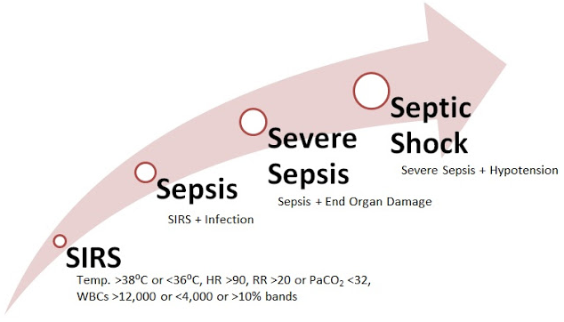

Slide 9
Normal Response to Infection
Local infection
Non-specific inflammatory response
3 phases
Vasodilation - increased blood flow to site, infusion of antibodies and cells to fight infection
Vessel permeability - antibodies and cells exit bloodstream and enter infected tissue
Once infection is controlled, tissue repairs itself

Slide 10
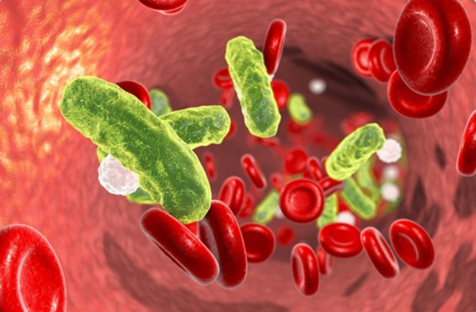
Pathophysiology of Sepsis
Uncontrolled, exaggerated immune response
Endothelium damage, cell mediator activation, disruption of coagulation system homeostasis
Vasodilation and capillary permeability
Systemic inflammatory response
End-organ damage, death
Notes:
The fundamental concept to keep in mind when discussing sepsis is that of “hemostasis,” the healthy balance of blood coagulation vs anti-coagulation. In times of normal health, our bodies produce clotting factors in the blood that are always on standby to clot whenever necessary. These factors are activated whenever the endothelium (the lining of organs and blood vessels) is disturbed or traumatized. Clotting factors are like a cache of highly unstable gun powder. Once activated, they can set off a dangerous chain-reaction of clotting everywhere. This potential is kept in check by anticoagulating factors also present in healthy blood.
In sepsis, infecting organisms cause direct trauma to endothelium, and the body also suppresses or depletes the supply of available anticoagulating factors. A perfect storm of intravascular coagulation occurs everywhere in the body, most notably in the most delicate microvascular system. This leads to hypoperfusion and clinical exam findings of “end-organ injury.” The endothelium continues to malfunction, resulting in loss of blood vessel wall motor tone, which leads to hypotension, as well as leaky blood vessels, which leads to edema in the lungs, brain, and soft tissues.

Slide 11
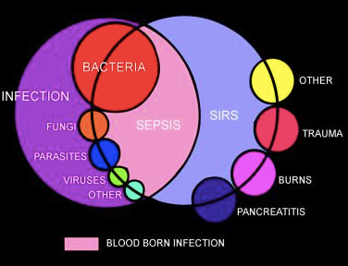
Notes:
There are multiple infectious causes of sepsis. There are multiple triggers for SIRS. Once you identify SIRS, you must look for the trigger. Infection from any type of germ (bacteria, virus, fungi, etc) is possible. As shown in the Venn diagram above, conditions other than infection can result in SIRS (trauma, burns, pancreatitis, etc.).

Slide 12
SIRS
Systemic Inflammatory Response Syndrome
A constellation of abnormal signs
Many triggers, infection is most common
EMS uses a version of SIRS that doesn’t rely on blood test results (WBC count, ABG)
Temp, HR, RR, glucose, mental status
Notes:
SIRS is a constellation of associated abnormal vital signs that are not specific for any one disease. 60% of all ED patients happen to meet SIRS criteria, but they don’t all have infection. As a good rule of thumb, if your patient meets SIRS criteria for any reason, they are probably critically ill.
SIRS technically includes results from blood work, such as white blood cell counts. We adapted SIRS for EMS use that does not rely on WBC results and uses glucose and mental status instead.

Slide 13
Risk Factors for Sepsis
Extremes of age (old and young)
Can’t communicate, need careful assessment
Patients with developmental delay
Cerebral Palsy
Recent surgery, invasive procedure, illness, childbirth/pregnancy termination/miscarriage
Reduced immunity

Slide 14
Increased Risk for Sepsis
DIABETES, DIABETES, DIABETES
Various Chronic diseases
Para/quadriplegics
Compromised skin (chronic wounds, burns, ulcers)
Chemotherapy
Chronic steroid use
Indwelling catheters of any kind (dialysis, Foley, IV, PICC, PEG tubes, etc)
Notes:
Complete list of Increased Risk may include:
Chemotherapy
Post-organ transplant (bone marrow, solid organ)
Chronic steroid use
Recent antibiotic use
Indwelling catheters of any kind (dialysis, Foley, IV, PICC, PEG tubes, etc)
DIABETES, DIABETES, DIABETES
Liver cirrhosis
Autoimmune diseases (lupus, rheumatoid arthritis)
HIV/AIDS
Para/quadriplegics
Sickle cell disease
Splenectomy patients
Compromised skin (chronic wounds, burns, ulcers)

Slide 15
Signs/Symptoms of Sepsis
Symptoms of sepsis are often nonspecific and include the following:
Fever = most common (elderly patients often do NOT mount a febrile response)
Flu-like symptoms
Chills/shaking (mistaken for seizure)
Nausea/vomiting
Mental status changes/fatigue/lethargy
Patient often does NOT
appear acutely ill
Notes:
Symptoms may be seen in other illnesses or conditions.

Slide 16
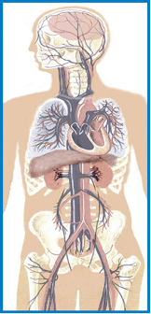
Multiple Organ System Dysfunction
CNS
Altered mental status
Cardiovascular
Tachycardia
Hypotension
Respiratory
Tachypnea
Hypoxia
Renal
Oliguria
Anuria
Renal failure
Hepatic
Jaundice
Liver inflammation
Coagulopathy
Hematologic
Consumptive coagulopathy
Petechiae
Purpura
Metabolic
Lactic acidosis
Notes:
Sepsis occurs when the inflammatory processes of the body in response to an infection exceed the boundaries of the local environment. The immune response becomes more global, more generalized to all parts of the body. It becomes uncontrolled, unregulated, and self-sustaining (domino-effect). This generalized inflammation causes wide-spread cellular injury. Cells are unable to perform their functions efficiently, leading to organ dysfunction. Tissue ischemia (low blood flow) results from a mismatch in available oxygen to changing tissue oxygen needs. The body responds by secreting catecholamine (fight or flight) hormones like epinephrine to compensate. The body produces lactic acid as it uses epinephrine to help jump start energy production.
Mortality is high in septic patients with elevated lactic acid levels.
Different criteria of what constitutes organ dysfunction have been defined for each organ system. These criteria are used in many ways when treating sepsis, primarily in identifying the severity and progression of sepsis.

Slide 17
Causes of Sepsis

Slide 18
United Effort to Improve Survival from Sepsis
Research from past 20 years is saving lives
Rapid identification, fluids, antibiotics
Education to all physicians, nurses, technicians
“Care bundles”
Sepsis alert teams in hospitals
Chart review
Administrative support at all levels
Notes:
At many hospitals around the Valley, administrative leaders are educating all those that are in contact with these patients: docs, nurses, technicians. We are using posters, videos, lectures, placards to educate. In addition, some hospitals have formed sepsis alert teams to respond to all septic workups to assist with IV access, antibiotic and fluid administration, and perform audits to maintain compliance with care bundles. Some hospitals perform chart audits to assess compliance in the ED, ICU and floor.

Slide 19
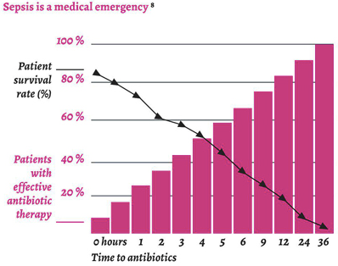
(Crit Care Med 2006;34[6]:1589.)
Notes:
Early identification of sepsis is important for many reasons. The time it takes to administer the correct antibiotics is one of the most important factors. Mortality increases by 7.6% for every hour that antibiotics are delayed.

Slide 20
EMS and Sepsis
Notes:
The whole principle behind Emergency Medical Services is early identification and treatment of life and limb-threatening disease and injury. This is the fundamental reason the EMS was created. EMS has demonstrated a benefit in STEMI, stroke, and trauma. As it happens, it appears that sepsis is no different. EMS can benefit patients by early recognition and early management.
Over the past 20 years, we have learned that we can improve survival from sepsis when we identify it faster, provide the supportive care to reverse organ hypoperfusion (IV fluids and other drugs that reverse shock), and provide antibiotics as quickly as possible. EMS can play a very important role in helping hospital staff achieve these goals even before the patient gets to the ED.

Slide 21
Notes:
Sepsis has high mortality rates compared to many diseases we treat in the prehospital setting.
QuickStats: Sepsis-Related Death Rates Among Persons Aged ≥65 Years, by Age Group and Sex — National Vital Statistics System, United States, 2021. MMWR Morb Mortal Wkly Rep 2023;72:1043. DOI: http://dx.doi.org/10.15585/mmwr.mm7238a5
National Vital Statistics System – Mortality Data (2021) via CDC WONDER

Slide 22
Emerg Med J. 2009
“In time critical conditions such as AMI or stroke, specific interventions by prehospital practitioners make a significant difference to mortality.”

Slide 23
Notes:
This study reviewed 253 patients diagnosed with sepsis once they arrived to the hospital.131 of them were transported by ambulance. The mortality rate of the total population was 21%. EMS staff recognized 18/131 (13.7%) transported patients with (severe) sepsis or septic shock. In 52 cases (39.7%) sepsis went unrecognized, probably due to an incomplete primary survey. In 60 cases (45.8%) sepsis went unrecognized, although enough systemic inflammatory response syndrome criteria were present at initial presentation. This study concluded that recognition of sepsis by EMS staff is low, probably due to a lack of awareness of the syndrome and infrequent measurement of temperature and respiratory rate. As early initiation of treatment is crucial, the EMS staff, general practitioners, and other specialties could benefit from more education on this critical illness.

Slide 24
Notes:
Abstract Background: Sepsis is a life-threatening condition where the risk of death has been reported to be even higher than that associated with the major complications of atherosclerosis, i.e. myocardial infarction and stroke. In all three conditions, early treatment could limit organ dysfunction and thereby improve the prognosis.
Results: In overall terms, we found a small number of articles (n = 12 of 1,162 unique hits) which addressed the prehospital phase. For each hour of delay until the start of antibiotics, the prognosis appeared to become worse. However, there was no evidence that prehospital treatment improved the prognosis. Studies indicated that about half of the patients with severe sepsis used the emergency medical service (EMS) for transport to hospital. Patients who used the EMS experienced a shorter delay to treatment with antibiotics and the start of early goal-directed therapy (EGDT). Among EMS-transported patients, those in whom the EMS staff already suspected sepsis at the scene had a shorter delay to treatment with antibiotics and the start of EGDT. There are insufficient data on other links in the prehospital chain of care, i.e. patients, bystanders and dispatchers. Conclusion: Severe sepsis is a life-threatening condition. Previous studies suggest that, with every hour of delay until the start of antibiotics, the prognosis deteriorates. About half of the patients use the EMS. We need to know more about the present situation with regard to the different links in the prehospital chain of care in sepsis. Keywords: Sepsis, Dispatch centre, Emergency medical serv

Slide 25
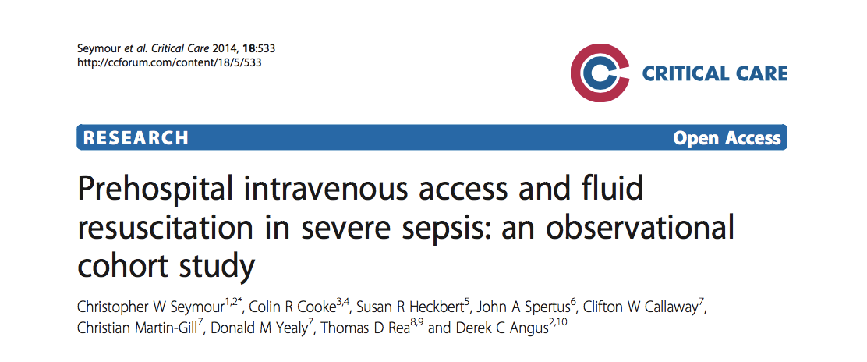
45,394 EMS encounters in King County, Washington
1350 met criteria for severe sepsis
Administration of prehospital fluid was associated with decreased odds of hospital mortality
Notes:
This study showed that IV fluids given by EMS decreased mortality in sepsis patients

Slide 26
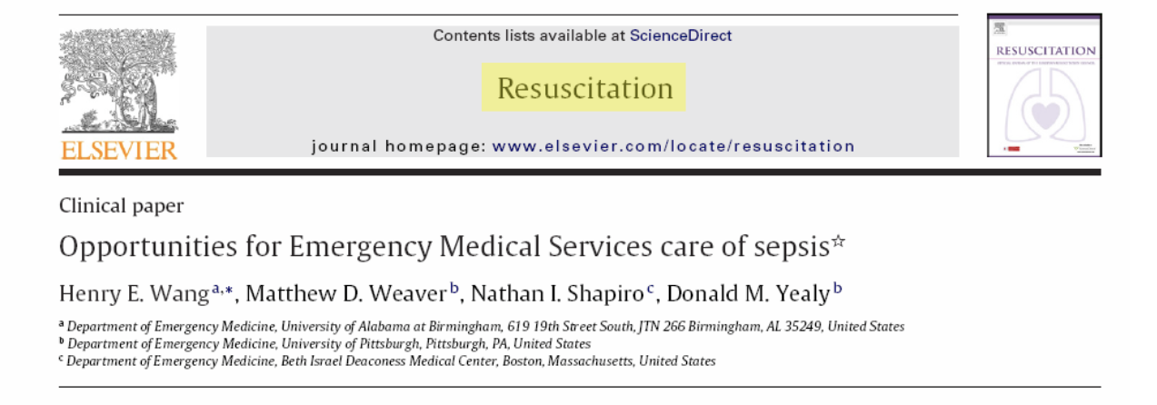
34% of patients presenting to the ED with a serious infection arrived by EMS
In these patients, mortality was higher for EMS patients (8%) than non-EMS patients (2%)
EMS cares for the “sickest” sepsis patients
Notes:
This study observed that of all sepsis patients, the ones brought in by EMS were more likely to be elderly, from a nursing home, have abnormal vital signs, have an elevated lactate, and have organ dysfunction.
In other words, EMS gets the sickest of the sick!

Slide 27
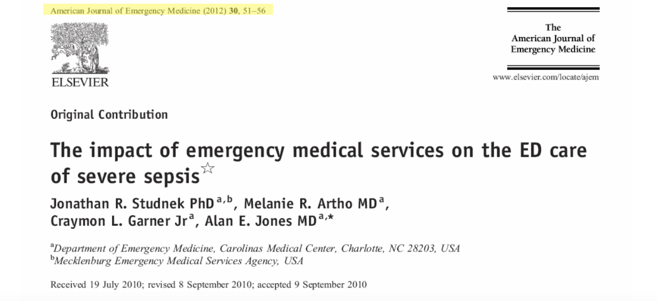
Compared severe sepsis patients arriving by EMS to those that did not
35 minute reduction to initiation of antibiotics
41 minute reduction to targeted sepsis resuscitation
Notes:
This study observed that if EMS diagnosed sepsis in the field before arrival to the hospital, time to antibiotics was reduced by 52 minutes and time to goal-directed resuscitation was reduced by 62 minutes.

Slide 28
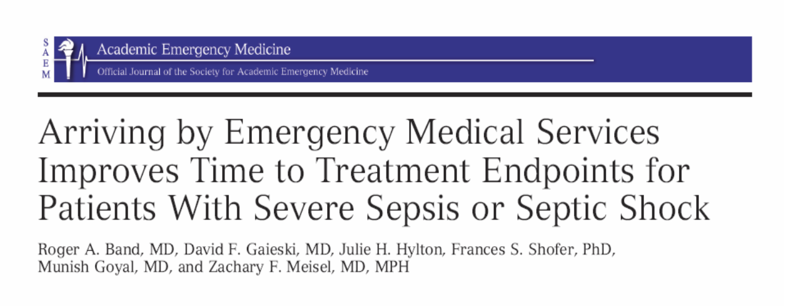
Notes:
Multiple studies have demonstrated a benefit with EMS with early detection and treatment initiation.

Slide 29
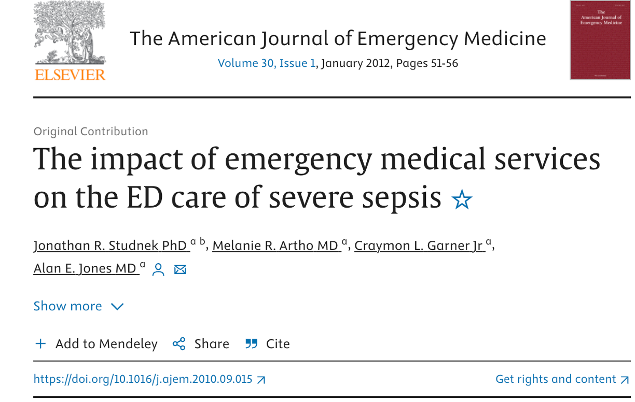
Notes:
In this prospective cohort, EMS provided initial care for half of the patients with severe sepsis requiring EGDT. Patients presented by EMS had more organ failure and a shorter time to both antibiotic and EGDT initiation in the ED.

Slide 30
EMS Role in Sepsis
Decreased time to intravenous fluids
Decreased time to antibiotics
Decreased mortality
Shorter hospital stay
Notes:
EMS can have a significant impact on these patients!

Slide 31
Identifying the Sepsis Patient
Look for and ask about infection
Did you look at all the skin???
Look for and ask about risk factors for infection
Check a temperature accurately
> 38°C (100.4°F)
< 36°C (96°F) more dangerous

Slide 32
Identifying the Sepsis Patient
Look for SIRS criteria in the vital signs
Look for shock/dehydration
Check end-tidal CO2

Slide 33
Treating the Sepsis Patient
Airway/breathing
Get sats > 94%
NRB, CPAP, invasive airway
Circulation
2 large bore IV, consider IO
30 cc/kg NS bolus
May repeat if lungs remain clear

Slide 34
Sepsis Alert
Communicate your suspicion early!
It doesn’t matter if accepting facility has a formal sepsis alert response process
Explicitly communicate abnormal vitals (especially temp) just as you would in trauma
Notes:
Some hospitals recognized EMS-initiated sepsis alerts like stroke, STEMI, and trauma alerts, and others may not. IT WON’T MATTER TO YOU AS THE EMS PROVIDER! It may help save a life just because you explicitly communicate your concern for sepsis to the accepting facility! Early notification of the hospital will help trigger the process of more aggressive care. As they say, attitude is infectious. Your heightened tone of alarm gets attention from others and helps combat the systematic inertia that can doom a septic patient. “Load the boat! Get everybody on board!”

Slide 35
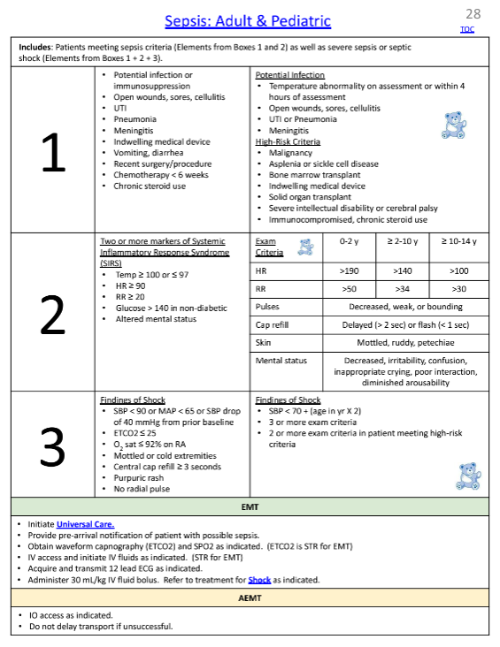

Slide 36
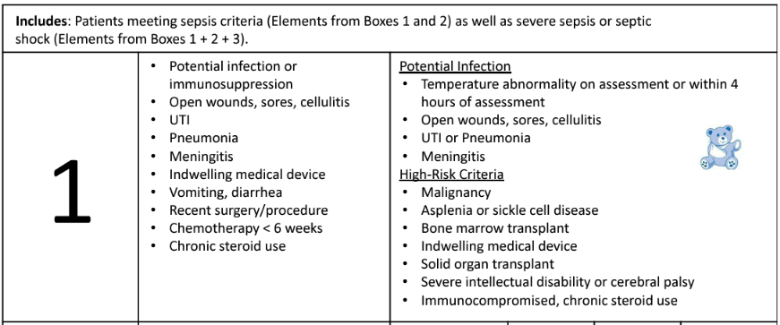

Slide 37
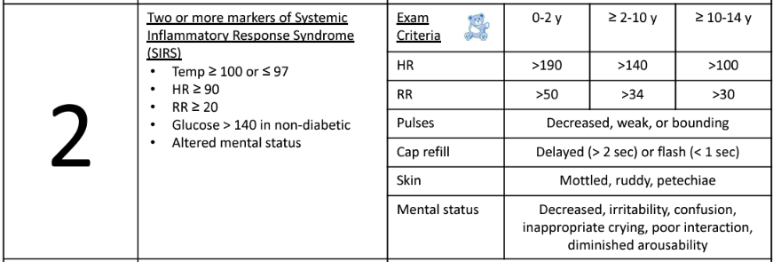

Slide 38
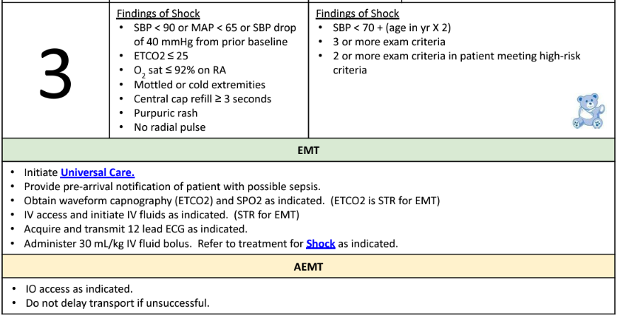

Slide 39
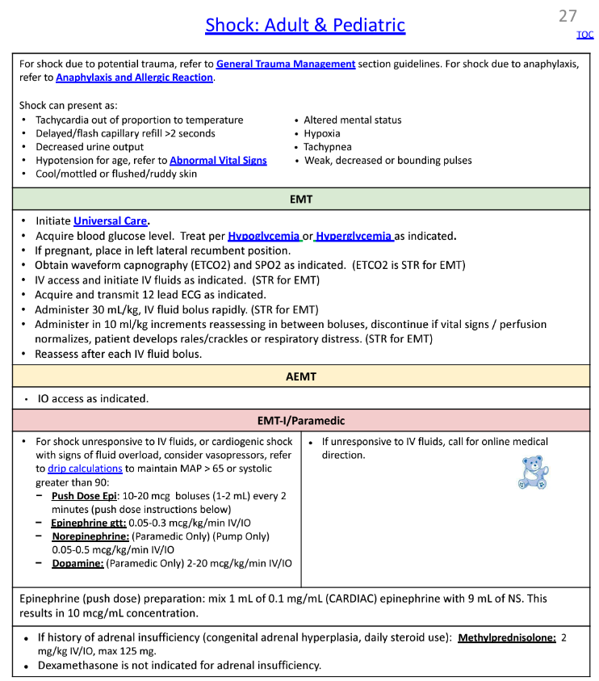

Slide 40
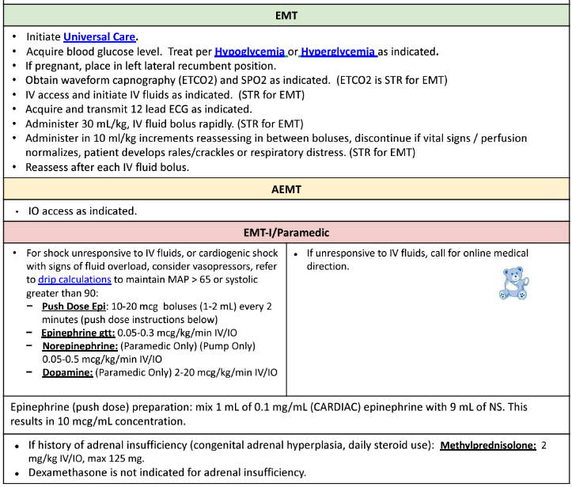

Slide 41
Treatment of Shock in Sepsis
For shock unresponsive to IV fluids, or cardiogenic shock with signs of fluid overload, consider vasopressors, refer to drip calculations to maintain MAP > 65 or systolic greater than 90:
Push Dose Epi: 10-20 mcg boluses (1-2 mL) every 2 minutes (push dose instructions below)
Epinephrine gtt: 0.05-0.3 mcg/kg/min IV/IO
Norepinephrine: (Paramedic Only) (Pump Only) 0.05-0.5 mcg/kg/min IV/IO
Dopamine: (Paramedic Only) 2-20 mcg/kg/min IV/IO

Slide 42
Respiratory Component of Sepsis
Mismatch of oxygen availability to changing needs of organs (ie. Increased oxygen demand)
Keep sats ≥ 94 % (NRB, CPAP, intubation)
Respiratory failure can happen quickly
Acute Respiratory Distress Syndrome
Notes:
ARDS - Acute Respiratory Distress Syndrome is an acute condition characterized by bilateral pulmonary infiltrates and severe hypoxemia in the absence of evidence for cardiogenic pulmonary edema. It is the most severe form of acute lung injury (ALI), a form of diffuse alveolar injury. There are many causes (trauma, aspiration), but severe sepsis is the most common cause.
Severe shortness of breath — the main symptom of ARDS — usually develops within a few hours to a few days after the precipitating injury or infection.

Slide 43
Severe Sepsis/Septic Shock
A story of imbalance…
Oxygen
Consumption
Oxygen
Delivery
As sepsis progresses, circulatory abnormalities lead to an imbalance of systemic oxygen delivery and demand, resulting in global tissue hypoxia.
Global tissue hypoxia is a key development preceding multi-organ failure and death.

Slide 44
Sepsis Pitfalls
Beta blockers block tachycardia response
Altered mentation not recognized as “end-organ failure”
Temperatures not checked
EtCO2 not checked or recognized
Discouragement due to hospital response

Slide 45
EtCO2 and Lactate
Low EtCO2 associated with high lactic acid
Low EtCO2 predicts mortality
EtCO2 of 25 mmHg = lactate up to 6.1 mm/L
Notes:
Capnography, a well-known tool in EMS, provides valuable information not only about ventilation but perfusion as well. As long as the body is metabolizing glucose and oxygen, waste products will be eliminated into the bloodstream. They can only be released into the alveolus and exhaled in the breath if there’s normal perfusion of the lung with blood.
As perfusion decreases, so does the EtCO2. This results in elevation of the metabolic waste, which is comprised mainly of lactic acid. Therefore, EtCO2 level is inversely proportional to lactate levels. As we see lactate levels rise in septic patients, we see EtCO2 levels drop. EtCO2 readings of less than 25 mmHg in the clinical setting of shock are associated with significant increase in mortality. Patients with EtCO2 of 25 mmHg may have lactate levels as high as 6.1 mmol/L. Capnography can be monitored and helpful in assessing the impact of therapies designed to improve perfusion.
Remember, mortality is higher in septic patients with elevated lactic acid (and thus low EtCO2) levels.

Slide 46
THANK YOU
Presenter Name | Title
presentersemail@azdhs.gov | 602-542-1025
azhealth.gov
@azdhs
facebook.com/azdhs

