Slide 1


Bureau of EMS and Trauma System
Secure, Encrypted, On-Line
EMS Services System
2015 Training Programs
System Instruction
2015
Training Programs
System Instruction
Requesting A New Instructor To Be Added To The Database

Slide 2
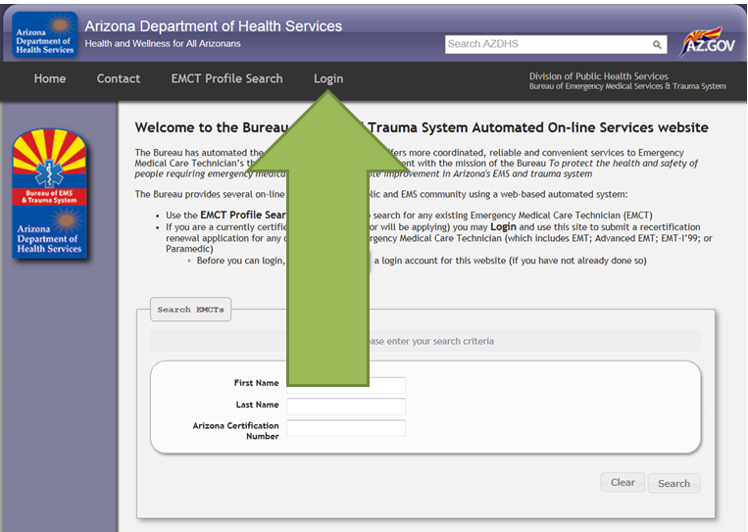
Bureau of EMS and Trauma System
Secure, Encrypted, On-Line
EMS Services System
Click login from the public home page. This will take you to the authorized user login screen shown on the next slide.

Slide 3
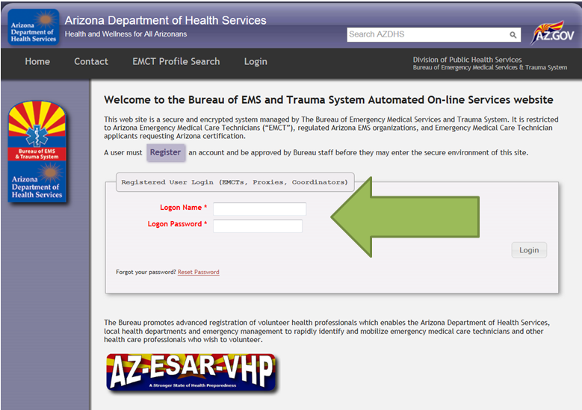
Bureau of EMS and Trauma System
Secure, Encrypted, On-Line
EMS Services System
From this authorized user login, enter your logon name and logon password. Use the login you developed for a Org Coordinator, not your EMCT.

Slide 4
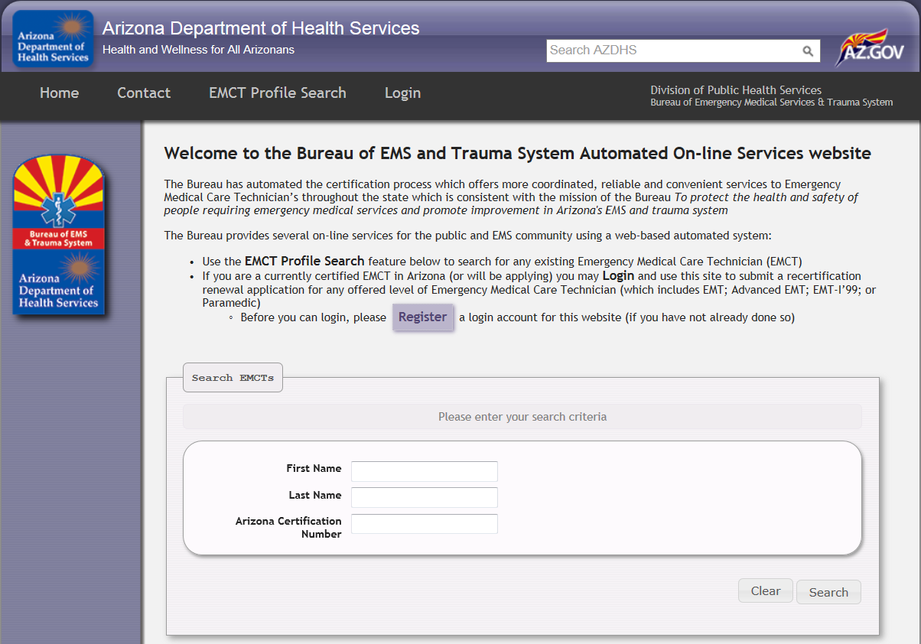

Bureau of EMS and Trauma System
Secure, Encrypted, On-Line
EMS Services System
If you can not locate the individual you wish to select as your new instructor from the pool of authorized account users. This means that the individual has not yet created a user account with the Bureau. Refer them to the following web site and have them register an account as shown here.
https://ems.azdhs.gov/

Slide 5
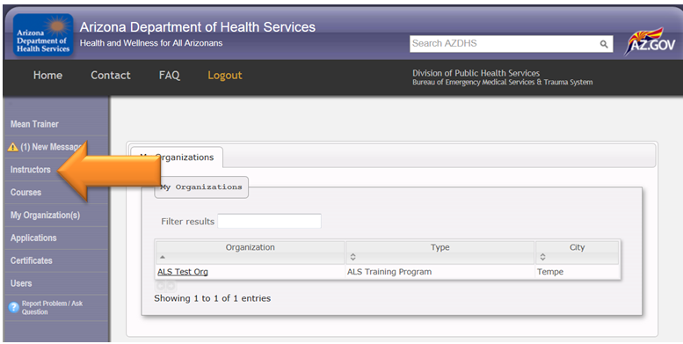
Bureau of EMS and Trauma System
Secure, Encrypted, On-Line
EMS Services System
To add a new instructor to the Bureau Database click on the “Instructors” link on the left side of the screen.
This is to add an instructor not already in the Database and requires Bureau approval.

Slide 6
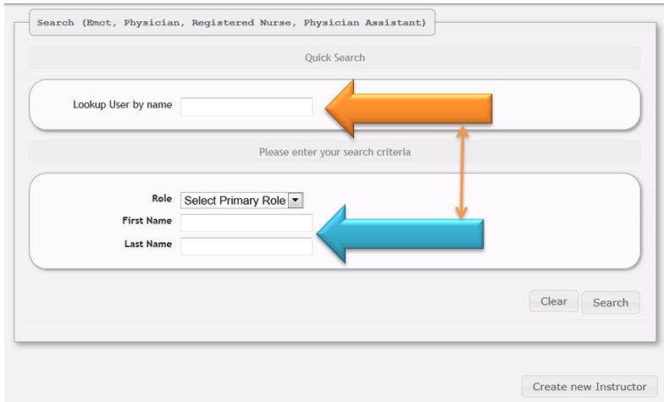
Bureau of EMS and Trauma System
Secure, Encrypted, On-Line
EMS Services System
This screen allows you to either enter the name of the individual in the top “Quick Search” Box, or use the more specific First & Last name in the bottom two boxes.
If you elect to use the more specific method, you will need to select the type of role of that individual.
This is shown on the next two slides.

Slide 7
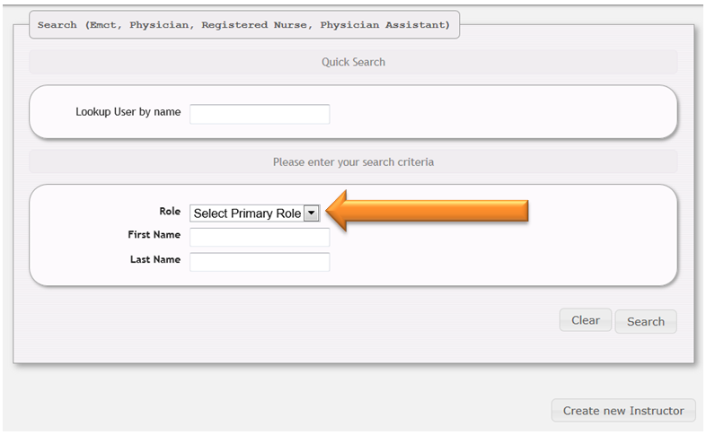
Bureau of EMS and Trauma System
Secure, Encrypted, On-Line
EMS Services System
The “Select Primary Role” drop down menu is asking you to identify the profession of this new instructor.
EMCT
Medical Doctor
Registered Nurse
Physician Assistant
When this field is selected an additional box appears allowing for the entry of the certification or license number instead of the name of the individual; as shown on the next slide.

Slide 8
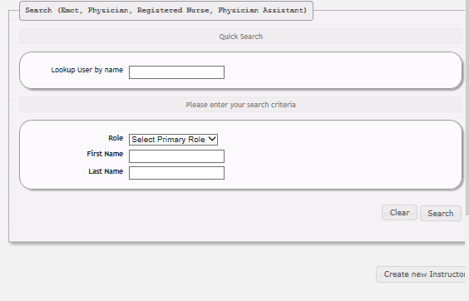
Bureau of EMS and Trauma System
Secure, Encrypted, On-Line
EMS Services System
To begin the process of adding an instructor, click the Create New Instructor tab.

Slide 9
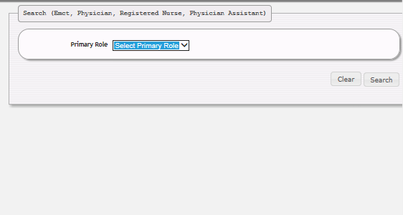
Bureau of EMS and Trauma System
Secure, Encrypted, On-Line
EMS Services System
Choose the Primary Role of the instructor to be added and click on it.
EMCT
Medical Director
Registered Nurse
Physician Assistant

Slide 10
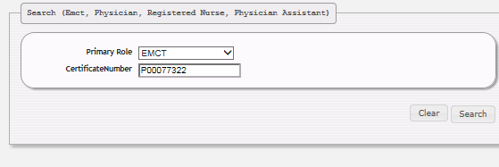
Bureau of EMS and Trauma System
Secure, Encrypted, On-Line
EMS Services System
For this example, we are using the primary role of EMCT.
Enter the instructors certificate / license number and click Search.

Slide 11
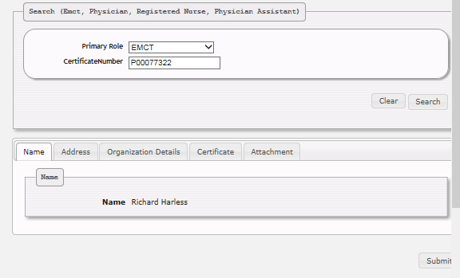
Bureau of EMS and Trauma System
Secure, Encrypted, On-Line
EMS Services System
To verify the information on a prospective instructor toggle the tabs above their name. The next three slides will show a representation of this instructors account.

Slide 12
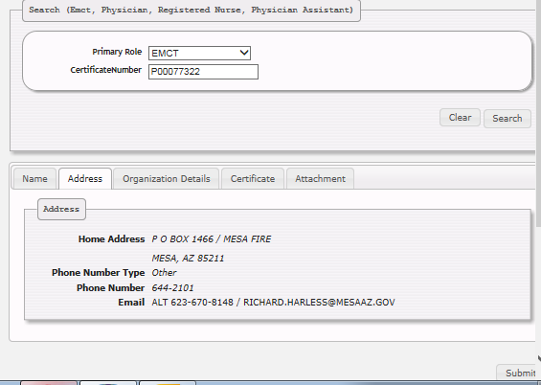
Bureau of EMS and Trauma System
Secure, Encrypted, On-Line
EMS Services System

Slide 13
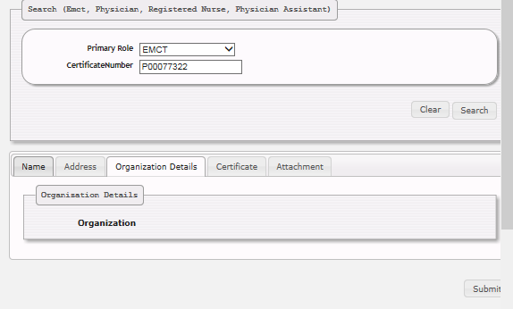
Bureau of EMS and Trauma System
Secure, Encrypted, On-Line
EMS Services System

Slide 14
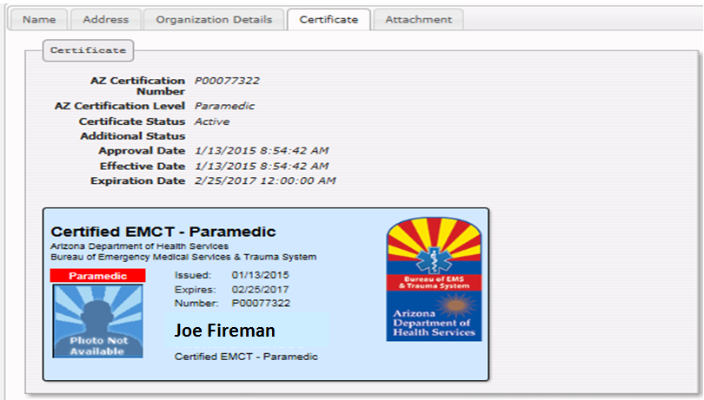
Bureau of EMS and Trauma System
Secure, Encrypted, On-Line
EMS Services System

Slide 15
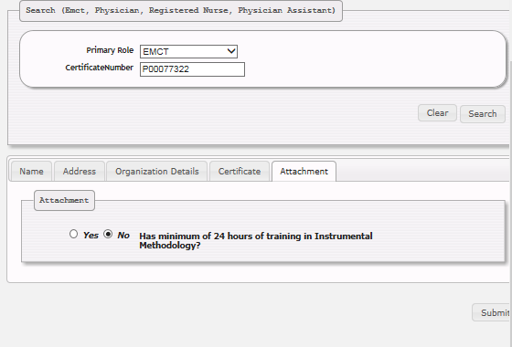
Bureau of EMS and Trauma System
Secure, Encrypted, On-Line
EMS Services System
The fifth and final tab on this screen allows a Org Coordinator to attest the candidates methodology qualification and attach required documentation.

Slide 16
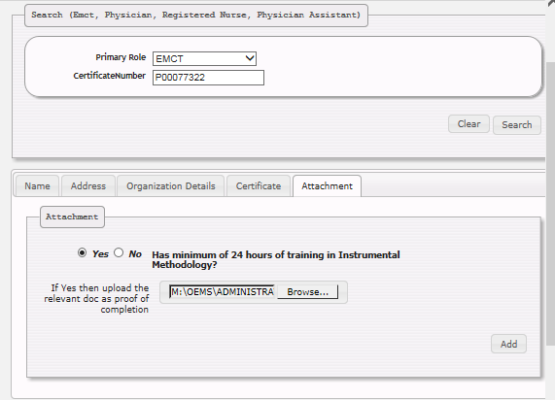
Bureau of EMS and Trauma System
Secure, Encrypted, On-Line
EMS Services System
Once the Org Coordinator has selected Yes, as an attestation, they can attach corresponding documentation through the browse feature.

Slide 17
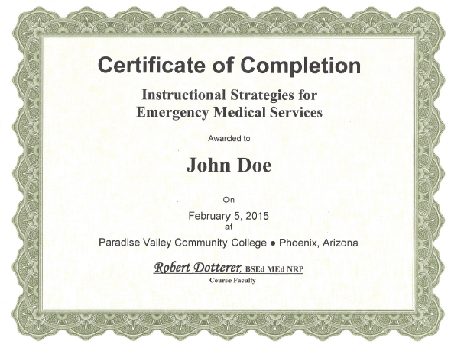
Bureau of EMS and Trauma System
Secure, Encrypted, On-Line
EMS Services System

Slide 18
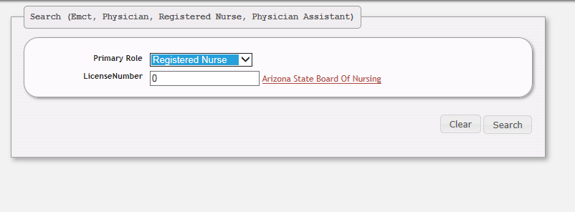
Bureau of EMS and Trauma System
Secure, Encrypted, On-Line
EMS Services System
For this example, we are using the primary role of a Registered Nurse.
Choosing the role of Registered Nurse will load this screen, allowing the Org Coordinator to either enter the License Number of a nurse.
If you don’t know the license number, we provide a direct link to the Arizona State Board of Nursing as shown on the next slide.

Slide 19
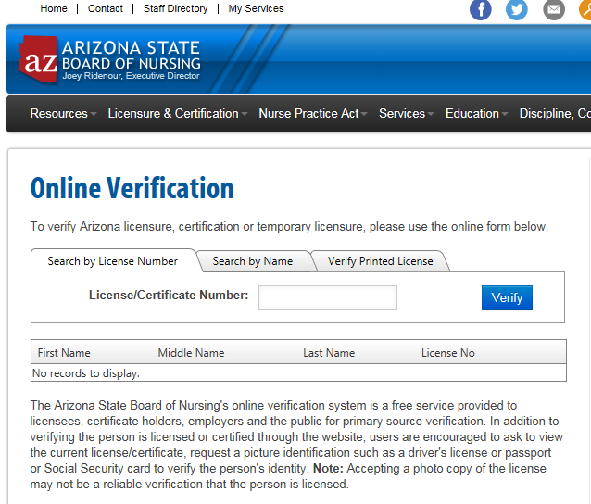
Bureau of EMS and Trauma System
Secure, Encrypted, On-Line
EMS Services System
This is the Arizona
State Board of Nursing screen
where an Org
Coordinator can search
for a nurse to be added as an
Instructor.
Remember that a nurse also
Has to have methodology
Documentation.

Slide 20
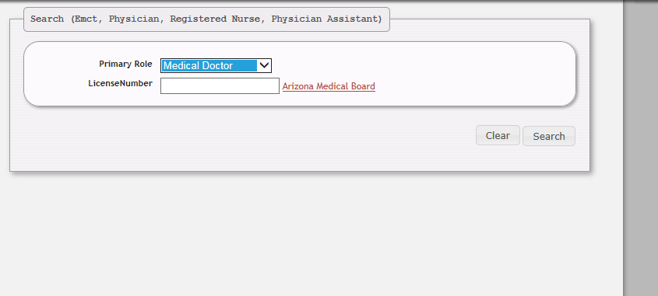
Bureau of EMS and Trauma System
Secure, Encrypted, On-Line
EMS Services System
For this example, we are using the primary role of a Registered Nurse.
Choosing the role of MD, DO, or Physician Assistant, will load this screen, allowing the Org Coordinator to either enter the License Number of a Physician or Physician Assistant.
If you don’t know the license number, we provide a direct link to the Arizona Medical Board as shown on the next slide.

Slide 21
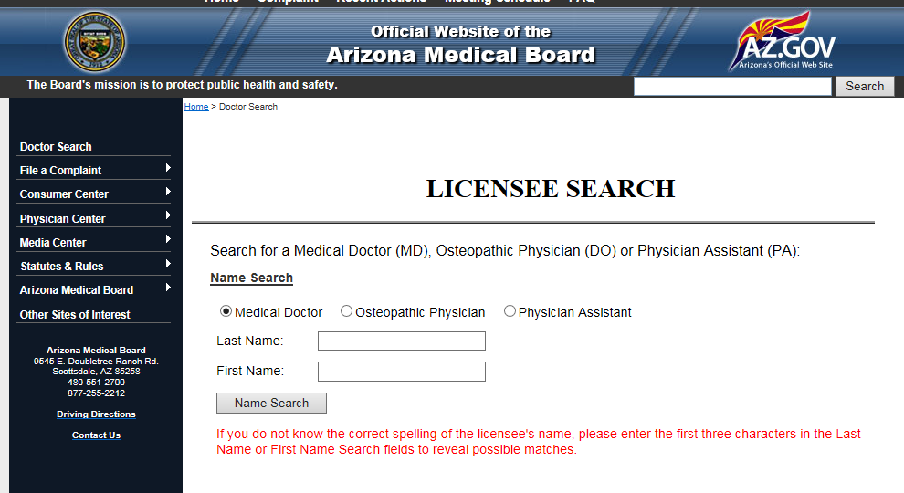
Bureau of EMS and Trauma System
Secure, Encrypted, On-Line
EMS Services System
This is the Arizona Medical Board
screen where an Org Coordinator
can search either an MD, DO, or
Physician Assistant.
Remember that a Doctor, or PA
also have to have Methodology
documentation.

Slide 22
Bureau of EMS and Trauma System
Secure, Encrypted, On-Line
EMS Services System
When all documentation has been satisfied click the add button. This instructor will remain in a pending status until approved by a Bureau staff member.
Once approved this instructor will be available to any training center in the state instructor pool.

Slide 23
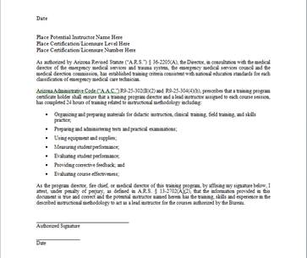
Bureau of EMS and Trauma System
Secure, Encrypted, On-Line
EMS Services System
If you received your instructor methodology many years ago in a galaxy far far away……
Simply, upload this sample letter using this content on your agency letterhead signed by your fire chief, medical director, or program director

Slide 24
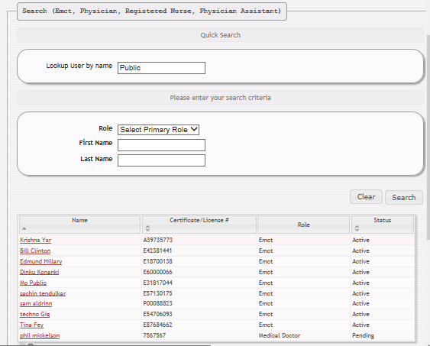
Bureau of EMS and Trauma System
Secure, Encrypted, On-Line
EMS Services System
Another method for finding your instructor is to either enter their last name in the Lookup field or a global search in the Primary Role drop down box.

Slide 25
Bureau of EMS and Trauma System
Secure, Encrypted, On-Line
EMS Services System
To add a name using either one of these methods, click on the space to the right of the candidates name and choose Create New Instructor. Follow previous instructions to finish entering this prospective instructor.

Slide 26
Bureau of EMS and Trauma System
Secure, Encrypted, On-Line
EMS Services System
Login as Org Coordinator
Search By Name
Search By Certificate
Or License Number
Search By Role
Create New Instructor
Verify Instructor
Information
Attach Methodology
Documentation
Check Status As Approved By Bureau

Slide 27

Bureau of EMS and Trauma System
Secure, Encrypted, On-Line
EMS Services System
This instructor, once approved, will be placed in the state instructor pool.
They are now available to be pulled from that pool, to your ORG pool
for daily use. If an instructor is approved to be placed in the state
Instructor pool and does not show as either a Lead Instructor or Substitute
Lead Instructor for a period of 24 months, the database will automatically
drop them from use.

Slide 28
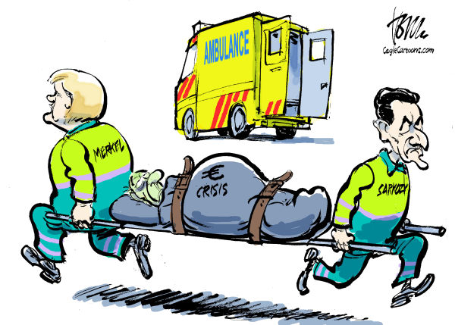
Bureau of EMS and Trauma System
Secure, Encrypted, On-Line
EMS Services System
Moving On!

