Slide 1


Bureau of EMS and Trauma System
Secure, Encrypted, On-Line
EMS Services System
2015 Training Programs
System Instruction
2015
Training Programs
System Instruction
Requesting Approval of A Course Session

Slide 2
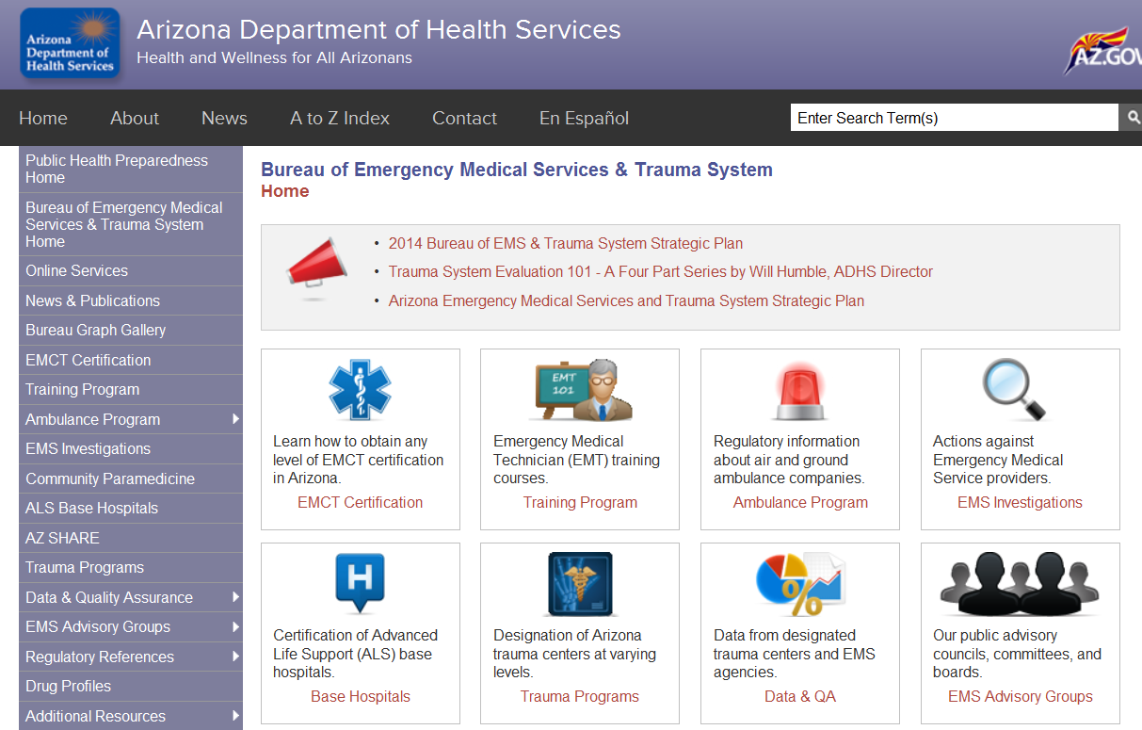

Bureau of EMS and Trauma System
Secure, Encrypted, On-Line
EMS Services System
How Do We Access The New System?
Simply go to www.azdhs.gov/bems On the left side of the Bureau Web Page Select:
“Online Services”

Slide 3
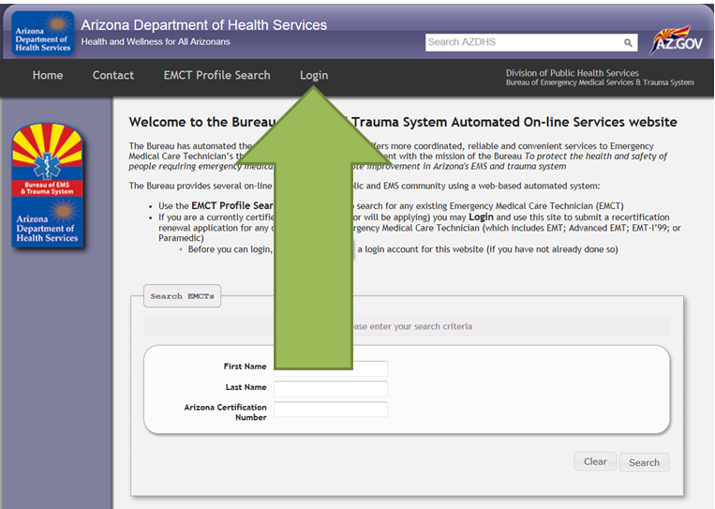
Bureau of EMS and Trauma System
Secure, Encrypted, On-Line
EMS Services System
Click on the login from the public home page. This will take you to the authorized user login screen shown on the next slide.

Slide 4
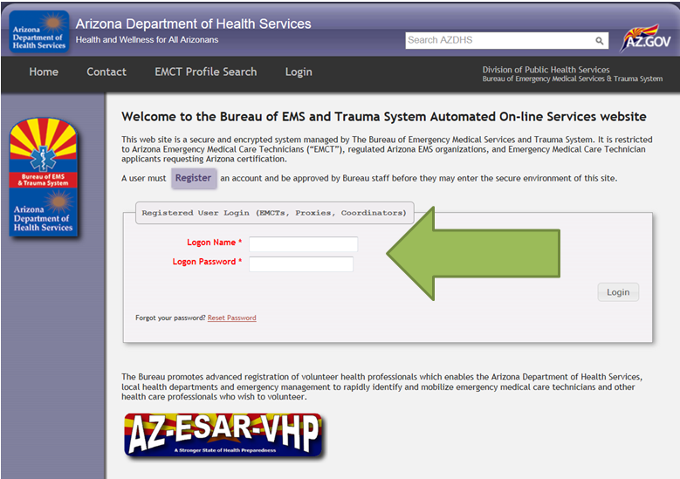
Bureau of EMS and Trauma System
Secure, Encrypted, On-Line
EMS Services System
From this authorized user login, enter your logon name and logon password. Use the Logon you developed for a Org Coordinator, not your EMCT.

Slide 5
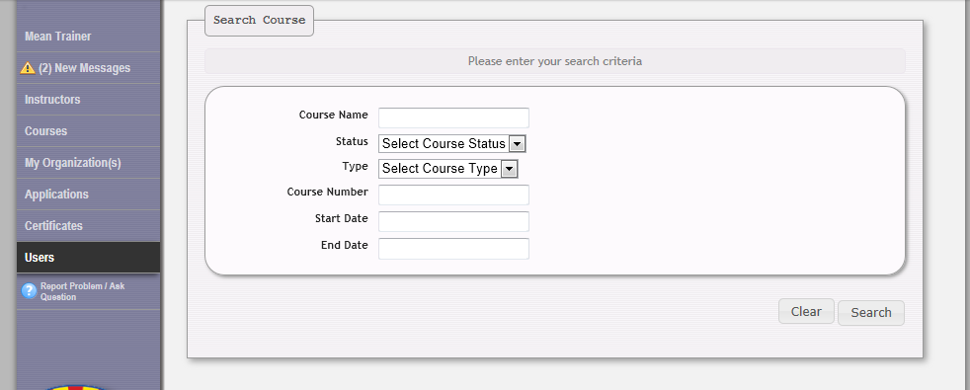
Bureau of EMS and Trauma System
Secure, Encrypted, On-Line
EMS Services System
From the menu on the
left side of the page,
choose the courses tab.

Slide 6
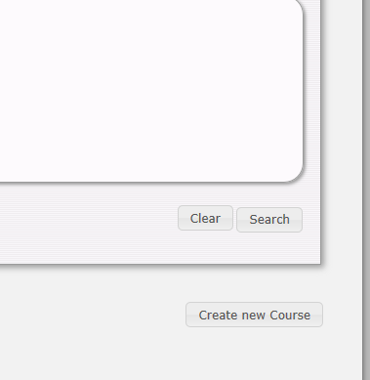
Bureau of EMS and Trauma System
Secure, Encrypted, On-Line
EMS Services System
Next click on the
“Create New
Course” tab.

Slide 7
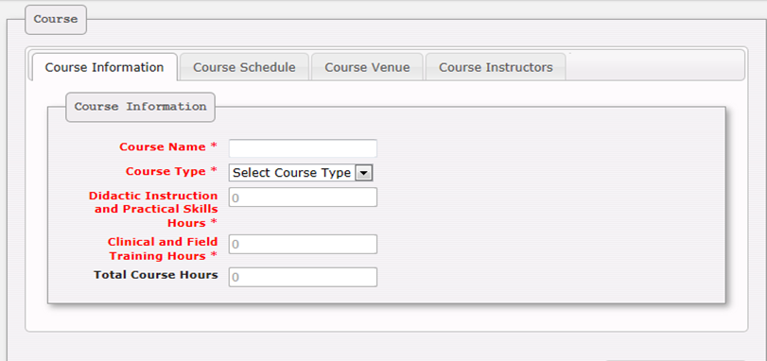
Bureau of EMS and Trauma System
Secure, Encrypted, On-Line
EMS Services System
You are now ready to input
the course information; a
field at a time beginning
with course name.

Slide 8
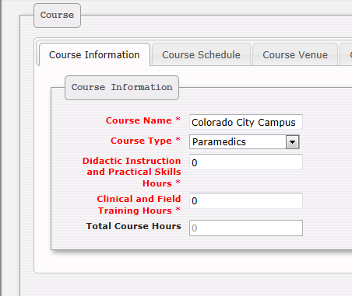
Bureau of EMS and Trauma System
Secure, Encrypted, On-Line
EMS Services System
This is a new field that allows another electronic lookup
for any individual course.

Slide 9
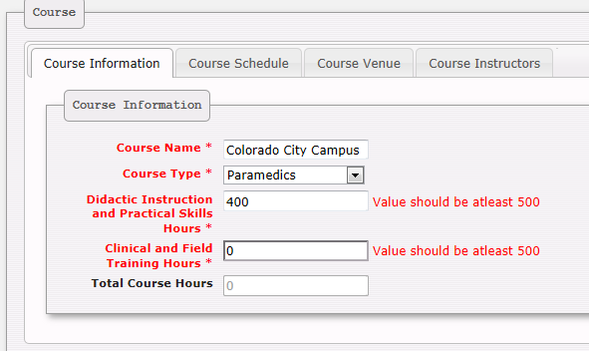
Bureau of EMS and Trauma System
Secure, Encrypted, On-Line
EMS Services System
Entering the parameters of any individual course
must meet that of rule.
As you can see 400 didactic hours would flag the field and disallow moving to the next tab.

Slide 10
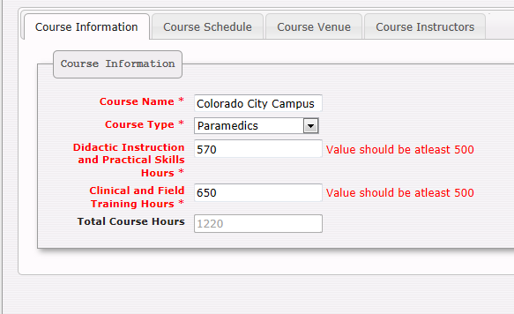
Bureau of EMS and Trauma System
Secure, Encrypted, On-Line
EMS Services System
Once the allotted hours
are above the minimum
criteria by rule, you are
ready to select the “Course Schedule” tab.

Slide 11
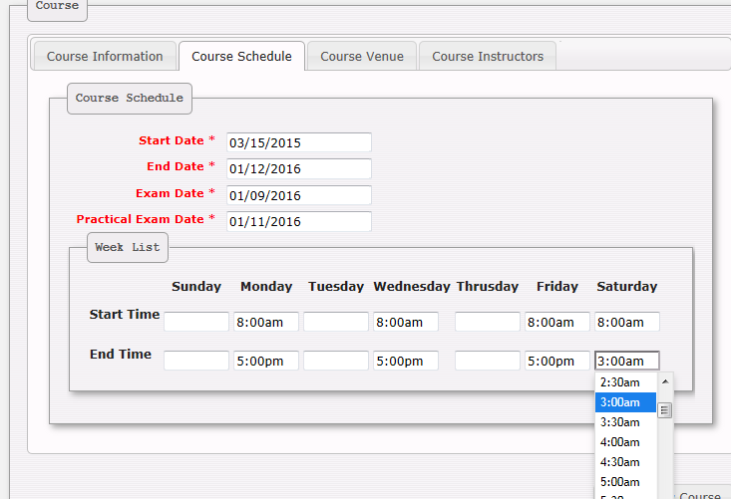
Bureau of EMS and Trauma System
Secure, Encrypted, On-Line
EMS Services System
This screen and the input of information, should be self explanatory.
Next, select the “Course Venue” tab

Slide 12
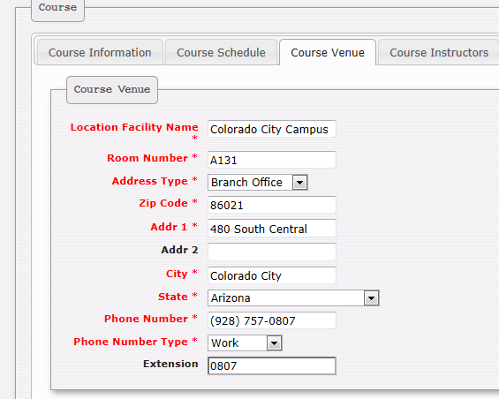
Bureau of EMS and Trauma System
Secure, Encrypted, On-Line
EMS Services System
This information is the
actual location of instruction and NOT that of the main campus or training center.
Unless, the instruction
is at the main campus or training center.

Slide 13
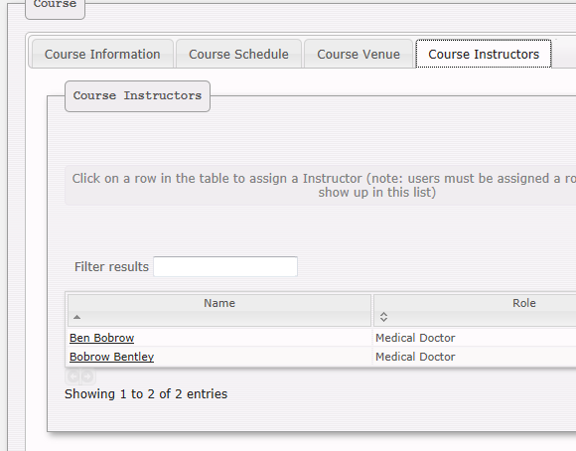
Bureau of EMS and Trauma System
Secure, Encrypted, On-Line
EMS Services System
Click on the “Course Instructors” tab and you will see the qualified instructors in your training center pool of names.

Slide 14
Bureau of EMS and Trauma System
Secure, Encrypted, On-Line
EMS Services System
Choose an instructor from the list of instructors approved for your training center.
Simply click in the blank space to the right of their name as shown.

Slide 15
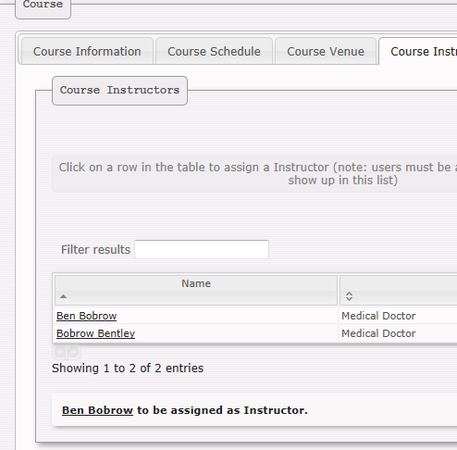
Bureau of EMS and Trauma System
Secure, Encrypted, On-Line
EMS Services System
You can verify your choice by noting the assigned instructor highlighted below.

Slide 16
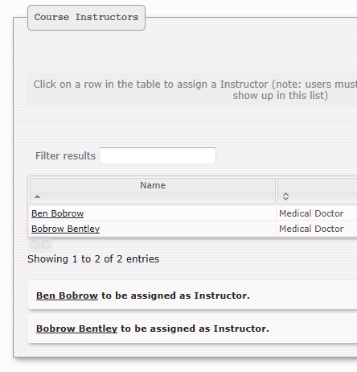
Bureau of EMS and Trauma System
Secure, Encrypted, On-Line
EMS Services System
You must choose two instructors, for all submitted courses.
one lead
one substitute lead
“Qualified adjunct faculty, does not count as substitute lead”.

Slide 17
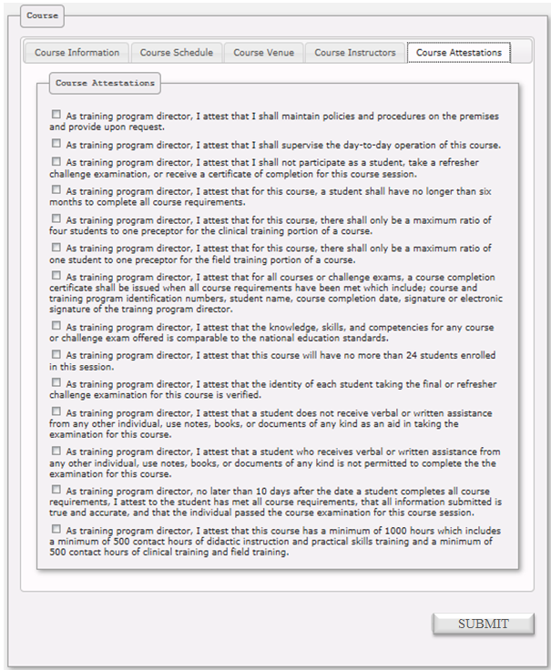
Bureau of EMS and Trauma System
Secure, Encrypted, On-Line
EMS Services System
This final screen before submission, are required attestations taken from rule and must be acknowledged and check marked before submitting.

Slide 18
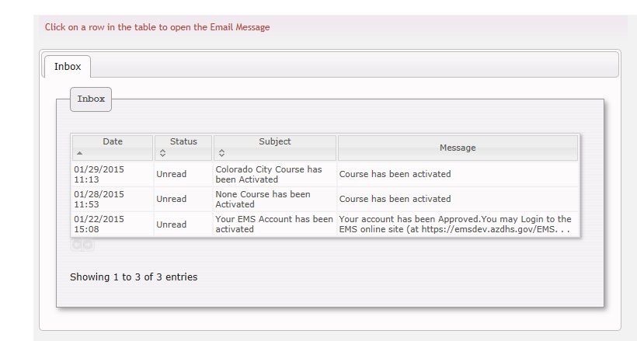
Bureau of EMS and Trauma System
Secure, Encrypted, On-Line
EMS Services System
Once submitted to the Bureau for approval, this course will be reviewed & approved as provided for in rule.
An electronic “Course Session Approval Number”, will be sent back to your secure email box and looks like this:
451-2-333467
↓ ↓ ↓
Program Course Course
Type Level Session
Use this number from that day forward & include it on your completion certificates.

Slide 19
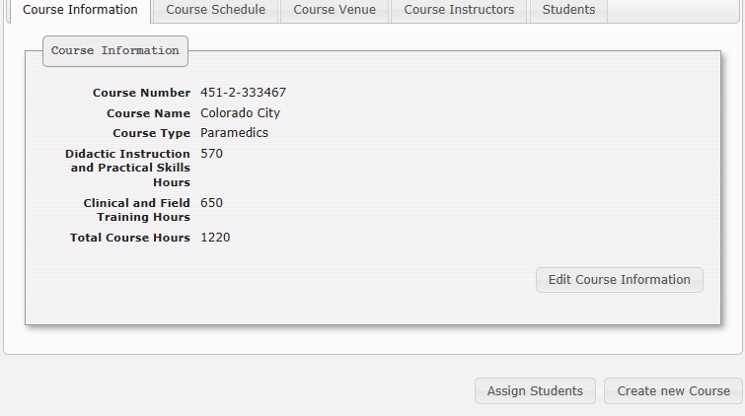
Bureau of EMS and Trauma System
Secure, Encrypted, On-Line
EMS Services System
Once approved, you will see the associated
course session number, and you may now assign
students to this course beginning to build
the course “Assigned
Student” list.

Slide 20
Bureau of EMS and Trauma System
Secure, Encrypted, On-Line
EMS Services System
Select “ Assign Students” tab by clicking on it.

Slide 21
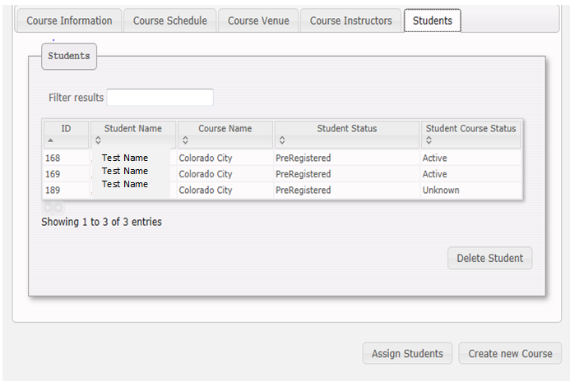
Bureau of EMS and Trauma System
Secure, Encrypted, On-Line
EMS Services System
All students are added to a course through the current EMCT Database.
An EMCT that shows as Preregistered is one who has not opened an active account and must do so before they can be attached.
We will cover this in the
next PowerPoint.

Slide 22
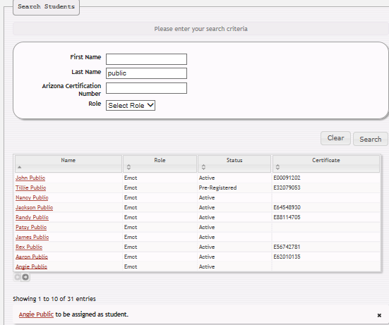
Bureau of EMS and Trauma System
Secure, Encrypted, On-Line
EMS Services System
Enter the name you are looking for in the Filter results field and look below for results.
Once located, click to the right of the selected name.

Slide 23
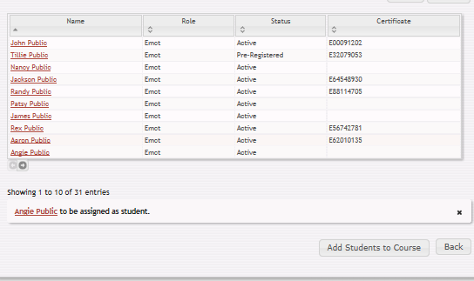
Bureau of EMS and Trauma System
Secure, Encrypted, On-Line
EMS Services System
As you can see, the student is ready to be assigned to the course.
Make sure your selection is correct and click the “Add Student to Course” tab.

Slide 24
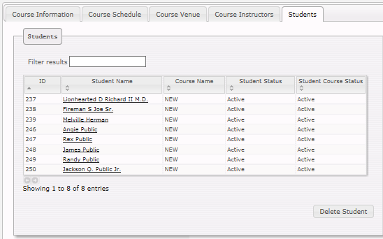
Bureau of EMS and Trauma System
Secure, Encrypted, On-Line
EMS Services System
This student has now been added to your active “Assigned Students” list.

Slide 25
Bureau of EMS and Trauma System
Secure, Encrypted, On-Line
EMS Services System
This student can also be deleted from the active student assigned list by selecting and clicking the delete tab.

Slide 26
Bureau of EMS and Trauma System
Secure, Encrypted, On-Line
EMS Services System
Once your assigned students listing has met the maximum students by rule, the database will not allow the addition of other students.

Slide 27

Bureau of EMS and Trauma System
Secure, Encrypted, On-Line
EMS Services System
Moving On!

