Slide 1


Bureau of EMS and Trauma System
Secure, Encrypted, On-Line
EMS Services System
2015 Training Programs
System Instruction
2015
Training Programs
System Instruction
Adding Student Final Scores To A Course Session

Slide 2
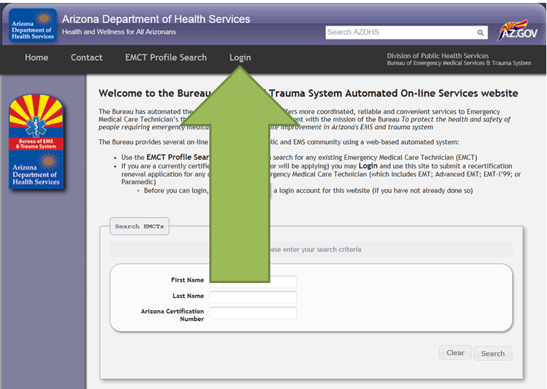
Bureau of EMS and Trauma System
Secure, Encrypted, On-Line
EMS Services System
Click on the login from the public home page. This will take you to the authorized user login screen shown on the next slide.

Slide 3
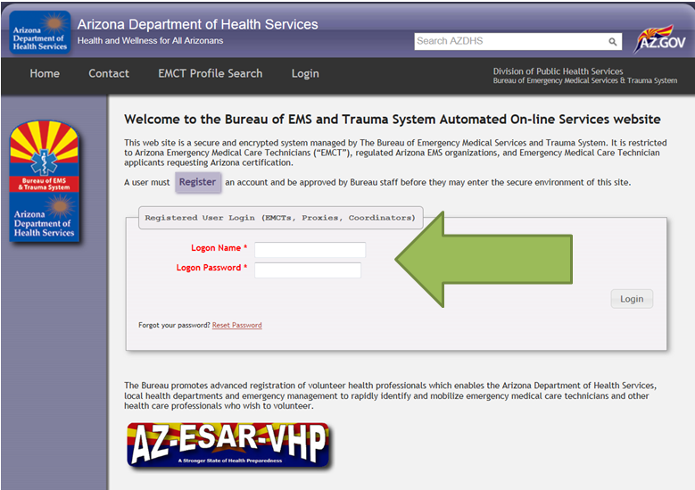
Bureau of EMS and Trauma System
Secure, Encrypted, On-Line
EMS Services System
From this authorized user login, enter your logon name and logon password. Use the logon you developed for a Org Coordinator, not your EMCT.

Slide 4
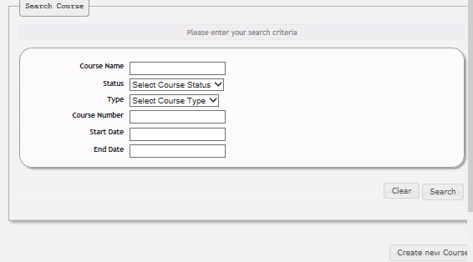
Bureau of EMS and Trauma System
Secure, Encrypted, On-Line
EMS Services System
Select and click the Course tab on the left. Using the quick search feature of the Course Name field, enter the appointed course name to continue.

Slide 5
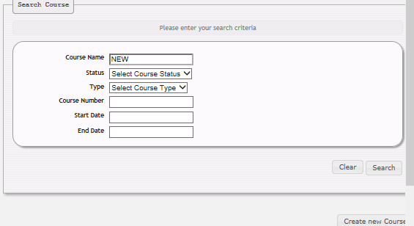
Bureau of EMS and Trauma System
Secure, Encrypted, On-Line
EMS Services System
In this case, the Course Name Used is NEW. Once inputted click Search.

Slide 6
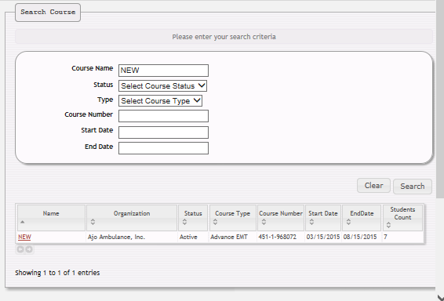
Bureau of EMS and Trauma System
Secure, Encrypted, On-Line
EMS Services System
Your programs selected course session will appear as shown below. Click directly on the Name (NEW) of the course.

Slide 7
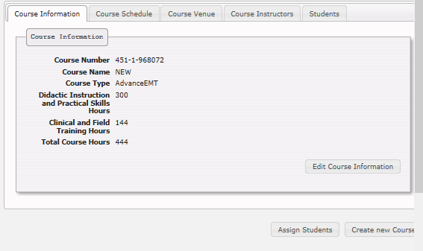
Bureau of EMS and Trauma System
Secure, Encrypted, On-Line
EMS Services System
Confirm the course session information by selecting each tab, and upon confirmation that this is the course you want to use. Select the Students tab.

Slide 8
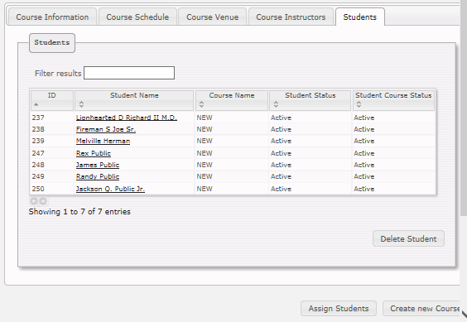
Bureau of EMS and Trauma System
Secure, Encrypted, On-Line
EMS Services System
Confirm student roster and select the first student for inputting of grades.
Click directly on the students name and their Student Details will populate.

Slide 9
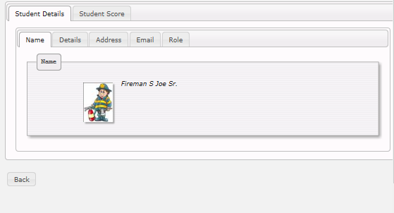
Bureau of EMS and Trauma System
Secure, Encrypted, On-Line
EMS Services System
Once you have confirmed that this is the correct student, click on the Student Score tab.

Slide 10
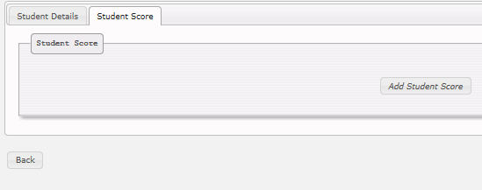
Bureau of EMS and Trauma System
Secure, Encrypted, On-Line
EMS Services System
Next choose the Add Student Score tab

Slide 11
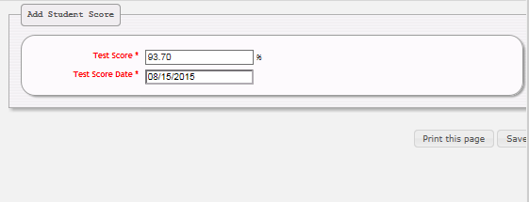
Bureau of EMS and Trauma System
Secure, Encrypted, On-Line
EMS Services System
Input Test Score and Test Score Date and click Save.

Slide 12
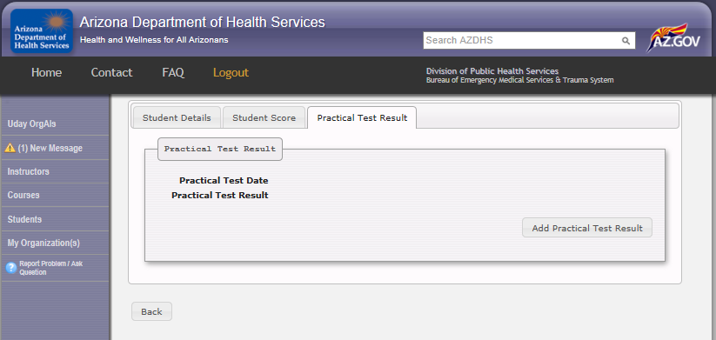
Bureau of EMS and Trauma System
Secure, Encrypted, On-Line
EMS Services System
Next click on the ADD Practical Skills
Results button to input results

Slide 13
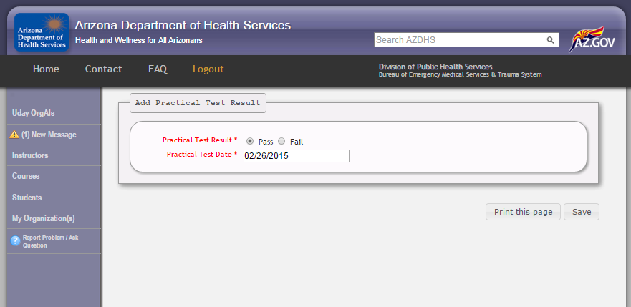
Bureau of EMS and Trauma System
Secure, Encrypted, On-Line
EMS Services System
Enter the results as either a pass
or fail, and the date the student
took the exam, and click save.

Slide 14
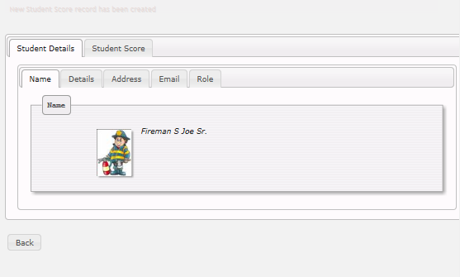
Bureau of EMS and Trauma System
Secure, Encrypted, On-Line
EMS Services System
New Student Score record has been created
As you can see a ”New Student Score Record” has been created

Slide 15
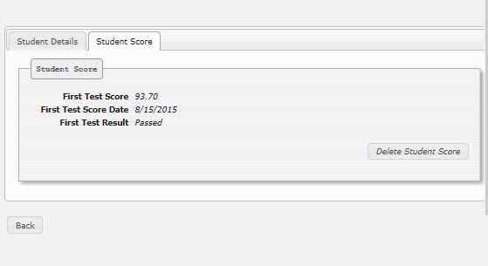
Bureau of EMS and Trauma System
Secure, Encrypted, On-Line
EMS Services System
Scores can be confirmed by checking the Student Score tab. If a correction needs to be made select the Delete Student Score tab.

Slide 16
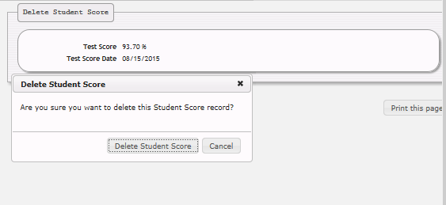
Bureau of EMS and Trauma System
Secure, Encrypted, On-Line
EMS Services System
The database will offer you a drop down box confirming your desire to delete the students score. By selecting this it will effectively eliminate any scores for this student and this course.

Slide 17
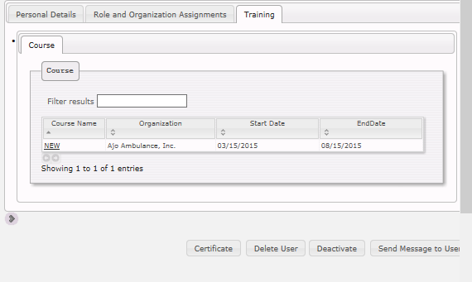
Bureau of EMS and Trauma System
Secure, Encrypted, On-Line
EMS Services System
All recorded training will stay in this users file perpetually and can be seen by their Agency Administration or authorized staff individuals.

Slide 18
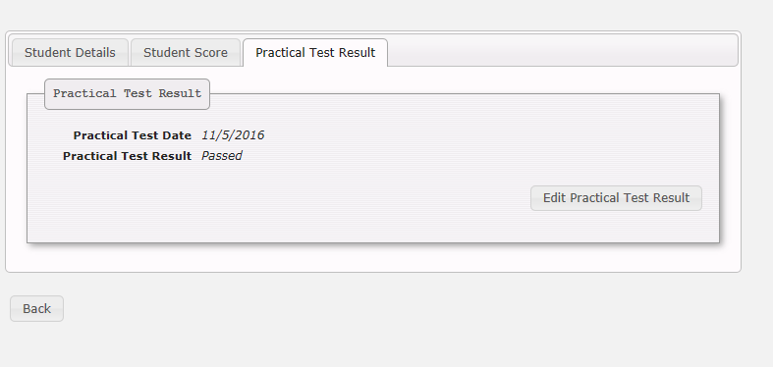
Bureau of EMS and Trauma System
Secure, Encrypted, On-Line
EMS Services System
Results are shown as
a pass or fail, and
reflect the date of the
Practical exam for review
By both their school and
Agency if they have one.

Slide 19
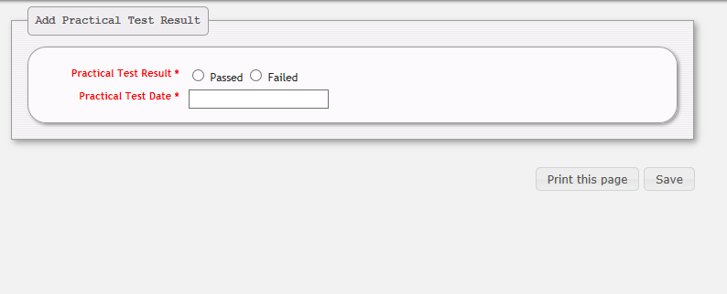
Bureau of EMS and Trauma System
Secure, Encrypted, On-Line
EMS Services System
Enter students Practical
Test results by clicking
Pass or Failed, and the test
date completed.

Slide 20
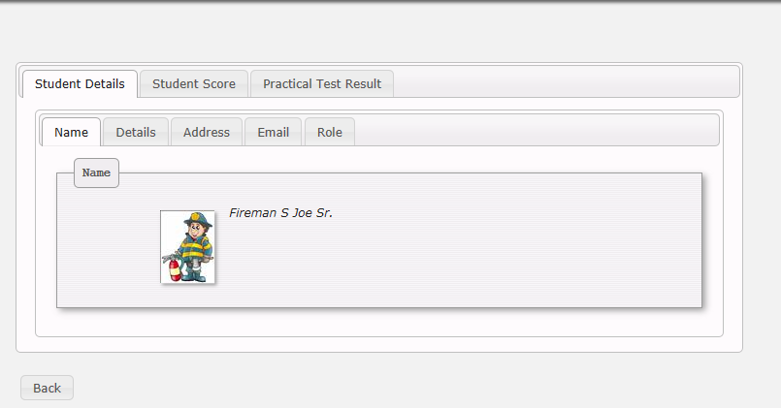
Bureau of EMS and Trauma System
Secure, Encrypted, On-Line
EMS Services System
To insert the students
Practical Test Results
select the tab of the
Same name.

Slide 21
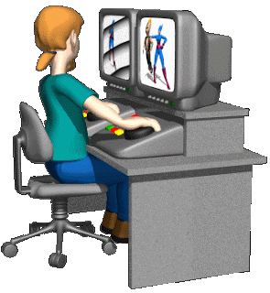
Bureau of EMS and Trauma System
Secure, Encrypted, On-Line
EMS Services System
MOVING ON!!

