Slide 1
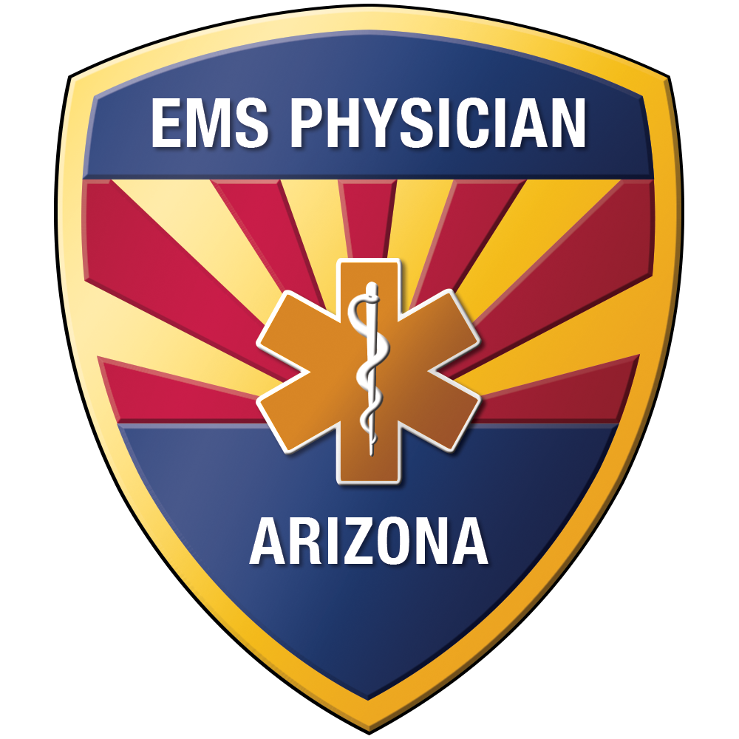
Spinal Motion Restriction Refresher
2019 Update
AZ DHS BEMS
Notes:
Compliant with 2018 update from the National Association of EMS Physicians (NAEMSP) in collaboration with the American College of Surgeons Committee on Trauma (ACS-COT) and the American College of Emergency Physicians (ACEP). Revised and approved by Education Committee on July 18, 2019. Approved by MDC January 23, 2020.

Slide 2
Why are we doing a refresher?
Overall, we have had excellent success with the roll-out of SMR across Arizona
The incidence of spinal cord injury has NOT increased since the roll-out of SMR
However, there have been cases of missed cervical spine injuries
All of these cases have been due to protocol non-compliance***

Slide 3
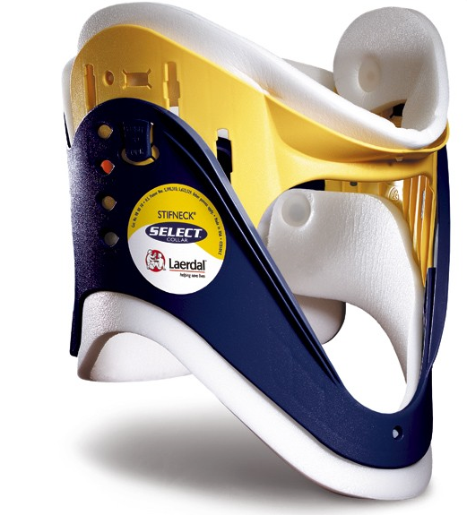
How Does SI Hurt?
Cervical collars
Proven to increase ICP
Transfer force to ends
Obscure neck injuries
Produce axial distracting force
Make airway management more difficult
Notes:
When applied to the patient, a cervical collar can cause vascular obstruction of blood draining from the brain. This effect was prospectively observed in the study published in 1996. The authors tested standard Stifneck rigid collars on injured patients requiring ICP monitoring. They observed a mean rise in ICP of 4.5 mm Hg. At the same time, MAP was not changing significantly, so they new this rise was from distortion of venous drainage specifically.

Slide 4

How Does SI Hurt?
Rigid long back boards
Cause iatrogenic pain
Cause 15-20% reduction in respiratory capacity
Causes delays in transport
Possible risk of pressure ulcers
Notes:
It has been proven that backboards cause neck and back pain in previously asymptomatic patients; clinically this often results in the ordering of costly diagnostic testing that initially may not have been necessary. Studies have shown that spinal immobilization in a supine position results in a reduction of respiratory capacity by as much as 15-20% and furthermore, respiratory effectiveness is markedly reduced by commonly used restraint systems. We all know that spinal immobilization takes time and multiple personnel. Delays in transport are known to worsen outcomes for critically ill trauma patients. Rigid backboards are known to cause elevations in tissue interface pressure enough to potentially cause pressure necrosis (aka decubitus ulcers); this risk is highest in the patient who is insensate from spinal cord injury and cannot feel pain from a pressure spot.

Slide 5
Backboards
IMPORTANT!!!
Still reasonable for…
Blunt trauma with ALOC
Spine pain/tenderness and neuro complaint
Anatomic deformity of spine
High-energy mechanism or ALOC, distracting injury, inability to communicate
Notes:
Before you take to the streets and burn all your collars and backboards, remember the concept of arguing from ignorance. We simply don’t know if this equipment offers any real benefit, but that doesn’t automatically mean that it doesn’t.
Our EMS providers should probably still be applying full collar and backboard to these patients unless they have a reasonable and well-documented concern that full board and collar would make the patient’s situation or condition worse.

Slide 6
SMR Indications
Apply spinal motion restriction to any patient identified by the SMR algorithm to have a potential spine injury that might benefit from splinting and packaging
A complete patient assessment should be performed prior to application of SMR
This requires MORE critical thinking than simply putting everyone in a collar & strapping them to a backboard
Remember, EMS is not “clearing” the patient’s cervical spine
Notes:
The application of the equipment is now a matter of “risk vs benefit” in every case – no longer default to packaging all patients with mechanism.

Slide 7
Who needs SMR Screening?
Fall Injury
MVC
Pedestrian Struck
Bicyclist Struck
ATV accident
Altered & Found down
Head injury
Diving injury
Contact sports injury
Horseback riding injury
Motorcycle accident

Slide 8
Spinal Motion Restriction Includes:
Cervical collar with patient in supine position on gurney
Supine position with vacuum mattress
Supine position on scoop stretcher, secured with straps
Child car seat with supplemental padding
Supine position on long spine board, secured with straps and supplemental padding
***Level of SMR dependent on pt condition, comorbidities, & ability to tolerate position***

Slide 9
The Big Change for SMR is Supine Positioning

Slide 10
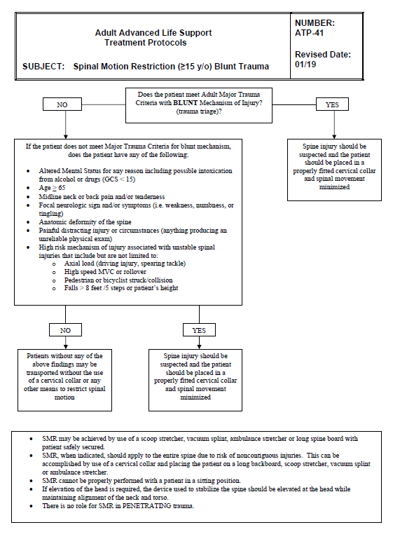
SMR Adult
Blunt Trauma

Slide 11
Adults: Low Risk Patients
Minor rear-end collisions
Ambulatory on scene at any time
No neck pain on scene
No midline cervical spine tenderness or anatomic abnormality
MUST BE GCS = 15, reliable, no distracting injuries, no intoxication, no neuro complaints or findings***
Notes:
Any of these low risk findings in NORMAL, RELIABLE, NON-DISTRACTED, NON-INTOXICATED patients allow for safe omission of SMR.

Slide 12
Adult Low Risk Patients
Ages15-65
***These patients do not need a collar or backboard***

Slide 13
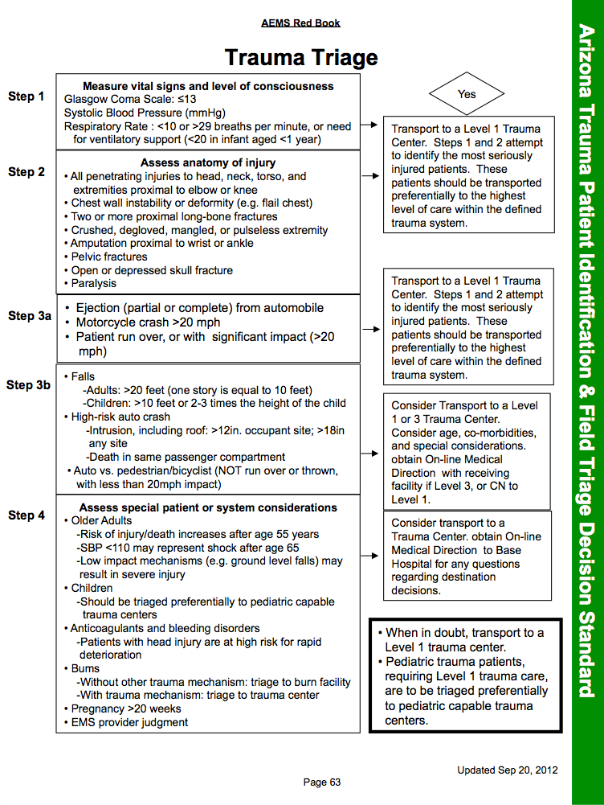
Notes:
** replace with CDC version-wg 4/16/19 ** add box for highlights. Review the dangerous mechanisms from the adult Trauma Triage page. For adults, these mechanisms justify the use of SMR.

Slide 14
** add slide for reminder decreasing movement verbage/increase pt safety. If refusal, please document.

Slide 15
Adult High Risk Patients
Age > 65!!!
Positive exam or complaint (deformity, midline pain, numbness, tingling or weakness)

Slide 16
Adult High Risk Patients
Step 3 from the trauma triage criteria (ACS criteria)
Adult fall > 20 feet (One story is equal 10 feet)
Ejection from automobile
Death in the same passenger compartment
Vehicle intrusion > 12 inches, occupant site. > 18 inches, any site
Motorcycle crash > 20mph
Auto vs. Pedestrian/Bicyclist (Thrown, run over, or with significant impact)

Slide 17
Adult High Risk Patients
Diving injuries or axial loading
Sudden acceleration/deceleration
Bending forces to the neck and torso
Violent impacts to the head, neck, torso or pelvis (excludes isolated penetrating trauma)
Presence of numbness or parasthesias

Slide 18
Adult High Risk Patients
***You should STRONGLY CONSIDER SMR packaging these patients***
As in, “default to a collar/supine at a minimum, until patient condition obviously deteriorates because of it.” If patient does not tolerate this, document on ePCR.

Slide 19
Adult High Risk Patients
If a patient meets high risk mechanism criteria, strongly consider SMR
Cervical collar and supine position on gurney, scoop stretcher, vacuum mattress, or backboard
If patient is unable to tolerate a collar, supine position, or backboard this MUST be clearly documented in the ePCR
If needed, hold manual c-spine instead of forcing a collar onto patient

Slide 20
Unreliable Patients
Uncooperative
Evidence of drug or alcohol intoxication and/or use
Do they have decision making capacity???
Painful or distracting injuries
Language barrier or inability to communicate
Dementia, developmental delay
**All of these patients must get some form of SMR. If you cannot apply a cervical collar, you must document why.**
Notes:
This group of patients is extremely high risk, as you cannot perform an adequate history and exam on them

Slide 21
Backboards
IMPORTANT!!!
Still reasonable for…
Blunt trauma with ALOC
Spine pain/tenderness and neuro complaint
Anatomic deformity of spine
High-energy mechanism or ALOC, distracting injury, inability to communicate
Notes:
One more time…

Slide 22
Isolated Penetrating Trauma
No role for SMR in Isolated Penetrating Trauma
**Applies to both Adults and Pediatrics**

Slide 23
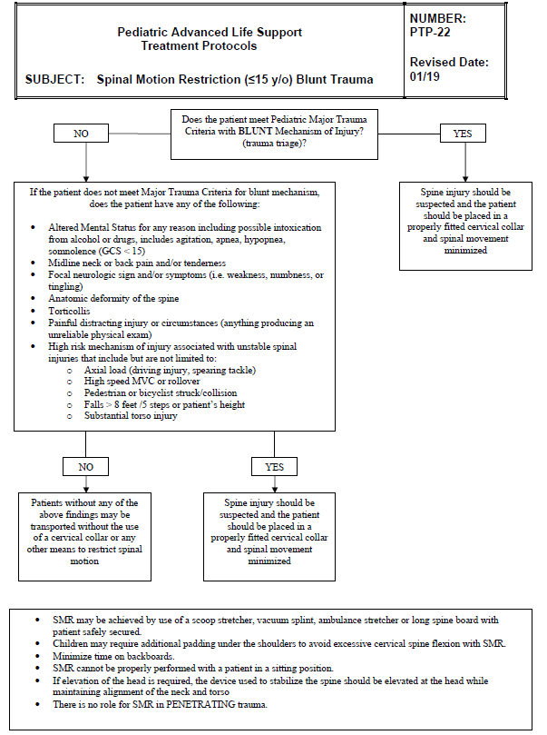
SMR Peds
Blunt Trauma

Slide 24
Pediatric High Risk Patients
Step 3 from the trauma triage criteria (ACS criteria)
Pediatric fall > 10 feet or 2-3 times the height of the child
Speed > 55 MPH
Ejection from automobile
Death in the same passenger compartment
Vehicle intrusion > 12 inches, occupant site. > 18 inches, any site
Head on or roll over collision
Motorcycle crash > 20mph
Auto vs. Pedestrian/Bicyclist (Thrown, run over, or with significant impact)
Notes:
Fall height is from CDC Field Triage

Slide 25
Pediatric High Risk Patients
Diving injuries or Axial loading
Sudden acceleration/deceleration
Bending forces to the neck and torso
Violent impacts to the head, neck, torso or pelvis (excludes isolated penetrating trauma)
Presence of numbness, parasthesias, or weakness
Altered LOC (GCS less than 15)

Slide 26
Pediatric Physical Assessment
Palpate the spine – pain or deformity?
Self-Limited movement of the neck = predictive of injury → Use collar with log roll precautions
Wrist/Hand extension bilaterally (no longer grips)
Foot plantar flexion bilaterally (push foot down)
Foot dorsiflexion bilaterally (pull foot up)
Check sensation in all extremities
Evaluate for numbness/tingling/parasthesias

Slide 27
Backboards
IMPORTANT!!!
Still reasonable for…
Blunt trauma with ALOC
Spine pain/tenderness and neuro complaint
Anatomic deformity of spine
High-energy mechanism or ALOC, distracting injury, inability to communicate
Notes:
One more time… review this consensus-based list.

Slide 28
Case Studies

Slide 29
Case #1
0540: Fall Injury
55 yo male, fell from standing at home, c/o lac to eyebrow, admit to 3 beers, found on ground
Clear speech, A/Ox4, motor exam nl, no TTP, FROM, sensory grossly intact
Notes:
Does this patient meet criteria for SMR now?

Slide 30
Case #1
En route to hospital now C/o tingling in both hands
How does this change your initial SMR decision?
What do you think happened while en route?

Slide 31
Case #2
1430: Fall Injury
58 yo obese male found on bathroom floor – very small space
Denied falling, just too weak in legs
Complex extrication, A/Ox4, motor intact, no TTP

Slide 32
Case #2
Hx of cervical spinal stenosis
C/O severe burning and tingling in hands
“But they always tingle to some degree…”
Does it matter that tingling may be old?
Does it matter if he fell? Can you trust story?

Slide 33
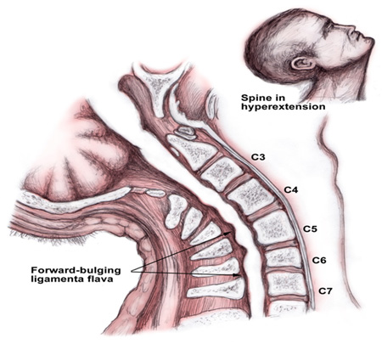
Central Cord Syndrome
Notes:
The classic example of cord injury from blunt compression without fracture is that of the central cord syndrome in a patient with hyperextension. The patient presents with extremity weakness in the upper extremities more than the lower, with possible sensory abnormalities below the level of the lesion and urinary retention. This results from buckling of hypertrophic ligamenta flava. This compression causes concussion or contusion of the central spinal cord.

Slide 34
Case #3
1815: 962
91 yo male, front passenger, T-boned to PS, moderate damage, found sitting in PS
C/O severe R ribcage pain, crying, difficult to assess due to pain
Motor intact, sensory intact, spine intact, ?TTP

Slide 35
Case #3
Patient screaming in pain once on backboard supine
HR 130, RR 30, obvious distress
Now what can you do?
Notes:
You have options in this case.
maintain full SMR, but treat pain with padding and/or fentanyl
Maintain collar and log-roll precautions, but remove backboard carefully and document why

Slide 36
Case #4
1448: Fall Injury
87 yo female, slip on wet sidewalk, found on ground, c/o R hip pain
RLE rotated, shortened, TTP hip, A/Ox4, motor/sensory intact, head normal, neck, back no TTP
Hip pain severe, tearful, yelling at times

Slide 37
Case #4
Isolated hip fractures and spine injury
Do we need to SMR all hip fractures > 65?
Study showed:
1394 patients with hip fracture, 23 (1.7%) had c-spine fracture as well
Of those > 65 (565 patients), standing or sitting mech only, only 2 (0.4%) had c-spine fractures
Both had other criteria to apply collar: head injury, ALOC

Slide 38
Case #4
Isolated hip fractures and spine injury
Do we need to SMR all hip fractures > 65?
Yes, SMR that hip fracture if you have sign or history of head injury, any ALOC, or other SMR indicators
But, pain from hip fracture alone might not mandate SMR

Slide 39
Case #5
62 y.o. female found by sister lying prone on ground with altered level of consciousness
Last seen 2 days prior
A & O x 2 (person & place)
Incontinent to urine
Left orbital swelling & bruising
Back = intact, no pain or step-offs
MS x 4 intact

Slide 40
Case #5
Collar?
Backboard?
Patient transported without any collar or backboard
Found to have diffusely metastatic cancer with brain lesions and lesions throughout the bones
C7 pathologic fracture with spinal cord compression
Underwent surgical repair of unstable fracture
Notes:
Pathologic fracture = fracture caused by cancer

Slide 41
Case #6
91 y.o. female sitting on the toilet
Fell forward, striking head
No loss of consciousness
Frontal hematoma
GCS 15 and A & O x 4
No midlines cervical, thoracic, or lumbar spine tenderness
No neurologic symptoms

Slide 42
Case #6
Collar?
Backboard?
Patient transported without cervical collar or SMR
Patient found to have Subdural hematoma and C1 fracture
Underwent surgical repair

Slide 43
Case #7
29 y.o. male police officer enters fire station to use the restroom
Fire personnel heard noise, found officer on ground
Officer not sure what caused him to fall
Repetitive questioning (what is GCS score?)
No midline cervical, thoracic, or lumbar spine tenderness
No neurologic symptoms

Slide 44
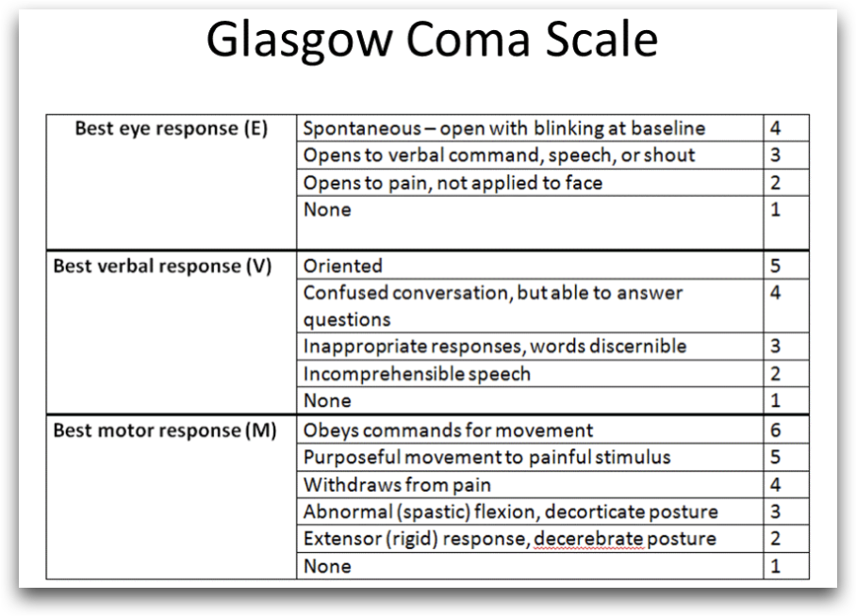
Notes:
Repetitive questioning is a verbal score of 4, not 5. This patient is UNRELIABLE and needs some form of SMR!!!

Slide 45
Case #7
Collar?
Backboard?
Patient transported without collar or SMR
GCS incorrectly scored as “15”
Patient found to have vertebral fracture with vertebral artery dissection

Slide 46
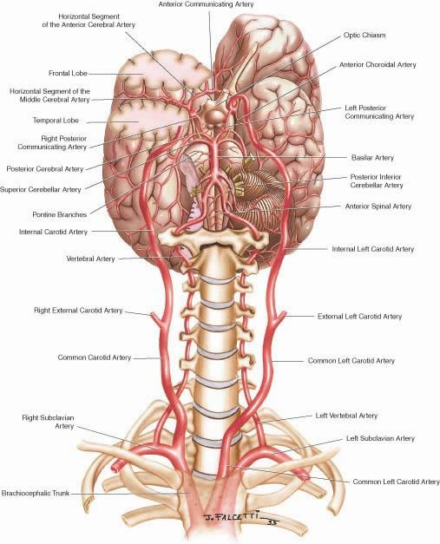
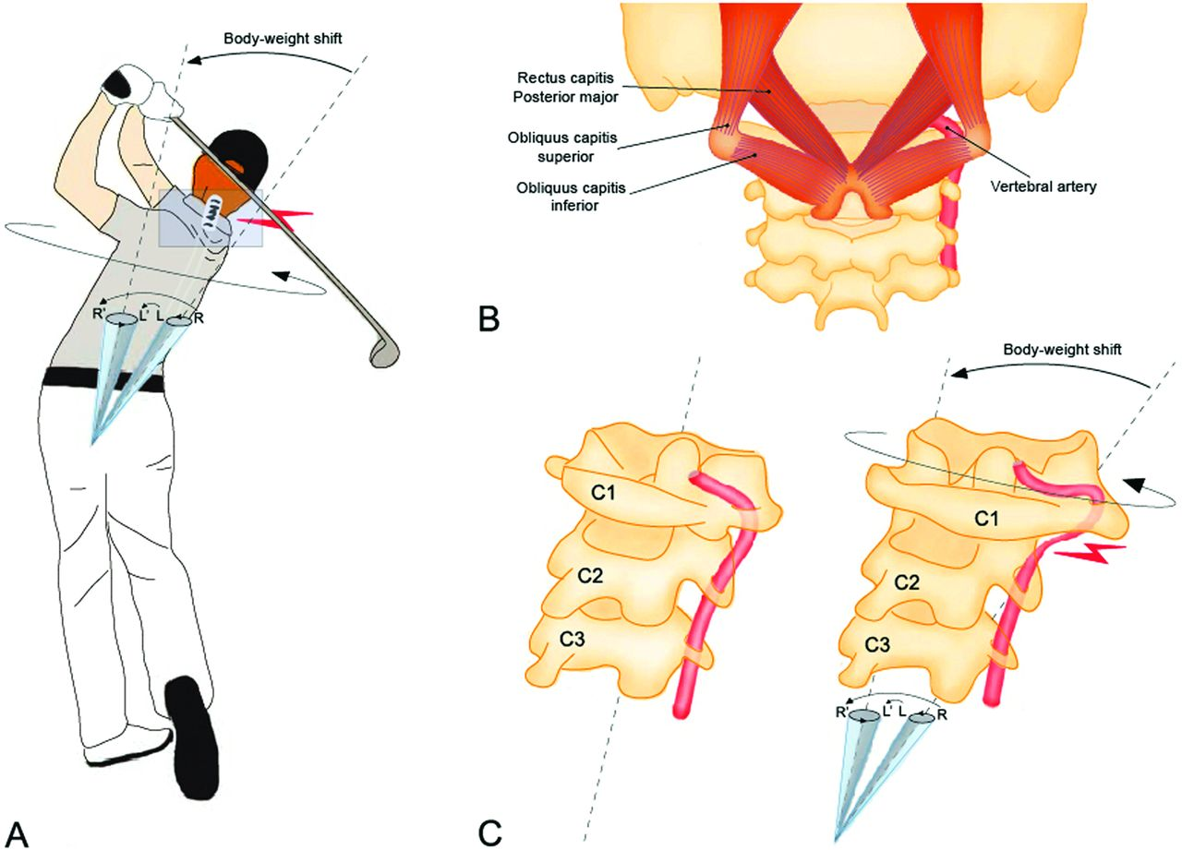
Vertebral Artery & Spine

Slide 47
Car Seats?

Slide 48
Car Seats
Ok to use if:
car drivable
nearest car door undamaged
no injuries to any occupant
no airbag deployment
no visible damage
Notes:
According to NHSTA

Slide 49
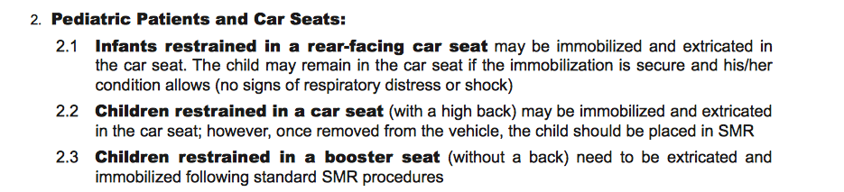
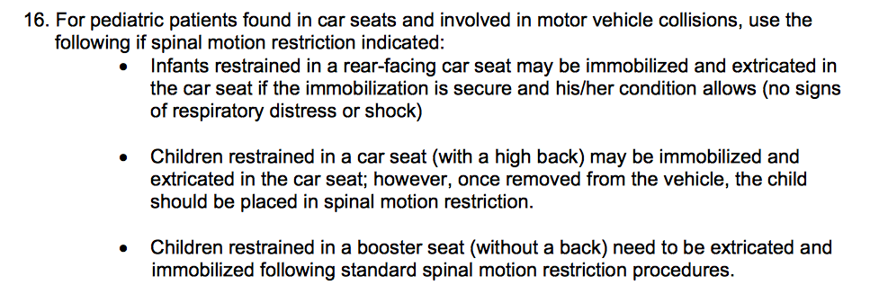
Car Seats
Notes:
Example from Alameda County and State of Oklahoma.

Slide 50
Case #8
1235: Sports Injury
17 yo male, high school football game, rough tackle with hard head impact, brief LOC
C/o headache, nausea, amnestic to event, but now A/Ox4; normal neuro exam, neck/back normal
Was ambulatory on scene
Trainer and private EMS applied full SMR: backboard/collar

Slide 51
Schools, Pools, Sports
Be a good neighbor
Reach out to city pools, school sports programs
Work with lifeguard, athletic trainer groups
Make sure vision, concepts, expectations are aligned
If already packaged, don’t change course unless something going wrong

Slide 52
Case #9
1755: Fall from horse
38 yo female fall from horse, walked out 0.5 miles to road
C/O neck/back soreness, +scalp abrasion diffuse back muscle TTP, neuro intact, GCS = 15, A/O x 4

Slide 53
Case #9
May not need any SMR
Patient transported in position of comfort
ED work up negative
Sister wrote complaint to Fire Chief and Mayor (no collar or backboard! “malpractice!”)
Crew didn’t explain decision/protocol to patient or family

Slide 54
Case #9
SMR is still considered new
Patients, family, other health care professionals might not understand
Make sure vision, concepts, expectations are aligned
Notes:
**combine slides 52-54 for discussion, decision making why/why not, expectations of others, mismatched expectations, reminder for communication onscene

Slide 55
Case #10
1010: MVC
12 yo male, rear passenger, car struck from behind, mod damage
Hx of Down’s Syndrome
Was ambulatory on scene

Slide 56
Case #10
Friendly on exam, follows commands, A/O to self, location, circumstance, day
GCS = 15
Mild muscular neck TTP, neuro intact

Slide 57
Pediatric Predictors of Spine Injury
AMS, neuro deficits (same as adults)
Neck pain, not midline tenderness
Torticollis (stiffness), substantial torso injury, diving, high-risk MVC, and predisposing conditions
What are predisposing conditions?
Notes:
There is high quality research that describes features uniquely associated to pediatric patients that help predict c-spine injury. The first 2 sound familiar; AMS and focal near deficits. However, researchers did not find posterior midline neck tenderness to be associated with injury, but self-reported neck pain and torticollis were.
We also see diving and high-risk auto accidents, both “mechanisms,” which is what we have been emphasizing less in screening adults. “Predisposing conditions” like Down’s syndrome are also included.
Leonard found that having 1 or more of these findings was 98% sensitive and 26% specific for c-spine injury.

Slide 58
Atlantoaxial Instability (AAI)
Occurs in approximately 15% of people with Down Syndrome
Typically asymptomatic
Can result in instability (laxity) of the cervical spine
More prone to spinal injuries with spinal manipulation (including SMR/collar use)
Manipulation of neck for airway management can result in spinal cord injury in patients with AAI

Slide 59
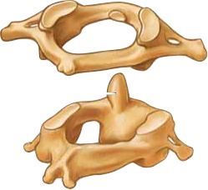
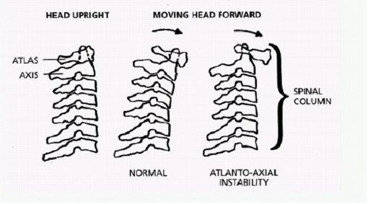
Atlantoaxial Instability
Atlas
Axis
Notes:
Approximately 15% of Downs Syndrome patients suffer from AAI. The exact cause is not known, but it likely is due to laxity in the cruciate ligament that holds together C1 and C2.

Slide 60
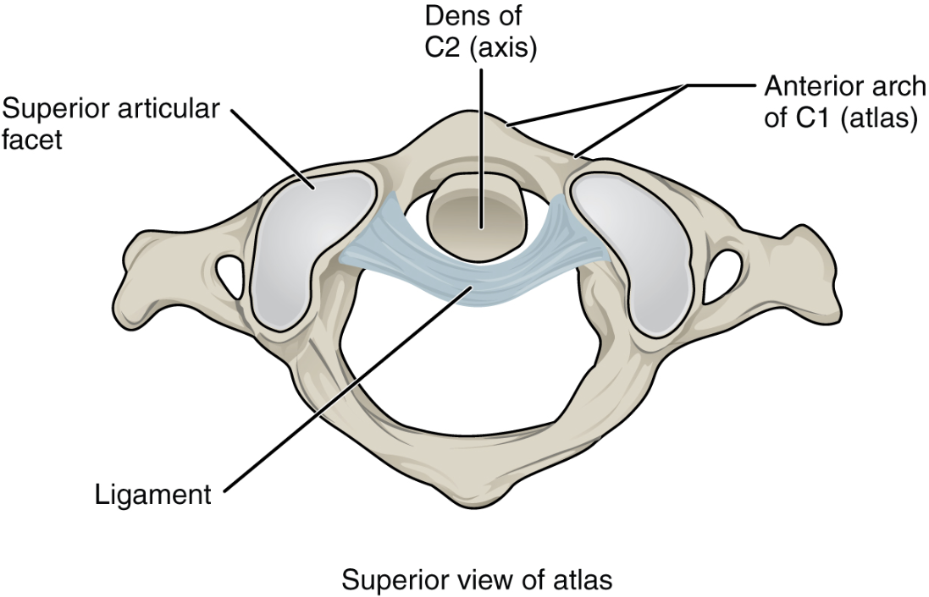

Slide 61
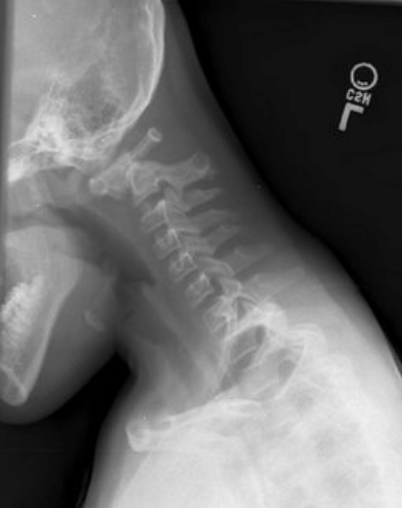
C-1 subluxed on C-2
compresses spinal cord

Slide 62
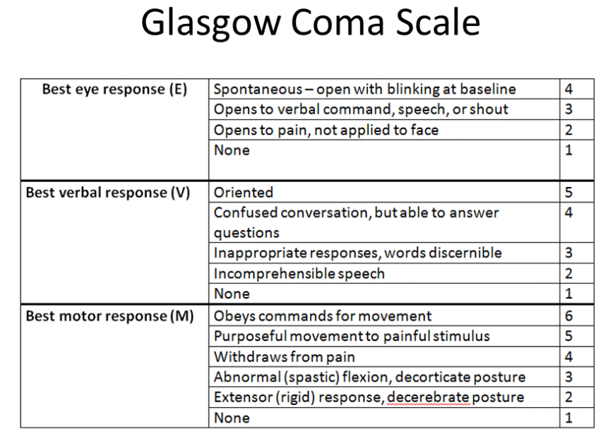
Notes:
Very often we see crews give patients GCS scores of 15 when they are confused, repetitive, amnestic to the event, etc. These are not 15s. They are less than 15 and as such, MANDATE some form of SMR when mechanism is present or suspected. If you don’t understand the GCS, best to revisit and rehearse it.

Slide 63
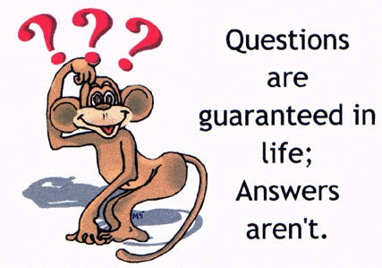
Questions

Slide 64
THANK YOU
Presenter Name | Title
presentersemail@azdhs.gov | 602-542-1025
azhealth.gov
@azdhs
facebook.com/azdhs

