Slide 1

Questions & Answers about Clostridium difficile Infection (CDI) for Non-Clinical
Healthcare Workers
HAI Prevention Strategies Subcommittee
August 2011
These presentation slide sets were developed by the Prevention Strategies Subcommittee of the Arizona Healthcare-Associated Infection (HAI) Advisory Committee. Their works was guided by the best available evidence at the time this document was created. The objectives of the PSS are directed at providing access to additional resources for healthcare facilities, creating a repository of informational anc constructing a toolkit of strategies to assist facilities in preventing healthcare-associated infections.

Slide 2
What is Clostridium difficile (C. difficile)?

Slide 3
Clostridium difficile [pronounced Klo-STRID-ee-um dif-uh-SEEL], also known as C. difficile [See-dif-uh-SEEL], is a germ that can cause diarrhea.
Most cases of C. difficile infection occur in patients taking antibiotics.
What is Clostridium difficile (C. difficile)?

Slide 4
C. difficile
Is a germ that causes diarrhea
It can occur when a person takes antibiotics
It can be transferred to others by not washing hands and cleaning equipment and the environment properly

Slide 5
How does C. difficile cause disease?

Slide 6
C. difficile bacteria can be found in the intestines of healthy people.
It is usually kept under control by other normal bacteria.
How does C. difficile cause disease? (continued)

Slide 7
When a person takes an antibiotic, some of the normal bacteria die and C. difficile bacteria can multiply.
When C. difficile bacteria multiply, some of them can produce toxins that cause diarrhea or inflammation of the colon.
How does C. difficile cause disease? (continued)

Slide 8
Good bacteria can die and the C. difficile bacteria can multiply and cause illness when people take antibiotics

Slide 9
What are the most common symptoms of CDI?

Slide 10
The most common symptoms are:
Watery diarrhea
Fever
Loss of appetite
Nausea
Belly pain and tenderness
What are the most common symptoms of CDI? (continued)

Slide 11
What are the differences between C. difficile colonization and
C. difficile -infection?

Slide 12
What are the differences between C. difficile colonization and
C. difficile -infection?
Characteristics | C. difficile colonization* | C. difficile infection
Patient has clinical symptoms | NO | Yes
Patient tests positive for Clostridium difficile organism and/or its toxin | Yes | Yes
Patient can transmit infection | Yes but not as easily | Yes
* More common than the C. difficile infection
What are the differences between of Clostridium difficile colonization and Clostridium difficile infection? (continued)

Slide 13
Infection causes symptoms such as diarrhea
Colonized people can be contagious but they do not have symptoms

Slide 14
Who is most likely to get CDI?

Slide 15
The risk for disease increases in patients who:
are being given antibiotics
have had gastrointestinal surgery
have been in a healthcare setting for a long time
have a serious illness
have a weak immune system
are older in age
Who is most likely to get CDI? (continued)

Slide 16
How is C. difficile spread?

Slide 17
C. difficile is shed in stool.
C. difficile can live outside the human body for a very long time.
How is Clostridium difficile spread? (continued)

Slide 18
C. difficile can live on surfaces for a long time and may be found on things around us such as:
  bed linens,
  bed rails,
  bathroom fixtures,
  and equipment.
How is Clostridium difficile spread? (continued)

Slide 19
C. difficile infection can easily spread from person-to-person on:
  contaminated equipment
  hands of:
    Doctors
    Nurses
    other healthcare providers
    visitors.
How is Clostridium difficile spread? (continued)

Slide 20
C. difficile
Can be spread by dirty hands and dirty equipment
Healthcare workers, visitors and patients can spread C. difficile if they do not wash their hands properly

Slide 21
How is CDI treated?

Slide 22
When patients taking antibiotics get C. difficile the symptoms will sometimes get better 2-3 days after stopping the antibiotic.
How is CDI treated? (continued)

Slide 23
Antibiotics can be used to treat
C. difficile. Some of these are:
  metronidazole and
  Vancomycin
How is CDI treated? (continued)

Slide 24
In some severe cases, a person might have to have surgery to remove the infected part of the intestines. This surgery is needed in only 1 or 2 out of 100 people with C. difficile.
How is CDI treated? (continued)

Slide 25
How can CDI infection be prevented in hospitals and other healthcare settings?

Slide 26
Use antibiotics carefully
Wash hands with soap and water before and after caring for every patient and touching contaminated surfaces and equipment
How can CDI be presented in hospitals and other healthcare settings? (continued)

Slide 27
Carefully clean hospital rooms and equipment that have been used for patients with C. difficile.
  Always follow the instructions on the container of cleaning agent that is being used.
How can CDI be presented in hospitals and other healthcare settings? (continued)

Slide 28
Use Contact Precautions for patients with known or suspected C. difficile infection:
  Place these patients in private rooms.
  If private rooms are not available, these patients can be placed in rooms (cohorted) with other patients with C. difficile infection.
How can CDI be presented in hospitals and other healthcare settings? (continued)

Slide 29
  Use gloves and gowns when entering patients’ rooms and during patient care.
  When leaving the room, remove gown and gloves and clean hands.
    Alcohol does not kill C. difficile spores.
    Wash hands vigorously with soap and water whenever possible.
    Some scientific studies have shown that even with soap and water removal of C. difficile can be hard.
    Because of this vigorously washing with the soap and water is very important
How can Clostridium difficile infection be presented in hospitals and other healthcare settings? (continued)

Slide 30
Isolation and PPE
Place patient is private room when possible or cohort
Make certain all persons entering the room use the proper personal protective equipment such as gowns and gloves
Wash Hands vigorously with Soap and Water

Slide 31

Donning Gown
    Fully cover torso from neck to knees,
    arms to end of wrist, and wrap around the back
    Fasten in back at neck and waist

Slide 32

Donning Gloves
Use non-sterile for isolation
Select according to hand size
Extend to cover wrist of isolation gown

Slide 33
Removing PPE
Remove PPE at doorway before leaving patient room or in anteroom
Remove gloves first
Then remove gown
Dispose of before leaving room

Slide 34

Glove Removal
Outside of gloves are contaminated!
Grasp outside of glove with opposite gloved hand; peel off
Hold removed glove in gloved hand
Slide fingers of ungloved hand under remaining glove at wrist

Slide 35
Gown Removal
Gown front and sleeves are contaminated!
Unfasten neck, then waist ties
Remove gown using a peeling motion; pull gown from each shoulder toward the same hand
Gown will turn inside out
Hold removed gown away from body, roll into a bundle and discard into waste or linen receptacle

Slide 36
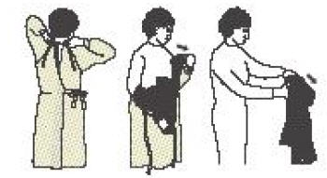

Slide 37
  Dedicate or perform cleaning of any shared medical equipment.
  CONTINUE THESE PRECAUTIONS UNTIL DIARRHEA STOPS
    Because patients infected with C. difficile still have the C. difficile spores in their body for a number of days after diarrhea has stopped some healthcare facilities continue contact precautions for awhile after symptoms have stopped. It is important to follow the rules of your facility.
How can CDI be presented in hospitals and other healthcare settings? (continued)

Slide 38
What can I use to clean and disinfect surfaces and devices to help control C. difficile ?

Slide 39
What can I use to clean and disinfect surfaces and devices to help control Clostridium difficile ?
Surfaces should be kept clean, and body fluid spills should be taken care of right away. (For more information see CDC’s “Guidelines for Environmental Infection Control in Health-Care Facilities.” found at http://www.cdc.gov/hicpac/pdf/guidelines/eic_in_HCF_03.pdf)

Slide 40
Clean surfaces as soon as possible after they become soiled and clean the patient area and equipment often

Slide 41
What can I use to clean and disinfect surfaces and devices to help control Clostridium difficile ?
Hospital cleaning products can be used for routine cleaning.
  Hypochlorite-based (bleach) disinfectants have been used with some success for cleaning and disinfection in patient-care areas where spread of C. difficile has been happening.
Note: EPA-registered hospital disinfectants are recommended for general use whenever possible in patient-care areas.

Slide 42
Use the correct cleaner and disinfectant
Follow the directions for use on the container.
Use EPA registered disinfectants in healthcare settings

Slide 43
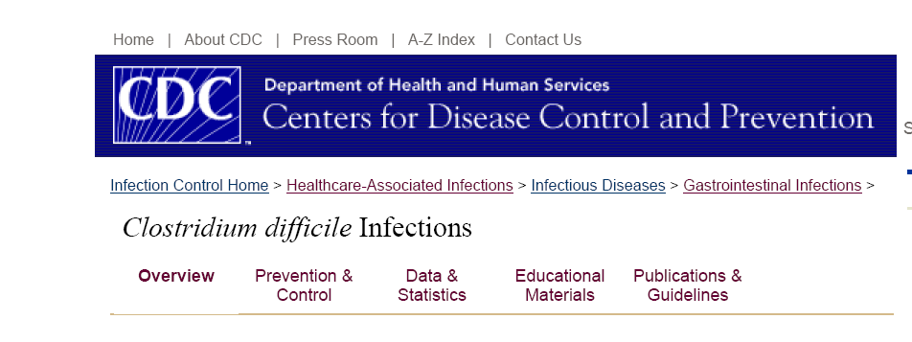
Primary References:
CDC Frequently Asked Questions: Information for Healthcare Providers, Released August 2004; Updated 07/20/2010
CDC Clostridium difficile Infections Web Site
http://www.cdc.gov/ncidod/dhqp/id_Cdiff.html
Frequently Asked Questions about Clostridium difficile. SHEA. 2008.

Slide 44
Guidelines
Clostridium difficile-associated diarrhea and colitis* SHEA 1995 : October 2008 Update to 1995 SHEA/IDSA CDI guidelines (ICHE October 2008) http://www.shea-online.org/assets/files/position_papers/Cldiff95.PDF
Guideline for Isolation Precautions: Preventing Transmission of Infectious Agents in Healthcare Settings 2007 http://www.cdc.gov/hicpac/2007IP/2007isolationPrecautions.html
Management of Multidrug-Resistant Organisms In Healthcare Settings, 2006 http://www.cdc.gov/hicpac/mdro/mdro_0.html
Guideline for Environmental Infection Control in Health-Care Facilities, 2003 http://www.cdc.gov/hicpac/pdf/guidelines/eic_in_HCF_03.pdf
C. difficile Excerpt: Guideline for Environmental Infection Control in Health-Care Facilities, 2003 http://www.cdc.gov/ncidod/dhqp/id_Cdiff_excerpts.html
Hand Hygiene in Healthcare Settings, 2002 MMWR 2002 http://www.cdc.gov/mmwr/PDF/rr/rr5116.pdf

Slide 45
Other Resources
Continuing Education
Risk Factors for and Estimated Incidence of Community-Associated Clostridium difficile Infection, North Carolina, USA *
http://cme.medscape.com/viewarticle/715799
Educational Materials
Patient FAQ's about Clostridium difficile
http://www.cdc.gov/ncidod/dhqp/pdf/guidelines/Cdiff_tagged.pdf
En español: Preguntas frecuentes "Clostridium difficile"
http://www.cdc.gov/ncidod/dhqp/pdf/guidelines/SPAN_C-Diff.pdf
Clostridium difficile (CDI) Infections Toolkit http://www.cdc.gov/hai/pdfs/toolkits/CDItoolkitwhite_clearance_edits.pdf
Wipe Out CDAD*
http://www.rmei.com/cdadposter/WipeOutCDAD-Poster.pdf
Understanding Clostridium difficile*
http://www.rmei.com/cdadbrochure/UnderstandingCD-Brochure.pdf

Slide 46

Questions?

