Slide 1
VFC 400 LogTag Data Logger Set Up Instructions and Training
Arizona Immunization Program Office

Slide 2
VFC400 Data Logger Installation Kit
Your Kit Includes:
VFC400 Data Logger
Stainless Steel Probe encased in glycol
Acrylic stand for probe and mounting equipment for logger
Adhesive backed zip tie mounts and zip ties for securing cable
Spare battery
2 year NIST traceable Certificate of Calibration compliant to ISO 17025: 2005

Slide 3
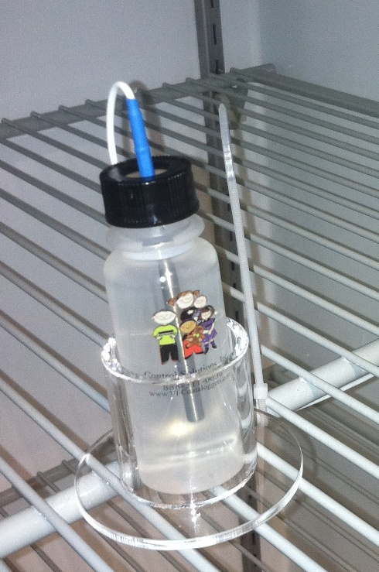
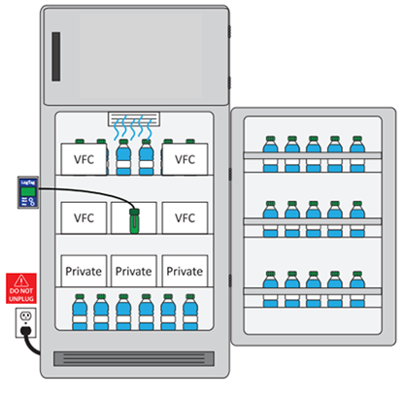
STEP 1: Place the Probe in the Unit
Place the glycol bottle and probe upright in the middle of the cold storage unit where the VFC vaccines are required to be placed.
  Allow the glycol bottle and probe to acclimate to the temperature of the unit prior to connecting the data logger display

Slide 4
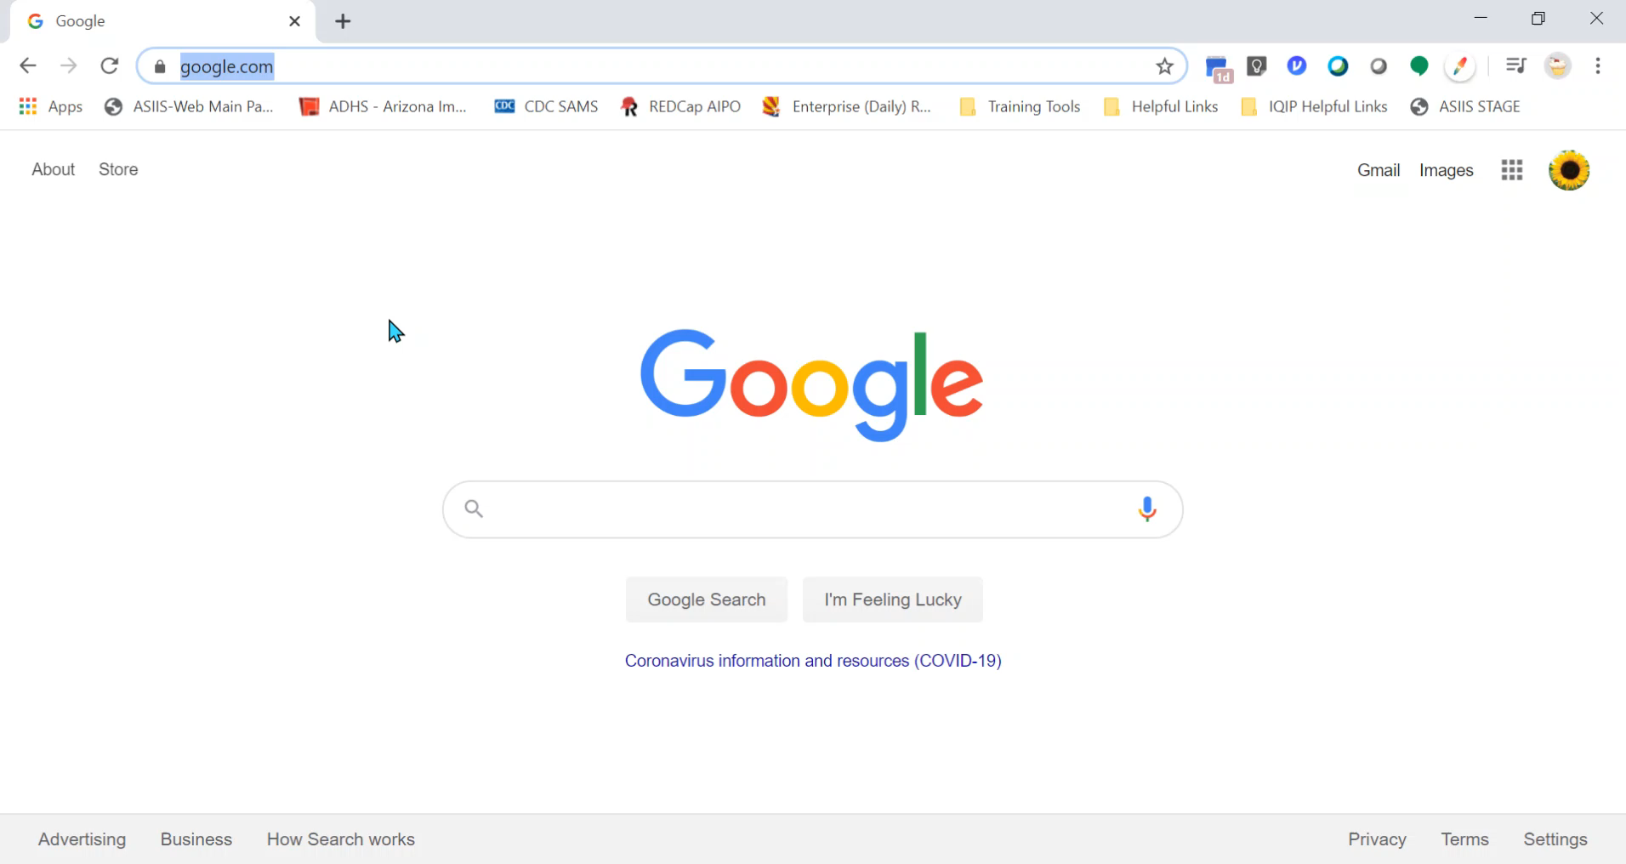
STEP 2: Download Software
Note: IT assistance may be required to download and install the software
PDF Download Instructions: http://www.vfcdataloggers.com/content/Part%202%20Software%20Download.pdf

Slide 5
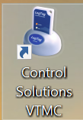
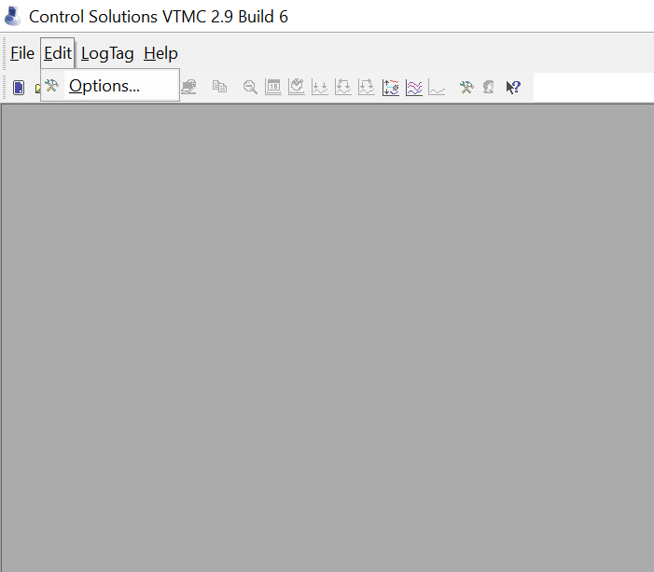
STEP 3: Software Set-up
After the software has been installed, double click on the Control Solutions VTMC icon.
When the program opens, select Edit and then select Options from the drop down.

Slide 6
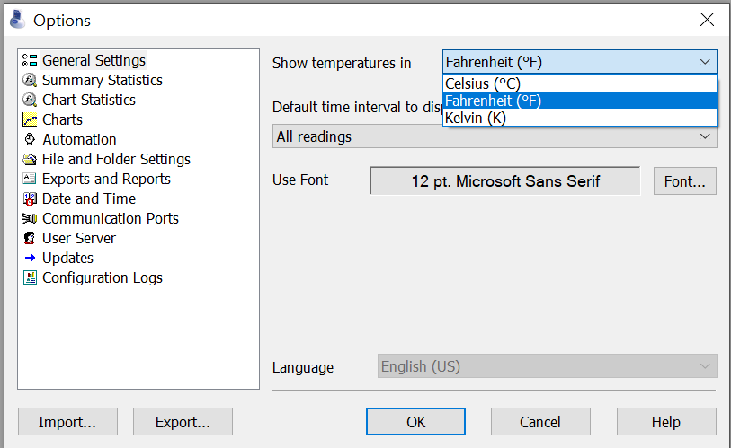
STEP 3: Software Set-up
Select
General Settings
Select °F or °C in the drop down list. This will be the temperature scale the reports will display in on your computer.

Slide 7
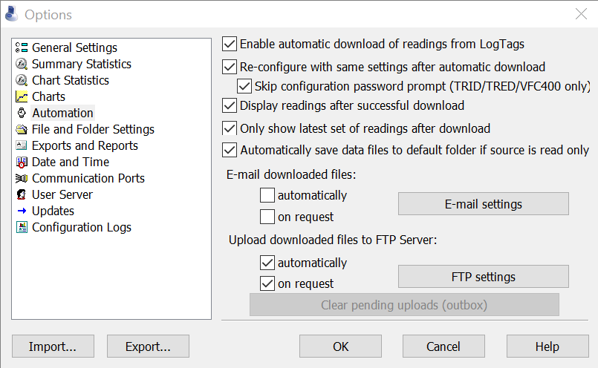
STEP 3: Software Set-up
Select Automation
Match the settings checked in the picture
Note: The FTP Server settings are for the VTMC Cloud Monitoring service. For more information on the cloud service please visit: vfcdataloggers.com or view the separate VFC 400 Cloud powerpoint if you received a VFC 400 data logger from the AIPO.

Slide 8
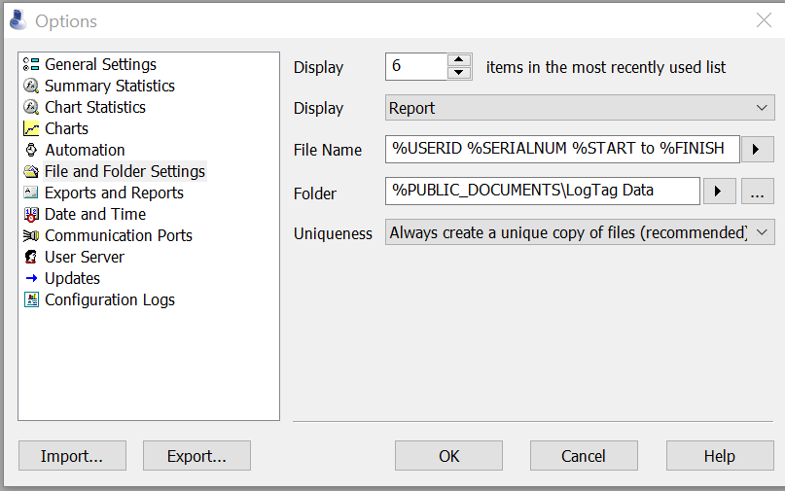
STEP 3: Software Set-up
Select
File and Folder Settings
By default the VFC 400 software will save the data to: Users>Public>Public Documents>LogTag Data so anyone logged onto the PC can access the data.
Select OK to finish the software set-up
Note: to change the location the data logger reports save to, select the … to choose a different folder
  Any location selected should be on a shared drive where all staff can access it.
  Data logger reports must be maintained for 6 years.

Slide 9
VFC 400: Data Logger Configuration
Arizona Immunization Program Office

Slide 10
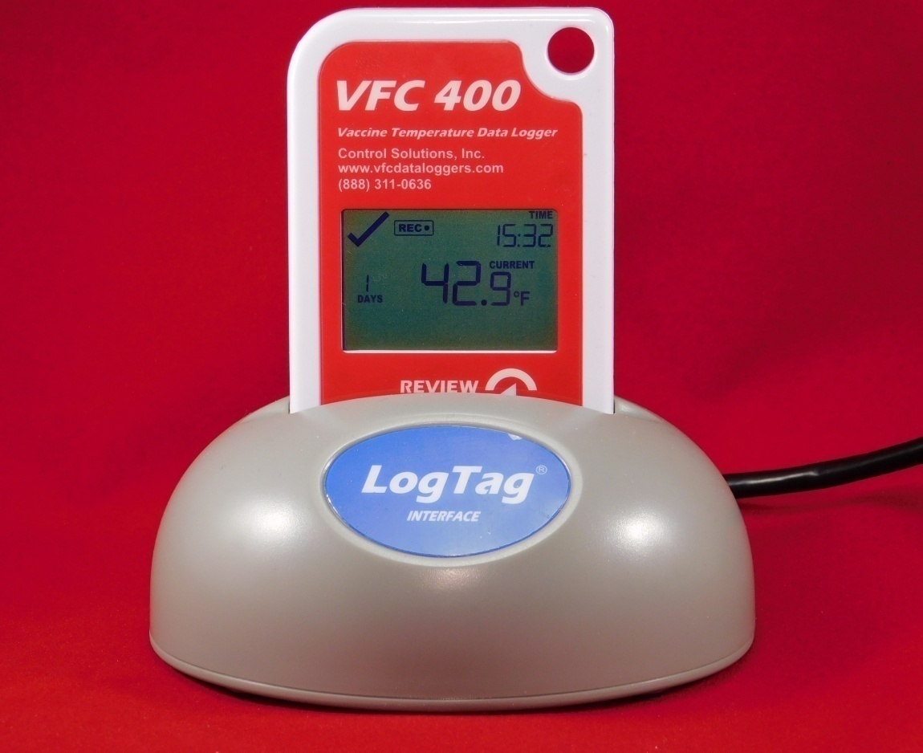
STEP 1: Docking your Data Logger
Open the Control Solutions VTMC Program
Plug the docking station into the USB port of the computer.
Firmly insert data logger into the docking station.
Note: If the data logger is inserted in the docking station before opening the Control Solutions VTMC program, remove it and re-insert it to begin the report download
Docking Station

Slide 11
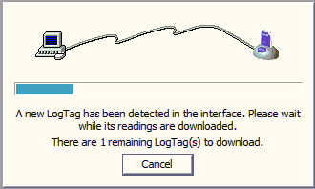
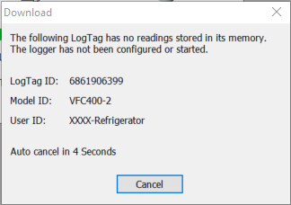
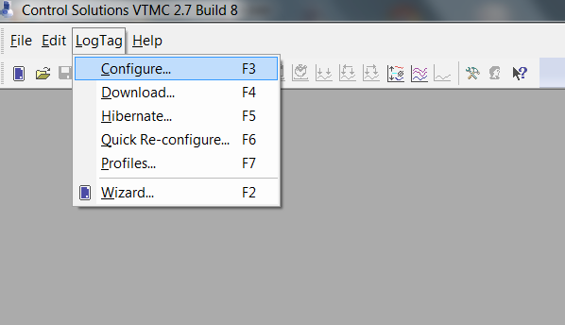
STEP 2: Data Logger Configuration
The following two screens will display in succession after the data logger has been docked for the first time
Select LogTag from the top left menu and then select Configure to begin the data logger configuration process

Slide 12
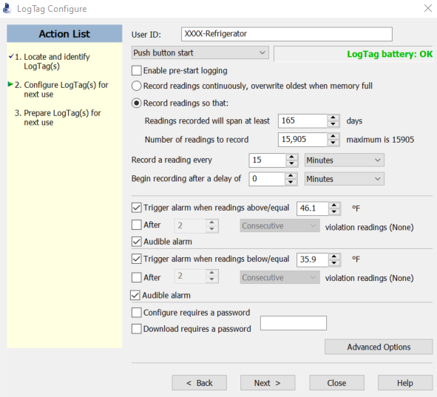
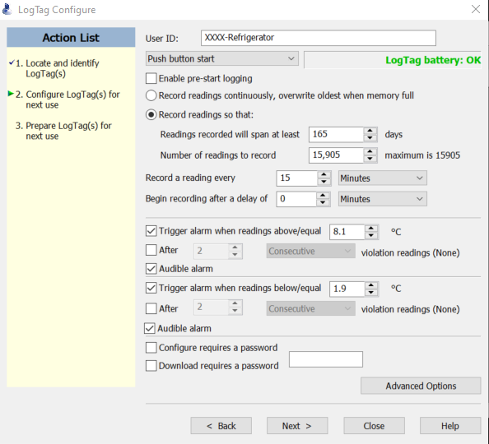
STEP 2: Refrigerator Configuration Settings
°F
°C
Match the above configuration settings for the temperature scale you will be documenting temperatures in. Once complete, press Next to finish the configuration process.

Slide 13
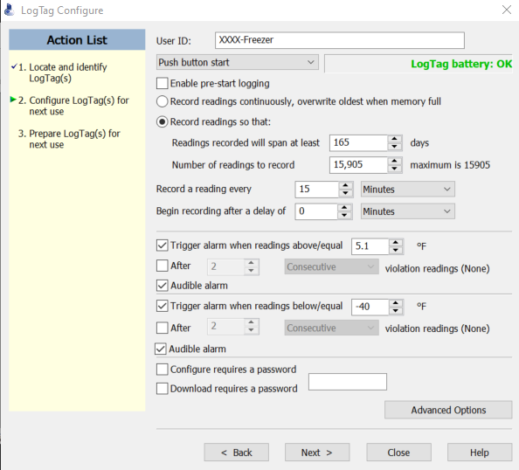
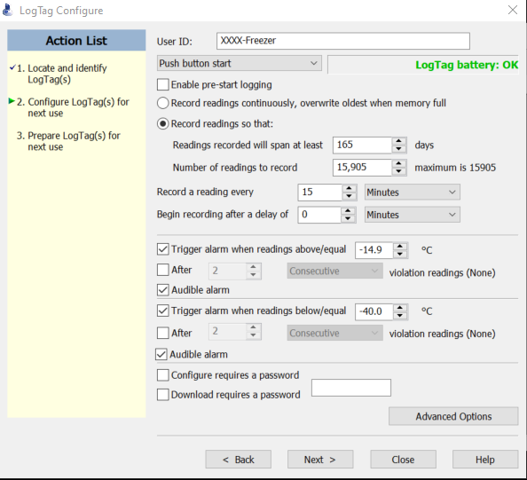
STEP 2: Freezer Configuration Setting
°F
°C
Match the above configuration settings for the temperature scale you will be documenting temperatures in. Once complete, press Next to finish the configuration process.

Slide 14
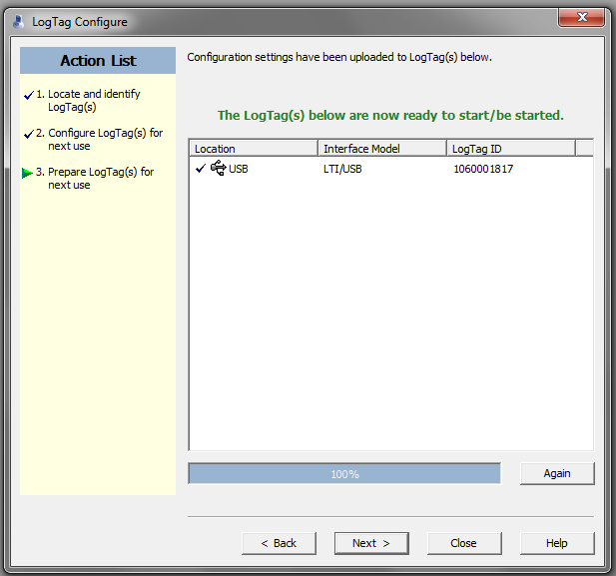
STEP 2: VFC 400 Data Logger Configuration
When this screen appears click “Close”.

Slide 15
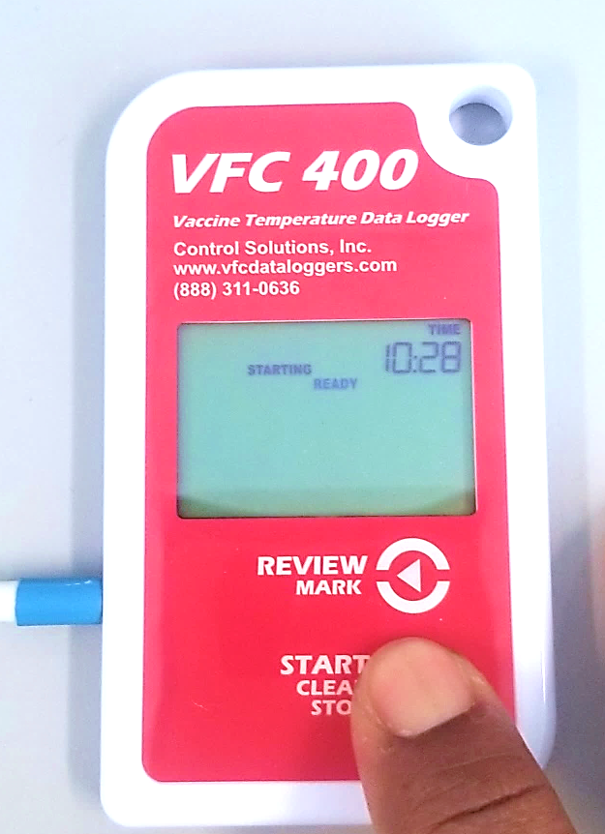
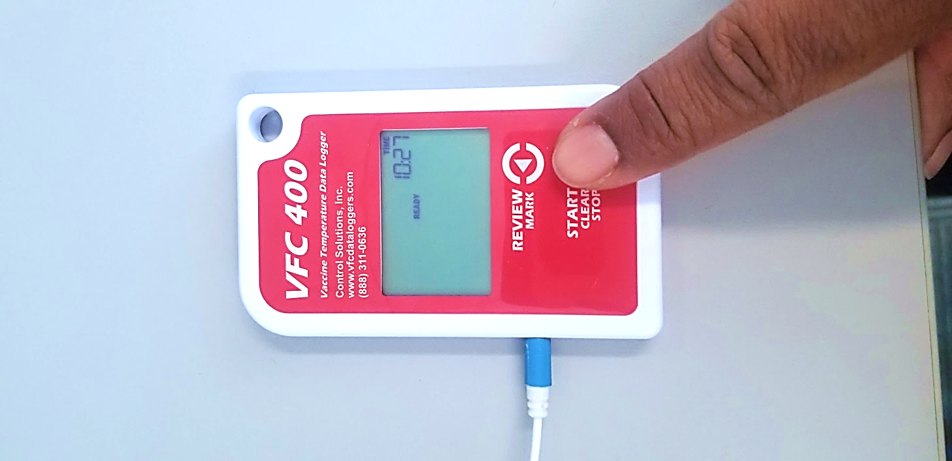
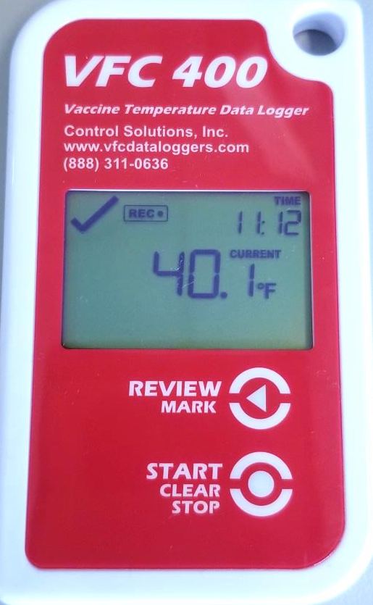
STEP 3: Start Data Recording
Remove the data logger from the docking station and re-attach it to the temperature probe.
Hold the START/CLEAR/STOP button until the word “starting” remains solid on the screen (about 1-2 seconds).
Remove your finger and the data logger will start recording. The current temperature will display and there will be an REC icon displayed on the screen
Ensure that the current temperature is showing on the display before walking away from the data logger.

Slide 16
VFC 400: Operation of the Data Logger
Arizona Immunization Program Office

Slide 17
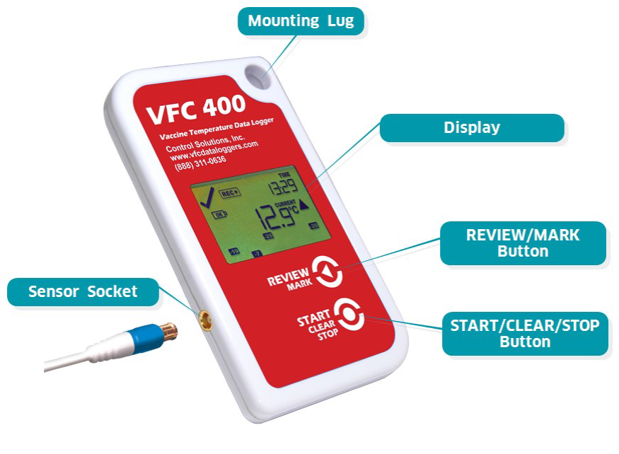
Operation of the VFC 400: Buttons/Actions Overview
Review/Mark button
Press to enter REVIEW mode and then press again to advance through the min/max temperatures.
Start/Clear/Stop button
Hold to start recording
Hold to stop recording
Press to exit day summary

Slide 18
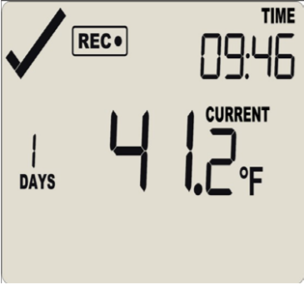
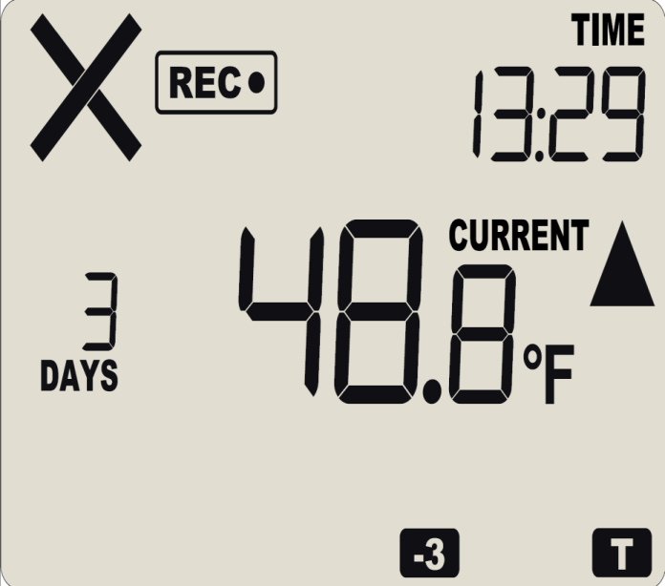
Operation of the VFC 400
Alarm Indicator: The alarm indicator in the top left will change from the ‘✔’ in the top image to the ‘X’ in the bottom image if out of range temperatures are recorded.
Recording Indicator: The REC● symbol will show when the data logger is recording.
Days Recording: The number above “DAYS” indicates how many days the data logger has been actively recording.
Temperature Display: By default the data logger will display the most recently recorded temperature.
High/Low Symbols: If an alarm has occurred, the ▲\▼ symbols communicate whether it was a high or low alarm.
Alarm Details: The “-3” on the bottom of the display informs that an alarm occurred three days ago; the “T” is displayed because another alarm occurred today.

Slide 19
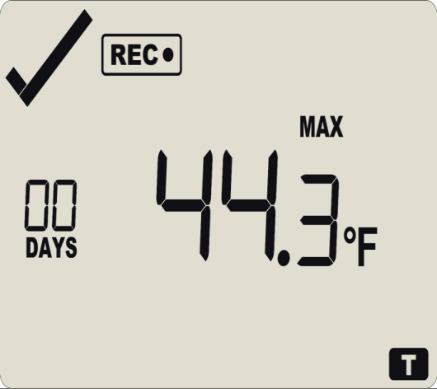
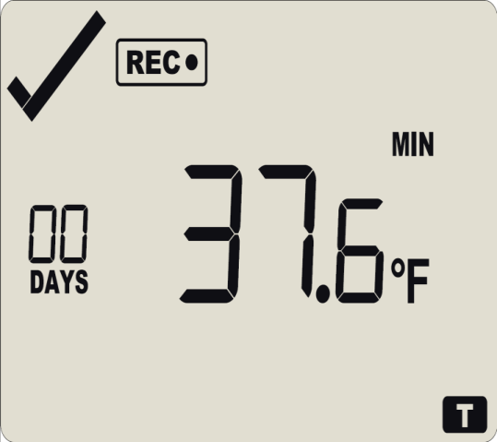
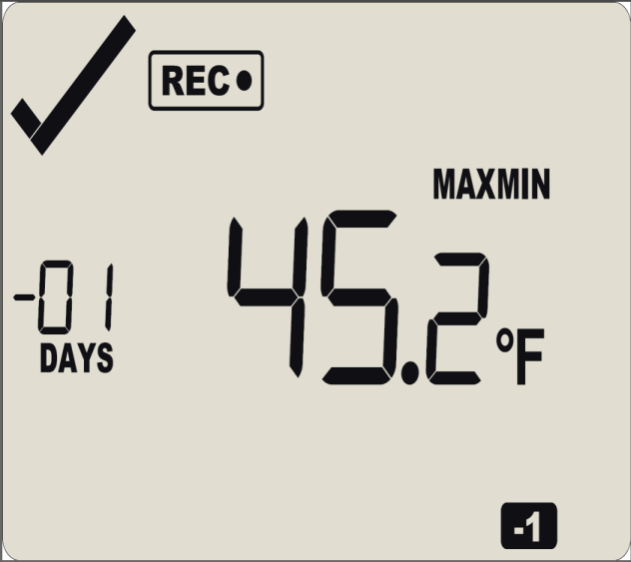
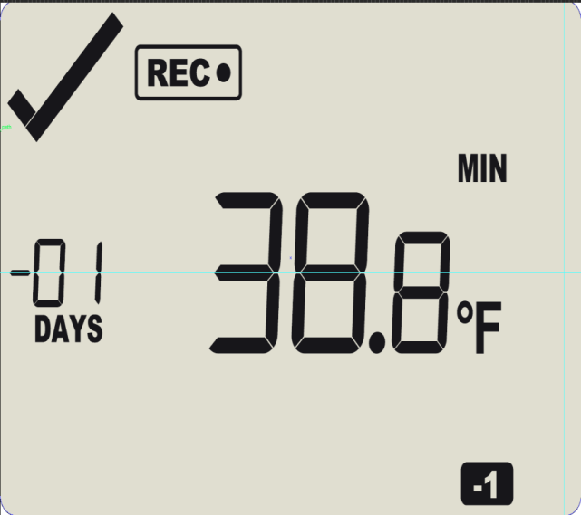
Operation of the VFC 400
Review Min/Max Temperatures: To review the minimum and maximum temperatures, press the Review/Mark button on the data logger to enter review mode. Continuing to press the Review/Mark button will cycle through all temperatures currently stored on the data logger.
Review Mode: The “T” in review mode will flash indicating you are reviewing the temperatures from the current day and will show “00” above “DAYS.”
Review Mode: When reviewing temperatures from the previous day a “-1” will show in the bottom right and “-01” will display above “DAYS” on the left of the display. These will display “-2” and “-02” for the day before that, and so on.

Slide 20
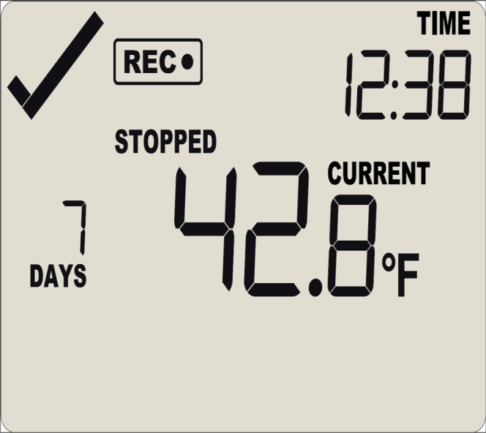
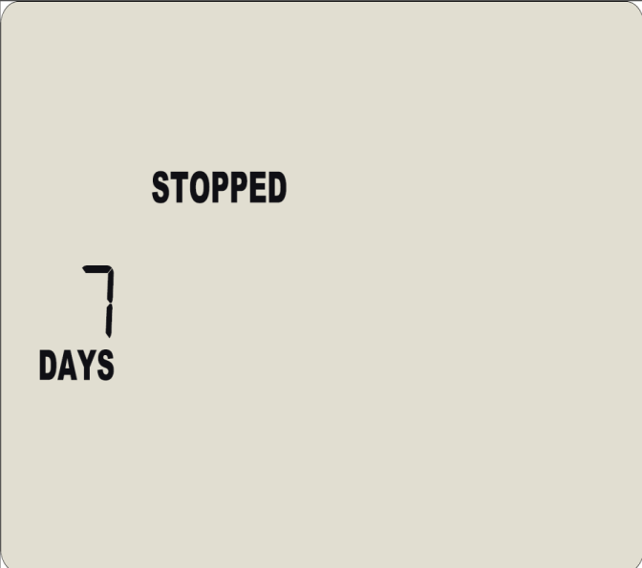
STEP 5: Operation of the VFC 400
Stopping the Data Logger: Press and hold Start/Clear/Stop for 1-2 seconds. The “STOPPED” text will display and the REC● symbol will disappear. Release the Start/Clear/Stop button after the REC● symbol disappears.
Total days recorded: When the data logger is stopped, the “DAYS” indicator on the left will display the total number of days for which the data logger was recording.
Important Note
The data logger must be stopped before it can be unplugged and placed in the docking station. Failure to do so will result in errant temperatures on the data logger report.

Slide 21
VFC 400: Downloading Your Report
Arizona Immunization Program Office

Slide 22
STEP 1: Stopping the Data Logger
Stopping the Data Logger: Press and hold Start/Clear/Stop for 1-2 seconds. The “STOPPED” text will display and the REC● symbol will disappear. Release the Start/Clear/Stop button after the REC● symbol disappears.
Total days recorded: When the data logger is stopped, the “DAYS” indicator on the left will display the total number of days for which the data logger was recording.
Important note
The data logger must be stopped before it can be unplugged and placed in the docking station. Failure to do so will result in errant temperatures on the data logger report.

Slide 23
STEP 2: Docking your Data Logger
Open the Control Solutions VTMC Program
Plug the docking station into the USB port of the computer.
Firmly insert data logger into the docking station.
Note: If the data logger is inserted in the docking station before opening the Control Solutions VTMC program, remove it and re-insert it to begin the report download
Docking Station

Slide 24
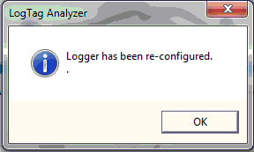
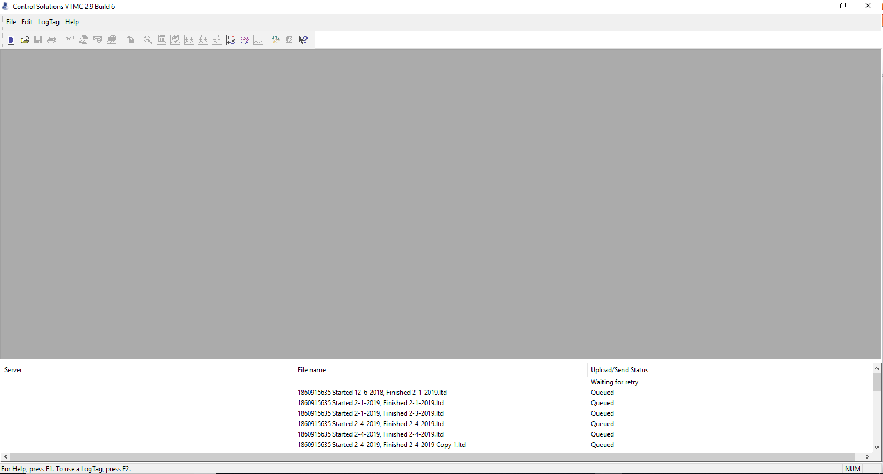
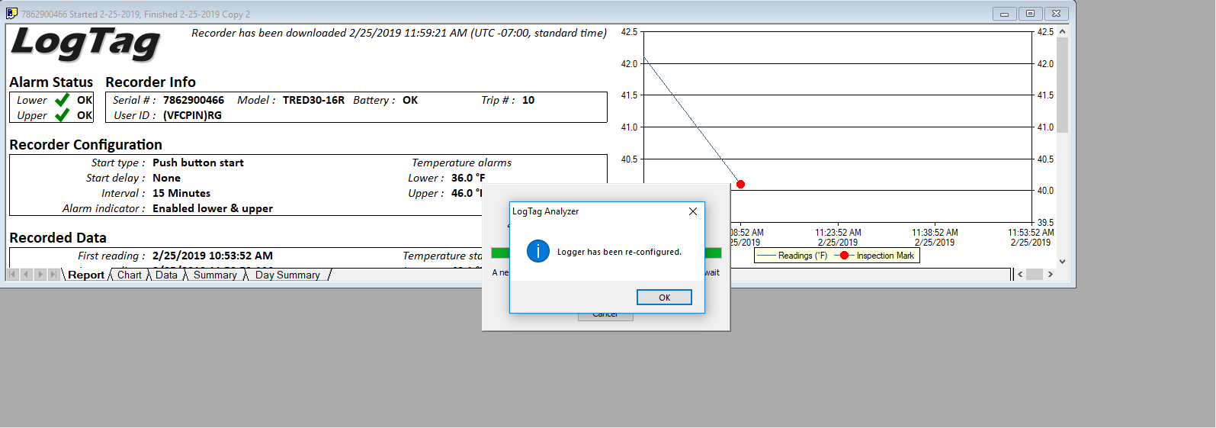
STEP 3: Downloading Data
The following two screens will display in succession after the data logger has been docked
The data logger report will then display behind the “Logger has been re-configured” message.

Slide 25
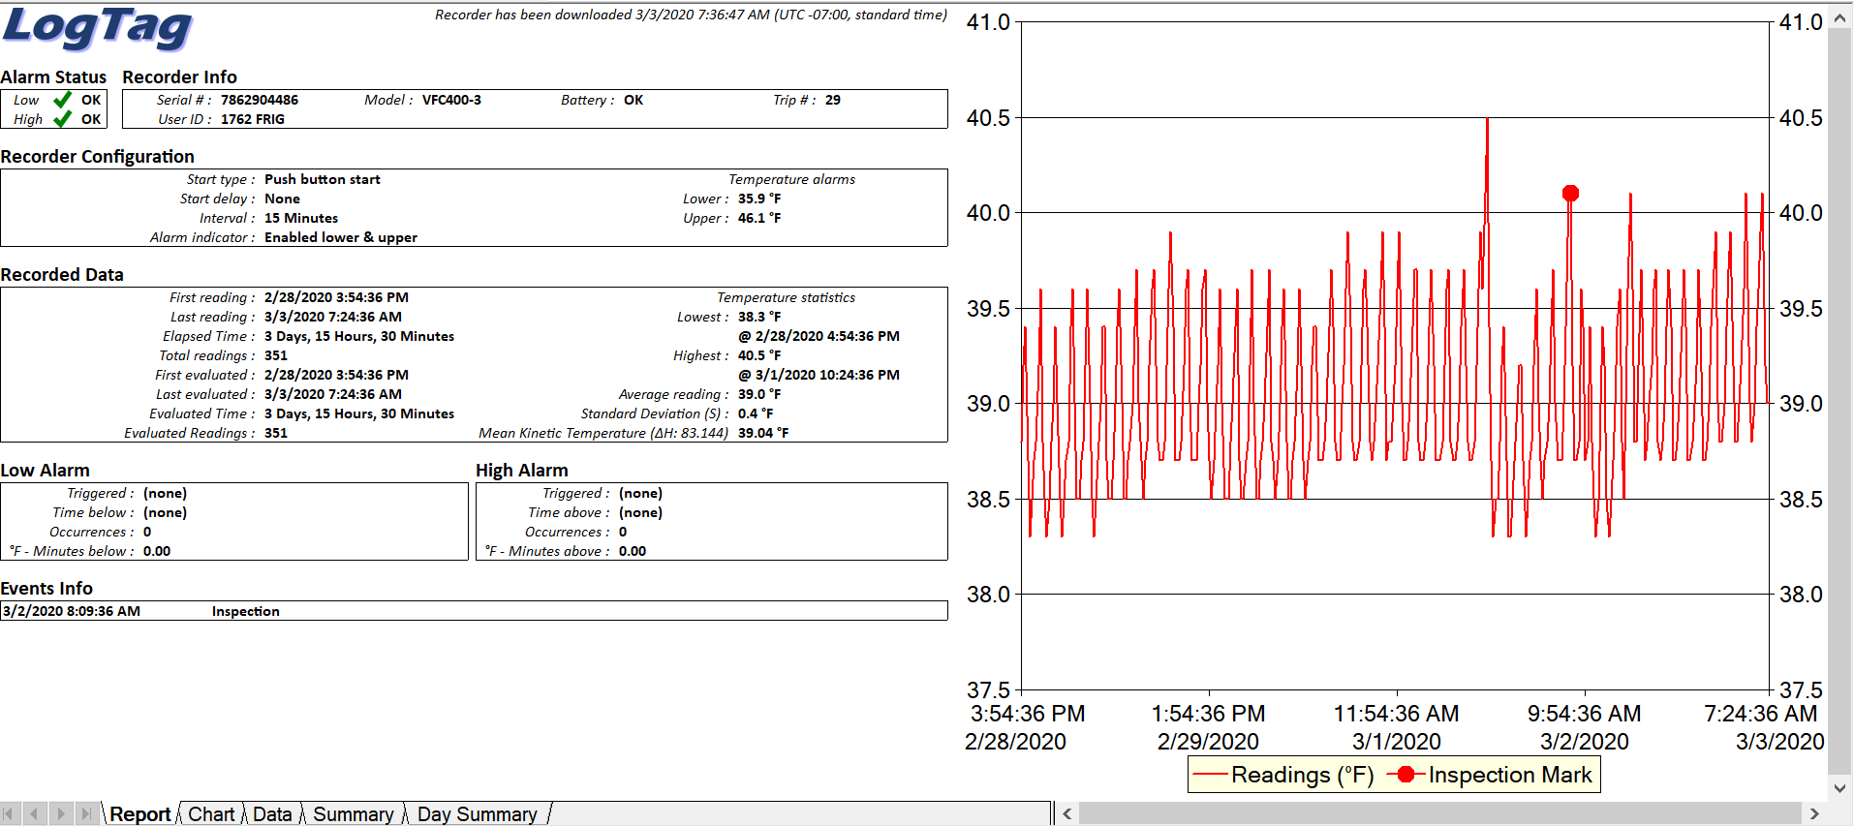
Alarm Status: Two green check marks will be displayed if no incidents have occured if temperature alarms are configured correctly
Recorder Configuration: Correctly configured logging interval and temperature alarms for refrigerator unit
First Reading and Last Reading: Displays date range and times of temperatures included on this report
Temperature Statistics: Displays the highest and lowest temperature recorded during report date range
This is the Report tab. The other tabs can be selected for more details

Slide 26
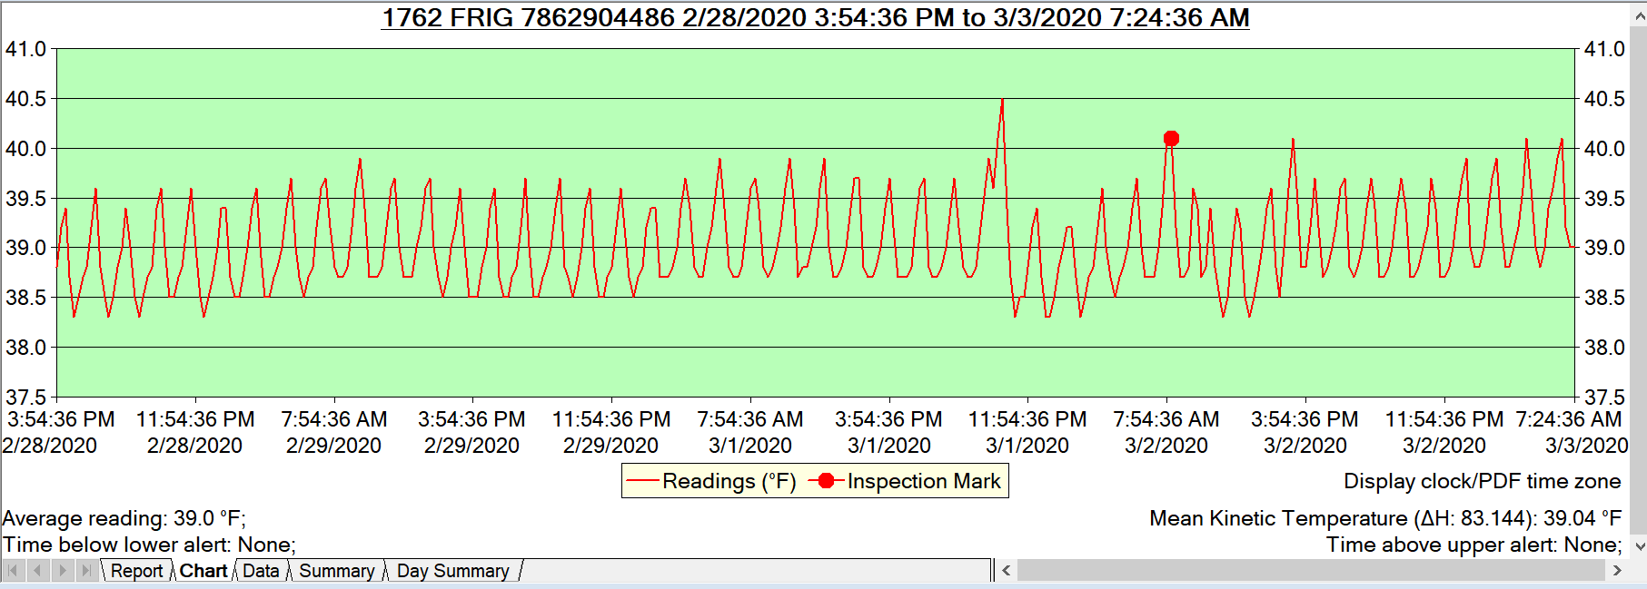
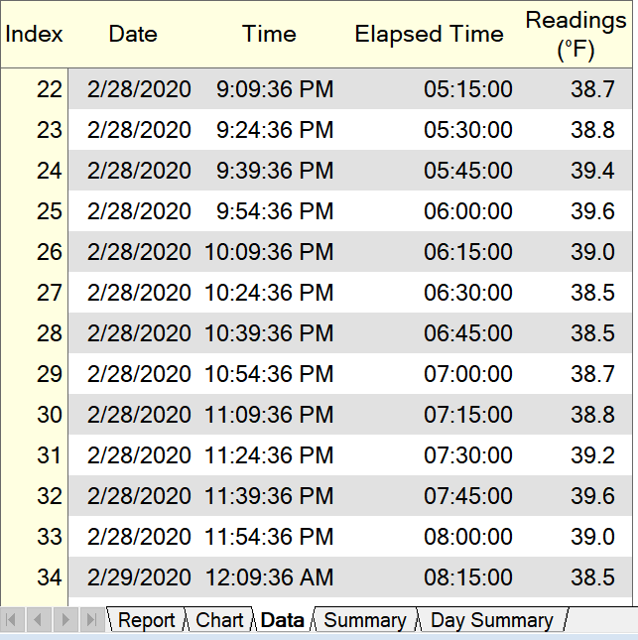
LogTag Report Tabs
Chart Tab: displays a graph including all of the temperature readings captured on this report
Large red dots on the report are inspection marks which document the time when the daily min/max temperatures are checked in the morning for the previous 24 hours
Data Tab: displays each individual temperature reading recorded every 15 minutes

Slide 27
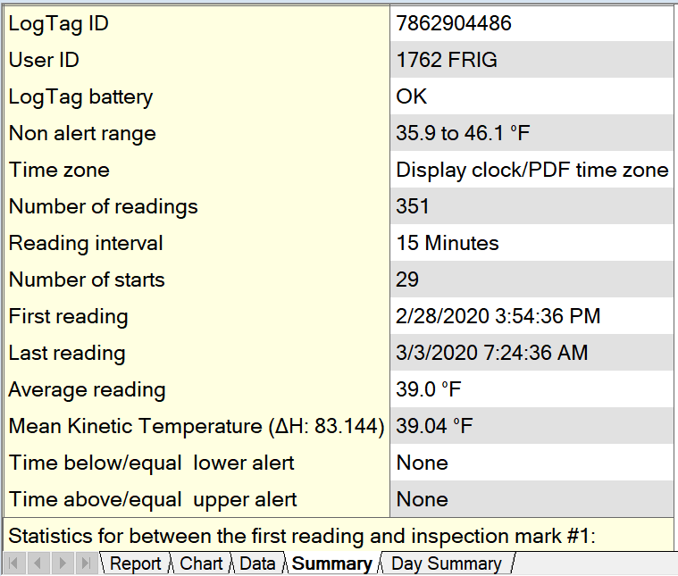
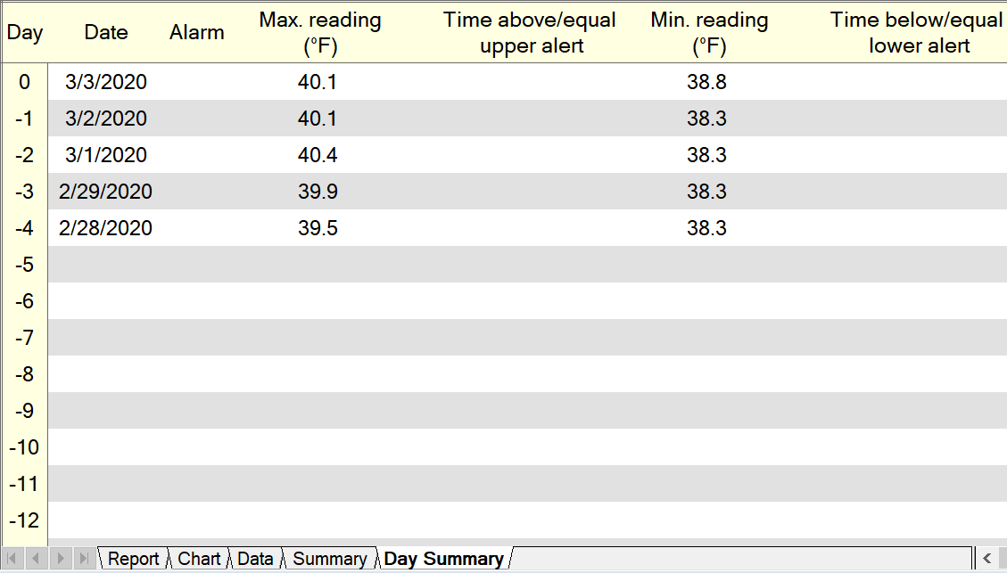
LogTag Reports Tabs
Day Summary Tab: displays the Min/Max temperatures for each day on the report and will also note if there were any temperature alarms triggered and for how long
Summary Tab: displays a statistical overview of the entire report

Slide 28
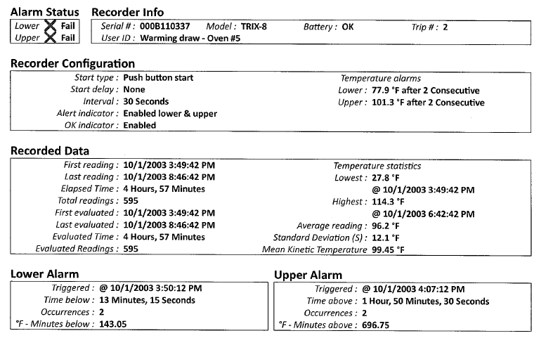
Alarm Status: A red X will display if out of range temperatures occurred
Recorder Configuration: Data Logger is configured to the wrong settings. Incorrect recording interval and Temperature alarms
First Reading and Last Reading: Displays date range and times of temperatures included on this report
Temperature Statistics: The lowest temperature recorded for this report date range was below freezing (32.0*F) at 27.8*F and the highest temperature was 114.3*F
Lower Alarm and Upper Alarm: Information will display here documenting when the temperature went outside of the configured temperature alarm range and the duration

Slide 29
STEP 4: Restart Data Recording
Remove the data logger from the docking station and re-attach it to the temperature probe.
Hold the START, CLEAR, STOP button until the word “starting” remains solid on the screen (about 1-2 seconds).
Remove your finger and the data logger will start recording. The current temperature will display and there will be an REC icon displayed on the screen
Ensure that the current temperature is showing on the display before walking away from the data logger.

Slide 30
VFC 400: Troubleshooting and Resources
Arizona Immunization Program Office

Slide 31
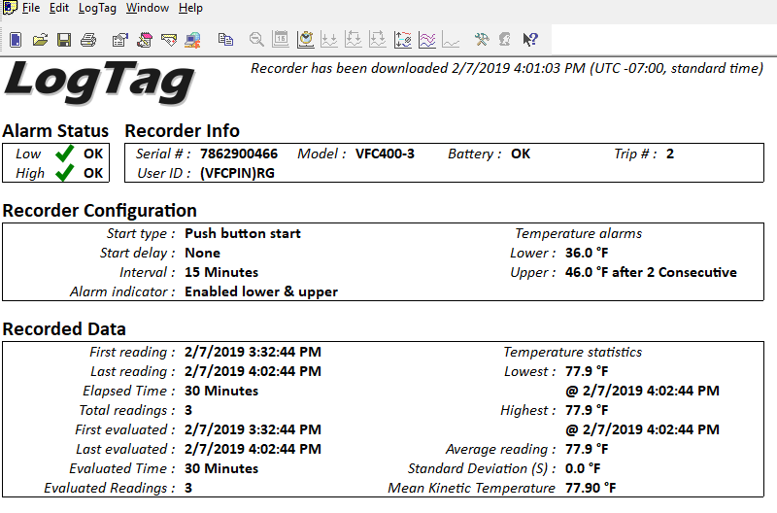
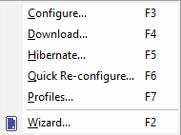
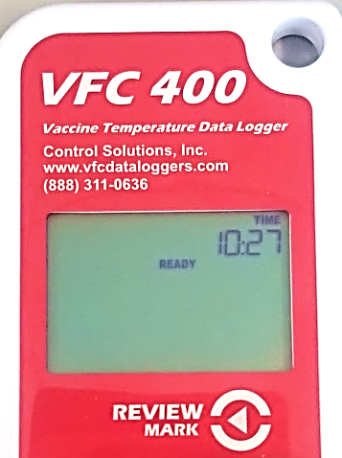
Troubleshooting: No Report Displayed when Data Logger was Docked
If the data logger report does not display after the data logger is inserted in the docking station, try these steps:
Ensure the Control Solutions VTMC program is open and then take the data logger out of the docking station and firmly re-insert it.
If a report still does not display:
In the upper left corner, click on LogTag and then select Download from the drop down.
After downloading, click LogTag and then select
Quick Reconfigure from the drop down.
Once the report has been downloaded and the data logger has been re-configured, the data logger will display READY

Slide 32
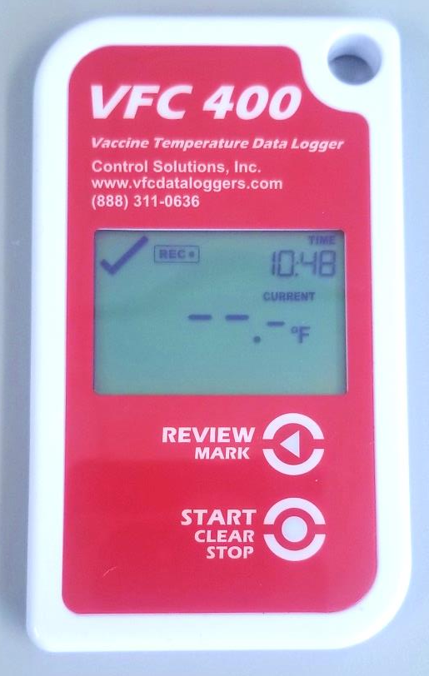
Troubleshooting: Reconnection Issues
This error will display if the data logger is not connected to the probe prior to being started again.
The data logger will display the current temperature once 15 minutes have passed, which is the interval the data logger should be configured to record readings at.

Slide 33
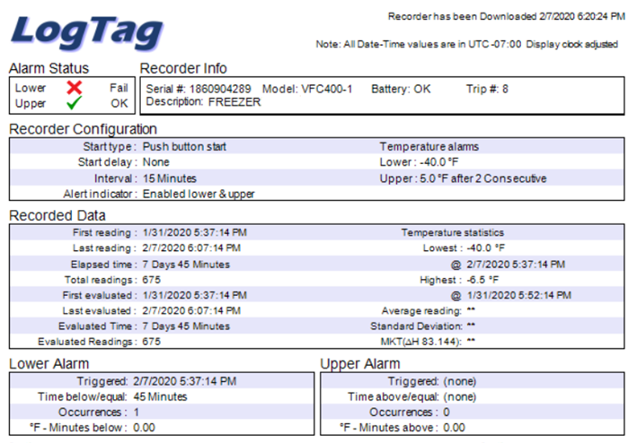
Troubleshooting: -40.0 Reading on Data Logger Report
-40.0 will display on the data logger report when the data logger is NOT stopped before unplugging it and downloading it.

Slide 34
AZ VFC Data Logger Guidelines
Each vaccine storage unit is required to have a data logger.
A portable back-up data logger that stays on site is also required.
Provider offices are responsible for maintaining valid calibration certificates for all data loggers, including the back-up data logger.
Data loggers must be downloaded twice monthly.
Data logger reports must be emailed to arizonavfc@azdhs.gov with each order and on a monthly basis from the data logger application or in data format (.xls, .txt, or .csv).
It is mandatory to record the temperature twice daily (once in the morning and once in the afternoon) on a paper temperature log that meets the required specifications.
The minimum and maximum (min/max) temperature readings must be recorded in the morning on the paper temperature log as well, for the previous 24 hours.

Slide 35
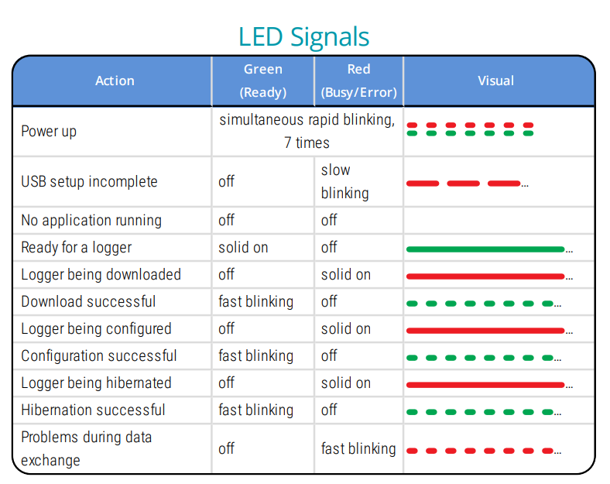
LTI-HID LED Light Indicator
If you have the LTI-HID Docking station, you will be using a dual LED light indicator.

Slide 36
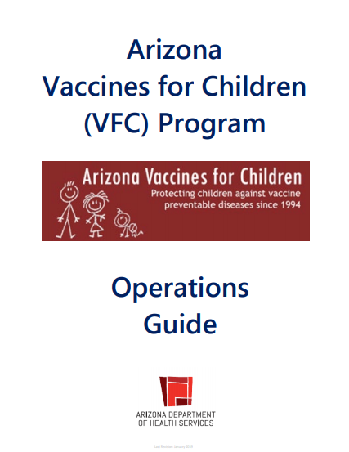
AZ VFC Guidelines
Please refer to the Arizona
VFC Operations Guide
for data logger requirements and temperature monitoring requirements.

Slide 37

AIPO Contact Information
If you have any questions, please contact the
Arizona Immunization Program Office (AIPO)
Main Line: 602-364-3630
Vaccine Center: 602-364-3642 | Email: ArizonaVFC@azdhs.gov
ASIIS Help Desk: 602-364-3899 | Email: ASIISHelpDesk@azdhs.gov
ADHS is open Monday through Friday from 8:00 am - 5:00 pm with the exception of federal holidays.

