Slide 1
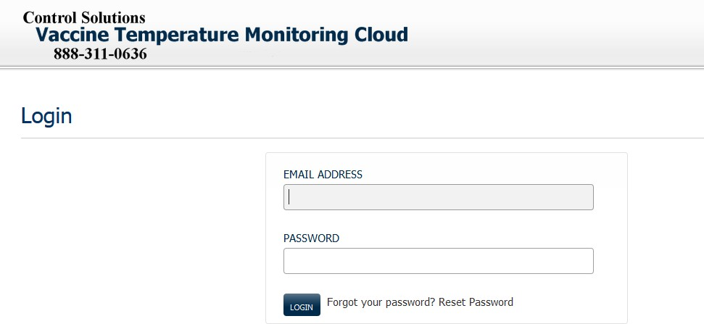

Step 6: VTMC Arizona User Dash Board
37
https://vtmc.ameri-pharma.com
Save As “Favorite”
Your E-Mail Address
Example:
Temporary Password: JDiaz123
First character of first name CAPTIAL
First character of last name CAPITAL, remaining letters lower case, followed by 123

Slide 2
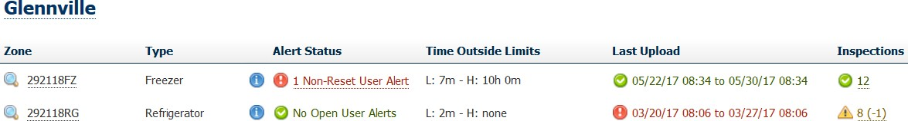
Step 6: VTMC Arizona User Dash Board
38
User dashboard display will only include locations that have been assigned to them.

Slide 3

Step 6: VTMC Arizona User Dash Board
39
Inspection Marks,
Green Check indicates provider has performed 100%
Yellow Warning, indicates provider has performed 90%
Red Alert, indicates provider has performed less than 80%

Slide 4
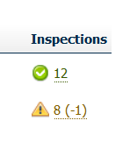
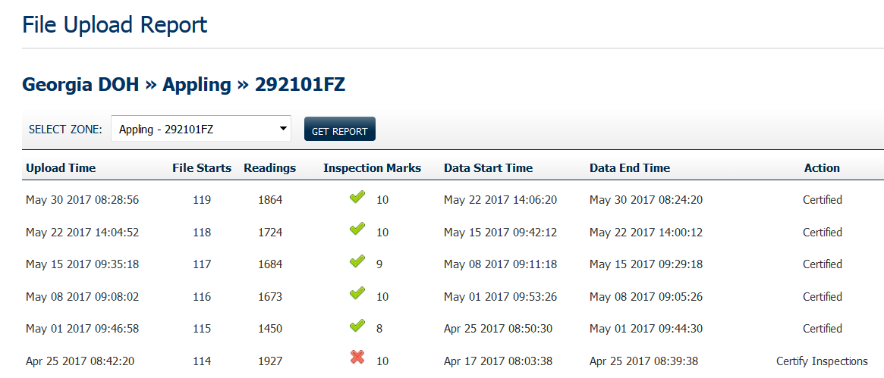
Step 6: VTMC Arizona User Dash Board
40
List lasts 30 downloaded reports
Certifying Inspections:
Opens on-line temperature log

Slide 5
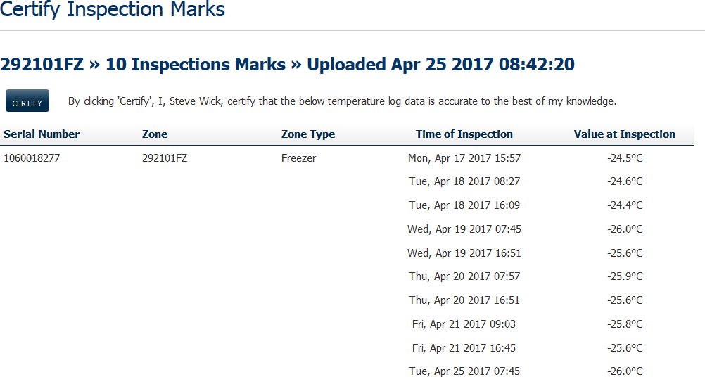

Step 6: VTMC Arizona User Dash Board
41
Certified by provider logged in

Slide 6
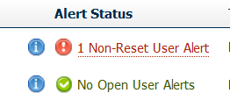
Step 6: VTMC Arizona User Dash Board
42
Acknowledging an alarm

Slide 7
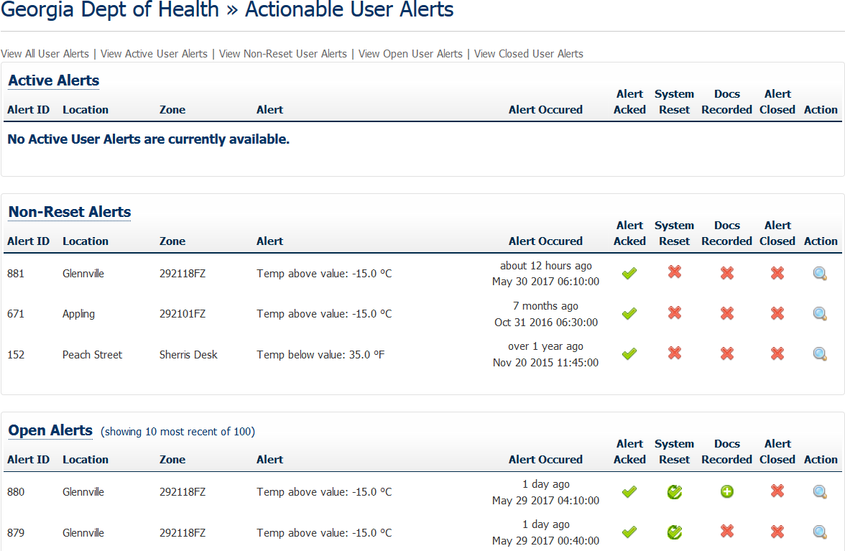
Step 6: VTMC Arizona User Dash Board
43
Provider must Acknowledge Alert, then enter Doc’s or CAR
information
Spyglass openings detail alert information

Slide 8
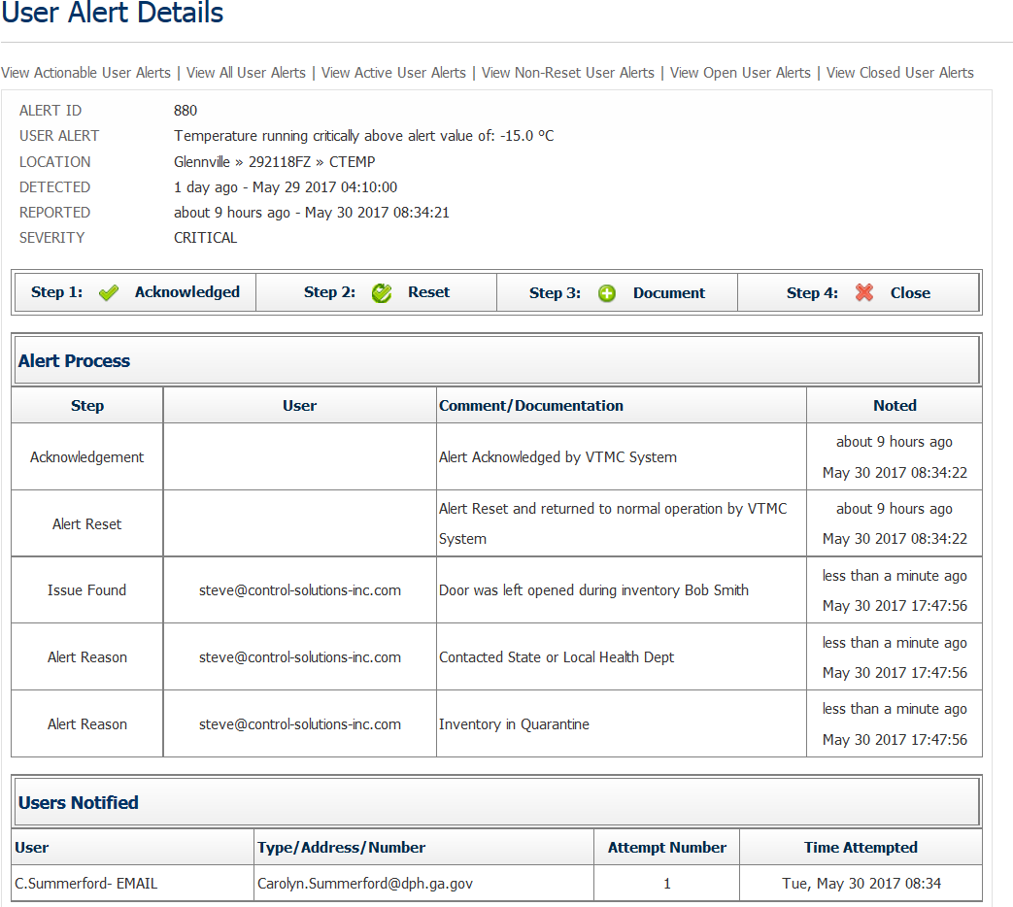
Step 6: VTMC Arizona User Dash Board
44

Slide 9
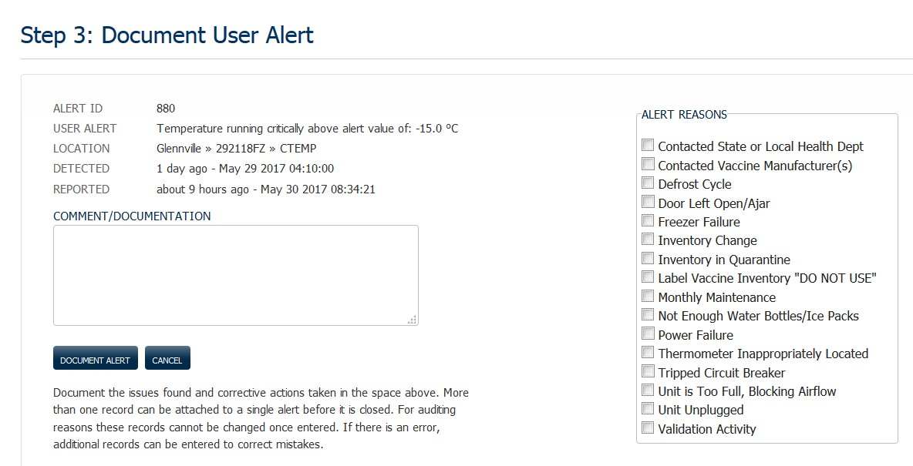
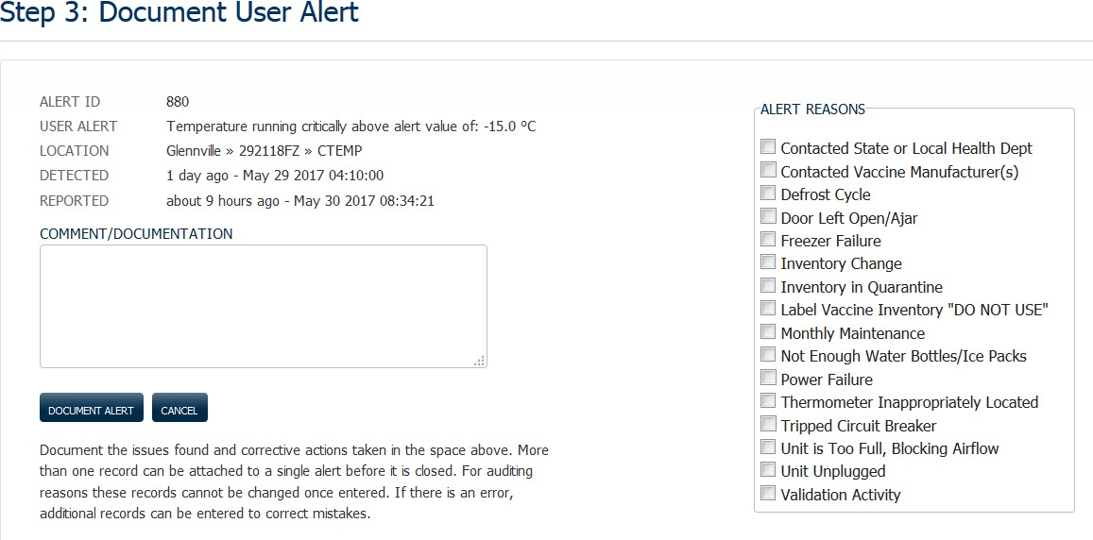
Step 6: VTMC Arizona User Dash Board
45
Select as many reasons necessary

Slide 10
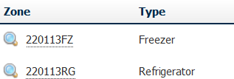
Step 6: VTMC Arizona User Dash Board
46
Opens Day over Day Report

Slide 11
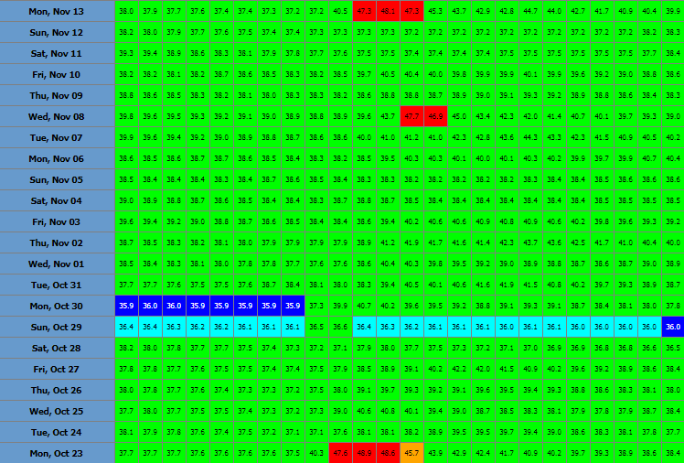
Step 6: VTMC Arizona User Dash Board
47
Selecting Day / month will open Zone Detail Chart
Displays hourly averages
Dark Blue: Low Alarm
Light Blue: Low warning
Red: High Alarm
Orange: High Warning
Green: Normal Temperature

Slide 12
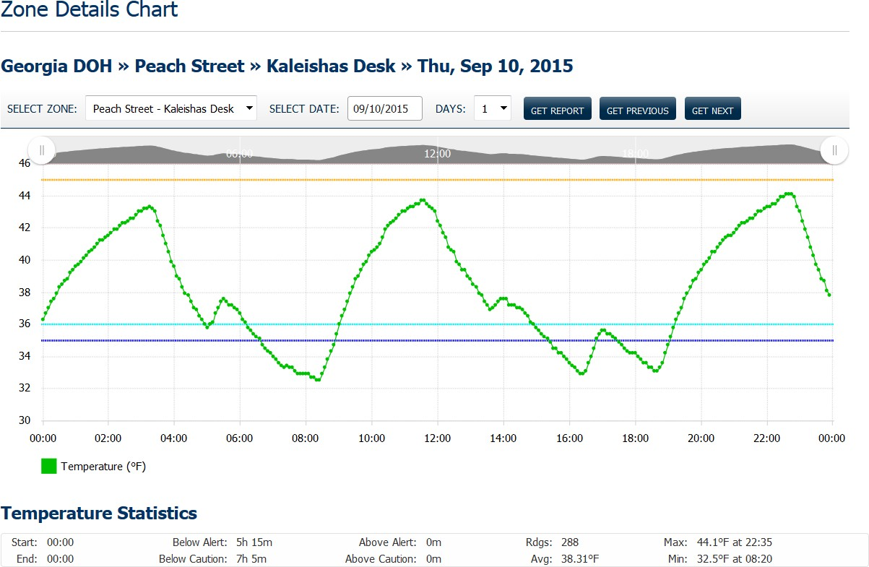
Step 6: VTMC Arizona User Dash Board
48

