Slide 1
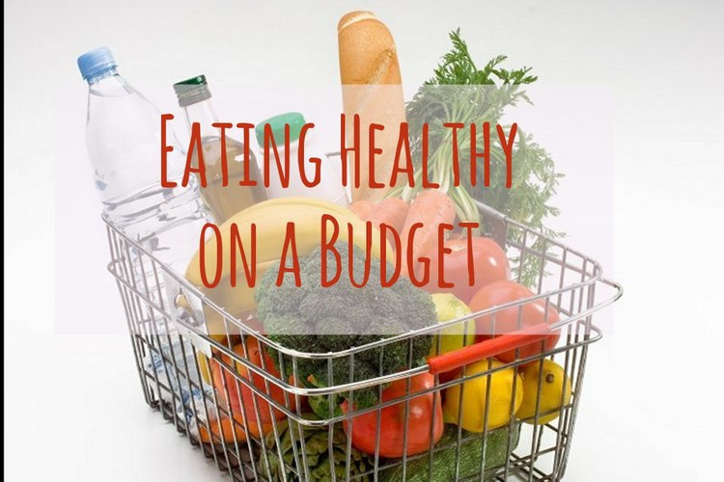

Slide 2
What’s for dinner tonight?
Notes:
Do you get this question often? How do you respond to this question? Some people have a plan, do you?

Slide 3
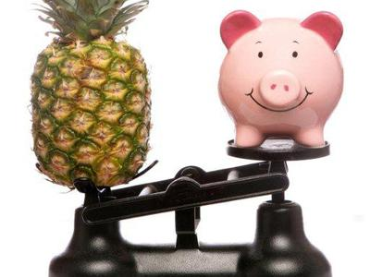
Today You Will Learn
How to make a healthy and affordable meal plan
How to get the most value when shopping

Slide 4

The Three P’s of Eating Healthy on a Budget
Planning
Purchasing
Preparing

Slide 5


Planning
Planning saves time and money
Planning also helps us chose healthier foods
Notes:
Who doesn’t want to save time and money? A lot of people do not plan, why don’t they?

Slide 6
Planning
Step 1 – Know What’s on Your Shelf
Knowing what you have will help you only buy the foods you need
Notes:
How many of you could make a meal from what you have on hand? Here is a list of basic, healthy items to keep on your shelves at home; this will be useful in creating great meals.

Slide 7
Planning
Step 2 – Know What You Want to Prepare
Let’s plan meals to
  Save time
  Stretch your dollar
  Help you feed your family healthy food

Slide 8
Planning
Let’s try together!
Let’s design three meals
  Two dinners
  One lunch
Notes:
Let’s design three meals
Two dinners
One lunch

Slide 9
Planning
Start with a protein you can make in large quantity
Add a grain
Add a fruit/veggie
Add a dairy
S-T-R-E-T-C-H it!
You can use your list of What’s on the Shelf?
Notes:
How can we stretch it? If you’re using chicken, you can roast it the first night and have enchiladas the second night. You can use leftovers to create a one-pot meal, such as stew, soup or casserole.

Slide 10
Planning
Step 3 – Know What You Are Missing
Making a grocery list is essential
Check and plan using ads, coupons and loyalty card savings
Notes:
What happens when you go to the store and you don’t have a list?

Slide 11
Purchasing
Stick to your list
Do not go grocery shopping hungry
Check the unit price
  Price of the food per pound of per ounce
  Found on the sticker on the shelves
  Helps you compare two different size packages or brands to find the best buy
  Always chose the lowest unit price
Notes:
How many of you check the unit price stickers on the shelves before you buy? Check out the savings from a real grocery store.

Slide 12
Preparing
Easiest part!
Let your children help you prepare
Use healthy cooking methods such as
  Broiling
  Baking
  Grilling
  Steaming

Slide 13
Remember
Keep healthy items on hand
Make a healthy meal plan for the week
Make a shopping list of items needed
Be a smart shopper at the store
Stick to your plan when you get home

Slide 14
Coupon Tips
Use coupons on sale items
Store brands can still be cheaper even when using a coupon on a national brand
Look for stores that double coupon values on certain days
Some stores will allow you to use a manufacturer's coupon plus a store coupon
Some stores will price match at the register, so do your research and bring ads with you to the store

Slide 15
Affordable Produce
POW-WOW (Used to be MOM, Market on the Move)
  http://www.borderlandfoodbank.org/POWWOW.html
  Various times and locations
Goodyear Community Farmers Market (accepts WIC and EBT)
  http://www.arizonafarmersmarkets.com/pageGoodyear/GoodyearFM.htm
  Saturdays, 9am – 1pm
  At Goodyear Community Park
    3151 N. Litchfield Rd. Goodyear AZ 85338

Slide 16
There’s an App for That!
Grocery Pal – Shows you sales in stores near your location
Coupon Sherpa – displays barcode on phone for the cashier to scan
Key Ring Rewards Cards – keep all your store loyalty cards on this app
ShopWell – allows you to scan barcodes of foods, gives nutrition advice about food
Apples2Oranges – allows you to compare the price or calorie content of two similar products
Notes:
All free!

Slide 17
Additional Info for RD

Slide 18
Note
Ct seen for group education class, Eating Healthy on a Budget. Discussed how to make a healthy and affordable meal plan, how to get the most value when shopping, coupon tips, affordable produce options and using CVVs at local farmers markets and digital apps to help plan meals and save money. RM, RDN.

Slide 19
Evaluation
Please circle your response. Thank you for coming.
Did you learn something today that will benefit you and your family’s nutritional habits?
  Yes
  No
Would you come back to a group education class?
  Yes
  No
What other topics would you like to see in a group education class?
  ___________________________________________

