Slide 1
State Loan Repayment Program
(SLRP)
Electronic Application System
Ana Roscetti, MPH
Arizona Department of Health Services
Bureau of Women’s and Children’s Health

Slide 2
Agenda
Introduction
Problem Statement
Goal Statement
Current State
Target State
Post CQI Plan
Site Registration “Show and Tell”

Slide 3
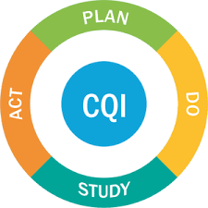
Notes:
The program embarked in a Continuous Quality Improvement Project back in April of 2017 until about mid-September of 2017.
We specifically looked at the program application process and through our process assessment, we’ve identified areas for improvement where we could eliminate waste and redundancy in the system as well as inefficient practices.
During the CQI project, we developed some “quick win” interventions that will help improve program efficiency and customer experience.
The SLRP electronic system is the last intervention that we are implementing as part of the CQI interventions we planned to execute.
We currently are in the “DO” phase. After the electronic system implementation, we will revisit the impact of all the interventions we’ve created and we will measure how we’ve improved from the last time.
Then, we will do some modifications as we see necessary to continue with our process improvements.

Slide 4
Problem Statement
Significant number of incomplete applications
High volume of inquiries to program due to unclear information about the application requirements or application materials

Slide 5
Goal Statement
To improve customer experience through implementing the electronic SLRP application system
To reduce waste and redundancy and improve program efficiency

Slide 6
Current State
Application materials do not directly address provider questions about the application resulting to incomplete or deficient applications
Website information contributes to a significant volume of phones calls to the programs
  96 out of 182 (53%) total inquiries from Jan 1 to Jun 1, 2017
Multiple phones calls and emails from providers about the application/application materials

Slide 7
Data
Notes:
Here is the graph that shows the number of inquiries by applicant type.
The program received a total of 182 inquiries.
130 or 71% of those were from non-applicants. These were providers whom we believe were planning ahead and looking at our website information and potentially looking to apply to the program in the future.
52 of the total 182 inquiries or 29% were applicants of the June 1st 2017 cycle.

Slide 8
Data
Notes:
Here is a pareto chart showing 96 web-specific inquiries out of 182 total inquiries.
Pareto chart is used to show the most common problems where we can make the biggest impact with our interventions.
The purple bar represents the frequency of the type of questions received by program.
The burgundy line represents the percent reduction if the program were to address each web-specific question.
Based on this graph, the most common inquiry was whether or not a provdier is eligible for the program. These were provdiers who called idnicating specifically that they were on the website and were unclear about the eligibility requirements.
The second most common question was from BH asking what sorts of licensure or credentials are needed to be eligible for the program.
From this graph you can see that if program were to improve the web information related to eligibility requirements and clarify the licensure and credential requirements for BH, we would have reduced the inquiries by 45% just addressing these 2 items. Then if we clarify all the other items say the MUA letter, W9, employer form and site eligibility requirements, we would have a cumulative reduction if about 80%.

Slide 9
Target State
Reduce the number of phone calls due to unclear or hard to find information on program website
Reduce phone calls from all interested providers about the application process and requirements
Reduce the number of or eliminate incomplete applications
Reduce the number of applicant phone calls related to application materials

Slide 10
CQI Interventions
Updated website information
Eligibility Screening Questionnaire
Frequently Asked Questions
Step-by-Step Instructions
  HPSA
  AzMUA
  Census Tract
  Substitute W9
  Itemized Consolidated Loans
Sample Documents
  SFS Policy
  SFS Signage
  SFS Table
Clarification Statement
  Arizona Residency
  Service to Medically Underserved
Letter Templates
  Letter Template – Certification of Service to MUA

Slide 11
Data/Results
Notes:
Here is a visual of all deficiencies pre and post.
A total of 165 deficiencies were noted from 76 applications received. This represents an average of 2 required documents that were deficient or missing per application.
Typically, after applciation cycle closes, each provdier application is reviewed for administrative completeness. During this process, we check whether all required documents were submitted using a checklist.
Then we send a Notice of Deficiency letter or NOD to the applciant listing all missing or deficient documents.
During this time, we have created sample documents, step by step instructions or clarification statement as part of the CQI project so that when we sent the NOD, we also sent the sample documents, step by step instructions or clarification statement based on the deficiencies noted to help clarify exactly what we are looking to receive from the provider.
After we did that, 79% of all deficiencies were addressed at initial attempt which tells us that the CQI interventions we did worked.

Slide 12
Data/Results
Notes:
This table shows the data for all the application deficiencies in the last application cycle in June 2017 plotted in a Pareto chart.
The blue bars represents the number of deficiencies per type and the orange line represents the percent cumulative reduction if program addresses each deficiency.
The top three deficiencies identified were the SFS Signage, SFS Table based on current FPL, and SFS Policy.
Based on this chart, if we were to address only the top 3, we would reduce the deficiencies cumulatively by 42%.
Using this data, we knew that we needed to focus some of CQI interventions on making sure providers and sites understand what is required to be submitted for the SFS requirements.
You can see the distribution of the other deficiencies noted and the percent cumulative reduction if we implemented some sort of intervention.

Slide 13
Next Steps Post CQI
Results and products from the CQI project were used to develop/strengthen the electronic SLRP application system
Webinar trainings to inform about the SLRP CQI results and the launch of the electronic system

Slide 14
SLRP Electronic System Roll-Out
Launch Dates
March 1 – April 15, 2018
Site Registration Cycle
April 18 – June 1, 2018
Provider Application Cycle (Initial Applications Only)

Slide 15
Site Registration
What’s Improved?
Paper Application | Electronic System
One Employer and Service Site Form for each provider applying from that site Examples: 10 applicants = 10 paper forms 5 applicants X 5 sites = 25 paper forms 2. Supporting documents provided for each provider application SFS Table, Policy, Signage, Evidence of HPSA 3. Incomplete applications due to missing or incorrect site-specific documents | Site registers once in the system. Site information is used for applicants applying from site Example: 10 applicants = 1 site 2. Supporting documents uploaded once in the system SFS Table, Policy, Signage, Evidence of HPSA 4. Eliminate or minimize incomplete provider applications

Slide 16
Site Registration
Who Can Register?
Public, Non-Profit or Rural, Private Practices
Meets SLRP site eligibility requirements:
  Located in a HPSA
    For rural private practice sites, must meet Arizona Medically Underserved Area (AzMUA) designation if site is not in a HPSA
  AHCCCS, Medicare, Qualifying Health Plan
  Sliding Fee Scale (except free clinics and state prisons)

Slide 17
Site Registration
What are some ground rules to register service sites?
An employer can assign anyone to be a site administrator.
Only site administrators can create a profile in the SLRP portal.
Once a site administrator creates a profile in the portal, an email notification to verify the email account and access to the login page where the site administrator can continue with the site registration process.
A site administrator can register one or more sites.
Each site registration must indicate the service category (medical, dental, or behavioral health) for the site.
A site administrator can register a site for all 3 service categories.
Changes to the site information can only be done during an open site registration cycle.

Slide 18
Site Registration
Responsibilities of a Site Administrator
Gather, enter, and upload site specific documents in the portal and for completing the site registration
Verify provider employment and additional provider eligibility
Applicant’s point of contact at site
ADHS’ key contact person for any site-specific questions during the application process
ADHS’ key contact person for any questions related to the provider applicant or participants working at the site(s)
Upload required/supplemental documents that may be requested by ADHS during the application process
Update the site registration each calendar year during an open site registration cycle and upload required documents as evidence of continued compliance with SLRP requirements

Slide 19
Site Registration
What documents to prepare?
  Sliding Fee Scale based on current Federal Poverty Level Guidelines
  Sliding Fee Scale Policy
  Sliding Fee Scale Signage
  Evidence of site’s HPSA
  Encounters Data Table (Last 2 calendar years)

Slide 20
Site Registration
 | 2017 | 2018
TOTAL # ENCOUNTERS ⁽¹⁾⁽²⁾ AT THE SERVICE SITE
B. TOTAL # MEDICARE⁽³⁾ ENCOUNTERS
C. TOTAL # MEDICAID⁽⁴⁾ ENCOUNTERS
D. TOTAL # SFS⁽⁵⁾ ENCOUNTERS
E. TOTAL # ENCOUNTERS FREE OF CHARGE
F. C + D + E
G. F / A * 100 (% of underserved patients served
An encounter is an office visit with a patient.
All encounters must have been at the specific facility referred to in this application.
Number of encounters where patients used Medicare as a method of payment.
Number of encounters where patients used AHCCCS as a method of payment.
Number of self-pay encounters using a Sliding Fee Schedule.

Slide 21
Site Registration
What happens after site registers?
Providers at your site can submit their SLRP application online.
Watch for email notification.
  Employment Verification
  Additional Eligibility Verification
  Print and upload certification and notarized document
Applicant may contact you to follow up about their application.
ADHS may contact you for additional documents.

Slide 22
Customer Support
Ana Roscetti, ana.lyn.roscetti@azdhs.gov, 602-542-1066
Ashley Neves, ashley.neves@azdhs.gov, 602-542-1211

Slide 23
Our Team
Patricia Tarango, Bureau Chief, BWCH
Ana Roscetti, Workforce Section Manager, ADHS
Ashley Neves, Workforce Health Planning Consultant, ADHS
Tracy Lenartz, ADHS Consultant
Luke Evans, Database Manager, IT ADHS
Avi Veerlapati, System Developer, IT ADHS

Slide 24
Site Registration
Live Demonstration
Avinash Veerlapati
Information Technology Services
Arizona Department of Health Services

Slide 25
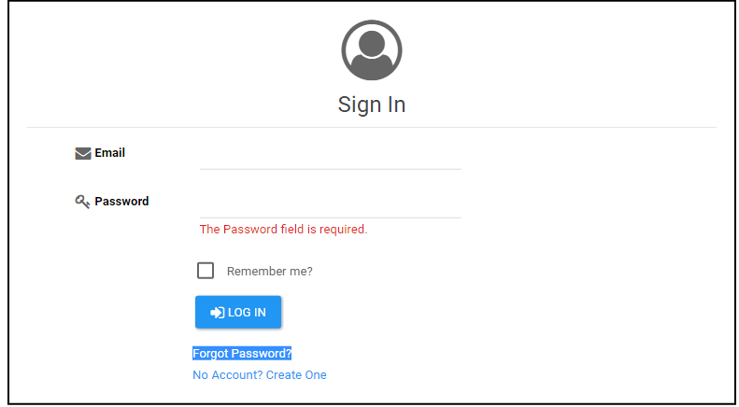
Create an Account
Log-in: https://apps.azdhs.gov.PCO

Slide 26
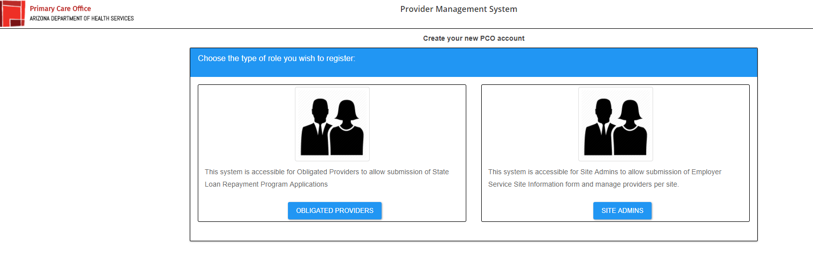

Slide 27
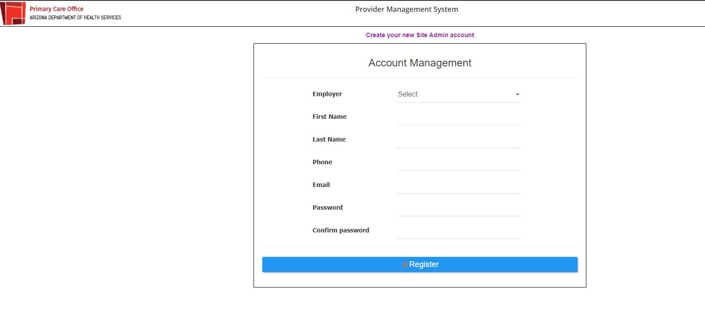
Required fields

Slide 28
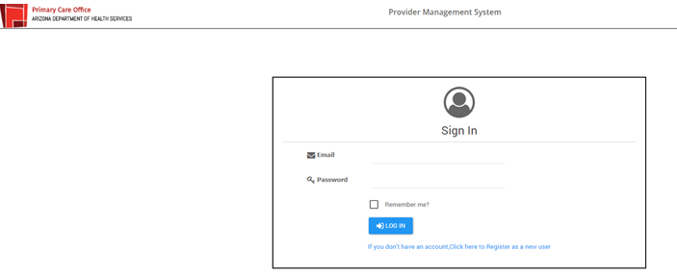

Slide 29
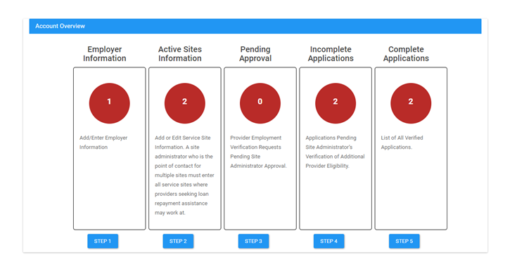
Landing Page After Log-In
Number of approved provider requests pending additional eligibility verifications (i.e. start date, full-time/half-time status, etc.)
Registered employer where you were assigned as the site admin in the system
Number of sites successfully entered in the system.
Number of pending employment verification requests
Number of fully verified applications

Slide 30
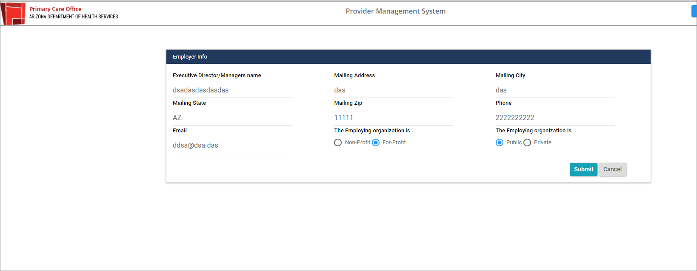
Step 1: Employer Information
Click on the ADHS logo to go back to the landing page.

Slide 31
Landing Page
Number of approved provider requests pending additional eligibility verifications (i.e. start date, full-time/half-time status, etc.)
Registered employer where you were assigned as the site admin in the system
Number of sites successfully entered in the system.
Number of pending employment verification requests
Number of fully verified applications

Slide 32
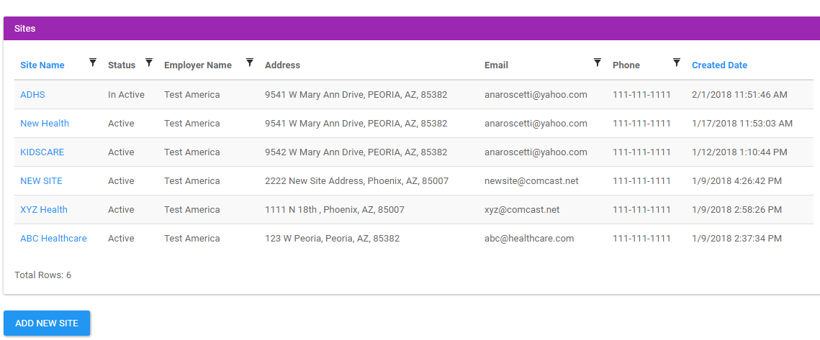
Step 2: Active Sites Information

Slide 33
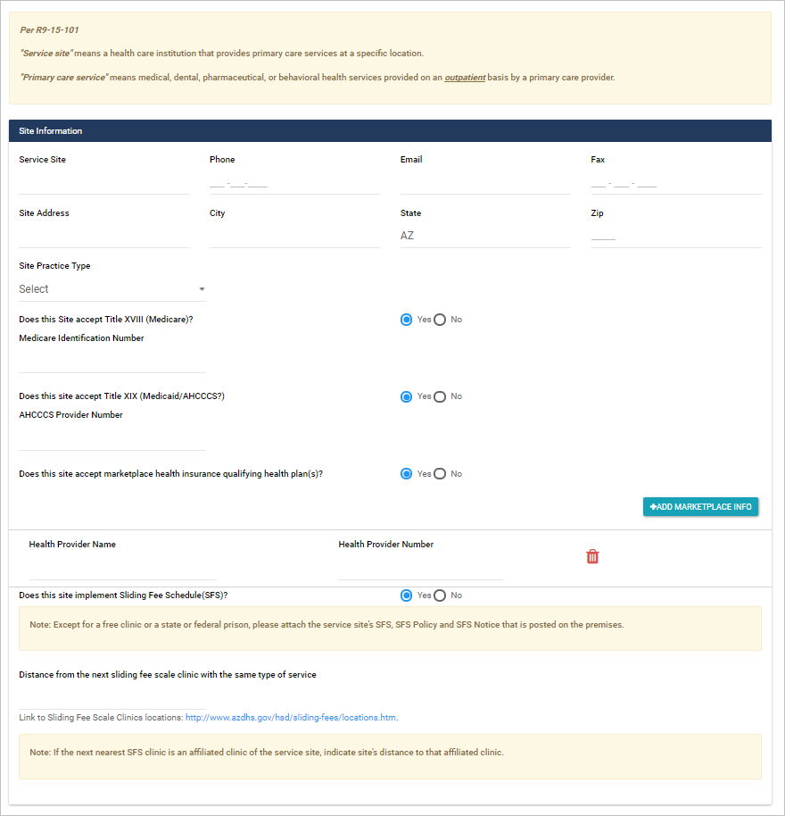
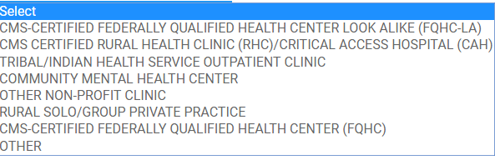
Add/Register A Site
http://www.azdhs.gov/prevention/health-systems-development/sliding-fee-schedule/index.php#clinic-locations

Slide 34
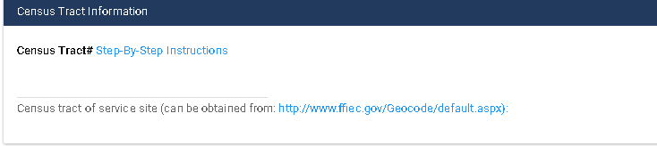
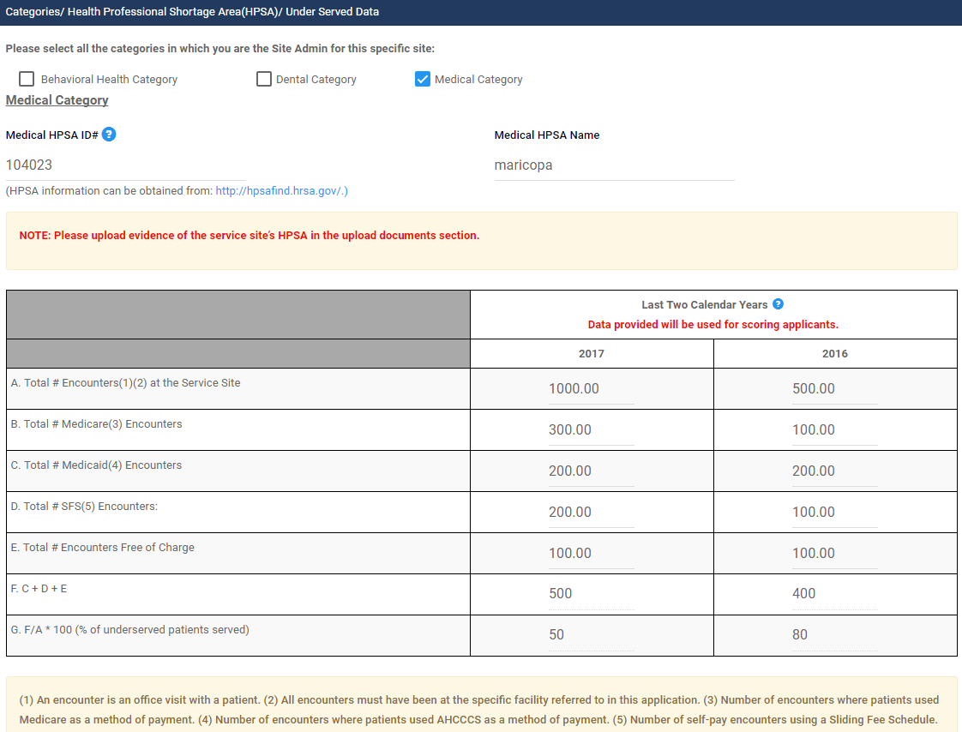
Add/Register A Site – Continuation
http://www.azdhs.gov/documents/prevention/womens-childrens-health/how-to-obtain-census-tract.pdf

Slide 35
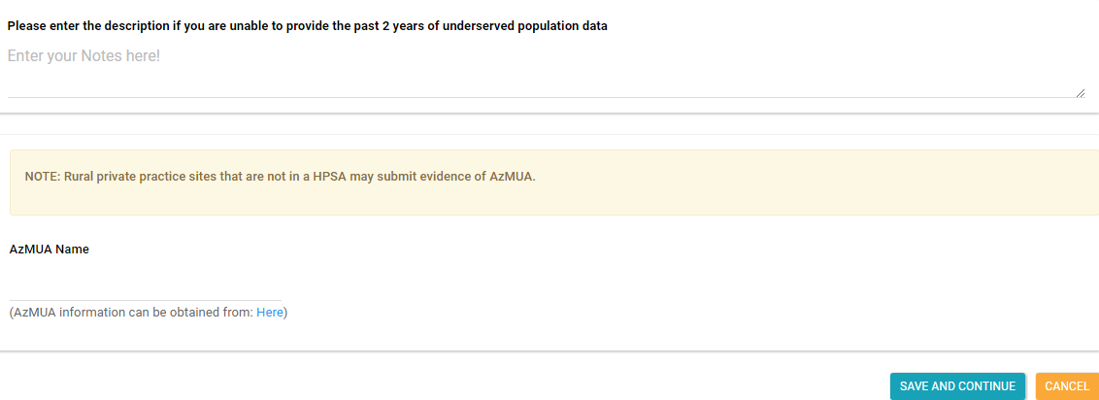
Add/Register A Site - Continuation
If data for the past two years is not available, please enter your explanation on this section.
An AzMUA designation is required ONLY if the service site is a RURAL PRIVATE PRACTICE that is NOT located in a Health Professional Shortage Area.
All public and non-profit entities MUST meet the HPSA requirement.
AzMUA Report

Slide 36
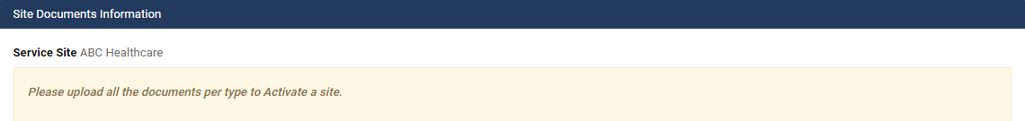
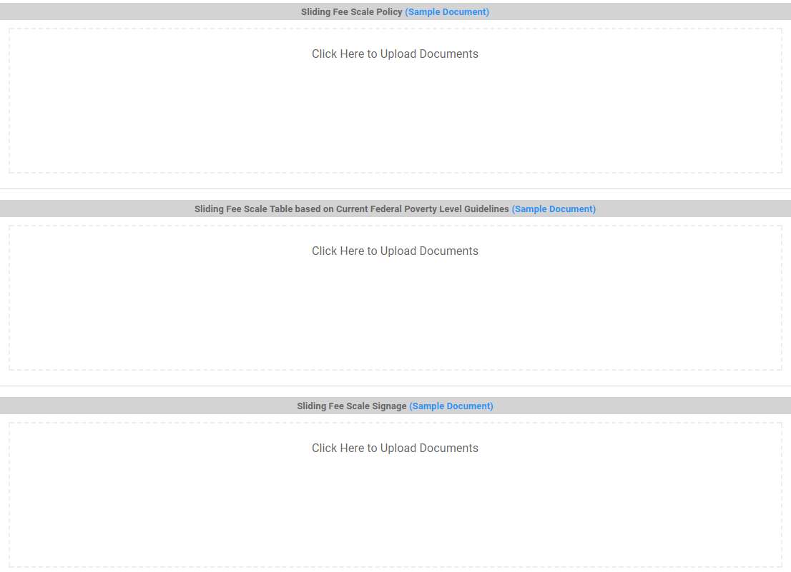
Add/Register A Site – Continuation

Slide 37
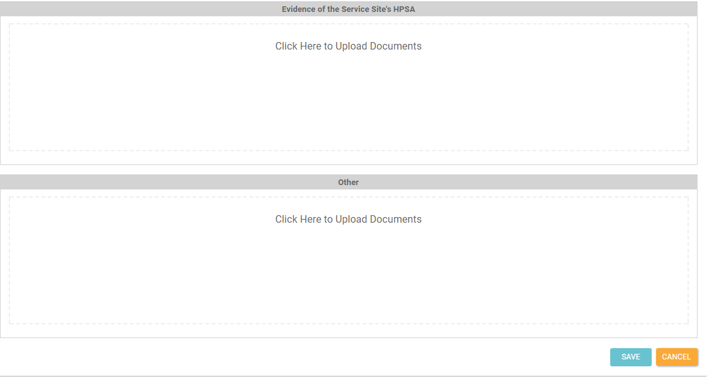
Add/Register A Site – Continuation

Slide 38
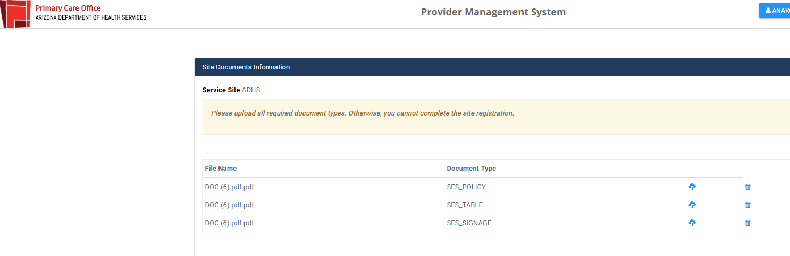
View Uploaded Documents
Click on ADHS Logo
End of Step 2

Slide 39
Landing Page
Number of approved provider requests pending additional eligibility verifications (i.e. start date, full-time/half-time status, etc.)
Registered employer where you were assigned as the site admin in the system
Number of sites successfully entered in the system.
Number of pending employment verification requests
Number of fully verified applications

Slide 40
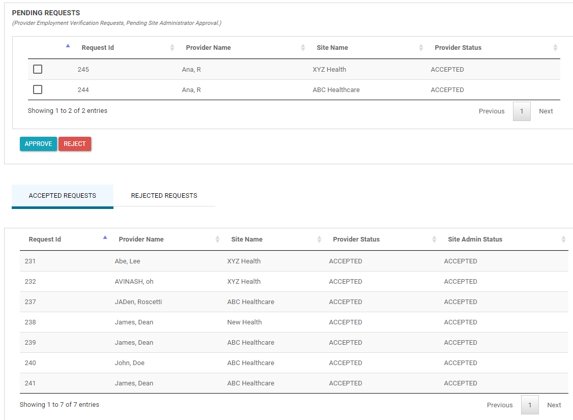
Step 3: Pending Approvals
Click here

Slide 41
Landing Page
Number of approved provider requests pending additional eligibility verifications (i.e. start date, full-time/half-time status, etc.)
Registered employer where you were assigned as the site admin in the system
Number of sites successfully entered in the system.
Number of pending employment verification requests
Number of fully verified applications

Slide 42
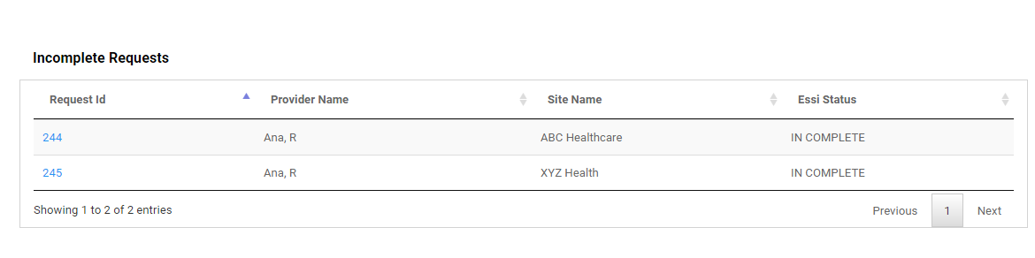
Step 4: Incomplete Applications

Slide 43
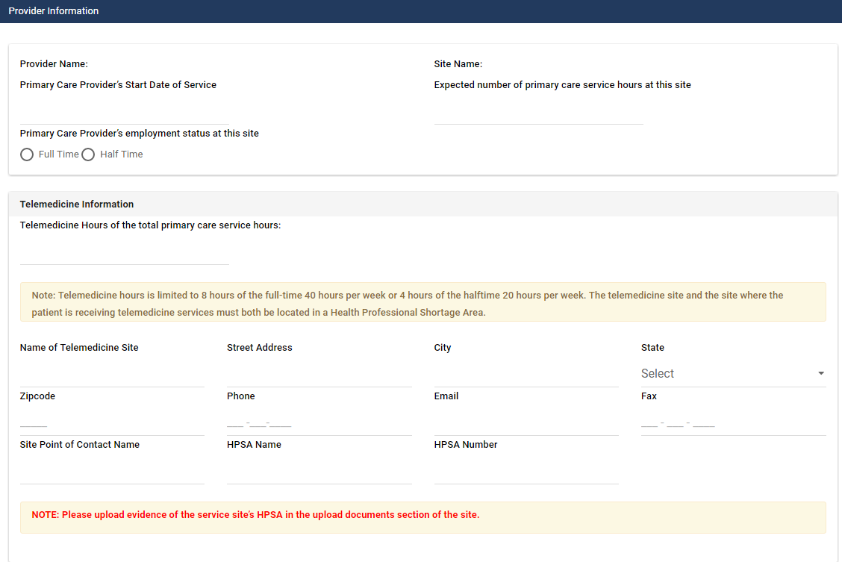
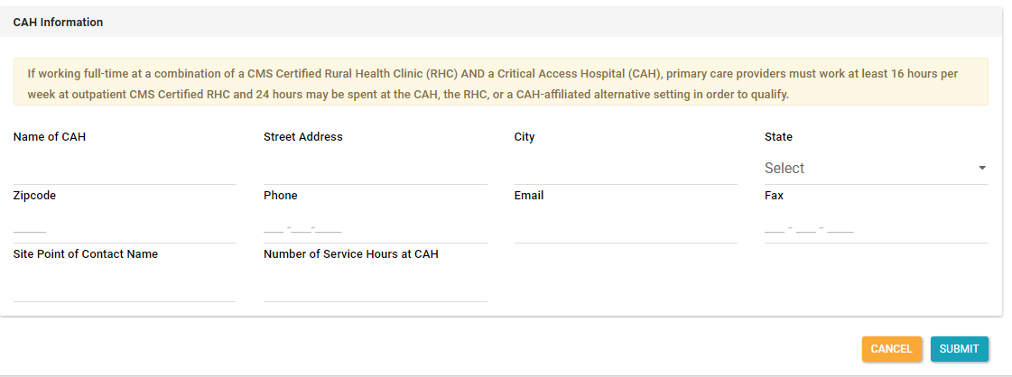

Slide 44
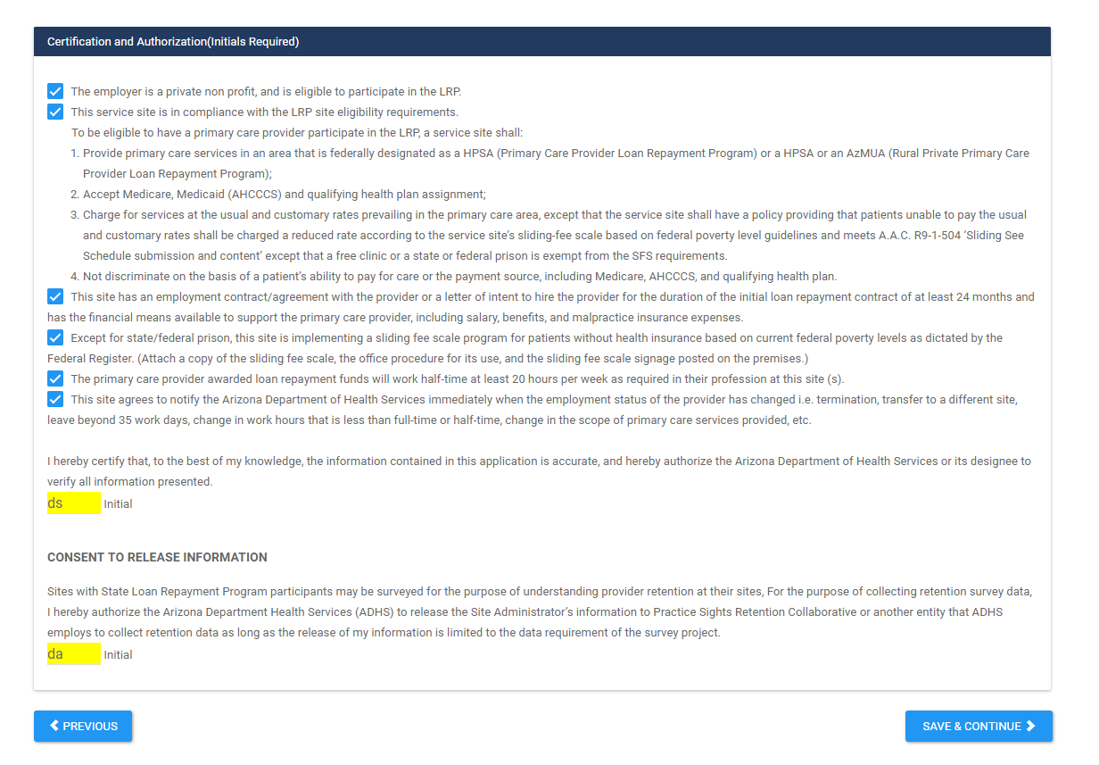
Certification Page

Slide 45
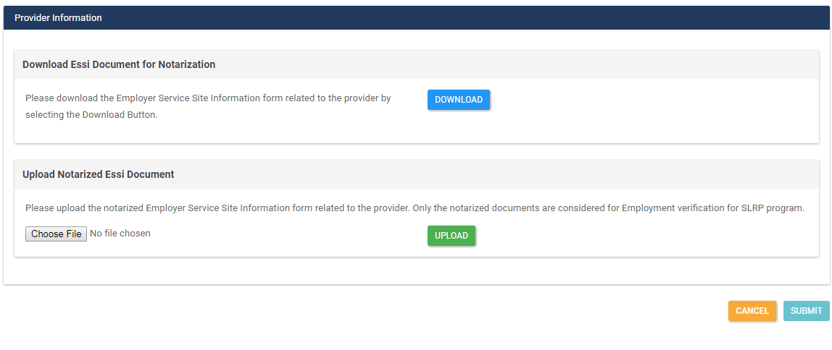
Notarized Document
Click here to download the completed Employer and Service Site Form.
Click here to upload the notarized PDF Employer and Service Site Form.

Slide 46
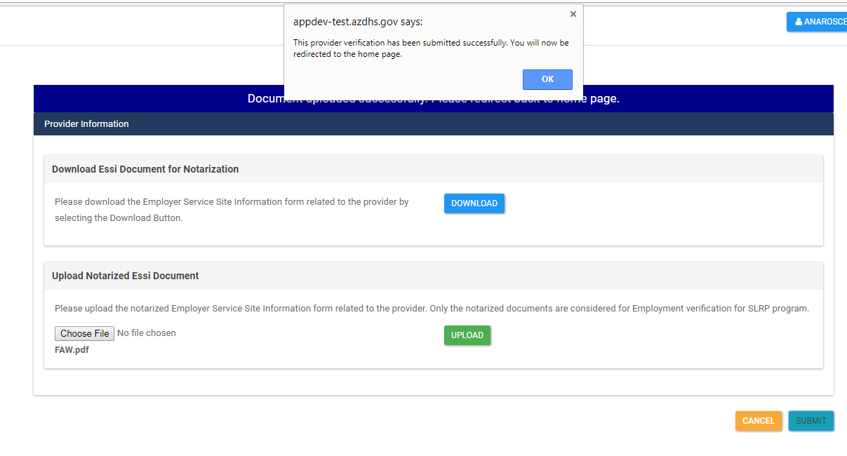
Provider Verification Completed!
Pop-Up Message

Slide 47
Landing Page
Number of approved provider requests pending additional eligibility verifications (i.e. start date, full-time/half-time status, etc.)
Registered employer where you were assigned as the site admin in the system
Number of sites successfully entered in the system.
Number of pending employment verification requests
Number of fully verified applications

Slide 48
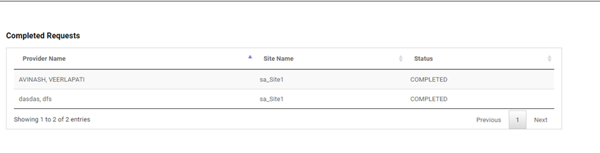
Completed Applications View

Slide 49

Thank You!

