Slide 1
State Loan Repayment Program
(SLRP)
Electronic Application System
Ana Roscetti, MPH
Arizona Department of Health Services
Bureau of Women’s and Children’s Health

Slide 2
IMPORTANT NOTES
Service sites have to be registered in the SLRP portal before providers can apply or re-apply.
Site registration cycle is open until February 28, 2019.
Please check with your site administrators to confirm that your site has registered.

Slide 3
Provider Application
What’s Improved?
Paper Application | Electronic System
Outdated paper-based system 2. Providers had to request site-specific documents from the employer. (SFS Table, Policy, Signage, Evidence of HPSA) Incomplete applications due to missing or incorrect site-specific documents Did not prevent ineligible applicants to apply. | Online application (paperless) Site-specific supporting documents are uploaded by sites directly into the system. (SFS Table, Policy, Signage, Evidence of HPSA) Eliminate or minimize incomplete provider applications System is set-up to screen for ineligible applicants.

Slide 4
Provider Application
Who Can Apply?
Allopathic (MD) or Osteopathic (DO) Physician: Family Medicine, Pediatrics, Obstetrics/Gynecology, Internal Medicine, Geriatrics, or Psychiatry;
Advance Practice Providers:
  A Nurse Practitioner or a Physician Assistant (Family Medicine, Pediatrics, Obstetrics/Gynecology, Internal Medicine, Geriatrics); or a certified nurse midwife
General Dentists
Behavioral Health Providers:
  A Nurse Practitioner or a Physician Assistant who is certified to practice as a behavioral health specialist
  Licensed Clinical Social Worker, Licensed Professional Counselor; Clinical Psychologist, or Licensed Marriage and Family Therapist
Pharmacists

Slide 5
Provider Application
Who Can Apply?
U.S. Citizen or U.S. National
Licensed in Arizona
Completed the final year of course of study
For physicians, must have completed residency
  Board Eligible or Board Certified
Have a prospective or current employment (full-time or half-time) at an eligible site providing outpatient primary medical, dental and behavioral health services
  Inpatient services in a Critical Access Hospital qualify for loan repayment in conjunction with outpatient services at the hospital-affiliated rural health clinic.
Have qualifying loans that are still owed
Have no current or unsatisfied obligation with any entity

Slide 6
Provider Application
Site Eligibility Requirements
Public, Private Non-Profit or RURAL Private Practices
Located in a HPSA specific to the provider’s discipline
For rural private practice sites, must meet Arizona Medically Underserved Area (AzMUA) designation if site is not in a HPSA
AHCCCS, Medicare, Qualifying Health Plan
Sliding Fee Scale (except free clinics and state prisons)

Slide 7
Provider Application
Provider Responsibilities
Understand program requirements and the online application system.
  The Provider Reference Guide is available online at http://www.azdhs.gov/documents/prevention/health-systems-development/workforce-programs/loan-repayment/loan-repayment-application/apply-for-repayment/slrp-provider-and-application-guidance.pdf
Complete your application online including uploading all required supporting documents
Follow-up with your site administrator about your application. Otherwise, you will not be able to complete your application.
  Site administrators must verify provider employment and provide additional eligibility verification

Slide 8
SLRP PORTAL
Step-by-Step

Slide 9
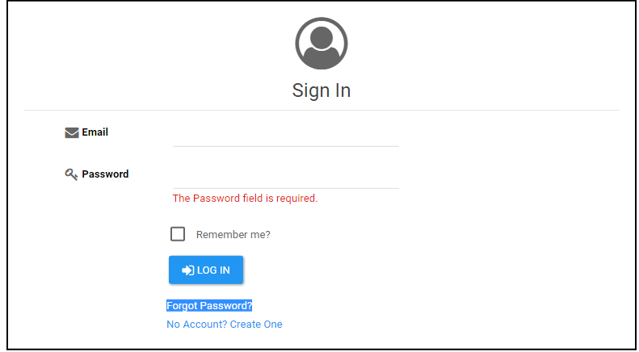
Create an Account
Log-in: https://apps.azdhs.gov/PCO/Account/Login

Slide 10
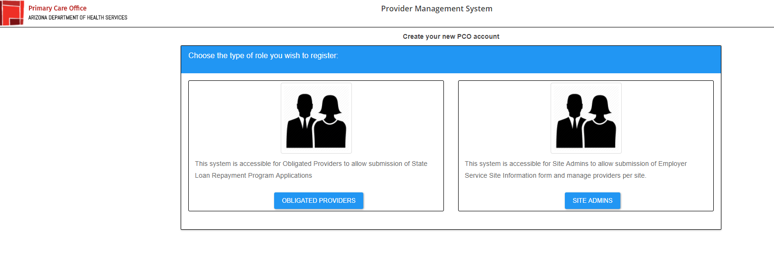

Slide 11
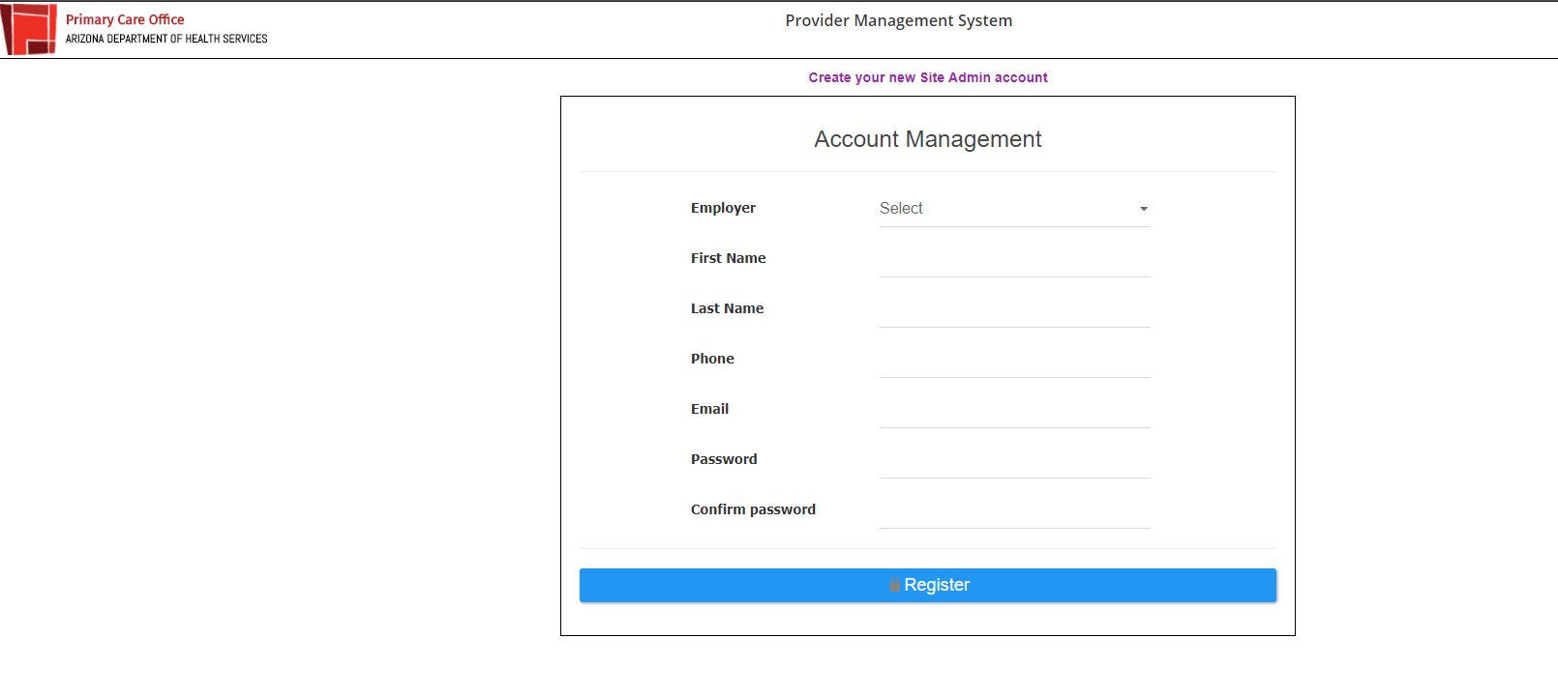
Required fields

Slide 12
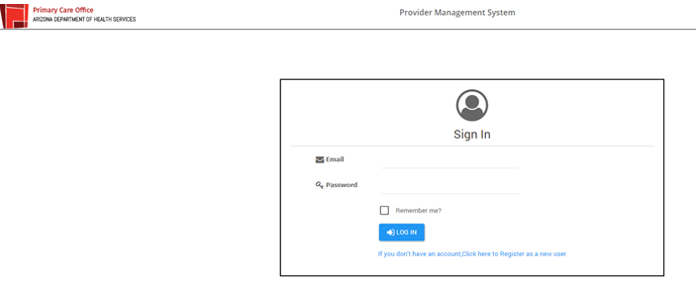

Slide 13
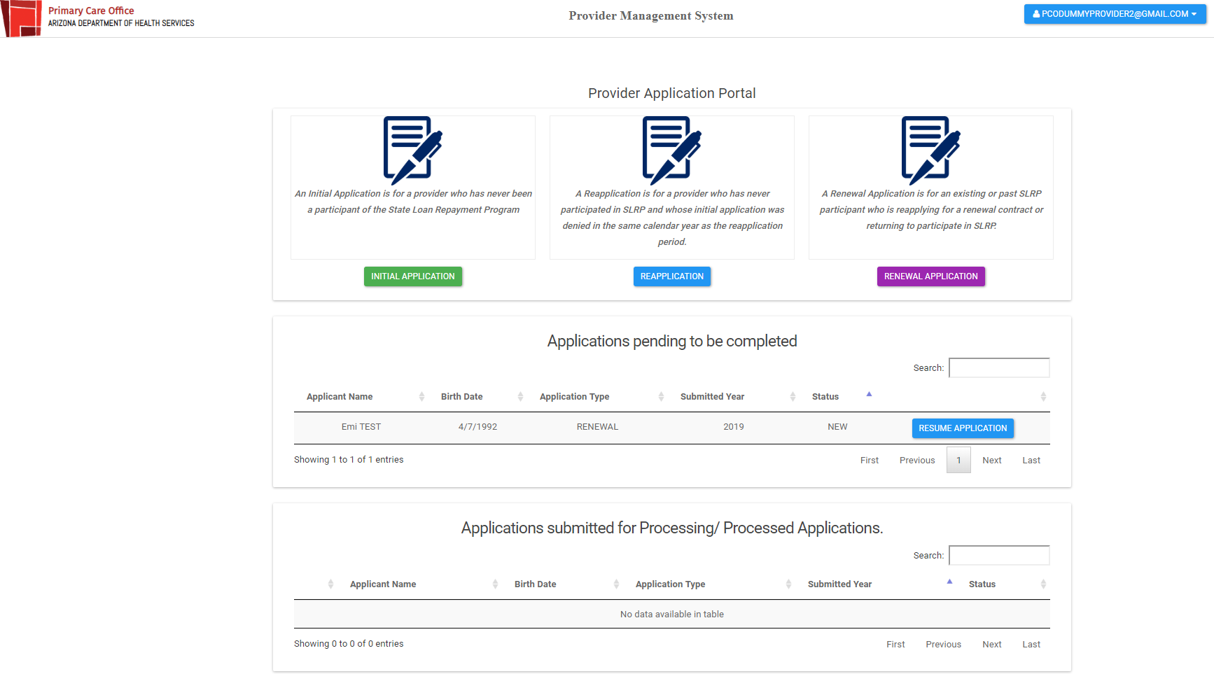
Landing Page
Initiated applications will appear here.
Completed applications will appear here.

Slide 14
Provider Application
Sections to Complete
Personal/Discipline
Education/License
Past/Present Commitment
Service to Underserved
Qualifying Loans
Employer/Service Site
Supporting Documents Upload Section
Certification
Checklist Verification

Slide 15
Provider Application
Documents To Prepare
  REQUIRED DOCUMENTS
  Substitute W9 Form
  Copy of registration confirmation email from the Arizona Procurement Portal (APP)
  Copy of Birth Certificate, U.S. Passport (current or expired), certificate of naturalization, or documentation as a U.S. National
  Copy of Social Security Card
  Copy of Arizona driver's license
  Copy of current Curriculum Vitae
  Copy of Arizona medical license
  Copy of undergraduate, graduate and if applicable, post-graduate studies diploma
  Copy of board certification or acceptance letter from examining authority (for physicians and dentists)
  Copy of a fully executed employment contract or employment letter (MUST INCLUDE full-time or half-time, hours per week, start date and name and address of site)
  Copy of most recent billing statement for each qualifying educational loan
  Documentation from the lender(s) that the loans were used solely for education and reasonable living expenses (i.e. disbursement report, NSLDS Aid Summary Report)
ADDITIONAL DOCUMENTS
Evidence of residency in AZ for the past 12 months
Evidence of service to the medically underserved (New applicants)

Slide 16
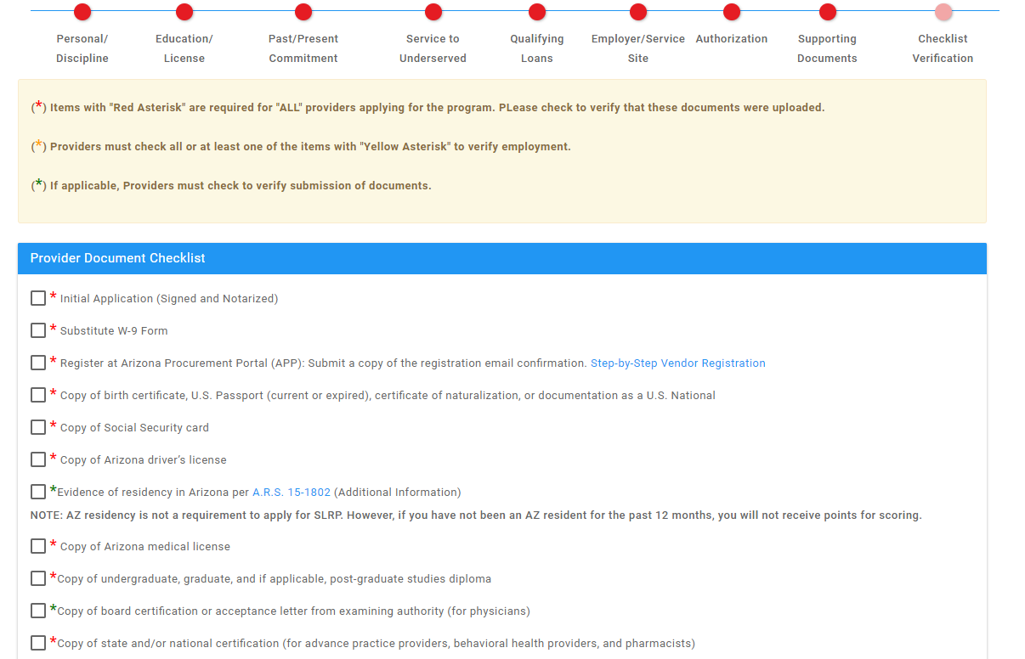
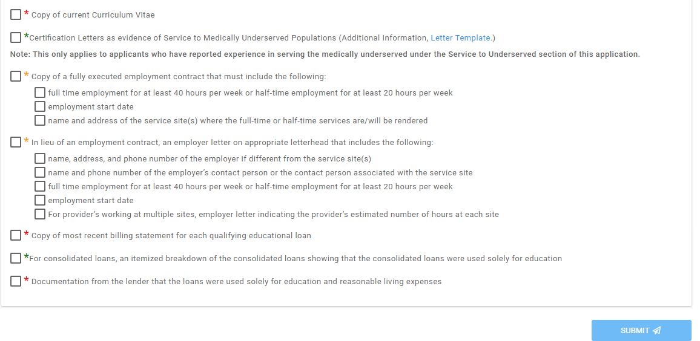

Slide 17
Customer Support
Ana Roscetti, ana.lyn.roscetti@azdhs.gov, 602-542-1066
Ashley Neves, ashley.neves@azdhs.gov, 602-542-1211

Slide 18
Our Team
Patricia Tarango, Bureau Chief, BWCH
Ana Roscetti, Workforce Section Manager, ADHS
Ashley Neves, Workforce Health Planning Consultant, ADHS
Tracy Lenartz, ADHS Consultant, Designations Specialist
Luke Evans, Database Manager, IT ADHS
Avi Veerlapati, System Developer, IT ADHS

Slide 19
Provider Application Portal
Live Demonstration

Slide 20

Thank You!

